Slide 1

LCLM4006:
Enterprise and Entrepreneurship
PowerPoint presentation techniques-how to present, examples of presentations etc

Slide 2
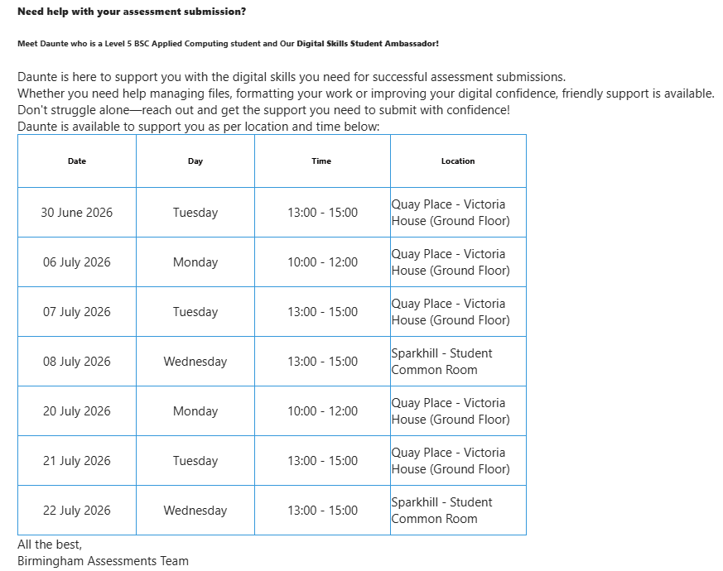
Digital Skills Support

Slide 3
LCLM4006: Enterprise & Entrepreneurship
Recap of previous session….
We
Had an assessment workshop, where we explored, answered questions and supported students with the two different assessments

Slide 4
LCLM4006: Enterprise & Entrepreneurship
In today’s session….
We will:
Learn what is and how to pitch business ideas
Look at some presentation techniques on how to present our business idea
Watch some presentation examples that would help you developing your own presentation

Slide 5
LCLM4006: Enterprise & Entrepreneurship
Pitching Business Idea…
What is pitching?
Pitching means presenting a business idea to a third party
How useful do you think it is?
How common do you think it is?

Slide 6
LCLM4006: Enterprise & Entrepreneurship
Presentation Techniques
Gently introduce people to your accent
Use language that your audience can understand & engage
Eye contact
Body language
Speed of your speech
Interact with visuals
Limit your presentation to one core idea
Spark curiosity in your audience
Answer questions confidently

Slide 7
LCLM4006: Enterprise & Entrepreneurship
How to start a pitch or presentation
Let’s watch the video below how to start a pitch or presentation
https://www.youtube.com/watch?v=P2LwuF7zn9c

Slide 8
Classroom Activity
LCLM4006: Enterprise & Entrepreneurship
Discuss in class the video and how you would pitch your idea?

Slide 9
How to successfully present or pitch idea
LCLM4006: Enterprise & Entrepreneurship
Let’s watch the videos below
https://www.youtube.com/watch?v=O408tB0iasA

Slide 10
Classroom Activity
LCLM4006: Enterprise & Entrepreneurship
Discuss in class the video and what steps would you take to pitch your idea?

Slide 11
Dragon’s Den Series
LCLM4006: Enterprise & Entrepreneurship
Let’s watch an example from Dragon’s Den series on how to respond to investors
https://www.youtube.com/watch?v=_ozwwXxop6o

Slide 12
Classroom Activity mock presentation
-40 minutes
LCLM4006: Enterprise & Entrepreneurship
Split in teams of two & sell a pen to the person
next to you

Slide 13
Presentation samples
Let’s look at some samples
What do you think?

Slide 14
Practical activity- Presentation
LCLM4006: Enterprise & Entrepreneurship
For the remaining of the session, work on your PowerPoint presentation using the tips you have learned today

Slide 15

Do you have any ……
LCLM4006: Enterprise & Entrepreneurship

Slide 16

Next week…..
We will learn about
Part 1:Developing a sustainable Business Model- Part 2: Enterprise Hub

Slide 17
References
Barrow, Barrow, P., & Brown, R. (2012). The business plan workbook (7th ed.). Kogan Page.
Mariotti, S., & Glackin, C., (2017). Entrepreneurship: Starting and Operating A Small Business, 4th Edition, Pearson.

