Slide 1

Component 1: Group Presentation
Social Epidemiology and Public Health Development (LCHS7000_LON)

Slide 2
Programme : | MSc Public Health and Social Care in Practice
Module Name: | Social Epidemiology and Public Health Development
Module Code : | LCHS7000
Assignment : | Component 1: Group Presentation
Student Name: Student ID Number: | Kati Nehme 2224741
Student Name: Student Number: | Yashkumar Patel 2612316
Student Name: Student number: | Tatiana Nedorea 2608447
Lecturer name: | Muhammad Aliyu

Slide 3
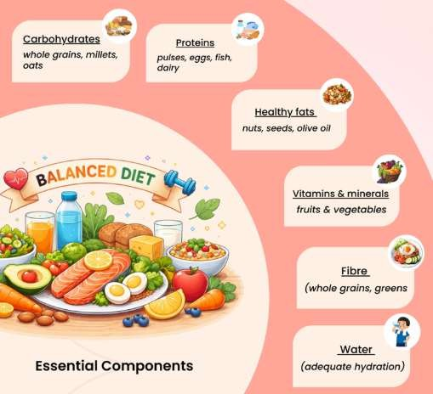
Introduction
“Proper diet” and “nutrition” are important for healthy living,
growth and prevention of diet-related disorders.
A balanced diet gives the human body the “energy” and “nutrients” for a healthy life both “physically” and “mentally”.
High consumption of sugar and low intake of fruits and
vegetables can lead to higher health risks.
Nutrition awareness campaigns are educational and involve practical activities and communities for healthier food choices.

Slide 4
Contents
Slide title | Slide no.
Behaviour, population and target activity | 3
Activity details | 4
Rationale | 5
National guidelines & statistics | 6
Short-and long-term consequences | 7
Aims of campaign and benefits | 8
Reference List | 9

Slide 5
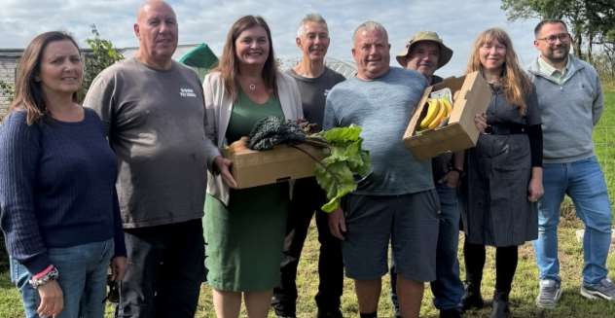
Behaviour, population and target activity
Health behaviour improvement area: Nutrition
Target population: individuals from low-income, communities in Wales
deprived
Wales’ deprived communities: 5 times more likely to face food insecurity and affordability issues with a healthy diet in comparison to non-deprived counterparts (Briazu et al., 2024)
Campaign title: ‘Nutritious Food, Healthy Life’
Target activity: seven-week-long cooking workshop

Slide 6
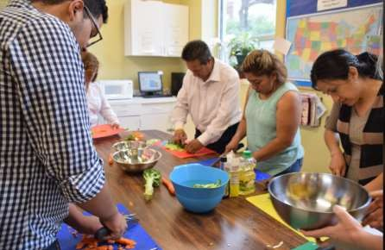
Activity details
Week | Activity | Behaviour
1 | Discussion on everyday eating habits, cook one quick meal that they have every day, and set a weekly goal | Improvement of everyday diet
2 | A food-sorting activity to identify ingrained portion ideas of fruit & vegetables in everyday meals | Making food and vegetables mandatory in everyday diet
3 | Shopping simulation activity: comparing prices and food labels of supermarket products | Making informed food/dietary choices
4 | Affordable meal planning activity: designing a shopping list and weekly menu activity | Budget-friendly yet balanced everyday meal planning
5 | Collaborative cooking activity: cooking an easy meal together with accessible ingredients | Preparing balanced meals at home
6 | Exploring carbonated, sugary drinks and brainstorming alternative healthy snack ideas | Adoption of healthier snacks and drinks
7 | Discuss progress on personal goal set in Week 1, preparing an action plan for upcoming four weeks | Sustaining healthy habits post-campaign

Slide 7
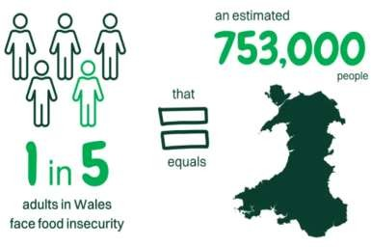
Rationale
Nutritious Food, Healthy Life campaign
Enabling the chosen population to adopt healthy diets
Multi-activity cooking workshop focused on: a) nutritional check-ins,
b) affordable meal planning, c) food price awareness and d) collaborative cooking
Improving dietary knowledge, enabling individuals to regain
confidence in cooking
Contribution to the reduction of food insecurity (Lee and Hammant, 2023)
(Source: Trussell, 2025)

Slide 8
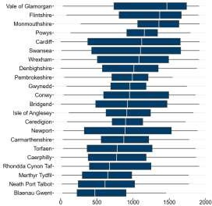
National guidelines & statistics
What a balanced diet constitutes: Eatwell Guide from the Government of the UK (NHS, n.d.)
Welsh Index of Multiple Deprivation (WIMD) 2025 report: some areas in Wales face chronic income deprivation, thus increasing vulnerability to food insecurity (Welsh Government, 2025)
E.g., Swansea in southwest Wales: 32% of areas
consistently ranked within the “top 50 most deprived” category (Welsh Government, 2025)
Fig.1 Areas studied in preparing WIMD
(Source: Welsh Government, 2025)

Slide 9
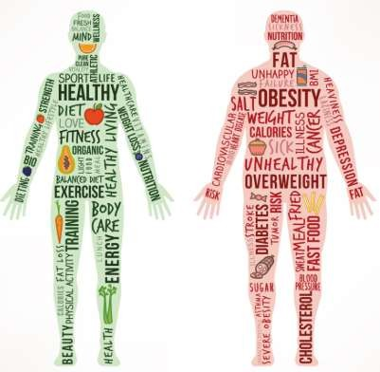
Short-and long-term consequences
Short-term consequences: fatigue, low energy
Irritation in the stomach, constipation (due to consumption
of fat-forward meals)
Long-term consequences: obesity
Can also cause cardiovascular (Micha, 2017)
diseases and obesity

Slide 10
Aims of campaign and benefits
Aim 1: To promote healthy eating by making fruits and vegetables at least 50% of the participants’ daily consumption
Aim 2: To raise awareness of food labels by enabling the participants to make healthy meals every day, at least 40% less than their previous expenditure
Aim 2: To restore 80% of participants’ confidence in cooking through practical cooking skills
development

Slide 11
Reference List
Briazu, R.A., Masood, F., Hunt, L., Pettinger, C., Wagstaff, C. and McCloy, R. (2024) ‘Barriers and facilitators to healthy eating in disadvantaged adults living in the UK: a scoping review,’ BMC Public Health, 24(1), p. 1770.
Lee, C. and Hammant, C. (2023) ‘Corporate social and community-oriented support by UK food retailers: a documentary review and typology of actions towards community wellbeing,’ Perspectives in Public Health, 143(4), pp. 211-219.
Micha, R., Peñalvo, J.L., Cudhea, F., Imamura, F., Rehm, C.D. and Mozaffarian, D. (2017) ‘Association between dietary factors and mortality from heart disease, stroke, and type 2 diabetes in the United States,’ JAMA, 317(9), pp. 912-924.
NHS National Health Service (n.d.) Eating a balanced diet. Available at: https://www.nhs.uk/live-well/eat-well/how-to-eat-a-balanced-diet/eating-a-balanced-diet/ (Accessed: 13 October 2026).
Trussell (2025) Hunger in Wales, Sept. Available at: https://cms.trussell.org.uk/sites/default/files/2026-09/Trussell%20Hunger%20in%20Wales%202025.pdf (Accessed: 12
October 2026).
Welsh Government (2025) Welsh Index of Multiple Deprivation (WIMD) 2025 results report, 9 Dec. Available at: https://www.gov.wales/welsh-index-multiple-deprivation-wimd-2025-results-report-overall-index-html

Slide 12

TASK 2: Campaign – Healthy Diet Promotion

Slide 13
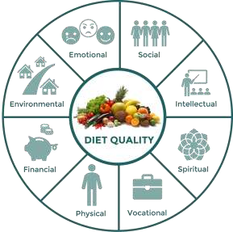
Campaign Concept and Target Audience
The campaign, “Fuel Your Future: Eat Smart, Live Well”, is used to promote healthy eating and balanced nutrition.
The promotion asks individuals to be mindful of their food
options and find sustainable eating plans.
The main target groups are teenagers (aged 18-25) “attending higher education institutions in London”, who may not eat regularly and may have unhealthy eating habits.
The campaign is raising awareness of low-cost healthful foods that lead to better physical health, energy levels, and general well-being (Capitão et al. 2022).

Slide 14
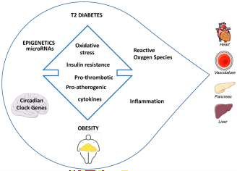
Rationale for the Nutrition Campaign
“Obesity”, “type 2 diabetes”, “cardiovascular diseases” and “other diet-related diseases” are risk factors associated with unhealthy lifestyle habits.
“Nutrition” concerns for university students are due to their busy schedules, financial constraints and convenient foods (Almoraie et al. 2025).
“Inadequate nutrition” awareness may influence food choices
and play a role in reducing consumption of fruit and vegetables
and essential nutrients.
Practical, economically feasible and environmentally sustainable dietary modification is the main thrust of the campaign, raising awareness about health and increasing healthy eating choices.

Slide 15
Aims and Objectives
Aim
The aim of the study is to promote healthy eating and improve nutrition awareness among university students aged 18-25 through accessible education and practical dietary guidance.
Objectives
To increase participants’ knowledge of balanced diets, essential nutrients and the health benefits of
nutritious food choices during the six-week campaign.
To encourage participants to adopt healthier eating habits, including regular meals and increased consumption of fruit and vegetables.
To evaluate changes in participants’ nutrition knowledge, dietary awareness and self-reported eating
habits by comparing pre-campaign and post-campaign survey results.

Slide 16
Six-Week Campaign Activities
Week 1: The campaign begins with nutrition awareness posters, a baseline survey and introduction
sessions to identify nutrition knowledge among participants.
Week 2: Interactive workshops provide information: Balanced Diets, Essential Nutrients, Portion Sizes,
Health benefits of healthy eating choices.
Weeks 3-4: Cooking demonstrations and cost-sensitive meal-planning exercises and the sharing of healthy
recipes stimulate participants to plan balanced meals on a shoestring.
Weeks 5-6: Dietary messages reinforced through social media challenges and healthy eating pledges, with subsequent surveys to evaluate nutrition knowledge and eating habits changes.

Slide 17
Types of Campaign Evaluation
“Formative evaluation” is conducted to find out about the target audience before the nutrition campaign,
and their nutritional knowledge, needs, and preferred communication channel.
A “process evaluation” is conducted by looking at attendance at the workshops, the number of posters
distributed, social media engagement and participation in activities.
Impact evaluation measures initial changes in participants’ nutrition knowledge, awareness and attitudes towards healthy eating.
Outcome evaluation looks at changes in self-reported dietary behaviours such as increasing the intake of
fruits and vegetables and implementing dietary changes (Mangwane et al. 2024).

Slide 18
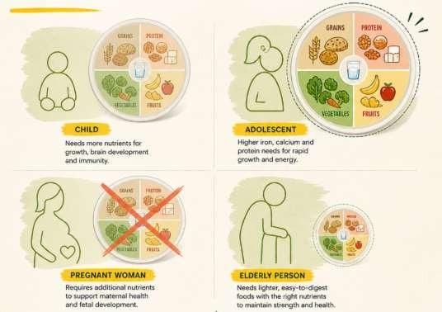
Types of Campaign Evaluation Cntd…
Baseline surveys assess pre-campaign subjects’ nutrition
knowledge, attitudes and eating behaviour (Moussi et al. 2024).
Attendance and engagement records are recorded for workshop participation, poster reach, social media interactions and involvement in campaign activities.
Changes in nutrition knowledge, awareness and self-reported dietary behaviours are measured by comparing the results of post-campaign surveys with the baseline results.
The opinions of participants are gathered using short questionnaires or discussions, thereby measuring the relevance, accessibility and opportunities for improvement of the campaign.

Slide 19
Measuring Campaign Effectiveness
Evidence of the effectiveness of the campaign is determined by comparing nutrition knowledge at the beginning and end of the 6-week period each participant was involved in the intervention (Flax et al. 2025).
The results of the surveys measure the level of understanding with regard to eating a balanced diet,
nutrients and serving sizes, and healthier food options.
Diet is assessed on self-reported intake of fruit and vegetables, regularity of eating meals, and number of days of eating “bad food”.
Reach and engagement of the campaign is measured by the number of participants, number of posters
seen, social media event interaction, and bottom-up feedback from participants.

Slide 20
Local Partners and Campus Collaboration
Student unions at the University can carry out activities to promote the campaign at the University, also
through student networks and nutrition awareness activities.
Campuses can access dietary advice and conduct workshops on a balanced diet and healthy eating from their health services that offer accurate and valuable advice.
Local community health centres have the potential to provide nutrition education resources and link
students to available health promotion services.
Local food companies and University cat services can assist with healthy eating demonstrations by
encouraging inexpensive, well-balanced meals and healthier foods

Slide 21
National Organisations and Existing Campaigns
The “National Health Service (NHS)” encourages healthy eating using the Eatwell Guide, which specifies
proportions of the various food groups that use in a balanced diet (Culliford et al. 2023).
The “Food Standards Agency (FSA)” offers guidance and resources for food and kitchen safety, which help people prepare, store and eat food better.
The “British Nutrition Foundation (BNF)” provides nutrition education via Healthy Eating Week
resources, which promote a balanced diet and healthier food choices for people every day.
The “Office for Health Improvement and Disparities (OHID)” can help implement national public health programs related to obesity, healthier diets and combatting health issues associated with diet.

Slide 22
Existing Campaign Resources and Adaptation
The “NHS Eatwell Guide” can be transformed into posters to create a visual representation of the “Eatwell
Guide” and recommended proportions of food groups for daily meals (Levy, 2025).
“British Nutrition Foundation Healthy Eating Week” resources can be used to complement interactive
activities, healthy eating challenges, or nutrition awareness sessions.
There is practical information available on the “Food Standards Agency” resources about food hygiene and
how to make and store safe, nutritious meals.
Current marketing materials can be modified as a basic recipe, social media message, and student-friendly meal planning program, making them more accessible and engaging.

Slide 23
References
Almoraie, N.M., Alothmani, N.M., Alomari, W.D. and Al-Amoudi, A.H., 2025. Addressing nutritional issues and eating behaviours among university students: a narrative review. Nutrition research reviews, 38(1), pp.53-68. https://www.cambridge.org/core/journals/nutrition-research-reviews/article/addressing-nutritional-issues-and-eating-behaviours-among-university-students-a-narrative-review/1CE93E9FFFFC7510653DDAA8FC08BF9B
Capitão, C., Martins, R., Feteira-Santos, R., Virgolino, A., Graça, P., Gregório, M.J. and Santos, O., 2022. Developing healthy eating promotion mass media campaigns: A qualitative study. Frontiers in Public Health, 10, p.931116. https://www.frontiersin.org/journals/public-health/articles/10.3389/fpubh.2022.931116/full
Culliford, A.E., Bradbury, J. and Medici, E.B., 2023. Improving communication of the UK sustainable
healthy dietary guidelines the Eatwell guide: a rapid review. Sustainability, 15(7), p.6149.
https://www.mdpi.com/2071-1050/15/7/6149

Slide 24
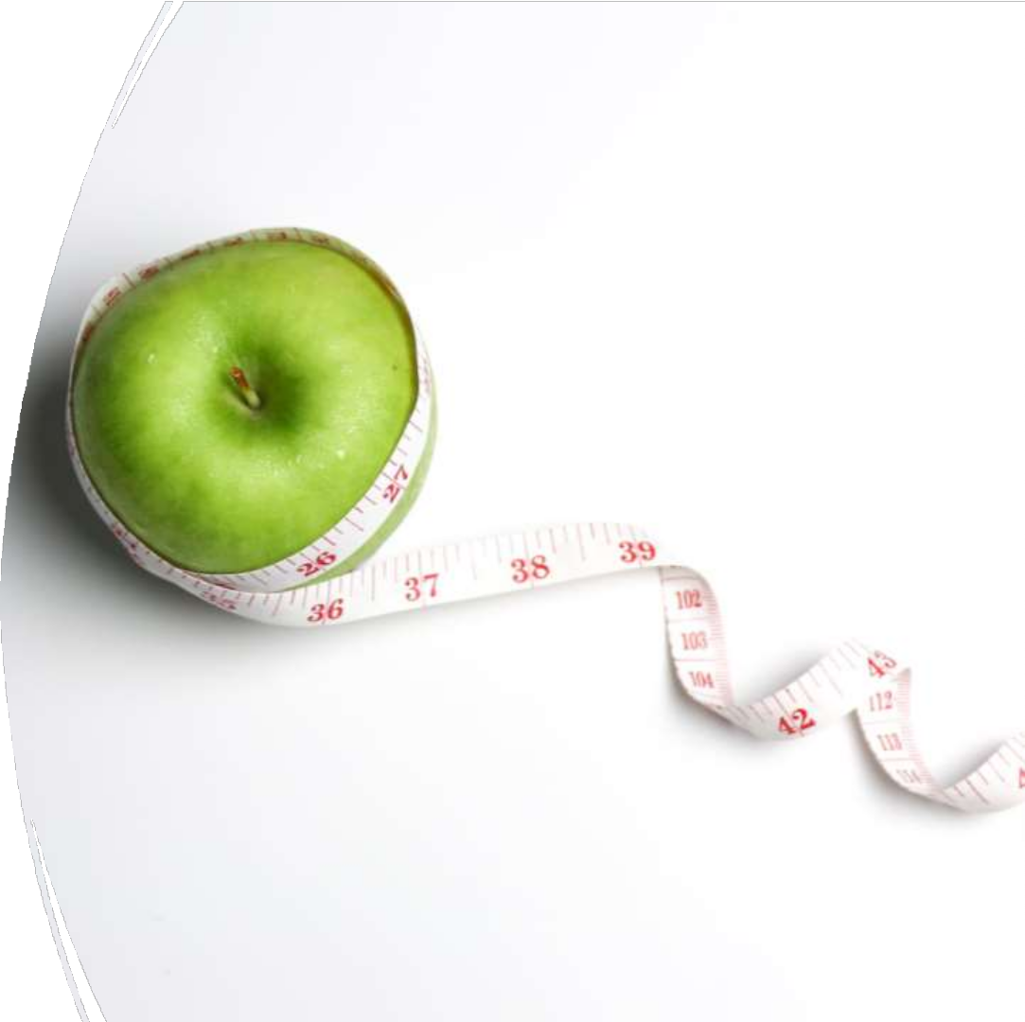
Task 3: Benefits, Models and Solution : Healthy Diet Promotion

Slide 25
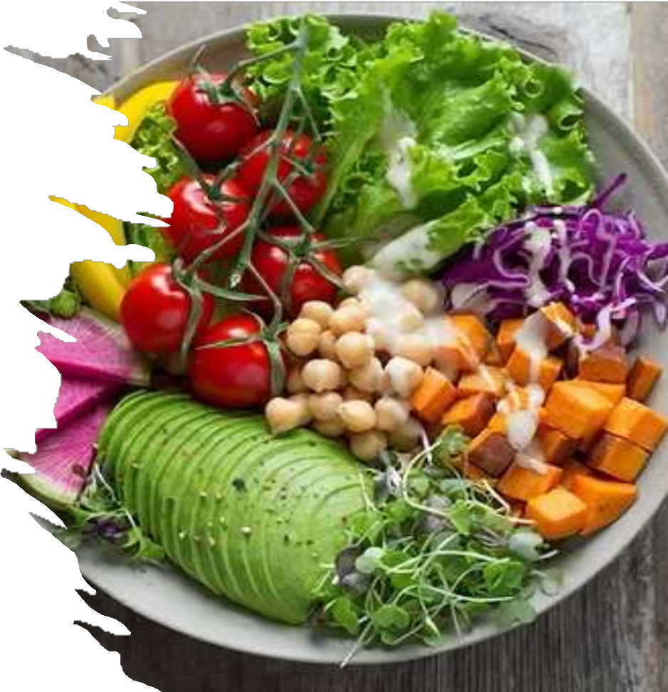
1. Physiological, Sociological &
Psychological Benefits of Improving Diet
Physiological Benefits
Enhanced biopsychosocial homeostasis and gut-brain control when dietary practices promote nutrient balance and proper digestion (PCM,2020).
Evidence-based nutrition therapies that lower the risk of chronic diseases (such as diabetes and cardiovascular disease) (PCM,2020).
Improved metabolic stability, immunity, and energy levels (derived from nutrition intervention frameworks)(PCM,2020).
(VACU,2026)

Slide 26

Sociological Benefits
Sharing healthy habits: families that dine together set an example of proper nutrition for kids and create long-lasting healthy routines(Jan.E et al,2025).
Community connection: Food initiatives, cooking workshops, and shared meals improve social ties and lessen feelings of loneliness(Jan.E et al,2025).
Economic and environmental: cooking at home is frequently less expensive than dining out, and eating sustainably promotes regional food systems(Jan.E et al,2025).
(VACU,2026)

Slide 27

Psychological Benefits
Better mood and mental health: The gut-brain axis affects emotional wellbeing, and diets high in nutrients are associated with reduced rates of anxiety and sadness
(Letts.R,2024).
Improved confidence and self-worth: Reaching dietary objectives increases body satisfaction and self-efficacy
(Letts.R,2024).
Sharper cognition: less weariness, better focus,
memory, and sleep quality (Letts.R,2024).

Slide 28
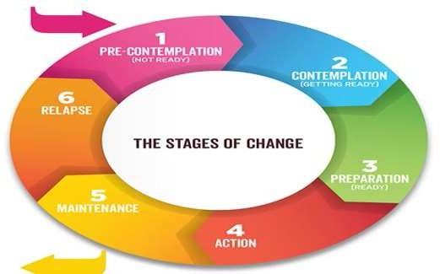
A. Health Belief Model (HBM)
Risk, benefit, and barrier perceptions are used by HBM to explain dietary behaviour.
It's possible that people don't think they are at risk for diet-related
diseases.
Motivation is lowered by obstacles like money, time, or culinary expertise.
Campaigns and other cues to action can be lacking (NIH,2024).
2. Behavioural Theories Explaining Barriers to
Dietary Change
B. Social Cognitive Theory (SCT)
SCT emphasises how individual characteristics, behaviour, and
surroundings interact.
little confidence in one's ability to prepare or cook meals.
adverse social norms (culture norms, family customs).
environmental obstacles, such the price or accessibility of food
(PCM,2024).
Transtheoretical Model (Stages
of Change)
C. Transtheoretical Model (Stages of Change)
Explains being prepared to adjust one diet.
Individuals may be stuck in pre-contemplation or contemplation.
Relapse is common due to environmental triggers or stress (PMC,2024).
(SUSTAINABLE RECOVERY,2026)

Slide 29
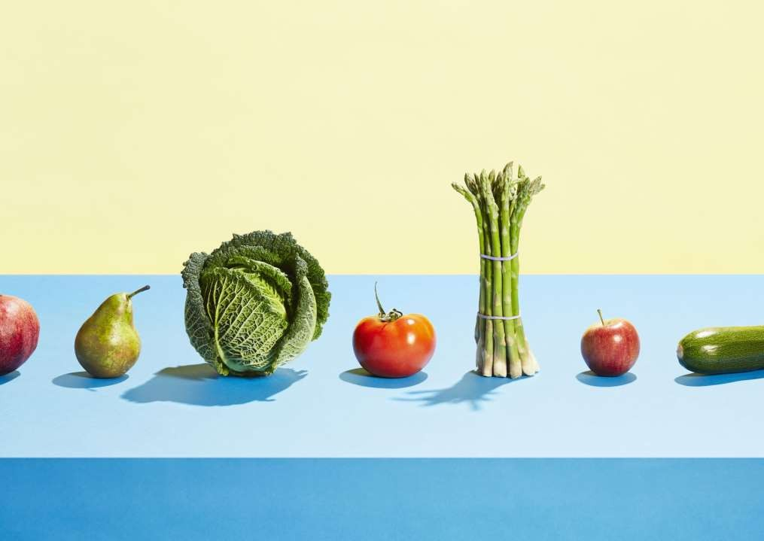
3 Solutions in Your Campaign to Overcome Individual Challeng.es
Solutions to Overcome Challenges Motivation:
Starter objectives, reward charts, and peer role models.
Cooking classes, basic recipes, and skill development all
contribute to self-efficacy(ED.H,2023).
Environmental constraints include school support and affordable meal plans(ED.H,2023).
Social constraints include family involvement and group
difficulties(ED.H,2023).
Knowledge gaps include myth-busting, visual aids, and
Eatwell plate exercises(ED.H,2023).

Slide 30
References
Ed.H,2023. Cooking Class Lesson Plan: A Comprehensive Guide to Crafting a Lesson Plan Available at: https://www.pembee.app/blog/cooking-class-lesson-plan
Accessed: 19th October 2026
Jan.E et al,2025. Sharing meals with others: How sharing meals supports happiness and social connections
Available at:https://www.worldhappiness.report/ed/2025/sharing-meals-with-others-how-sharing-meals-supports-happiness-and-social-connections/
Accessed: 19th October 2026
Letts.R,2024. How microbiome health affects your mood
Available at:https://www.nutritionist-resource.org.uk/articles/the-gut-brain-connection-how-microbiome-health-affects-your-mood
Accessed: 17th October 2026
NIH,2024. The Health Belief Model of Behavior Change. Available at: https://www.ncbi.nlm.nih.gov/books/NBK606120/ Accessed: 19th October 2026
PMC,2024. Behavior Change Theories and Models Within Health Belief Model Research: A Five-Decade Holistic Bibliometric Analysis
Available at: https://pmc.ncbi.nlm.nih.gov/articles/PMC11272221/
Accessed: 14th October 2026
PCM,2020. Food and mood: how do diet and nutrition affect mental wellbeing?
Available at: https://pmc.ncbi.nlm.nih.gov/articles/PMC7322666/ Accessed 15th October 2026
SUSTAINABLE RECOVERY,2026. Stages of Change Model.
Available at: https://www.sustainablerecovery.ca/post/stages-of-change-model
Accessed: 18th October 2026
VACU,2026. 10 Healthy Habits Everyone Should Follow
Available at: https://vasustore.com/blogs/health/10-healthy-habits-everyone-should-follow?srsltid=AU7gw4WTI0S27K4IljFyGrxW1AIR6vNp-zmTF3CtzSqk41JF-wXDIb-h
Accessed: 19th October 2026

Slide 31
Conclusion
Balanced nutrition and healthy eating habits are crucial for a healthy life and prevention from dietary-
related diseases.
The six-week program includes education workshops, cooking demonstrations, posters and interactive activities to raise awareness about nutrition.
Partnerships across the campus and national organisations enhance campaign delivery and help to
ensure access to credible nutrition resources.
Continuous assessment of nutrition knowledge, participant involvement and diet practices from the
campaigns helps to measure the success of the campaign and inform future campaign enhancements.

Slide 32

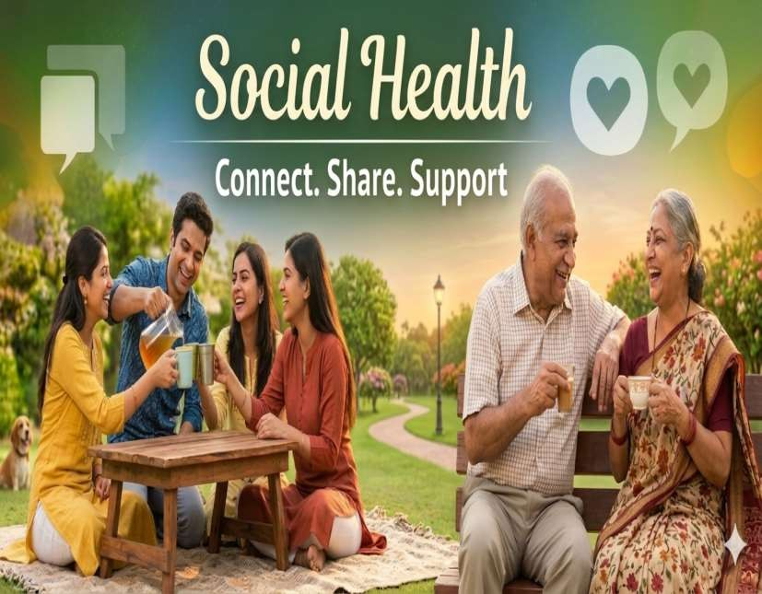

Questions

