Slide 1
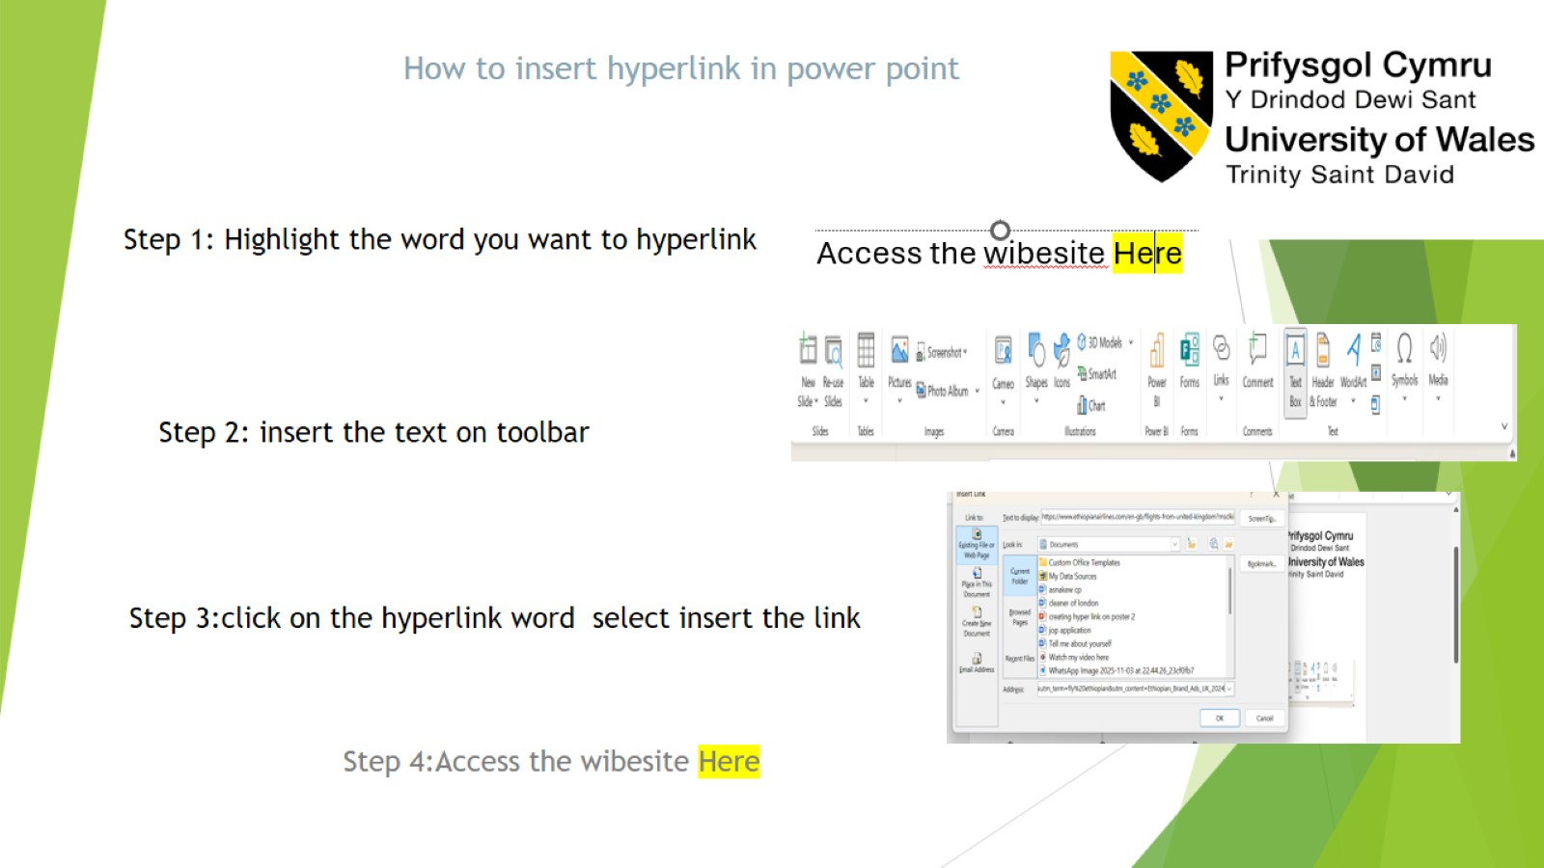
How to insert hyperlink in power point
Name ;Asnakew
Lecturer name:Mr.Rejwan Bin Suliman

