Slide 1
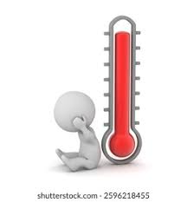


Employee Challenges & Emotional Strain
Employees did not receive adequate training; therefore, their expectations (both personal and corporate) were not clearly defined. In addition, employees have had to compete for pay raises; this has resulted in feelings of inadequacy and a decrease in motivation.
Lack of communication and emotional support has resulted in feelings of insignificance and isolation from the organisation.

Slide 2


Engagement Collapse & Collaboration Breakdown
Failure to provide conflict resolution resources and minimal employee input in organisational decisions has caused employee disengagement and lack of trust, resulting in failure to support established working relationships between peers.
Additionally, due to the absence of psychological safety, many employees have been excluded from the organisational change process, which has decreased the likelihood that they will engage with their new systems or collaborate with their peers.

