Slide 1


Care, empowerment and support
for older people
UK care settings and technology
BMHP6027 · Empowering the Older Person
01

Slide 2
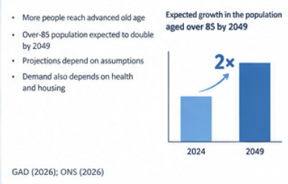
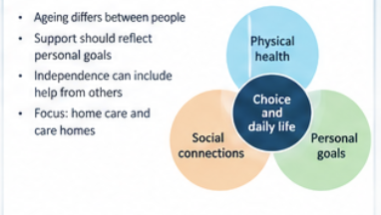
Ageing and the purpose of care
• Ageing differs between people
• Support should reflect personal goals(Equality Act,2010)
• Independence can include help from others
• Focus: home care and care homes(NIHCE,2015)
Choice and daily life
This lecture discusses how different forms of care can aid older people live better and make choices. The authors want to focus on home and institutional care first, and then on telecare and remote medical monitoring. The focus is on the laws and policies in England and Wales (National Institute for Health and Care Excellence, 2015).
WHO (2025); Atchley (1989)
02
Notes:
This presentation discusses how different forms of care can aid older people live better and make choices. The authors want to focus on home and institutional care first, and then on telecare and remote medical monitoring. The focus is on the laws and policies in England and Wales (National Institute for Health and Care Excellence, 2015). The WHO defines biological aging in 2025 as cellular and tissue damage. Aging in years is not always indicative of one’s abilities or support needs. Events such as retiring from work, losing one's spouse, or moving might affect people in late adulthood. Additionally to illness, assessment of care needs should include daily living activities, hobbies, and goals. For instance, joining a local group may be more significant than taking a shower (Equality Act, 2010). It is possible to assess the quality of service by whether it accommodates the user’s requirements. Respect for people who want to keep quiet or turn down an offer is also very important. Empowerment is explained as having enough information, assistance, and power to make decisions throughout the presentation.

Slide 3
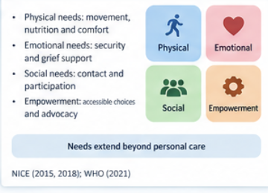
Why population ageing matters
• More people reach advanced old age
• Over-85 population expected to double by 2049
• Projections depend on assumptions(Government Actuary’s Department , 2026)
• Demand also depends on health and housing
GAD (2026); ONS (2026)
03
Notes:
Because population aging can bring more people needing coordinated support over time. The Government Actuary's Department reports that the ONS forecasts state that the population aged 85 years and above will increase fourfold by 2049. This is a prediction, an idea of what may be possible, not a guarantee. Potentially, death, migration, and other factors can change later prospects. City and Town Population Counts do not make population predictions about the numbers of people needing personal care (Mental Capacity Act, 2005). Good housing, good transport, preventive measures, and a supportive environment will help people remain independent (Government Actuary's Department, 2026). Poor health and low income may increase demands for assistance earlier in life (Havighurst, 1961). Services should estimate a range of need groups rather than assume all of them require the same level of care. Work, volunteer activity, and unpaid care may equally provide substantial opportunities for the growing older population. Aging in demographics is a potential cost, therefore an avenue to reinforce ageism. The practical challenge consists in reconciling the need for emphasizing their contribution with securing enough capacity in local services. Commissioners need national forecasts along with their information about disability, living arrangements, and unmet need data on local levels. They should ask seniors about difficulty accessing particular services. Planning should be based on the joint foundation of demographics and lived experience rather than on age alone.

Slide 4
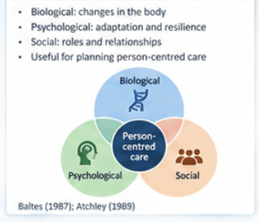
Care, support and empowerment needs
• Physical needs: movement, nutrition and comfort
Needs extend beyond personal care
• Emotional needs: security and grief support
• Social needs: contact and participation(NICE,2015)
• Empowerment: accessible choices and advocacy
NICE; WHO (2021)
04
Notes:
One may not understand the full meaning of care and how it differs from help in everyday should one have to deal with an individual suffering from grief, anxiety, or loneliness. There could be a range of care needs to be needed in such a case from mobility to continence and food. Often, there is a connection between these needs, as there may be challenges faced by a person who has a disability preventing him/her from expressing ideas. It is also important to evaluate the unique strengths and weaknesses of the individual. In 2018, NICE brought attention to a person and his/her family caregivers in the dementia Guidelines (NICE, 2015). Although this information is mostly applicable to individuals suffering from dementia, it is important to remember that the same principles should be applicable to others as well. Another important point to remember is that the person must know and have time to ask about options available in order to get empowered. A mere list of services offered will not benefit the individual if the services offered are not suited to their individual needs. Family members are able to provide some information but healthcare providers should communicate directly with the individual.

Slide 5
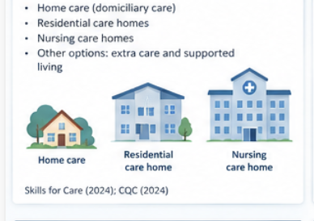
Theories of ageing in practice
• Activity: support meaningful participation
Theory informs questions, not fixed rules
• Continuity: protect familiar routines
• Disengagement: question assumed withdrawal(nihce,2015)
• Personal preference should guide practice (Government Actuary Department,2026)
Atchley (1989); Cumming and Henry (1961); Havighurst (1961)
05
Notes:
Social theories explain later life, but none should be universal. In Havighurst's 1961 work on successful aging, activity methods link wellbeing to meaningful responsibilities and engagement. A care service may help someone keep friends or pursue a hobby. If staff expect everyone to attend, an activity program might become domineering. The 1989 continuity theory of Atchley emphasizes how people change while retaining identity and recognizable routines (National Institute for Health and Care Excellence, 2015). This emphasizes favorite foods, cultural practices, and connections. Limits to continuity. Once-safe routines may no longer suit a person. Instead than preserving habits, staff should encourage adaptation. Cumming and Henry's 1961 disengagement theory describes elderly people's social withdrawal. Seeing withdrawal as normal can be a bad reason for excluding people, making transportation hard to get to, or not giving enough help. Some people do choose to have less social contact, so staff should find out why instead of assuming that the person is either lonely or happy (Government Actuary’s Department, 2026). These theories lead to a practical question: Does the service give the person more choices? The best way to use them is to start a conversation or a critical analysis, and then compare that to the person's own account of what's important to them (Government Actuary’s Department, 2026).

Slide 6
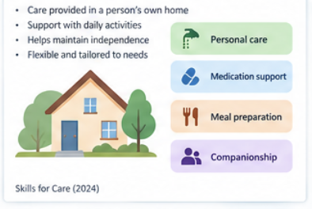
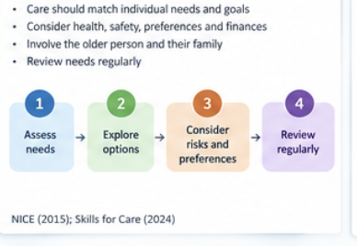
Law and policy across the UK
• England: Care Act 2014
Legal duties depend on location
• Wales: Social Services and Well-being Act 2014
• Equality Act 2010: Great Britain( Equality Act,2010)
• Capacity law supports decision making( Mental Cpaacity Act,2005(
Laws from 2014 (Care Act), 2010 (Equality Act), 2005 (Mental Capacity Act), and 2014 (Welsh Act) (Government Actuary’s Department, 2026)
06
Notes:
The health and social care systems differ from one another in the UK. The statement that refers to the Care Act 2014 as the social care law of the UK may be misleading as its framework of adult-care laws operates only in England. The social services legislations differ between Scotland and Northern Ireland from the Social Services and Well-being (Wales) Act 2014 of Wales (Government Actuary's Department, 2026). The Equality Act of 2010 protects the citizens of the UK from discrimination on the grounds of age and disability. The Mental Capacity Act of 2005 applies only in England and Wales. The professionals should always presume capability and help with decision-making. The evaluation should always be made in relation to the situation and specific decision (Equality Act, 2010). The incapacity due to dementia does not cancel the right to make decisions. All the concepts have implications for care provision and monitoring technology. Most importantly, consent must be separated from relatives’ preferences. The 2019 NHS Long Term Plan refers to the situation in England but it should be complemented with the information regarding the 2025 ten-year health plan that emphasizes prevention, community care, and digital services (Mental Capacity Act, 2005). It should be noted that a policy does not mean a guaranteed successful result. Evaluation should examine whether the staff, funds, and accessibility arrangements meet the needs of older people and to which extent the certain country policy influences the recommendations made.

Slide 7
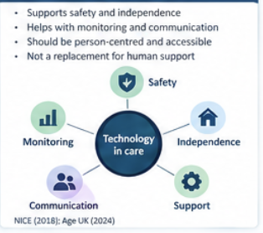
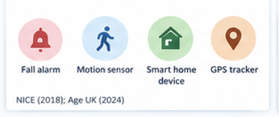
Current care and support settings
• Home care and reablement therefore to review all of it.
Several services may share responsibility
• Residential and nursing care in this considerations.
• Community groups and day services
• NHS, housing and unpaid carer support( Mental Capacity Act,2005)
NICE; NHS England (2019); DHSC (2025)
07
Notes:
The system can provide assistance to elderly people with many issues at the same time. Homecare workers help elderly people in conducting their everyday activities, while community nurses provide them with medical services. Community groups involve elderly people in being social (Government Actuary’s Department, 2026). Reablement provides people with the chance to recover their skills of independent living that they might be lacking. Residential care homes can provide elderly individuals with housing and help them in their day-to-day activities. Hospital wards can provide health care for elderly people. Some elderly patients need hospice and palliative help to ease their condition. These services should be personalized according to the requirements of elderly people rather than to the duties performed. The way of getting funding can differ. Separate laws regulate social care by the local government and medical services provided by NHS, thus making the issue difficult to approach. A conflict appears when it comes to using home care versus nursing homes. Home care allows elderly people to stay in their homes but requires getting a sufficient number of visits (Mental Capacity Act, 2005). Nursing homes can provide 24-hour assistance but provide with limitations as regards independence (National Institute for Health and Care Excellence, 2015). Not every option provides less independence than the others, as the chosen option will depend on the needs, preferences of the patient, and available funding. The assessment of this situation should involve unpaid caregivers who are not supposed to be treated as a source of unlimited assistance.

Slide 8
Home care: strengths and limits
• Familiar surroundings support continuity
A familiar home still needs reliable support
• Flexible visits can protect personal routines as per this the aid of considerations (NIHCE,2015)
• Short or changing visits restrict choice
• Quality depends on coordination and staffing
NICE (2015); Atchley (1989)
08
Notes:
Domiciliary care allows seniors to remain at home, preserving relationships with their neighbors and friends. This supports continuity theory since an individual can keep important experiences in life. Nevertheless, staying at home does not mean independence or being healthy. A person can be on their own and have a bad access to toilets or relatives. In 2015, NICE advised home care services to focus on wellbeing and coordination (Mental Capacity Act, 2005). The recommendations assist in the assessment of the quality of the services, however, they cannot guarantee that they will be fulfilled. Visits should be long enough for proper support and assistance (Mental Capacity Act, 2005). Frequent staff changes can lead to routine and mistrust. Strong concentration on work can make it hard to notice changes in mood or functioning. Everything stated above proves that commissioners need to consider continuity and results along with the costs. Personal assistance, adaptations, transportation and community support can be well applied at home (National Institute for Health and Care Excellence, 2015). Without these services the limitations are strong. Thus, evaluation should include experience, unsuccessful assistance and caregiver's distress.

Slide 9
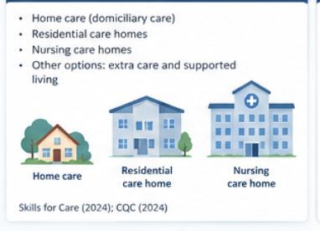
Care homes: safety and personal choice
• Continuous assistance can meet complex needs
Support and autonomy must work together
• Shared routines may restrict autonomy(NICE,2015)
• Relationships and meaningful activity matter
• Residents need accessible complaints routes(Havighurst,1961)
NICE (2018); Ballard et al. (2018)
09
Notes:
Once the demands of caregiving become too great for families to handle on their own, assisted living and nursing facilities may be of assistance. Facility staff is able to provide support with meals, taking care of personal needs, and engaging in social interactions with other people, whereas the nursing facilities provide assistance from nursing specialists (NICE, 2015). All these benefits provide ease and comfort to the residents of facilities and families. relocation may lead to changes in identity and relationships. Routine activities of rising in the morning, having meals and going for walks limit independence and self-control (NICE). Also, proper organization of care within families is among the most important aspects of care facility safety. NICE recommendations regarding dementia care suggest that facilities ensure that their staff obtains all the necessary training for providing personalized care to their patients. The findings of the study conducted by Ballard and colleagues in 2018 demonstrated that the staff deployment and programs provided give significant results on their residents. But it does not mean that the same program will be successful in all cases (NICE). Proper time, supervision and knowledge of residents’ individual cases should be provided for nursing specialists. The nursing facility residents are to get support in communicating the problems related to their condition. Family members may assist in this; however, special consideration must be paid to the desire of the resident as well as legal decision-making arrangements of that person. Assessment of quality involves various parameters, including relations, choices and comfort of the persons receiving care (Havighurst, 1961).

Slide 10
Comparing care settings
• Home care: control over familiar space
The best setting depends on the person
• Care homes: help available across the day
• Both require consent and personal planning
• Review outcomes when needs change
NICE; Care Act 2014
10
Notes:
Looking at these cases indicates that choosing accommodation is more than just about what is cheap or offers maximum independence. While home based care guarantees independence, it does not mean that the bare minimum will really meet the person’s needs. Residential care can offer care during the day, but if people who are providing the service are not flexible enough, care will be not as proper as necessary. Consideration of care should include housing, access to the community, and unpaid help. The costs of service should involve costs related to family obligations. The total costs related to the formal services may be lower than the prices of informal service while the family can spend a lot of money on informal help.
(Mental Capacity Act, 2005) Even though home based coordination creates some problems, residential care should not be seen as the best option.
(Havighurst, 1961) The evaluation should be based on people’s desires.

Slide 11
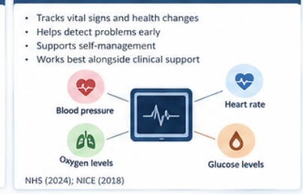
Telecare and personal alarms
• Alarms and sensors can request help
An alert needs an effective response
• Benefits depend on a response service
• False alerts and outages create risks
• Consent and privacy need regular review
Steventon et al. (2013); Mental Capacity Act 2005
11
Notes:
The usage of telecare alarms and sensors gives an alert so that response services can be notified if help is required. Such systems can increase comfort among `singles.` Usage of the devices is only justified if there is an alert and response to it. If a person does not put a pendant on or cannot reach it, then telecare will not serve its purpose. Automatic sensors reduce dependence but may send false alarms and intrusions. According to Steventon et al. (2013), their implementations in the Whole Systems Telecare did not show any decrease in service use for the period of twelve months (Mental Capacity Act, 2005). This contradicts the statements that equipment will reduce the necessity to go to hospitals and cut the costs (Equality Act, 2010). It does not mean that all modern telecare is useless as the end-user performs different objectives and uses different equipment and responses.
Services do not need to make the assumption about the financial benefits of telecare but consider its importance for a person, including reassurance and preventing the obstacles. Staff should thoroughly explain how the system works and make sure that the user is aware of the information that is collected.

Slide 12
Remote health monitoring
• Home readings can support clinical review
Digital access requires practical support
• Staff need clear escalation arrangements
• Access requires suitable support and equipment
• Monitoring cannot cover every care need
DHSC (2025); NICE (2025); WHO (2021)
12
Notes:
Health workers collect data from home so it can be used later through remote health monitoring. Unlike telecare, it is different from safety assistance as it is concentrated on clinical evaluation and handling. It can be handy for individuals who could save traveling and be notified in case of any changes. The 2025 health strategy of England argues that digital services and community services will become a trend in the healthcare of the elderly. Clinical reasoning, equipment, and actions are necessary to be taken in case of abnormal readings. Having misleading data due to the wrong technique, absent readings, or technical errors is a possibility (Havighurst, 1961). Additionally, monitoring could be burdensome for the family or create worries related to the changes in routine of the individual. Digital barrier is not just about the internet. Vision, hand ability, language, knowledge, and the cost of connection can discourage participation (National Institute for Health and Care Excellence, 2015). Staff needs to provide people with either training or alternative solutions. People opting against the digital monitoring need help, too. As stated by NICE, information obtained cannot substitute individual assessment and appropriate actions in the 2025 report on falls prevention (Mental Capacity Act, 2005). Evaluation should show comparative details of collected data, workload done, and inequality in monitoring. Efficient services provide easy access to monitoring as well as appropriate clinical evaluation when needed.

Slide 13
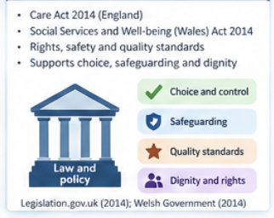
Case study: the WHELD trial
• 69 UK nursing homes
69
• Training with personalised activities
• Quality of life and agitation improved
UK nursing homes
847 residents with dementia
• Benefits require support for staff
Ballard et al. (2018)
13
Notes:
According to the WHELD trial, the increase in care level was due to the presence of staff and individual attention towards each resident. This cluster-randomized trial was described by Ballard et al. in 2018. The intervention was tested against the control group in 847 patients suffering from dementia, for a period of nine months in 69 nursing homes in the UK. The training program consists of training in patient-centered care and the provision of individual activities and support. The results of the trial showed improvement in residents' quality of life and reduction in agitation levels among them. The effect cannot be deemed sufficient enough to call the intervention a cure for dementia or to state that all residents of nursing homes benefited from the intervention. The design of the study gives more evidence than simply a promotional story thanks to the fact that there was a control group available. However, in order to understand the results, one should take into account the follow-up, evaluation of outcomes, and program delivery conditions. Knowing the interests of the residents can be of help in the process of staff management during the everyday activities. This connects to the theories of activities and continuity through the concept of meaningful involvement. The intervention also explains the need for proper staff assistance. Providing personalized assistance takes time and constant monitoring of the results. It means that in order to use the program locally the facility has to evaluate resident experience rather than simply assuming that the name of the program will result in favorable outcomes.

Slide 14
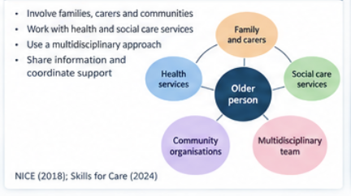
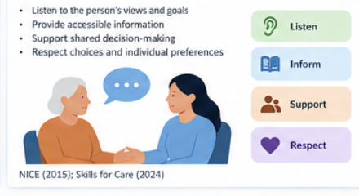
Applied example: choosing support at home
• Fictional example: an older person after a fall
Applied example, not a reported patient
• Explore goals, housing and carer capacity
• Agree visits and optional telecare
• Review confidence, choice and unmet need
NICE; Mental Capacity Act 2005
14
Notes:
In this made-up scenario, evidence is used without stating any misleading outcomes as research. A senior citizen who lives alone has had a fall and does not want to leave home. Local faith-based organizations and professionals are very crucial to them. The assessment should include evaluation of mobility capabilities, medications used, living environment, and the nature of the fall. The guidelines on falls that NICE (2025) issued state that assessments and preventive measures should not exclusively focus on age. The occupational therapy assessment may include a home visit, home care, and community support. Provide details on its advantages, limitations, and contingency measures before offering telecare (Equality Act, 2010). Staff members should check whether the individual wants and feels comfortable about it. If the person has capacity, the total reassurance of the relative cannot replace the person's decision. The activity theory argues that participating in activities that are considered valuable constitutes a significant experience, whereas continuity theory highlights the importance of habits and routines. The service must assess the relative's willingness and ability to help (Government Actuary’s Department, 2026). The evaluation may assess purpose, missed activities, reliability of reactions, and needs for assistance (Government Actuary’s Department, 2026). The proposed actions do not involve results of any research.

Slide 15
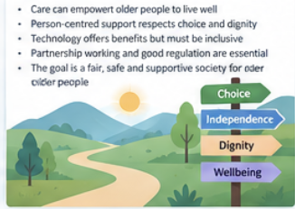
Recommendations and barriers
• Fund continuity and adequate care time
Improvement needs resources and evaluation
• Include older people in service decisions
• Offer supported digital and offline access
• Evaluate outcomes before wider expansion
NICE; Ballard et al. (2018); Steventon et al. (2013)
15
Notes:
Evaluation results in improvements. To begin with, commissioners must ensure funding for enough care time and continuity of staff for quality control of services (Mental Capacity Act, 2005). Budget constraints and issues with recruitment should be taken into account, but contracts need to keep track of the stable workforce and the lack of caregivers along with expenses. Then, seniors need to be included in the planning and evaluation of services (National Institute for Health and Care Excellence, 2015). The feedback is important as it allows bringing attention to the voices of the groups that are usually ignored. The problem comes from the fact that consultation may end up being only a formality. The providers should provide explanations regarding what changes were made after the feedback was received and give a refusal to the requests. The need for technology is increased, but the services need to ensure maintenance, training and good response time. Moreover, the alternatives for the people who cannot use technology should be in place. This means that other financing sources apart from the equipment purchase are needed. Finally, it is necessary to evaluate the process before making any changes. The results of the pilot of telecare services demonstrate that the effect of the service usage is minimal, while the results of WHELD clearly demonstrate the need for extensive testing of promising approaches. Articles should include assessment of the quality of life, effectiveness of operations, caregiver’s workload, and inequality of access. Local evaluation cannot present itself as proof of causation.

Slide 16
Conclusion: judging care by lived outcomes
The evaluation shows that the concept of empowerment is determined by an individual’s functioning in everyday life. An elderly person can still obtain help and have some independence in the organization of daily activities, interpersonal relations, and the choice of decisions made. Simultaneously, staying at home may mean that needs are not satisfied if please where support is periodic and touch-and-go (Government Actuary’s Department, 2026). Accordingly, home care and care homes need to be measured according to a person’s aims and avoiding presuppositions about the best type of care.
• Age alone cannot define support needs
• Care setting must fit personal goals
• Technology needs consent and human support
• Quality includes choice, relationships and comfort
Choice remains a core outcome
Atchley (1989); NICE (2015, 2018); WHO (2021)
16
Notes:
The evaluation shows that the concept of empowerment is determined by an individual’s functioning in everyday life. An elderly person can still obtain help and have some independence in the organization of daily activities, interpersonal relations, and the choice of decisions made. Simultaneously, staying at home may mean that needs are not satisfied if please where support is periodic and touch-and-go (Government Actuary’s Department, 2026). Accordingly, home care and care homes need to be measured according to a person’s aims and avoiding presuppositions about the best type of care. Ageing theory helps to understand the importance of taking part in life, but any theory needs to be carefully assessed in case it may result in excluding people from living their lives (National Institute for Health and Care Excellence, 2015). Law creates responsibilities and ensures safety, while policies shape the way to go. Law and policies do not guarantee availability of services according to appropriate needs and resources. Unlike the policy, technology gives chances provided that it meets the aim and includes consent, maintenance and a person. Results from telecare experiment show that one should not conclude automatically that applications make a difference in the number of services invoked. WHELD provides a good foundation to invest in personalized activities and help from staff in this location. The main conclusion is that the assessment of successfulness should be done in terms of what people get from this. Future evaluation needs to focus on who is left out and how implementation influences the results. More satisfactory services will be provided if older people are involved in the process from the very first stages.

Slide 17
References 1 of 4
Atchley, R. C. (1989) ‘A continuity theory of normal aging’, The Gerontologist, 29, pp. 183–190. doi: 10.1093/geront/29.2.183.
Ballard, C. et al. (2018) ‘Impact of person-centred care training and person-centred activities on quality of life, agitation, and antipsychotic usage in individuals with dementia living in nursing homes: a cluster-randomised controlled trial’, PLOS Medicine, 15, e1002500. doi: 10.1371/.1002500.
Care Act 2014, c. 23. Available at:.
Cumming, E. and Henry, W. E. (1961) Growing old: the process of disengagement. New York: Basic Books.
Department of Health and Social Care (DHSC) (2025) 10 Year Health Plan for England: fit for the future. Available at:.
17

Slide 18
References 2 of 4
Equality Act 2010, c. 15. Available at: https://www.legislation.gov.uk/ukpga/2010/15/contents (Accessed: 25 October 2026).
Government Actuary’s Department (GAD) (2026) 2024-based population projections: a GAD technical bulletin. Available at: https://www.gov.uk/government/publications/2024-based-population-projections-a-gad-technical-bulletin (Accessed: 25 October 2026).
Havighurst, R.J. (1961) ‘Successful aging’, The Gerontologist, 1(1), pp. 8–13. doi: 10.1093/geront/1.1.8.
Mental Capacity Act 2005, c. 9. Available at: https://www.legislation.gov.uk/ukpga/2005/9/contents (Accessed: 25 October 2026).
National Institute for Health and Care Excellence (NICE) (2015) Home care: delivering personal care and practical support to older people living in their own homes. NG21. Available at: https://www.nice.org.uk/guidance/ng21 (Accessed: 25 October 2026).
18

Slide 19
References 3 of 4
National Institute for Health and Care Excellence (NICE) (2018) Dementia: assessment, management and support for people living with dementia and their carers. NG97. Available at:.
National Institute for Health and Care Excellence (NICE) (2025) Falls: assessment and prevention in older individuals and in people 50 and over at higher risk. NG249. Available at:.
NHS England (2019) The NHS Long Term Plan. London: NHS England. Archived plan signposted at:.
Office for National Statistics (ONS) (2026) National population projections, variant projections: 2024-based. Available at:.
19

Slide 20
References 4 of 4
Social Services and Well-being (Wales) Act 2014, anaw 4. Available at:.
Steventon, A. et al. (2013) ‘Effect of telecare on use of health and social care services: findings from the Whole Systems Demonstrator cluster randomised trial’, Age and Ageing, 42, pp. 501–508. doi: 10.1093/ageing/aft008.
World Health Organization (WHO) (2021) Global report on ageism. Geneva: WHO. Available at:.
World Health Organization (WHO) (2025) Ageing and health. Available at:.
20

