Slide 1
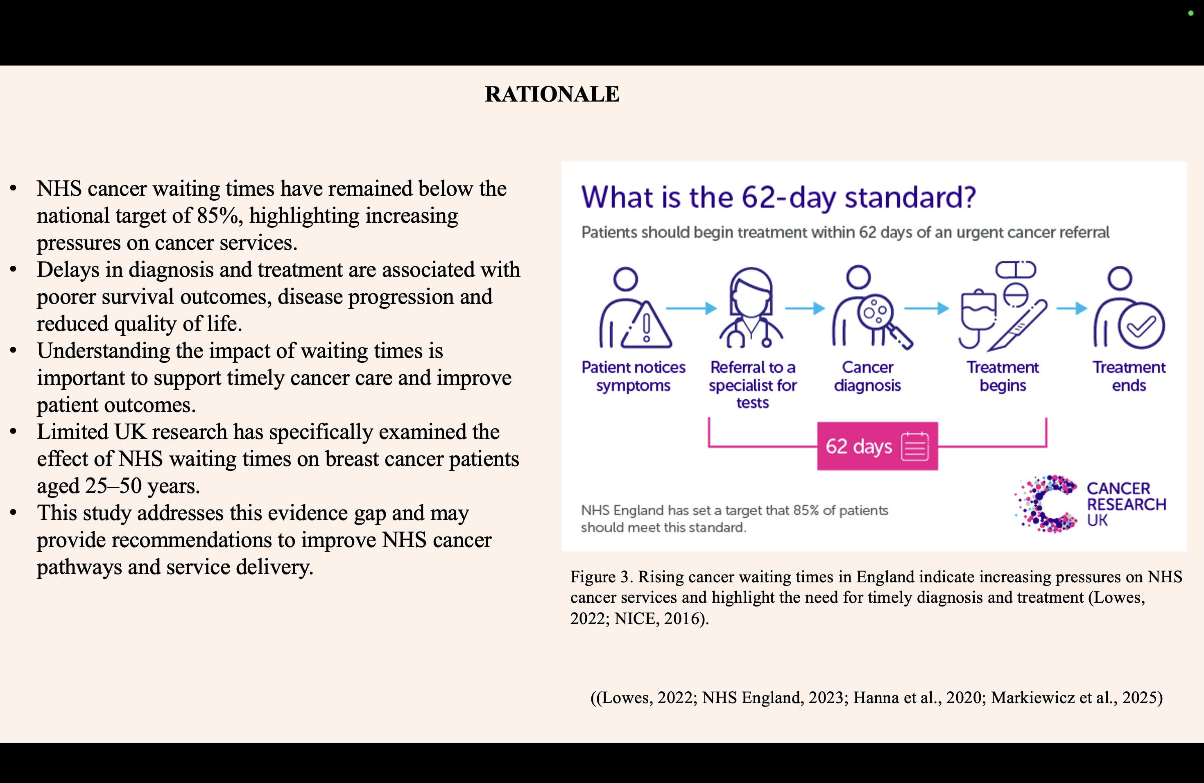
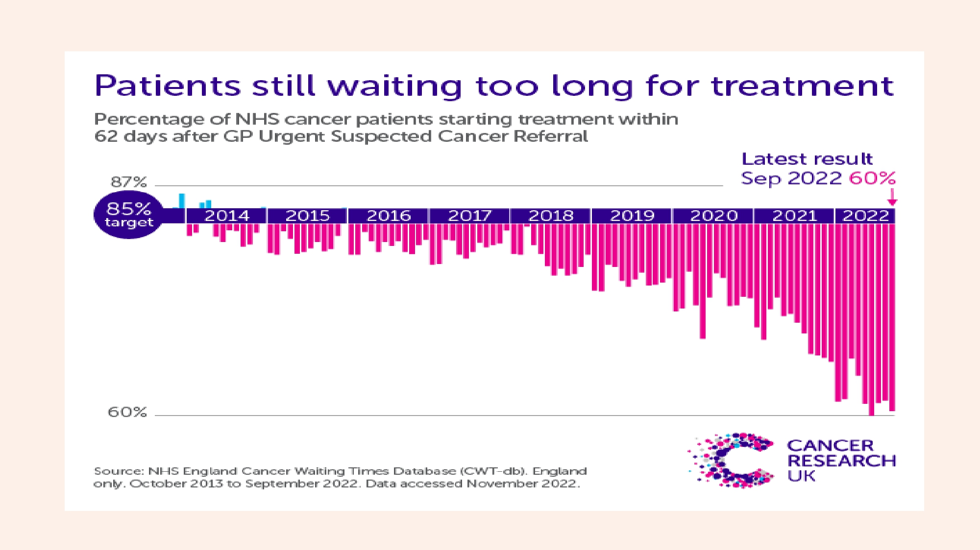
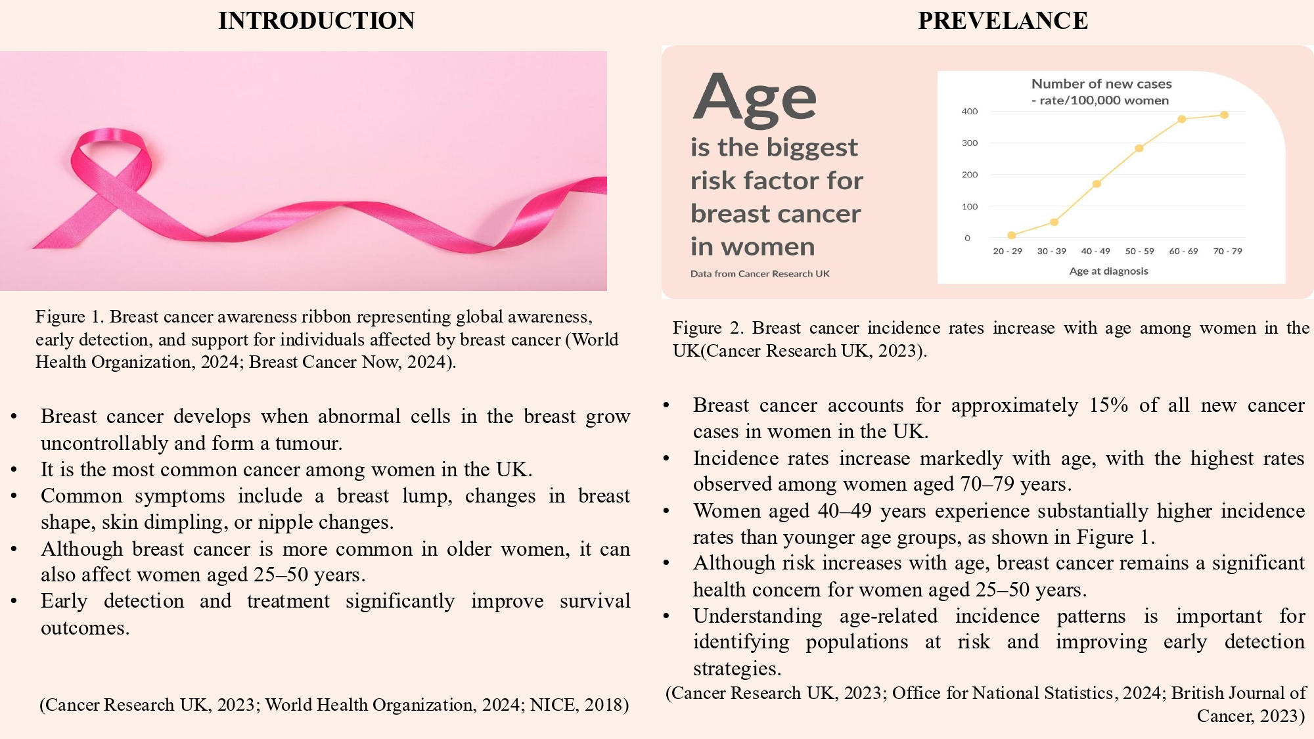
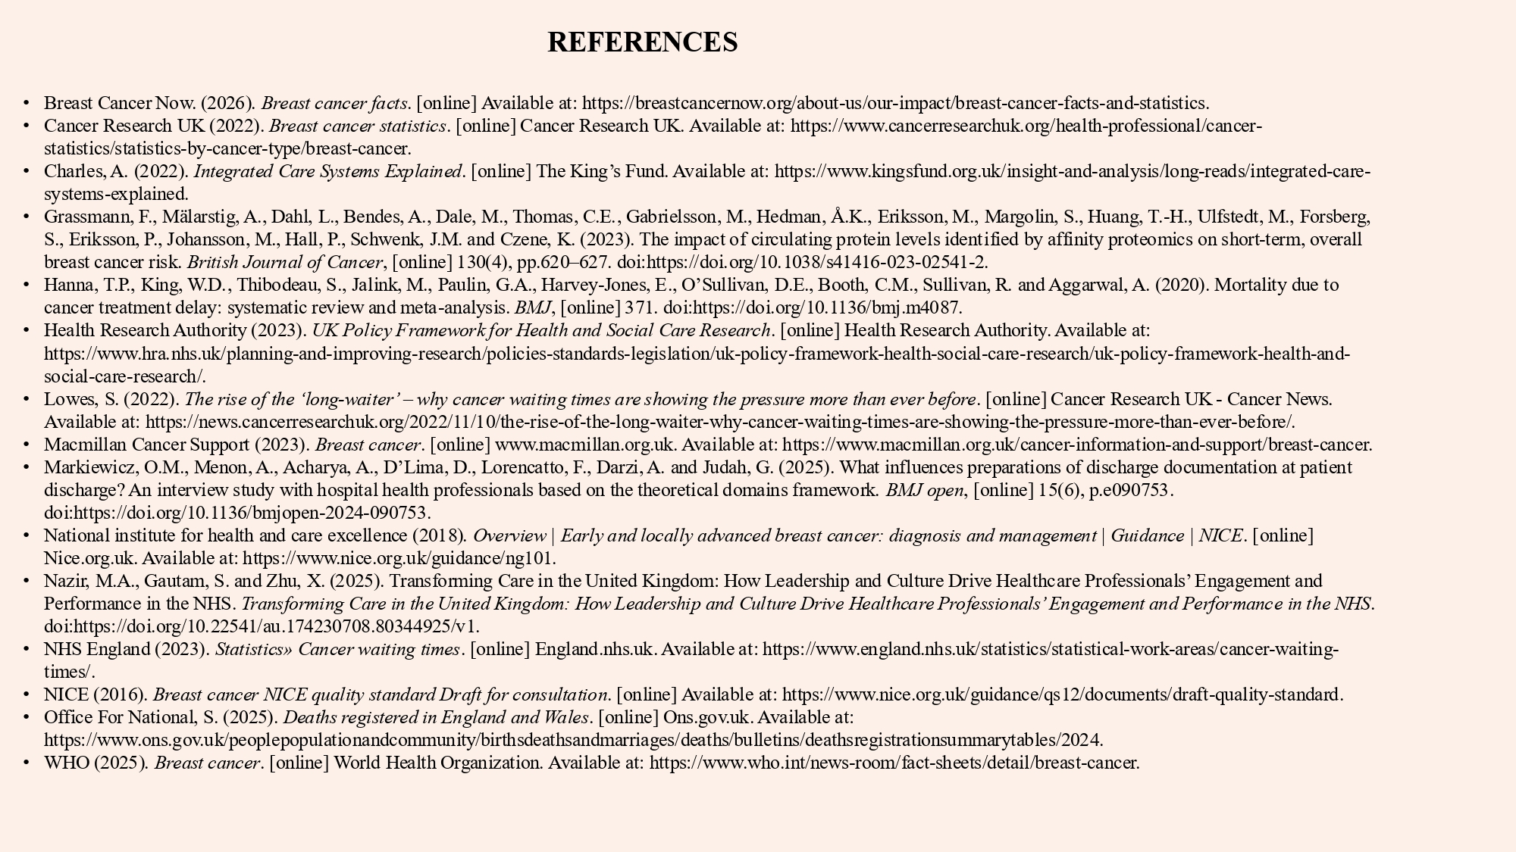
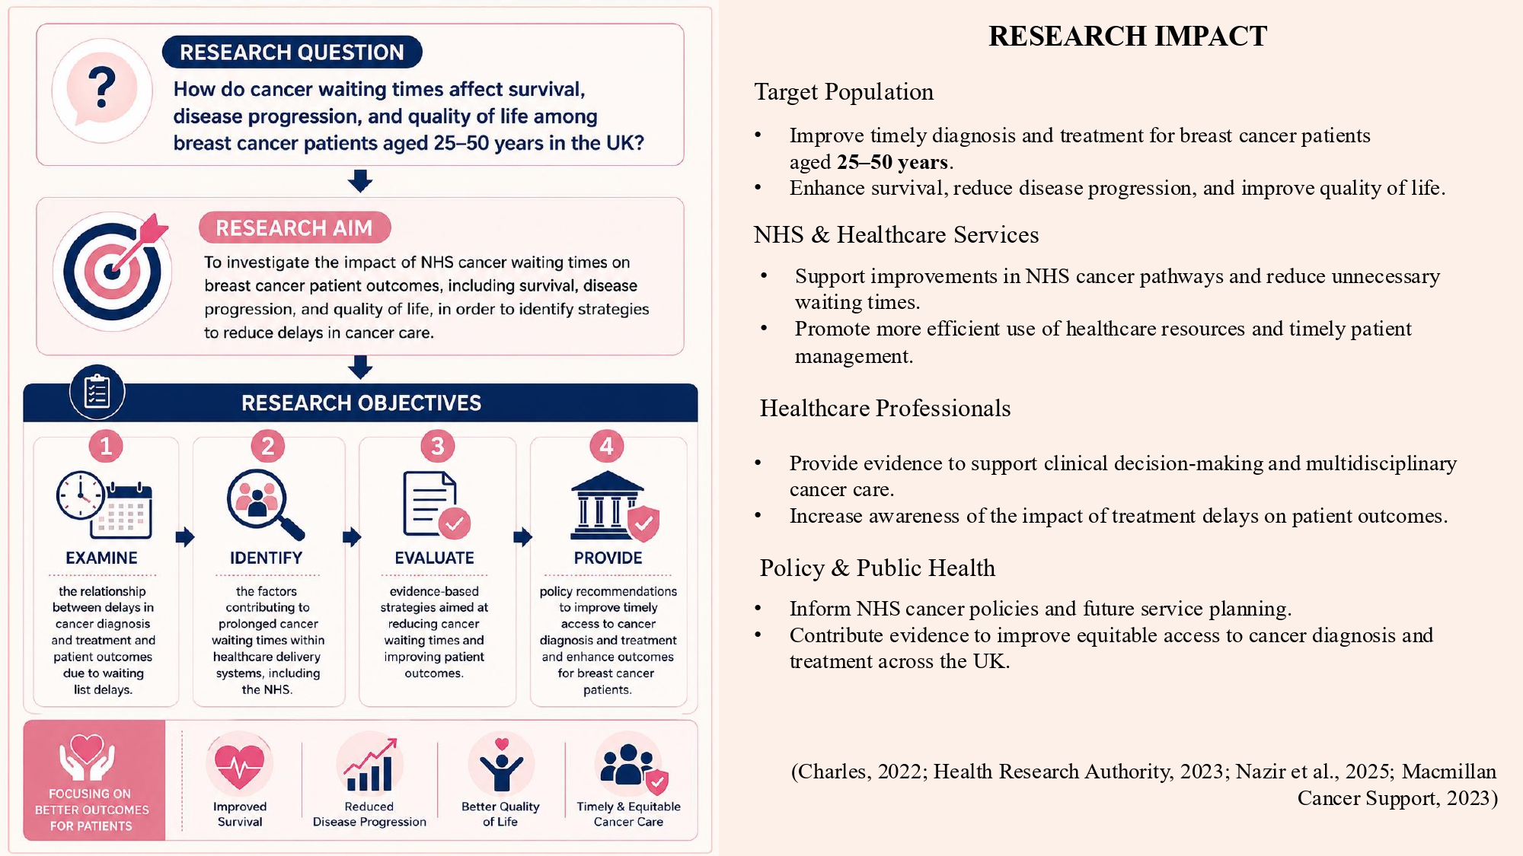
Student Name- Amit Tiwari Student ID- 2526931
Lecturer- Dr. Diola Bijlhout
Topic- The Impact of Cancer Waiting Times on Breast Cancer Patients (Age 25–50) Outcomes in the UK: A Systematic Review.

