Slide 1
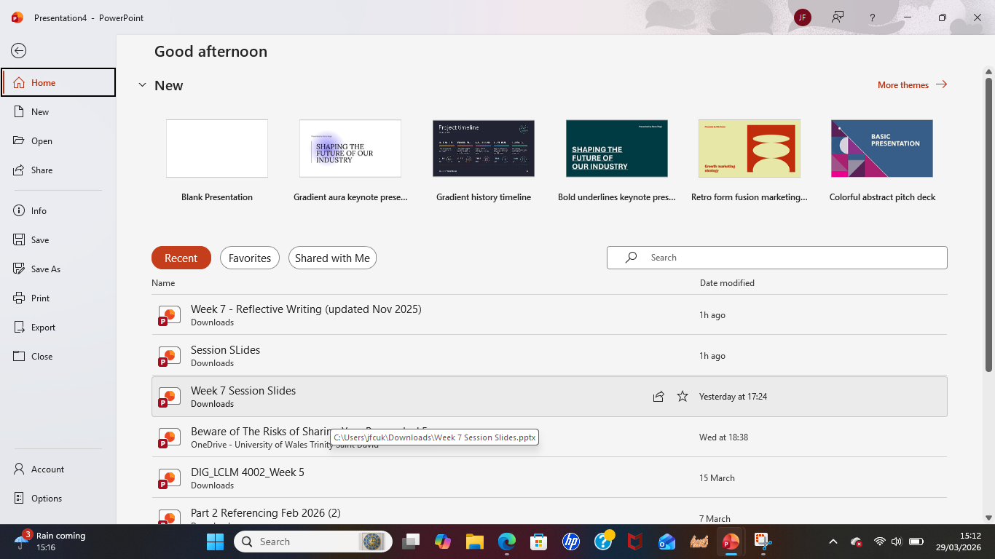

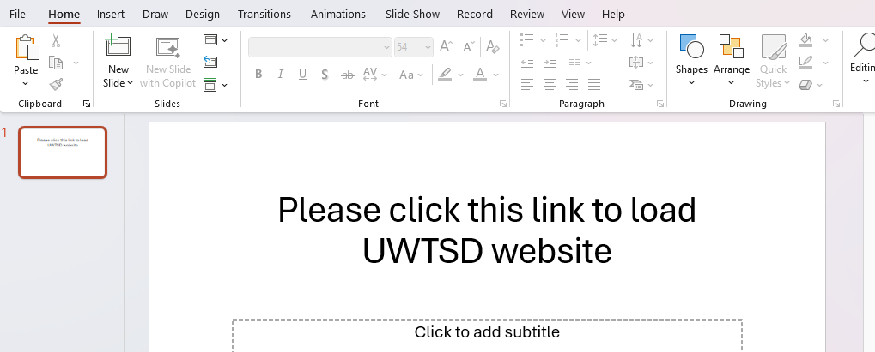
How to create a hyperlink in Power Point
Step 01: Please load Power Point and select blank presentation slide
Step 02: Please write a sentence to create a hyperlink
dPlease click this link to load UWTSD website
Step 04: Highlight the word which you are going to create the hyperlink and then copy the URL of the website and then click insert and click link
Step 03: Load your website which you use to create the hyperlink
Step 05: Click the URL showed in the link tab
Step 06: Click the link word by holding ctrl + Alt button the view the website.
Please click this link to load UWTDS website

