Slide 1

Certificate of higher education skills for the workplace module: INTRODUCTION TO PUBLIC HEALTH assignment 1: group presentation
Names:
Angela Maria Gonzalez Caro
ID: 2442780
Agne Eidukiene
ID: 2435270
Cher Miles
ID: 2440437
Sharlotte Winstanley
ID: 2441177

Slide 2

DEMENTIA CASE STUDY- ROSEWOOD COMMUNITY CENTRE
INTRODUCTION AND MEASUREMENT
Dementia is a progressive neurological disorder that mainly affects older adults. It causes memory loss, difficulties with thinking, changes in normal behaviour, and loss of ability to perform daily activities. The most common type of dementia is Alzheimer’s disease, which represents around 60’70% of all cases (World Health Organization, 2023).
In the United Kingdom, dementia is considered a major public health priority. According to Alzheimer's Society (2024), more than 944,000 people currently live with dementia, and the number is expected to exceed one million by 2030.
In 2023, approximately 209,000 new cases were reported (Office for National Statistics,2023). In 2022, dementia and Alzheimer’s disease were the leading causes of death in the UK, representing 11.4% of all deaths (ONS, 2023).

Slide 3

Monitoring and Public Health Strategies
The monitoring of dementia in the UK is mainly carried out through the National Health Service (NHS) and the Office for National Statistics (ONS). These Organisations collect and analyse data on diagnoses, age, type of dementia, and location to plan health services and design national policies.
One of the main tools is the NHS Digital-Dementia Profile, part of the Public Health England (PHE) Fingertips Tool. It gathers data from hospitals, GPs, and community centres to measure prevalence and quality of care. The Uk Health Security Agency (UKHSA) also monitors factors that increase dementia risk, such as cardiovascular disease, inactivity, or lack of vaccination. Infection control and vaccination programmes are important because severe infections can worsen dementia symptoms or lead to hospitalisation.

Slide 4

Practical Strategies and Proposed Initiative
The United Kingdom has several national strategies to improve dementia care. The “Prime Minister’s Challenge on Dementia 2020” promotes early diagnosis, staff training, and dementia-friendly communities. The NHS Long Term Plan (2019) focuses on faster diagnosis, personalised care, and better service coordination.
For the Rosewood Community Centre, a local programme called “Memory & Support Sessions” could be developed. This initiative would offer weekly sessions with cognitive activities, light exercise, music, and social interaction. NHS professionals could lead short talks on healthy eating, fall prevention, and stress management for families.
Working with GPs and social services would help identify those who would benefit most. This kind of initiative encourages social connection, improves wellbeing, and reduces isolation among older residents with dementia.

Slide 5

the main approaches and strategies that could be used to control an infectious disease outbreak for people with dementia
Immunisations for people with dementia have weaker immune systems so making sure their immunisations are up to date is very important
Vaccines can help keep them safe and healthy
Stay physically active
Do more exercise every day and making sure to stretch, physical exercise to help with memory and thinking skills, exercise has been shown to help lower
inflammation in the brain which is linked to the brain.
Eat healthy: Having a healthy diet can helps prevent dementia by giving nutrient for brain function.
Modifying the environment: vector control
Keeping things clean such as work surfaces, door handles and doorknobs.
Using clear and simple signs like wash your hands
Putting hand sanitiser close to bathrooms and kitchens.
Vector control. By stopping bugs, rodents and mosquitoes that spread diseases.

Slide 6

the main approaches and strategies that could be used to control an infectious disease outbreak for people with dementia
Why this matters for people with dementia:
They may forget not to touch dirty surfaces or avoid bugs.
They might not notice or report pain or illness from bites or infections.
A clean and simple environment helps keep them healthy and safe
Quarantine
This is very important for people with dementia because they may forget that they are sick and contagious
Quarantine can help protect themselves and others weather that is inn a care home or somewhere else
Use of PPE’s (personal, protective equipment)
To protect people with dementia and carers from getting infections.

Slide 7
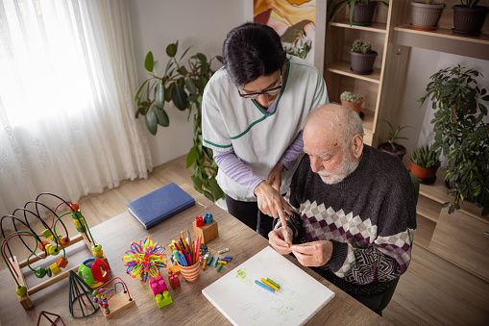
policies and strategies are available to the UK government to maintain public health
Dementia & UK Government Policy – Simple Summary
What’s being done:
NHS Long Term Plan:
Earlier diagnosis
Support at home
Friendly hospital spaces
Use of tech
More research
Other plans:
Prime Minister’s Challenge on Dementia
10-Year Dementia Plan (2022)
2025 Health Plan (includes dementia care)
Health protection policies
Prepare for health threats
Respond quickly to outbreaks
Improve health security
More Diseases Must Be Reported (from April 2025
Helps catch outbreaks faster Protecting People from Bad Weather

Slide 8

policies and strategies are available to the UK government to maintain public health
Health promotion policies of the disease
The NHS has many of ways to prevent people from getting dementia by helping people understand it and supporting those who are at risk.
According to the NHS
“There’s no certain way to prevent all types of dementia … however, there’s good evidence that a healthy lifestyle can help reduce your risk of developing dementia when you’re older.”
Digital health and technology integration
The NHS is using new technology to help people with dementia live a better and saver life.
Sensors and smart watches can spot problems early such as fall or not eating.
Nurses get alerts if something’s wrong.
People can talk to doctors on video or send updates from their devices.
This means they can be at home longer and not in hospital or a care home.

Slide 9

what recommendations as public health practitioners we could provide to the policy makers in rosewood community Centre for dementia peoples
Improve systems to find and track dementia early.
Raise public awareness about dementia and how to spot the early signs.
Make the healthcare system stronger to give better care and support to people with dementia and their families.
Support research to find better ways to prevent, treat, and manage dementia.
Give healthcare workers more training on how to care for people with dementia.
Create community programs to help families and reduce the stigma around dementia.
Encourage better teamwork between health and social care services.
Develop dementia-friendly communities that make life easier and safer for people living with disease.
Promote the use of technology and digital tools to monitor cognitive health and support independent living for as long as possible.

Slide 10

Health Education & Awareness Campaign
Provide:
Provide information about dementia symptoms, risk factors, and support options
Promote:
Promote brain health – healthy eating, exercise, and mental stimulation
Organise:
Organize awareness sessions for students, staff, and families
Work:
Work with Alzheimer’s Society to promote 'Dementia Friends' training
Hand Hygiene & Infection Control:
Dementia is not infectious, but good hygiene protects vulnerable elderly people
Encourage regular handwashing and sanitizer use among staff and visitors
Educate carers on infection prevention during personal care

Slide 11
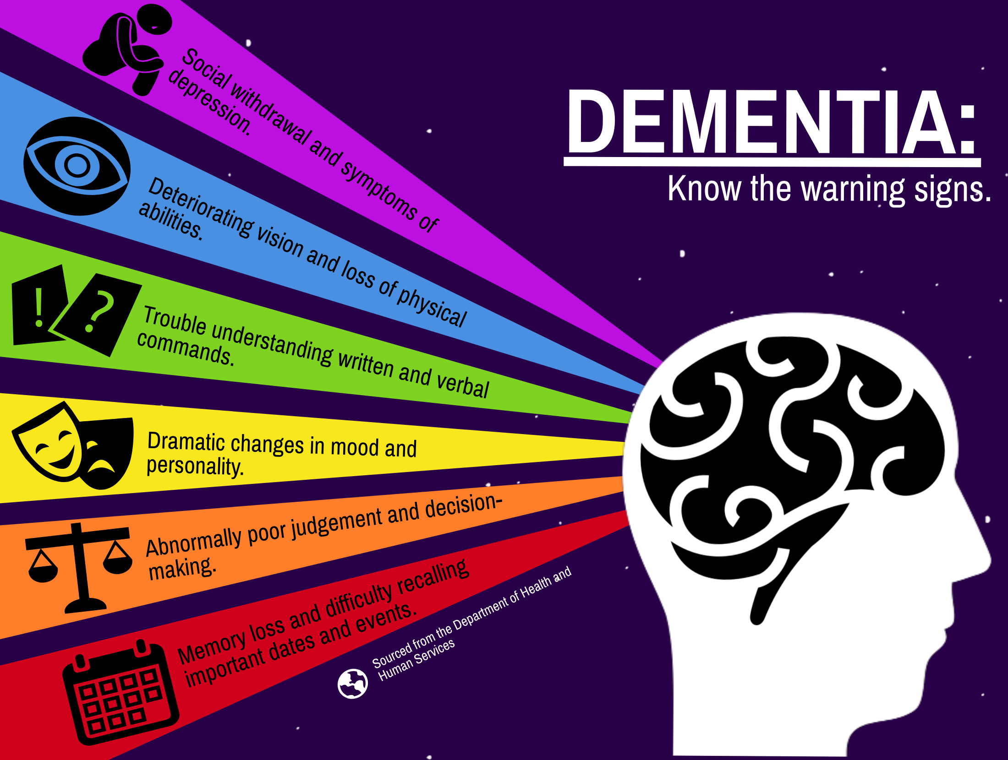
Health education to prevent the outbreak
Sanitation & Environmental Hygiene
Keep community spaces clean, calm, and safe to prevent falls and confusion
Use clear signage and clutter-free areas to help orientation for dementia patients
Ensure food preparation and toilets meet hygiene standards
Health Monitoring & Screening
Carry out regular health checks - blood pressure, diabetes, memory assessments
Encourage early reporting of memory or behavior changes
Collaborate with GPs and mental health professionals for early diagnosis and support
Goal
Create a safe, dementia-friendly environment
Promote wellbeing, independence, and dignity for elderly residents and carers

Slide 12

Conclusion
PROMOTING dementia awareness through education and community support helps create a safer, more inclusive environment for elderly residents
ENCOURAGING healthy lifestyles, maintaining hygiene and sanitation, and monitoring health regularly can reduce risks and support early diagnosis
WORKING with health professionals and families ensures individuals living with dementia maintain independence, dignity, and quality of life.

Slide 13

References
Leach Murphy, L. & Patel, J. (2021) Living a good life with Dementia: A practitioner’s guide. London: Routledge.
Brooker, D., Lillyman, S. & Bruce, M. (2022) Dementia Care, 2nd edn. London: Taylor & Francis.
Wonderlin, R. (2022) The Caregiver’s Guide to Memory Care and Dementia Communities. Baltimore, MD: Johns Hopkins University.
Parker, I., Coaten, R. & Hopfenbeck, M. (2022) The Practical Handbook of Living with Dementia. PCCS Books.
Leach Murphy, L. & Patel, J. (2023) A Family Guide to Living Well with Dementia. London: Routledge.
Huelat, B. J. (2023) Taming the Chaos of Dementia: A Caregiver’s Guide to Interventions That Make a Difference. Rowman & Littlefield Publishers.
Alzheimer’s Society (2024) Dementia UK report 2024: Statistics and trends. Available at: https://www.alzheimers.org.uk/ ( Accessed: 18 October 2025).
Public Health England (PHE) (2023) Dementia Profile – Fingertips Tool. Available at: https://fingertips.phe.org.uk/profilr-group/mental-health/profile/dementia ( Accessed: 18 October 2025).

