Slide 1
The Marketing Environment

Slide 2
Learning Outcomes
Outline the terminology used to identify micro and macro environments.
Critically appraise both the micro and macro environments in which organizations must operate.
Consider how the micro and macro environments affect all aspects of business, in addition to marketing.
Monitor changes that occur within both the micro and macro environments.
Debate how environmental scanning could help to predict changes within both the micro and macro environments.
Consider the validity of scenario analysis within a dynamic global business and marketing environment.

Slide 3
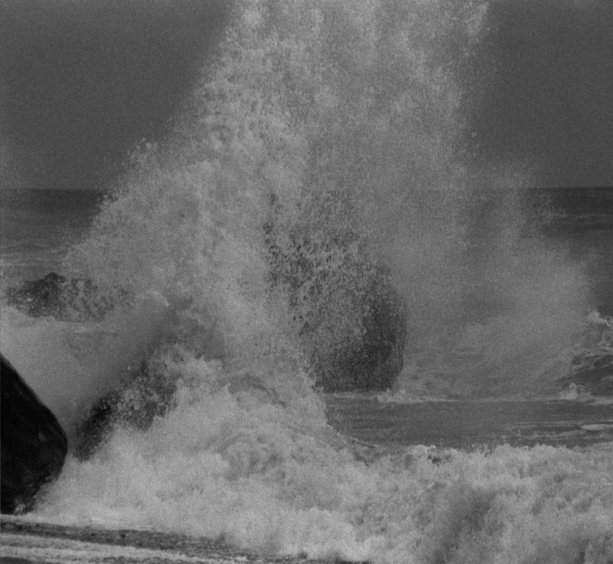
Volatile Environments
Micro and macro environments are in a state of flux.
They are fluid and dynamic and continually interacting with each other.
Levels of increasing ‘connectivity’ and ‘convergence’ – political and economic influence.
Examples:
  Aftermath of September 11 2001
  Tsunami in South East Asia
  Situation in the Middle East
© Jonathan Groucutt 2006

Slide 4
What Is the Macro Environment?
Various short forms:
PEST/STEP
SLEPT
LE-PEST-C
SPECTALCLES
PESTEL/PESTLE
Notes:
All of these are variations of the same thing – a framework for analysing the wider environment in which we operate. The following slides go into each aspect in more detail.

Slide 5
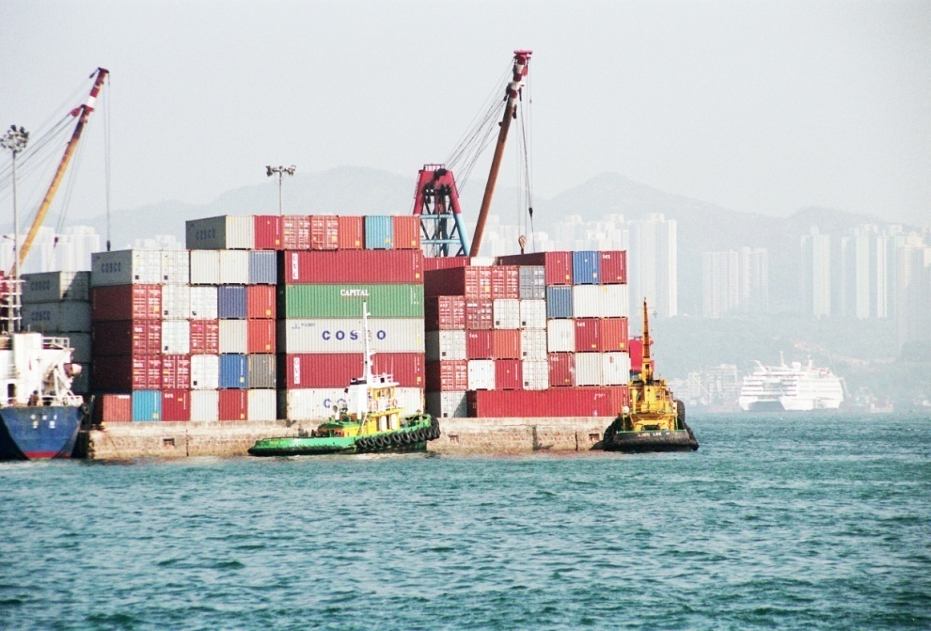
PESTLE Factors
Political
Economic
Societal
Technology
Legal
Environmental - Ecological
© Jonathan Groucutt 2006
Hong Kong – Major Global Trading Centre

Slide 6
Political
Geopolitical events
  Short lived or prolonged
  Trading alliances
Political risks
  Expropriation
  Confiscation
  Domestication
  Revolution/Civil Unrest
  Terrorism
  Strikes
National politics
  Political influence on a national level. This could be both positive and negative. You will need to consider this from the perspective of a home country business and one marketing into that country.

Slide 7
Economic
Business & economic cycles:
  Depression – slump
  Recovery
  Steady Growth
  Boom
  Recession
  Stagnation
Inflation
Interest rates
Taxation systems
Income levels
Poverty – developing nations

Slide 8
Societal (1)
Hofstede (1980) defines culture as:
  ‘The collective programming of the mind which distinguishes the numbers of one human group from another….Culture, in this sense, includes systems of value: and values are among the building blocks of culture.’

Slide 9
Societal (2)
Doole and Lowe (1999) suggest culture,
from an international perspective, is:
‘The sum total of learning beliefs, values and customs that serve to direct consumer behaviour in a particular country market.’

Slide 10
Societal (3)
Cultural orientation & behaviours:
  Parochialism
  Ethnocentrism
  Polycentrism
  Regiocentrism
  Geocentrism

Slide 11
Societal (4)
Attitudes to health
  Obesity,‘junk’ food, fast food,healthy eating.
Demographics
  Role of the family
  Communications
  Transportation
  Migration
Education
  Can range from TV cookery programmes through to university.

Slide 12
Technology
Over centuries technologies have fuelled economic expansion and development.
Also new industries have replaced older industries.
New products have replaced older products eg: computers and typewriters.
Technologies and the creation of economies of scale
Manufacturing and service industries have been revolutionised by:
  Communications
  New materials
  Computing power
Negative impacts

Slide 13
Legal - Regulatory
Potential degree of political influence.
  Imposition of sanctions and embargoes.
Marketing of goods.
  Ban on certain types of products eg: fireworks in Hong Kong.
  Restrictions on advertising in certain countries e.g. marketing to children on TV or the advertising of cigarettes on TV within the European Union.

Slide 14
Environmental - Ecological
The impact of weather
  Severe storms
  Heat waves
Disease: both animal and human
  BSE/CJD
  Avian flu
  SARs
Global warming/global dimming
Geophysical
  Earthquakes
  Tsunamis
  Volcanoes

Slide 15
Micro Factors
Suppliers
Competitors/Co-operators
Local community
Employees
Local government
Intermediaries
Customers
Retired employees
Trade unions
Opinion formers
Local regulators
Profit and not-for-profit
organizations

Slide 16
Elements of the Micro Factors
Suppliers
Employees
Local community
Local government
Intermediaries
Customers
Competitors/
Co-operators
Retired employees
Trade unions
Opinion formers
Local regulators

Slide 17
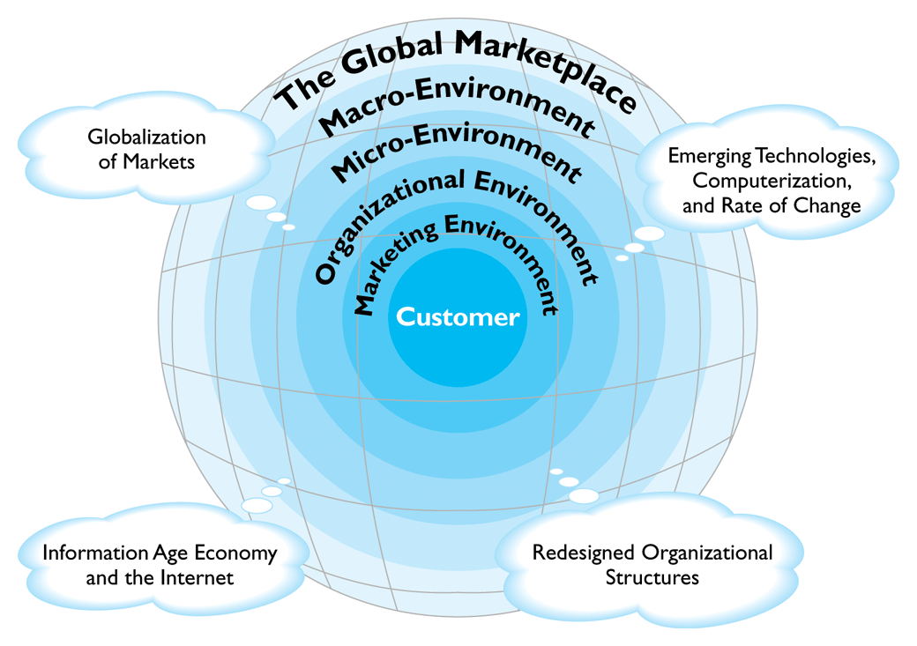
Copyright © Houghton Mifflin Company. All rights reserved.

Slide 18
Summary
Micro and macro factors do not operate in isolation.
These factors are not static – but in a state of flux.
Ecological – natural environmental factors can have major impacts upon organizations now and in the future.
Realisation that new materials and technologies are being developed.
Organizations must be aware of the influence of various stakeholders.
Organizations must continually monitor internal and external factors.

Slide 19
Further Reading
Philip Kotler and Kevin Lane (2006) Marketing Management 12ed, Pearson, pp.79-97
(or the chapter on environmental analysis in any of the books by Kotler)
Michael J. Baker (2000) Marketing Strategy and Management 3rd edition, Macmillan, pp. 171-191.

Slide 20
Next Session
Segmentation, Targeting and Positioning (STP)
Benefits of which can be:
  More efficient use of resources.
  Added clarity to marketing planning.
  Increasing opportunity for creating effective customer relationship management (CRM).
  Market position analysis in relation to the competitors.
  Increasing opportunity for gaining and sustaining competitive advantage.

