Slide 1
Essential skills for Coaching and Mentoring

Slide 2
Skills in common
Instructing Giving direction
Advising Guiding
Listening Questioning
Giving feedback Interpersonal skills
Analysing Paraphrasing
Summarising Reflecting
Networking Verbal

Slide 3
Skills focus for today
Listening
Questioning
Analysing
Reflecting and summarising
Giving feedback

Slide 4


Adapted from: http://www.freefoto.com/preview/23-23-16/Stop-Look-Listen-Sign. Accessed on 19/12/2016

Slide 5
What do you do when you listen?
Mentalise - capacity to make inference about people and their behaviour.
Empathise - subjectively experience life from another person’s angle.
Intuit - apply professional judgement to the unfolding situation
Empower the client.
Manfred et al 2007

Slide 6
Why is it so hard to listen?
Because our minds work faster than our hearing. We speak at an average of 120 wpm whilst brain has capacity of 400 wpm ( Lee and Hatesohl )
We are culturally tuned to keep a conversation flowing and so are creatively involved in how best to respond.
We filter what we hear through our own autobiographies.
Listening attentively is mentally demanding.

Slide 7
Listening
Listening is not done by the ears but by the mind. We hear sounds but we listen to meanings.
(Meissner 2000:p.323)
Available from http://wondergressive.com/dogs-can-predict-earthquakes-by-hearing-them/ Accessed on 19/12/2016

Slide 8
Active listening
The listening is an ongoing operative with effects on both the speaker and the person addressed.
It gives value to what is said and positions the speaker in a reflective frame of mind.
Listening helps to increase the coachee’s self awareness and resourcefulness.
        Hardingham et al. 2004: p.114

Slide 9

EARS
Empathise
Acknowledge
Reflect
Summarise

Slide 10

Questions
Available from: http://frankensteinlessons.wikispaces.com/Questions+to+consider. Accessed on 19/12/2016

Slide 11
Why questions are important to coaching
Questioning is the second most important skill and together with active listening, probably achieves 80% of the positive outcome of coaching.
Hardingham et al. 2004: p.46
...curiosity and questioning are the foundational drivers of learning, development and change Adam 2012: p.10
Questions oil the wheels of communication
Muir 2012

Slide 12
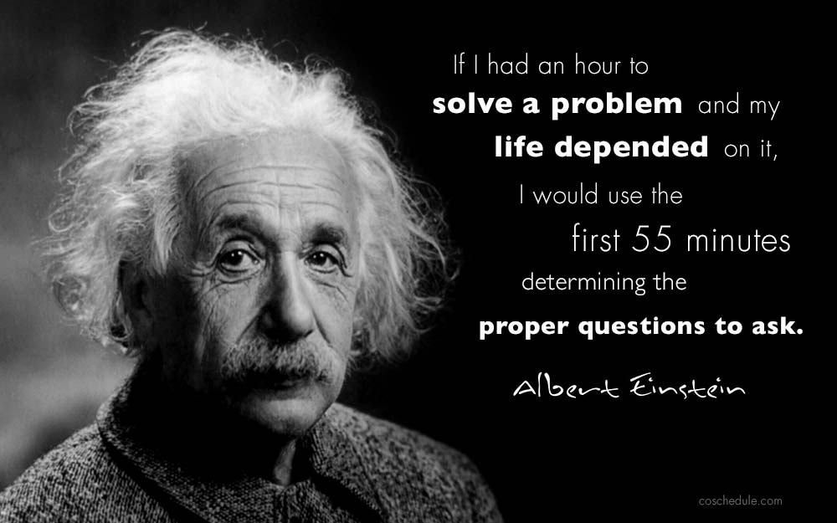

Slide 13
Aptness of the question
Asking the right question means the difference between a one way interrogation and a dynamic learning session. Good coaching questions cause someone who is competent and busy the space to step back and examine herself (Su 2014)

Slide 14

What a good question can achieve
Generate curiosity
Stimulate reflection
Provoke thought
Bring to light underlying assumptions
Invite creativity
Generate energy
Channel attention
Touch deep meaning
Stay with the listener
Unleash more questions
(Vogt et al. 2003)

Slide 15
Types of questions
Useful questions | Questions to avoid
Awareness - raising | Closed Long winded
Reflective | Multiple complex
Justifying | Loaded
Probing | Trick
Checking

Slide 16
Where do good questions come from?
Our mindset frames how we see the world. Mindsets define the parameters of our actions and interaction with others. They are a determinant in the types of questions we ask ourselves and others.
Adams, M. (2004).
Good questions come from curiosity and a genuine interest in someone’s welfare

Slide 17
Competency in Questioning
Become more aware of the questions you ask now and of the questions other people ask of you:
Ask yourself – what do I want this question to accomplish?
Encourage others to ask you questions
Continuous practicing and application of questioning improves the skill of asking better questions
Ask yourselves:
What is the quality of our questions?
What is preventing us from asking better questions?
How could we ask better questions?

Slide 18
Analysing
Effective coaches and mentors take time to analyse what their clients have said. Is the meaning clear or are there underlying issues. Analytical skills can be enhanced by the application of good questioning skills

Slide 19
Summarising and Reflecting
Summarising is a useful tool to use during coaching and mentoring conversations as it helps to keep discussions focussed and on track
Coaches can help a person to track their thinking by periodically reflecting back what they have said. It is important when doing this that the coach uses the words that the person used as closely as possible. (Thomas and Smith 2004: p.57)
Reflecting back what you have been told...is a very powerful way to show someone that you are listening to someone with empathy. (Muir 2011)

Slide 20
Feedback:
should be used to improve effectiveness and should be developmental. It should focus on behaviour and performance, not personality
should be used to acknowledge and praise positive behaviour
should be used to help learners to explore solutions to problem areas
should be two way

Slide 21
Conclusion
If you give of your time as a mentor or coach be an instrument of change by paying attention to who you are, to the questions you ask and the way you listen.

Slide 22
References
Adams, M.( 2009) Change Your Questions, change Your Life. 2nd ed. San Francisco: Berrett-Koehler Publishers.
Covey, S., (2004). The 7 Habits of Highly Effective People. London: Simon and Schuster UK Ltd.
Jarvis, J. ,. L. D. a. F.-T. A.( 2006) The Case for Coaching: Making Evidence-Based Decisions. London: CIPD.
Kempster, S. (2009). How Managers Have Learned to Lead. Basingstoke: Palgrave Macmillan.
Hardinham A, Brearly M Moorhouse A and Venter B(2004) The Coach’s coach. CIPD
Lee, D. and Hatsohl, D. (1993) Listening: Our most used communication skill

Slide 23
References (cont)
Meissner (2000) in Manfred F.R., Kets De Vries, Korotov, K. and Florent Treacy, E. (2007) Coach and Couch. Palgrave Macmillan. Basingstoke.
Manfred F.R., Kets De Vries, Korotov, K. and Florent Treacy, E. (2007) Coach and Couch. Palgrave Macmillan. Basingstoke.
Muir, A(2012) Get Results with NLP Flash. Hachette.
Thomas and Smith(2004) Coaching solutions.
Vogt, EE, Brown J, Isaacs, D.(2003) The Art of Powerful Questions. Catalyzing, insight, innovation and Action. Whole systems Associates.
Su, A. J. (2014) The questions good coaches ask. Harvard Business Review

