Slide 1
CertHE Skills for the Workplace
Module: BMSW4006
Managing Enterprise in 21st Century
Week 1

Slide 2

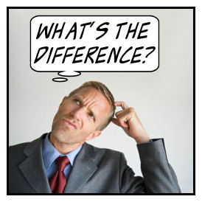
Business Identities

Slide 3

Business Identities
Sole Trader
Partnership
Limited Liability Partnerships
Limited Companies
Franchises
Social enterprises, co-operatives and charities
Notes:
https://www.gov.uk/business-legal-structures/overview

Slide 4

Sole Trader
A sole-trader is a self-employed person, but they are the sole owner of their business.
'A sole trader is a person who sets up and owns their own business. They may decide to employ other people but they are the only owner. A sole trader has unlimited liability.'
As a sole trader, your business is owned entirely by you, grown by you and ultimately succeeds or fails by you.

Slide 5

Partnership
A partnership is a form of business where two or more people share ownership, as well as the responsibility for managing the company and the income or losses the business generates. That income is paid to partners, who then claim it on their personal tax returns – the business is not taxed separately, as corporations are, on its profits or losses.

Slide 6

Limited Liability Partnerships - A limited liability partnership is designed for businesses that usually operate as a traditional partnership i.e. accountancy firms, solicitors, dentists, medical practitioners and other professional services firms. These types of businesses are able to operate as LLPs and provide limited liability to their members (partners). This means that individual partners are not personally responsible for business debts and liabilities beyond what they invest or guarantee to the LLP.

Slide 7

A limited company is a type of business structure that has been incorporated at Companies House as a legal ‘person’. It is completely separate from its owners, it can enter into contracts in its own name and is responsible for its own actions, finances and liabilities. The owners of a company are protected by ‘limited liability’, which means they are only responsible for business debts up to the value of their investments or what they guarantee to the company.
A limited company must be registered at Companies House (UK registrar of companies) as ‘limited by shares’ or ‘limited by guarantee’. Limited by shares companies are owned by one or more shareholders and managed by one or more directors.

Slide 8
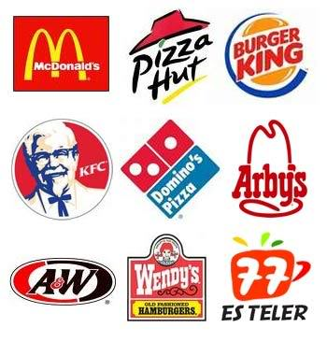
Franchises
A franchise is a type of license that a party (franchisee) acquires to allow them to have access to a business's (the franchiser) proprietary knowledge, processes, and trademarks in order to allow the party to sell a product or provide a service under the business's name. In exchange for gaining the franchise, the franchisee usually pays the franchisor an initial start-up and annual licensing fees.

Slide 9
Social Enterprise - businesses that are changing the world for the better. Like traditional businesses they aim to make a profit but it’s what they do with their profits that sets them apart – reinvesting or donating them to create positive social change. Social enterprises are in our communities and on our high streets – from coffee shops and cinemas, to pubs and leisure centres, banks and bus companies.
co-operatives - Firm owned, controlled, and operated by a group of users for their own benefit. Each member contributes equity capital, and shares in the control of the firm on the basis of one-member, one-vote principle (and not in proportion to his or her equity contribution
Charities- to be a charity in England and Wales, your organisation must satisfy the definition of a charity in the Charities Act. The Charities Act says that a ‘charity’ is an institution which is established for charitable purposes

Slide 10
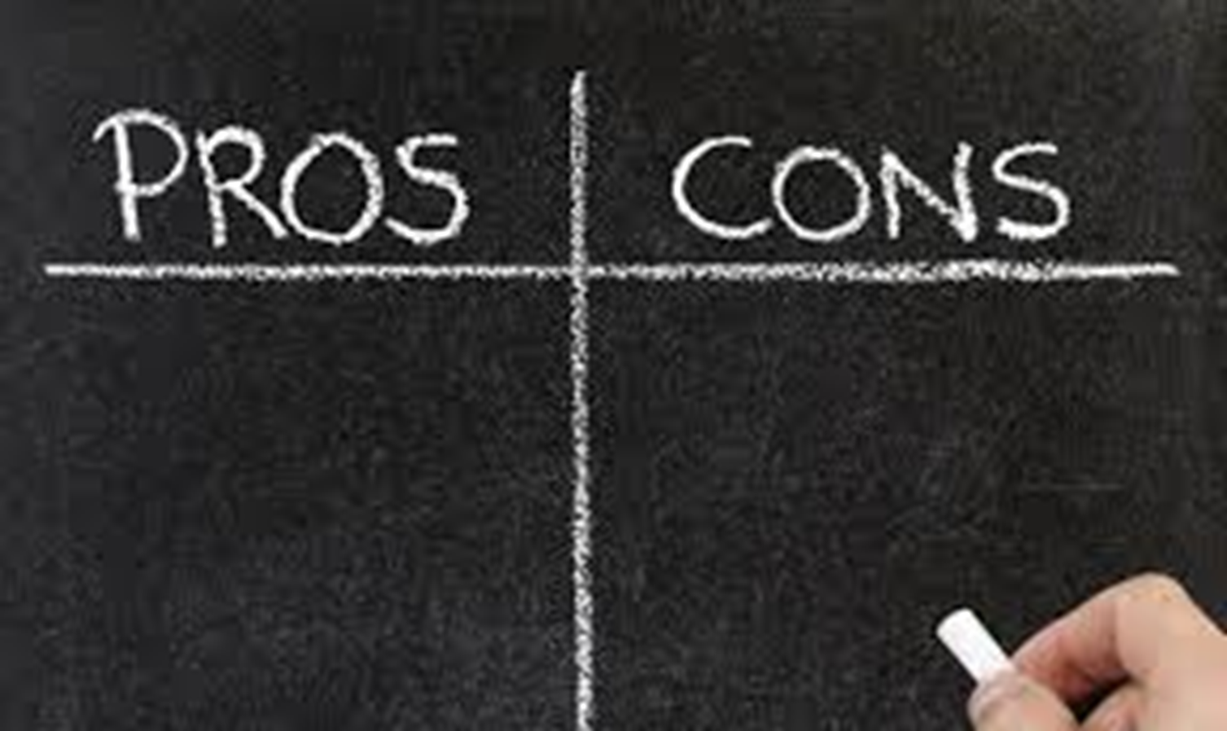
Business Identities

Slide 11

Pros of operating as a sole trader
Usually only a small amount of capital is required to start the business
You are entitled to all the profits that are made by the business
You do not have to answer to anyone else and can keep overall control of the business
There is little bureaucracy involved so changes can be made quickly
You have less paperwork to deal with regarding legislation and tax.

Slide 12
Cons of operating as a sole trader
Can become isolated as there is no one to share the running of the business with
You will probably have to work long hours and it will be difficult to take time off
The level of finance available can be limited, depending on the type of business, which may stifle the development of the business

Slide 13
Cons of operating as a sole trader
Businesses with greater access to funding may have an advantage over you
You are solely responsible for any losses the business incurs, i.e. you have unlimited liability. There is no distinction between personal and business putting your home and personal possessions at risk if you are unable to repay your debts.

Slide 14

Pros of forming a partnership
No need to produce audited accounts
Tax and National Insurance payments are generally lower than for a limited company
Increased capital available for investment
Shared management responsibilities
Shared risks and losses
Partners can bring a variety of different skills and experience to the business
They are easy to set up as they are not incorporated or registered
Partnerships cannot be taken over by other businesses

Slide 15

Cons of forming a partnership
There is unlimited liability and each partner is personally responsible for the debts of the partnership
Problems can occur when there are disagreements between partners
An individual can make a business decision without informing the other partners
Partnerships must be dissolved on death, resignation or bankruptcy of a partner

Slide 16
Pros of forming a limited liability partnership
Retains the flexibility of a partnership as opposed to the well-defined structure of a limited company
LLPs do not have to be dissolved on the resignation, death or bankruptcy of a member
There is limited personal liability for members
Tax and National Insurance contributions are lower than for a limited company

Slide 17
Pros of forming a limited liability partnership
Shared risks and losses
Members can bring a variety of different skills and experience to the business
Limited liability partnerships cannot be taken over by other businesses
Increased capital available for investment
Shared management responsibilities

Slide 18
Cons of forming a limited liability partnership
Formation is more complex and costly than that of a partnership
Most limited liability partnerships need to produce audited accounts
More administration overheads, eg informing Companies House of changes to members and designated members
Problems can occur when there is disagreements with other members

Slide 19

Pros of forming a limited company
Limited liability of the owners of the business
Ability to raise finance by selling shares in the business
Employees are able to own a share in the business
Suppliers are sometimes more willing to deal with a limited company
Can continue to trade if one of the members leaves
The company name is protected

Slide 20

Cons of forming a limited company
A wide range of complex and detailed legislation must be complied with, which is not applicable to sole traders and partnerships
Compulsory disclosure of company information
Credit is more difficult to obtain (especially when the business is starting up)

Slide 21
Mission Statements
The mission statement for the business should be clear and succinct representation of the enterprise’s purpose for existence.
Mission Statements Examples
Disney:
“We create happiness by providing the finest in entertainment for people of all ages, everywhere”
Sainsbury’s
“Our mission is to be the consumer’s first choice for food delivering products of outstanding quality and great service at a competitive cost through working ‘faster, simpler and together”.
ASDA
Our aim at ASDA is simple- to continually lower our prices so we can save our customers money every day.

Slide 22

When setting up mission statements
It’s the “why” of business strategy.
A mission statement define a company’s goals in three important ways:
It defines what the company does for its customers
It defines what the company does for its employees
It defines what the company does for its owners

