Slide 1


Behaviourist Approach
By Tyler king

Slide 2
Main Assumptions
Born as a blank slate
All behaviour is learned
Impacted by relationships and environment
Focus solely on observational and measurable behaviour
Not concerned with the processes of the mind

Slide 3

Nature or Nurture?
K Cherry. (2019)
According to behaviorists, Nurture. Mainly Our relationships and environment.
Our environment teaches us through conditioning.
Plomin, R., & Bergeman, C. (1991)

Slide 4


Main theorists
Ivan Pavlov 1849-1936
Best known for theory on Classical conditioning
Learning through association
Said to have shaped the field of behaviorism in psychology
Schweitzer, K. (2019)

Slide 5
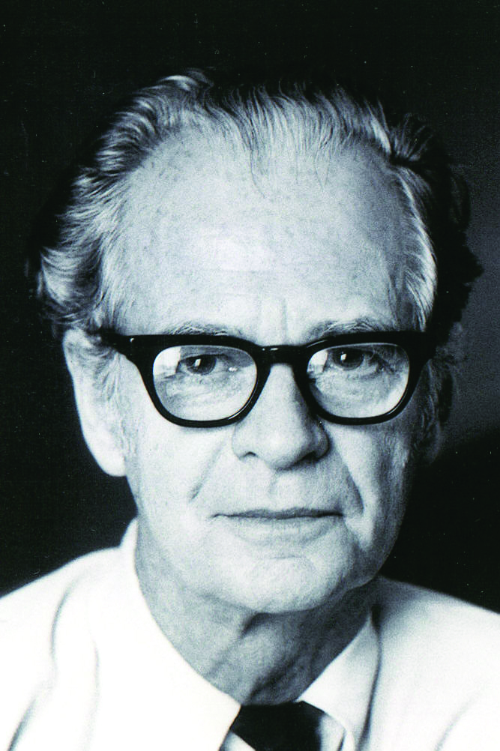
B F Skinner 1904-1990
Operant conditioning
Method of learning that arises through rewards and punishments for behavior. Learning through positive and negative reinforcement
McLeod (2018)

Slide 6


Social learning theory
Albert Bandura
Banduras Dolls

Slide 7
Relevant therapies
Systematic desensitisation
Aversion therapy
Flooding

Slide 8

Overviews of therapies used
Therapies | Brief overview
Systematic Desensitisation | Behaviour therapy where a patient is reconditioned to replace phobia and fear with relaxation. (F Dudley Mcglynn, 2002)
Aversion therapy | Can be controversial. Helps a client give up a bad behaviour/habit/ phobia by having them associate it with something unpleasant. (J Elmer 2019)
Flooding | Behaviour therapy where a patient will endure their fear until their anxiety and phobias subside. (W Marshall et el 1977)

Slide 9

Advantages
Research methods are scientific therefore easy to test.
No need to refer to previous medical history or past experiences
Its believed changing behavior is an adequate cure.
Doesn’t label people or their behavior as ‘abnormal’
Results can be quick and effective
K Cherry (2019)

Slide 10
Disadvantages
Can be considered narrow and limited
Ignores medical causes and conditions
Dehumanizes. Puts humans on the same par as dogs and rats
Deals with symptoms and not causes meaning the results can be short term
Charlotte (2013)

Slide 11

Thanks for listening!!

Slide 12
Reference list
Dudley Mcguinn, F. (2002). Encyclopedia of psychotherapy 2002. https://www.sciencedirect.com/topics/medicine-and-dentistry/systematic-desensitization (accessed October 31, 2020)
Elmer, J. (2019). What is aversion therapy and how does it work? https://www.healthline.com/health/mental-health/aversion-therapy#how-it-works (accessed October 31, 2020)
K Cherry., (2020). What is behaviour therapy?. https://www.verywellmind.com/what-is-behavioral-therapy-2795998 (accessed on 02/11/2020).
Marshall W L., Janal Gauthier., Christie M.M., Currie D.W., Gordon A. (1977). Behaviour research and therapy. Issue 1, pp 79,87
McLeod, S. A. (2018). Skinner - operant conditioning. Simply psychology. https://www.simplypsychology.org/operant-conditioning.html
National Health Service. (2019). Cognitive behavioural therapy (CBT). https://www.nhs.uk/conditions/cognitive-behavioural-therapy-cbt/ (accessed October 31, 2020)
Plomin, R., & Bergeman, C. (1991). Nature and nurture. Behavioral and Brain Sciences, 14(3), 414-427. doi:10.1017/S0140525X00070588
Schweitzer, K. (2019) Biography of Ivan Pavlov, Father of Classical Conditioning. ThoughtCo. https://www.thoughtco.com/ivan-pavlov-biography-4171875 (accessed October 30, 2020).
Watson, J B., (1919). Psychology; From the standpoint of a behaviourist. 3rd edn. Lippincott
Charlotte, (2013). Strengths and weaknesses of the behavioural approach. https://getrevising.co.uk/grids/strengths_and_weaknesses_of_behavioural_approach (accessed on 02/11/2020)

