Slide 1

Leadership and Management Theory and Practice
Assessment 1- LCBB6022_LON
Student: Maria Viorica Covete, Id: 2128947
Lecturer: Dr. Faizu Edu

Slide 2
Introduction
Leadership is becoming more complex in global organisations (Mendenhall, 2025)
Workforce diversity and globalisation increasing
Leaders must manage emotions and cultural differences
Emotional Intelligence (EI)
  Ability to perceive and manage emotions
Cultural Intelligence (CQ)
  Ability to operate across cultures
EI contributes to ≈58% of job performance
Both competencies critical for modern leadership

Slide 3
Emotional Intelligence in Leadership
Emotional Intelligence = recognising and managing emotions
Important leadership capability in organisations
Helps leaders to:
  Build trust
  Resolve conflict
  Motivate employees
Improve communication (Sharma, Dhanta and Sharma, 2024)
Leaders influence ≈70% of employee engagement
EI improves:
  Team collaboration
  Job satisfaction
  Organisational commitment

Slide 4
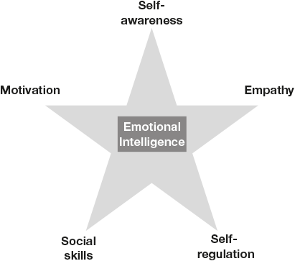
Goleman’s Emotional Intelligence Model
Goleman’s model of Emotional Intelligence.
Self-awareness: The learning of the emotional state and its impact.
Self-regulation: Being well and positive regarding feelings.Motivation: Utilizing feelings to acquire things that one desires.
Empathy: Compassion: This is the ability to be aware of how other people feel and treat them in a certain way.
Social skills: Have the capability to handle relationships and make people move in the right directions (Hurley and Linsley, 2026).
Strengths of Goleman's Model:
Lays stress on individual and inter-personal ability as a leader.
Generally accepted in the leadership discipline.
Limitations:
EI is a difficult variable to make quantitative.
Leadership cannot be successful only through EI, but it also depends on the situation in the organization.
Notes:
One of the building blocks of the phenomena of leadership can be found with the model of Emotional Intelligence created by Goleman. It emphasizes on five key competencies where the first one, self-awareness, aids leaders know their emotions and understand them. This is followed by self-regulation that involves the ability to manage emotions to build healthy working environments. Motivation refers to the capacity of leaders to use emotions to drive them and other people to goals. In effective leadership, empathy is important as it helps a leader to empathize and react to emotions of employees (Hurley and Linsley, 2026) . Finally, social skills make leaders relate with people and impact them positively. The skills are critical in cultivating trust, collaboration and inspiration in the workplace. There are high chances that an emotionally intelligent leader will manage conflict, be communicative and motivational to members of the team. However, the quantification of EI remains an issue and this impact can be also situation-specific in both organization and culture, and this must be considered during the measurement of leadership effectiveness. The Goleman model develops excellent understanding of the internal and social qualities of a leader therefore it necessitates in the analysis of leadership.

Slide 5
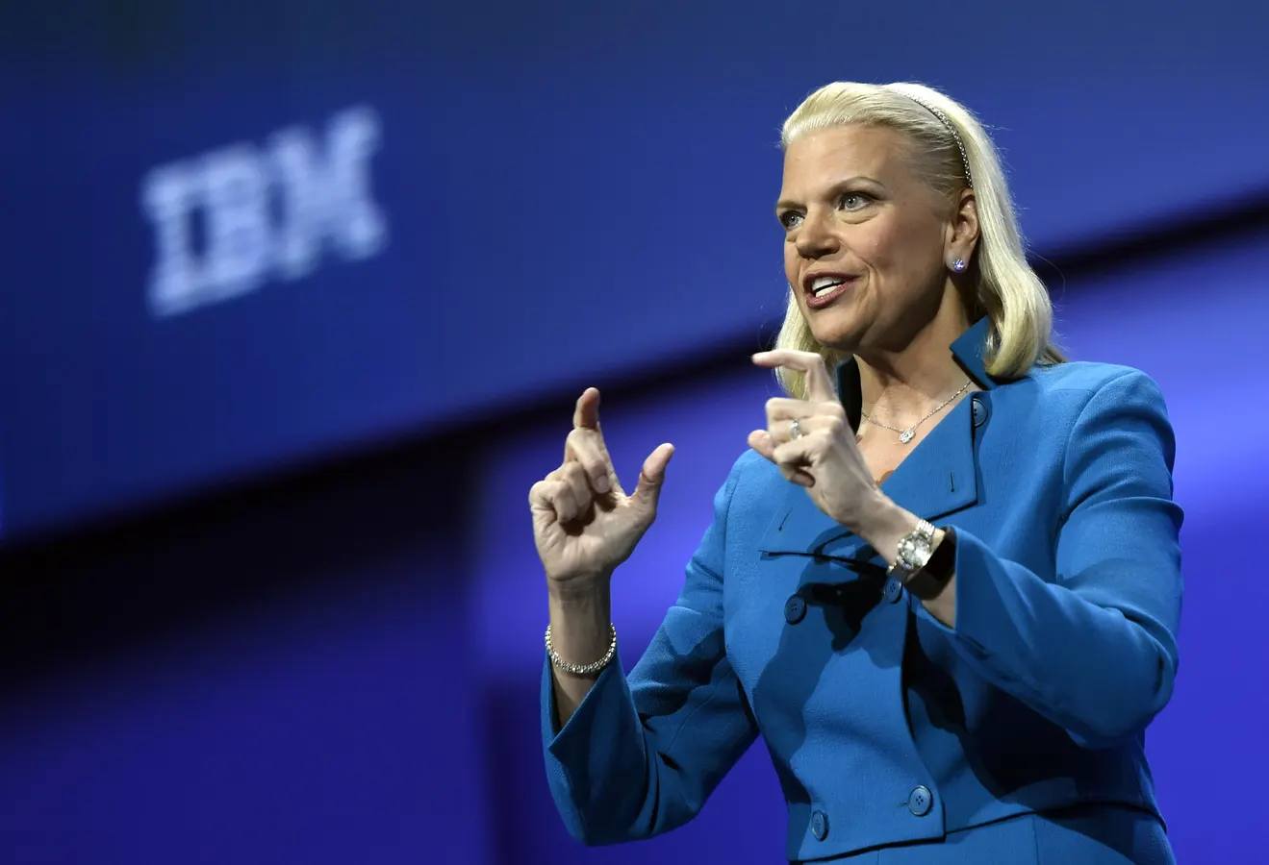
Business Example: IBM
Leader: Ginni Rometty
EI Application
Empathy: Rometty tried to build an empathy culture by placing herself in the shoes of the employee and understanding the requirements of the employees under the IBM transformation.
Self-regulation: She demonstrated stability in concentration, especially at challenging situations during decision-making, especially during the time when IBM was transitioning to AI and cloud computing (Kamal et al., 2025).
Leadership Outcome: Successful business model transformation and business culture re-energization at IBM.
Strengths: Planned change leadership, improving innovation.
Limitations: The measurement of emotional intelligence was in the opposition to major changes within the organization.

Slide 6
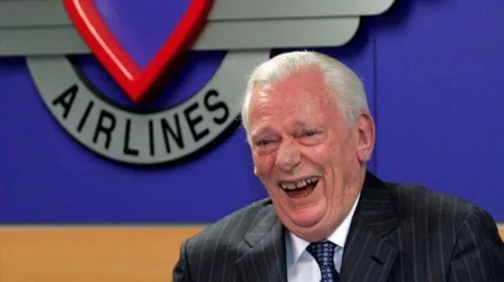
Business Example: Southwest Airlines
Leader: Herb Kelleher
EI Application:
Social Skills: Kelleher promoted proper relationship and trust amongst the employees.
Self awareness: He was a leader that was easy-going, humble and realized that he had a role to play in the development of the company culture.
Leadership Outcome: An excellent organizational culture and a well motivated work force (Mohamed, Almahroos and Fakhr, 2025).
Strengths:Employee satisfaction and minimal employee turnover.
Limitations:Culture is enhanced as competition rises.

Slide 7
Cultural Intelligence in Leadership
Cultural intelligence (CQ)
Ability to work effectively across cultures
Global organisations manage multicultural teams
Cultural awareness improves:
  Collaboration
  Communication
  Global partnerships (Wadhera and Gandhi, 2024)
CQ helps organisations adapt to:
  International markets
  Diverse employees
  Essential leadership capability in global business

Slide 8
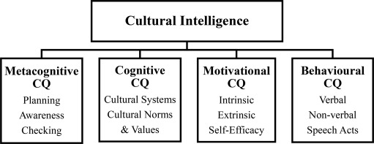
Earley and Ang's Model
Cognitive CQ: The acquirement of cultural norms and practices.
Motivational CQ: The desire to perform well in different culture.
Behavioral CQ: Adaptation of behavior according to culturally diverse environment.
Strengths: Focuses on realistic cultural adaptability towards leaders. Can be used in multi cultural, multinationals (Piotrowska and Piotrowski, 2023).
Limitations: CQ is an indicator that can be difficult. Existence can never be shared with all human beings according to their experiences and might not necessarily conform to the general cultural norms.

Slide 9

Business Example: McDonald
Leader: Steve Easterbrook
CQ Application:
Cognitive CQ: Understanding of the cultural differences in the global markets.
Behavioral CQ: Localizing the McDonalds menu and service to the local taste in terms of culture.
Leadership Outcome: Proper globalization through formulation of plans that are unique in each market.
Strengths: Adaptability in the different markets. Effective localization policies.
Limitations: Risk of losing the brand because of overemphasizing local preferences.

Slide 10
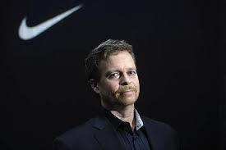
Business Example: Nike
Leader: Mark Parker
CQ Application:
Motivational CQ: Being aware of the significance of cultural diversity in teams.
Behavioral CQ: Culture and culturally relevant marketing and product development (Suh et al., 2022).
Leadership Outcome: Expansion into high brand loyalty markets.
Strengths: Proper contact with the various consumer segments. Imaginations in alternative thinking.
Limitations: Certain markets will have some cultural blunders.

Slide 11
EI vs CQ (Critical Comparison)
Emotional Intelligence (EI)
Concentration: The management of human relationship, enhanced communication, and team motivation.
Core Competencies: self-understanding, self-control, emotional intelligence, social abilities and drive.
Leadership Result: EI achieved results in greater performance in an organization through the development of trust, conflict resolution, and health team dynamics.
Cultural Intelligence (CQ)
Highlight: Cross-cultural contact and multicultural team management.
The most important Competencies are cognitive CQ (knowledge of cultures), Motivational CQ (drive to work in cultural differences) and Behavioral CQ (ability to adjust actions in different settings) (Jose, 2024).
Leadership Outcome: CQ is a part of the global leadership in terms of aiding in collaboration and offering cultural adoptions to the diverse work environments.
Combined Importance
The two, EI and CQ, are highly critical to leaders in multicultural organizations.
EI helps in the management of emotions and relationships, while CQ ensures the management of cross-culture.
They will also work together to encourage cooperation, decision-making, and leadership in the international business.

Slide 12
Conclusion
EI and CQ essential leadership capabilities
EI improves interpersonal leadership
CQ enables cross-cultural management
Business examples demonstrate real application
Global leaders must integrate both competencies
Enhances organisational performance and collaboration

Slide 13
References
‌Hurley, J. and Linsley, P. (2026) ‘Introducing Emotional Intelligence’, Emotional Intelligence for Health and Social Care Practice, pp.1–19. Available at: https://doi.org/10.4324/9781003673309-1.
Jose, J. (2024) ‘Cultural Intelligence in International Business Negotiations: a Systematic Review’, International Journal of Innovative Research in Technology and Science, 12(2), pp.69–78. Available at: https://ijirts.org/index.php/ijirts/article/view/13.
Kamal, M.B. et al. (2025) ’The Dynamics of Digital Leadership: Key Concepts and Principles’, Productivity Press eBooks, pp.12–32. Available at: https://doi.org/10.4324/9781003602293-2
Mendenhall, M.E. (2025) ‘Leadership and the Birth of Global Leadership’, Global Leadership, pp.3–31. Available at: https://doi.org/10.4324/9781003541752-2.
Mohamed, J., Almahroos, S. and Fakhr, S. (2025)’ A Comparative Study of Sustainable Leadership Management Styles Between Apple and Microsoft’, Lecture Notes in Networks and Systems, pp.58–66. Available at: https://doi.org/10.1007/978-3-032-16389-9_5.
Piotrowska, M.Z. and Piotrowski, J. (2023) ‘Hofstede’s Cultural Dimensions Theory’, Encyclopedia of Sexual Psychology and Behavior, 1(1), pp.1–4. Available at: https://doi.org/10.1007/978-3-031-08956-5_1124-1.
Saltzman, D. (2024) ‘Analysis of Toyota and the Automobile Industry’, Honors Theses. Available at: https://digitalcommons.cortland.edu/honorstheses/8/.
Sharma, P., Dhanta, R. and Sharma, A. (2024) Emotional Intelligence and Conflict Resolution in the Workplace, www.igi-global.com. Available at: https://www.igi-global.com/chapter/emotional-intelligence-and-conflict-resolution-in-the-workplace/335415.
Suh, J. et al. (2023) “A Cross-Cultural Study of Value Priorities between U.S. and Chinese Airbnb Guests: An Analysis of Social and Economic Benefits,” Sustainability, 15(1), p. 223. Available at: https://doi.org/10.3390/su15010223.
Wadhera, R. and Gandhi, R. (2024)’ CROSS-CULTURAL LEADERSHIP: MANAGING INTERNATIONAL TEAMS’, Journal of Foundational Research, XXXII(1), pp.2395–5635. Available at: https://www.staging2.rgcms.edu.in/wp-content/uploads/2024/02/57.pdf.

