Slide 1


Slide 2

Naima Bright Beginnings Childcare
Business Plan Overview

Slide 3
Presentation Overview
Product/Service Proposition
Business Name & Ownership
Mission, Aims, Objectives, and USP
Location & Rationale
Human Resources
Marketing & Promotional Activities
Market Research
Financial Resources & Cash Flow Forecast
SWOT Analysis
Threats & Mitigation Strategies
References

Slide 4

1. Product/Service Proposition
Naima Bright Beginnings Childcare will provide professional childminding services for children aged 6 months to 12 years.
Our service focuses on nurturing, educational care, healthy eating habits, with flexible hours for working parents, small class sizes, age-appropriate learning activities and creating an inviting, playful space for the child.
Dalli, C., 2014.

Slide 5

2. Business Name and Ownership
Business Name: Naima Bright Beginnings Childcare
Type of Ownership: Sole Trader
Astrachan, J. H., & Shanker, M. C. (2003).
- Pros: Full control, lower costs, simpler taxes
- Cons: Personal liability, limited growth potential

Slide 6

3. Mission, Aim, Objectives, and USP
Mission
Mission: To provide a safe, nurturing, and stimulating environment for children's growth and development.
Aim
Aim: Establish a trusted childcare service that supports families and retains customers.
Enroll
Objectives: Enroll 10 children in 3 months, achieve 90% satisfaction. Department for Education, 2024.
Class
USP: Small class sizes, flexible hours, tailored curriculum.

Slide 7
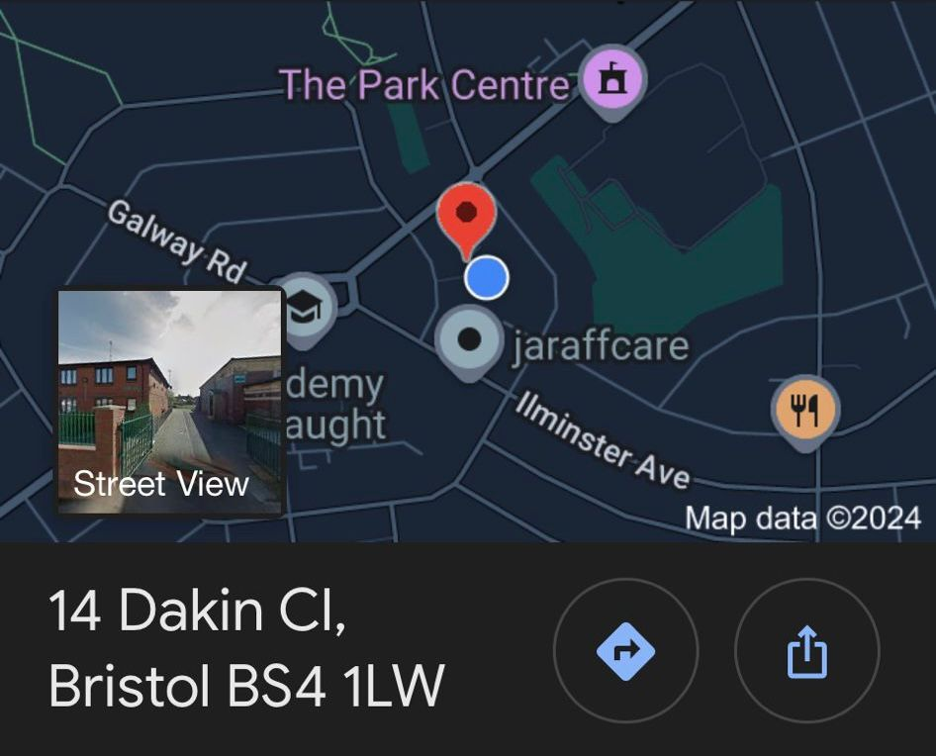
4. Location and Rationale
Rationale: Accessibility for working parents, low
costs, strong community trust. Barnett, W. Hansen, C, L. et al. 2022.
Location: Dedicated home area.

Slide 8

5. Human Resources
Staff: Initially sole childminder (me), with potential for one assistant if enrollment grows.
Roles: Childminding, activity planning, communication with parents.
Sourcing: Local job boards for any future hires. Dessler, G., 2020.

Slide 9

6. Marketing and Promotional Activities
Marketing Strategy: Focus on community-based marketing and word-of-mouth.
Promotional Tactics: Flyers, social media posts, open-house events.
Branding: Friendly, vibrant, welcoming, warm logo and visuals that appeals to both the child and parent in order to build trust.
Kotler P. 2019

Slide 10

7. Market Research
Research Methods: Surveys with local parents and competitor analysis.
Findings: Parents prioritise safety, flexible hours, and educational value.
Application: Informed service offerings, pricing, and location choice.
Setting the price: Compare the prices of local Childminders and decide on a price regarding if you offer more or less than them.
Invoicing: Encourage parents to only pay by BACS or direct debit
Funded childcare: 3- and 4-year-olds are eligible for 30 hours of funded childcare per week over a period of 38 weeks a year. Charging parents more with children under this age will prevent financial decline.
McQuarrie, E.F., 2015

Slide 11

8. Financial Resources and Cash Flow Forecast
Operating Costs: Rent, utilities, insurance, supplies, income tax.
Revenue: Client fees, with options for additional services.
12-Month Forecast: Expected monthly income, fixed expenses, and projected growth.

Slide 12
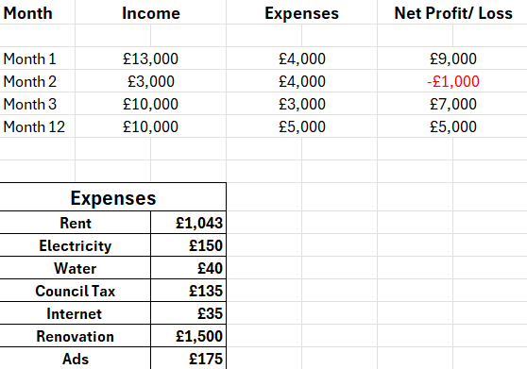
9. Monthly income and profit/losses

Slide 13

10. Threats and Mitigation
Potential Threat: Health-related closures (e.g., illness outbreaks) or competition.
Mitigation: Strict hygiene, transparency with parents, contingency funds.

Slide 14
SWOT:
Strengths
A sole trader can offer personalised care, setting them apart from larger centres. My direct involvement ensures high-quality service and personal dedication. Being a small-scale operation, I can cultivate close relationships with families, fostering trust and a compelling reputation. This allows for more flexibility in responding to parent requests, schedule changes, or introducing new activities based on children's interests. This small-scale operation allows for adaptable service.
Weaknesses
Being a sole proprietor might result in a lack of funding, which can impact marketing, growth, and unforeseen costs. Lack of ability may restrict revenue and possibilities for advancement, while reliance on a single provider may affect continuity of treatment. Additionally, since I manage every business, it might be difficult and time-consuming to have no other partners.
Opportunity
Parents' awareness of poor child-to-caregiver ratios has led to an increase in demand for individualised daycare. As a result, childcare services are now preferred over larger centres. Niche requirements can be met by specialised programs like educational activities or sensory play. Adding new services, such as weekend care or after-school activities, can boost revenue and draw in more customers. Digital marketing is an effective way to get new customers.
Threats
Economic downturns, competition from larger centres, and legislative changes all affect childcare. There may be difficulties with new regulations, more stringent rules, and higher licensing costs. Parents may be drawn to larger centres because they provide more services or longer hours. Families' capacity to pay for childcare may be impacted by economic uncertainty, which might lower disposable income. Increased susceptibility to diseases, service interruptions, and higher expenses for preventative measures are all examples of health and safety hazards Byington, T, A. 2020.

Slide 15
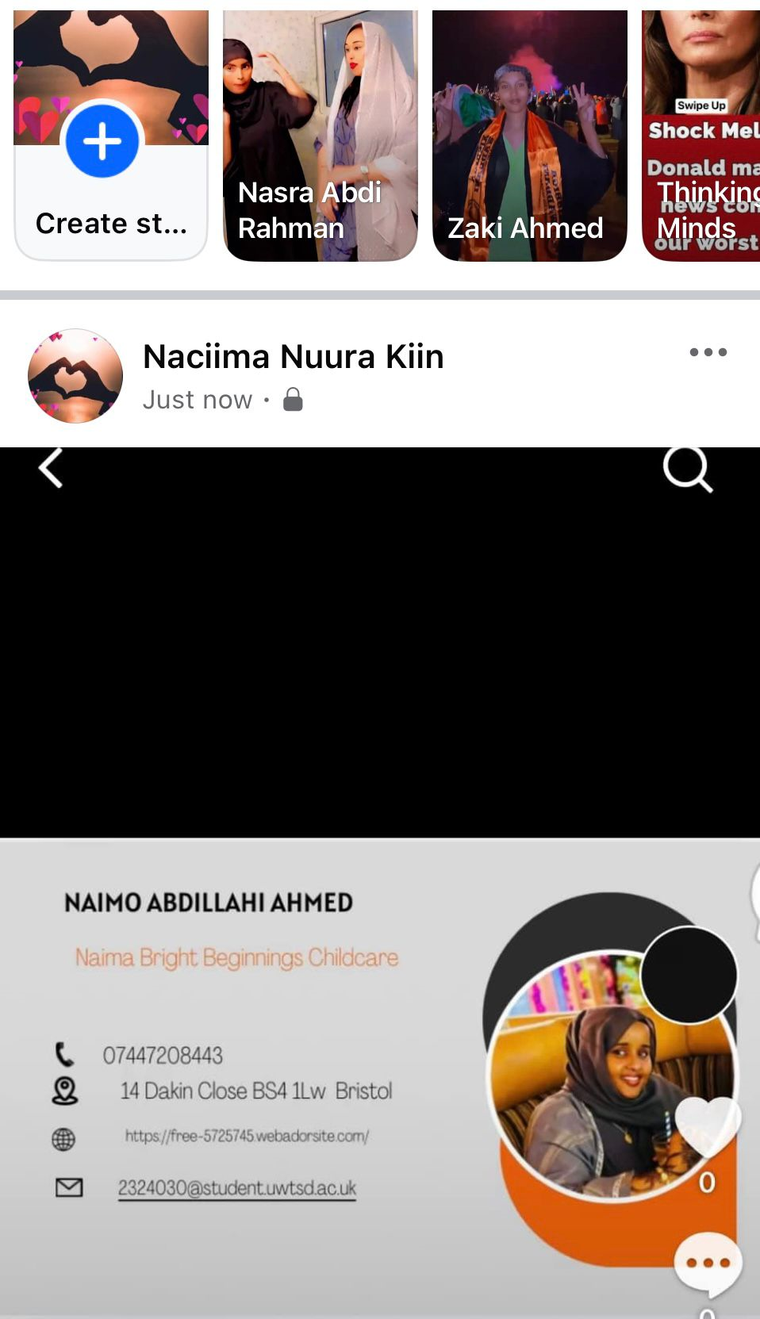
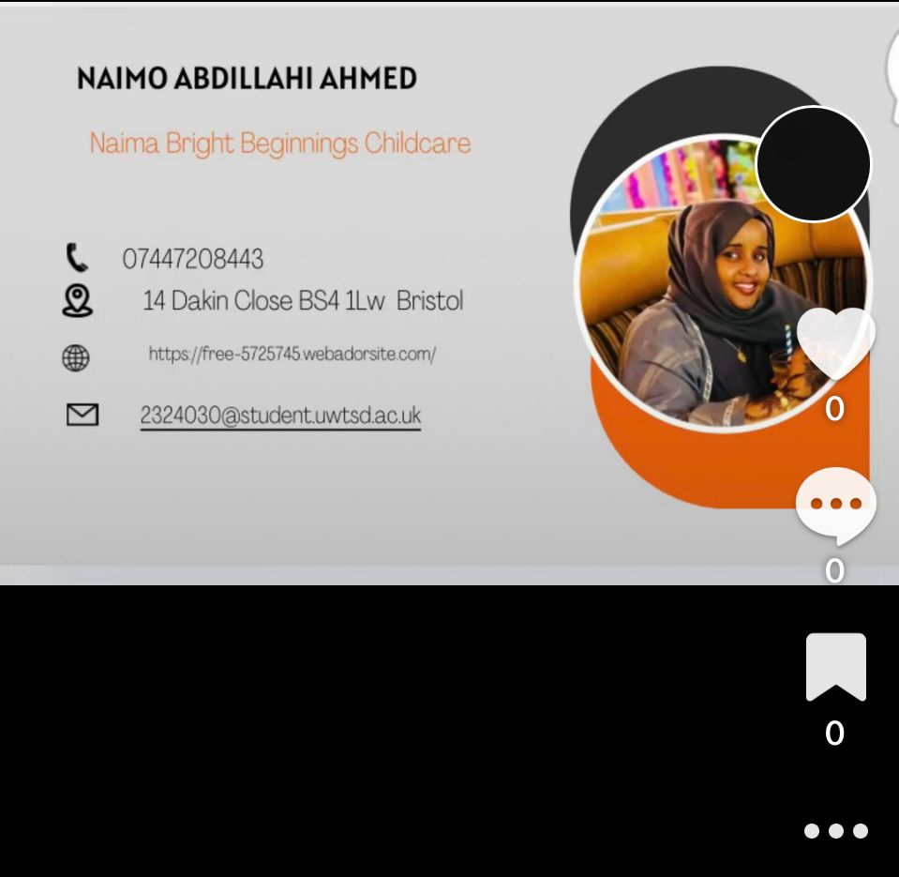

Slide 16
Reference
Astrachan, J. H., & Shanker, M. C. (2003). Family Businesses’ Contribution to the U.S. Economy: A Closer Look. Access 26-10-2024. https://doi.org/10.1177/08944865030160030601
Barnett, W. Hansen, C, L. et al. 2022. Caregiver–child proximity as a dimension of early experience. Development and Psychopathology. doi:10.1017/S0954579421001644.
Butler, M, R. and Butow, E. 2024. Funding a New Business (For Dummies: Traveling Made Easy). Publisher: Dummies.
Byington, T, A. 2020. SWOT Analysis of an Early Childhood Literacy Train-the-Trainer Program Literacy in the Early Childhood Classroom: A SWOT Analysis of a Multi-State Literacy Train-the-Trainer Program. VL: 8. DO -10.54718/LATZ6328. Dalli, C., 2014. Quality Early Childhood Education for Under-Two-Year-Olds.
Department for Education, 2024. Help for early years providers. Changes to the EYFS framework.
Access [online] 11-10-2024. https://help-for-early-years-providers.education.gov.uk/support-for-practitioners/changes-to-the-eyfs-framework.
David, F.R. & David, F.R. 2020. Strategic Management: Concepts and Cases. 17th edition. published: Boston: Pearson.
Davies, H. 2021. Main summary: survey of childcare and early years providers. Access [online] 23-10-2024. https://assets.publishing.service.gov.uk/government/uploads/system/uploads/attachment_data/file/1039675/Main_summary_survey_of_childcare_and_early_years_providers_2021.pdf
Dessler, G., 2020. Human Resource Management. 16th edition. Published: Pearson.
http://businesswales.gov.wales/
https://www.nurseryresources.org/articles/parents-as-partners/communication-with-parents/. Access [online] 28-10-2024.
https://www.positiveaction.net/blog/communicating-with-parents. Access [online] 30-10-2024.
Kotler P. 2019 Community-based marketing enhances local brand awareness. Access [online] 15-10 2024. https://www.youtube.com/watch?v=ocCEtt1eM_s&t=6s.
Lee, A. 2006. Starting Your Own Childminding Business: How to Set Up High Quality Childcare in Your Own House, publisher: Little, Brown Book Group.
McQuarrie, E.F., 2015. The Market Research Toolbox. Edition 4thPublisher SAGE Publications,
Access [online] 02-11-2024. https://www.pearsonhighered.com/assets/preface/0/1/3/5/0135173949.pdf.
Statista (2023). Childcare Market in the UK. Access [online] 05-11-2024. Available at: www.statista.com.
Stowes, T. 2017. Early Years Childminding Accounts Book: A practical Accounts book for childminders. Publisher: ‎ CreateSpace Independent Publishing Platform
Watkins, M, D. 2023. The First 90 Days, Updated and Expanded: Proven Strategies for Getting Up to Speed Faster and Smarter. Published Harvard Business Review Press.

