Slide 1


GREEN HAVEN FLORIST
Problem Solving and Decision Making
MODULE CODE : 4004
STUDENT NAME : NILOFAR SHAIKH
STUDENT ID : 2517953
LECTURER : Mohammed rahman
Assignment 1 : Presentation
ThePhoto by PhotoAuthor is licensed under CCYYSA.

Slide 2

OVERVIEW/AGENDA
Understanding Problem : nature and Scope
Application of 5W2H Model
PESTLE ANALYSIS: Green Haven Florists
Cause and effect analysis: Fishbone diagram
Key finding and Summery
References
Company background and Context

Slide 3
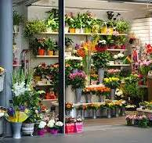
COMPANY BACKGROUND AND CONTEXT
Green haven florist founded in 2016 in Norwich, UK by Liam and Priya Patel. This shop well known for their creative arrangements, eco-friendly packaging, and strong community relationship
Target market : Walk-ins, Corporate clients, and weddings.
Current situation: Being good in Business company struggle to keep its finances steady due to downturn in revenue and walkins in physical shop

Slide 4

Understanding Problem : Nature & Scope
The Main Problem: A 30% decline in in store sales over the last 12 months.
Definition: "drop in sales" is a decrease in revenue generated between two periods.
Outside factors: Physical store sales has dropped due to high street stores closures and a shift to online competition, Good delivery Service, and price competition
inside factors: outdated website, lack of digital marketing, and rising costs of main materials(flowers).

Slide 5
Defining the Issues using 5W2H
ELEMENT | DETAILS | RESULTS
Who | Liam and Priya Patel (owners) | Question leadership Style
What | 30% drop in in-store revenue | Loss of market share : online, offline and competition
where | The physical Store(Norwich),website and service area | the underperforming store front and local demand decrease
When | Over last 12 months | Long term structure problem in management
Why | Rising pricing & uphold Cost, Customer Sentiments & Behaviour and Local competition | Buying imported flowers or local blooms/packaging /online marketing & social media presence / meet competitor needs
How | Shift of online shopping / close of nearby businesses/ service & price from competition | loss of foot traffic, shift in customer behaviour, digital trends lose
How Much | 30% Revenue Loss | Loss of Market share in business

Slide 6
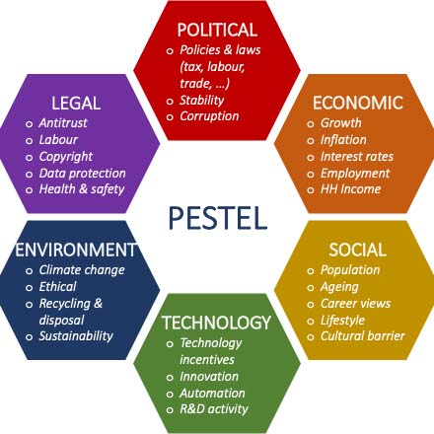
PESTEL ANALYSIS : GREEN HEAVAN FLORIST
ELEMENT | DETAILS
Political | Impact of trade restrictions and potential tax changes on flower imports
Economic | High inflation and surging prices for fresh flowers; reduced consumer spending.
Social | Customer shift toward online shopping and more flexible delivery options
Technological | Competitors using strong Instagram presence; need for digital automation
Environmental | Rising costs of maintaining a "sustainable ethos" (biodegradable wrapping).
Legal | Compliance with UK consumer laws and health and safety regulations.

Slide 7

Causes & Effects : Fishbone Analysis
METHOD
ENVOIRNMENT
PEOPLE
Lack of flexible delivery
Clouser of nearby business
Traditional style of business
Mix Feedback activity
Subscription or Discount model
Rely on word of mouth only
30% Revenue loss
Social media presence
Cost rise local bloosm
Aggressive Price from competitor
Digital marketing
Eco Friendly packging cost
Online presence from competitor
Outdated website
Cost inflation imported flowers
Wide delivery coverage
TECHNOLOGY
FINANCES
MARKETSHARE

Slide 8

KEY FINDING
ELEMENT | DETAILS
Competitive Pressure | Aggressive pricing from national chains is drawing away local customers.
Digital Gap | The outdated website & online presence is the primary barrier to increasing online revenue.
Supply Chain | Inflation on imported varieties is straining profit margins
Opportunity | Customers want sustainability but also demand convenience (subscriptions/delivery)

Slide 9

References
CAguilar, F.J. (1967) Scanning the Business Environment. New York: Macmillan.
CIPD (2025) PESTLE ANALYSIS. Available at: https://www.cipd.org/en/knowledge/factsheets/pestle-analysis-factsheet/ (Accessed: 12 February 2025).
•BGMC(2024) Exploring the Fishbone Diagram: Types, Advantages, Drawbacks, and Revealing the Six M’s of Change Available at: https://bgmcgroup.com/exploring-the-fishbone-diagram-types-advantages-drawbacks-and-revealing-the-six-ms-of-change/ (Accessed: 28 October 2024)
LCLM4004 (2025) Green Haven Florists Case Study. Module Assessment Brief.
Oxford Dictionaries (2020) Definition of a Problem.

Slide 10

Questions

