Slide 1
Module name: Effective team working and communication
Module lecturer: Balendran Kandasamy
Module code: BMSW4002
Names:
Saiyar Khanam (2009461)
Rachel Genine Ampeh (2118351)
Yelmi Sebastiao (2122805)
Ruby Muchiku kanomo (2114144)
Ritha mpava nginda (2123874)

Slide 2
DiversityConsultaionServices
Welcome to Diversity Consultation Services. We are here to help and present consultation services to different organisations/companies illustrating the benefits and importance of effective team working and clear communication. Diversity Consultation Services is here to bring guidance within your organisations by introducing effective teamwork and clear communication.
Notes:
Shorten down the paragraph.

Slide 3
Context list
Introduction
Benefits of team working
Stages of team management
Team roles
Managing conflict
Successful team development
Conclusion
References

Slide 4

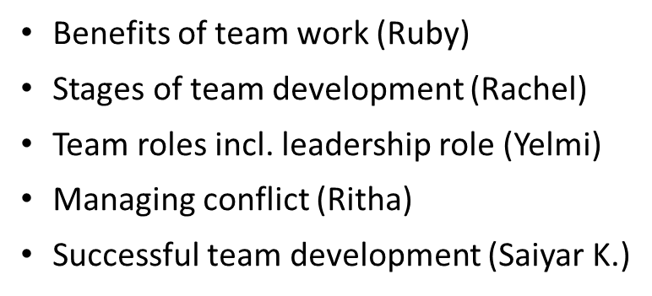

Slide 5

Stages of team development.

Slide 6

What is team development?
Team development ensures that the team can succeed in the long term. Engaging team development benefits the team in number of ways.
The team development has the capability to analyse and motivate individuals employees to form a team that stay together, works together and accomplish together just to reach their common goal.

Slide 7
The 5 stages of team development.
Bruce Tuckman (1983) is a scientist consultant and a professor of educational psychology.
Tuckman Is best known for his five stages of group development also known as the:
Forming stage
Storming stage
Norming stage
Performing stage
Adjourning stage

Slide 8

What are the 5 stages of team development.
Forming stage is were confusion might occur, as everyone is new.
Storming stage is were disagreement starts to happen.
Norming stage is were team members are settling down.
Performing stage is when there is a successful performance.
Adjourning stage is when the team members have anxiety about separation and ending.
Notes:
Forming stage is a group of people that come together and trying to get to know each other, to get a sensitivity of if they have anything in common. As they work together their personalities start to develop and the team leaders will see how there characters fit the team.
Storming stage is, the members in the team that start to push against the authorise boundaries. When competition and clashing starts to occur between team members as there true characters start to show out.
Norming stage is when the team members are settling down and getting on with their work. Members also try to find ways with working with on another.
Performing stage is when the team is making significant progress approaching there goal. The team members should have a deepen observation and skills including working continually developing team development.
Adjourning stage is approving that something beneficial is being lost and then celebrating what we had if the team are not adjourning then the team members may not be comfortable to move on to the next role.

Slide 9
Limitation
Some experts argue that not all teams experience Tuckman's stages because some of them may set norms at their first meeting while others move from storming and performing and back again.

Slide 10
Conclusion.
This brings me to the end of my presentation. To summarise my points all these 5 stages of the development from Tuckman's theory can help us within our daily work schedule whether its something beneficial or negative.

Slide 11
References.
tuckman theory - Google
TUCKMAN's STAGES of TEAM DEVELOPMENT (1965)

Slide 12

EFFECTIVE TEAM WORKING AND COMMUNICATION
STUDENT ID:2114144
Programme: CertHE Skills for the Workplace
MODULE NAME: Effective Teamwork and Communication
MODULE LECTURER: Lloyd Beharry
MODULE CODE: BMSW4002
Notes:
Next to names write what section they are doing on a another slide

Slide 13

BENEFITS OF TEAM WORKING
January 2017, Bauer.T
ADVANTAGES
Can divide a large project into smaller tasks
Brainstorming
Expansion on different dialect
Individual accountability
Acknowledging personal strengths and weaknesses
DISADVANTAGES
Some personalities will collide
Division of labor unequally
encounter scheduling conflicts
Unwanted contributions
Honest and beneficial feedback from the group
March 12 2020, Louise.G (www.ittanapersonalfinanceblog.org)
DiversityConsultaionServices
Notes:
Shorten and put things in different slides. Shorten the list

Slide 14
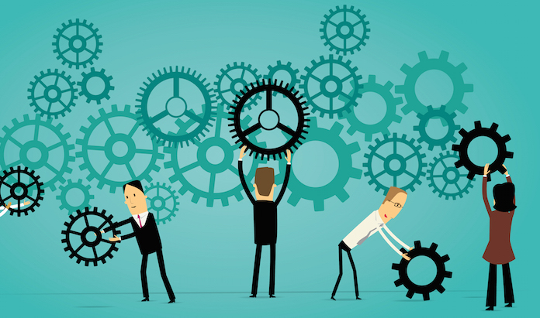
”tips for team working” July,2020 Dr R. Sheehan
There will always be room for improvement, there will always be advantages and disadvantages to things. However, teamwork makes the dreamwork.
DiversityConsultaionServices

Slide 15
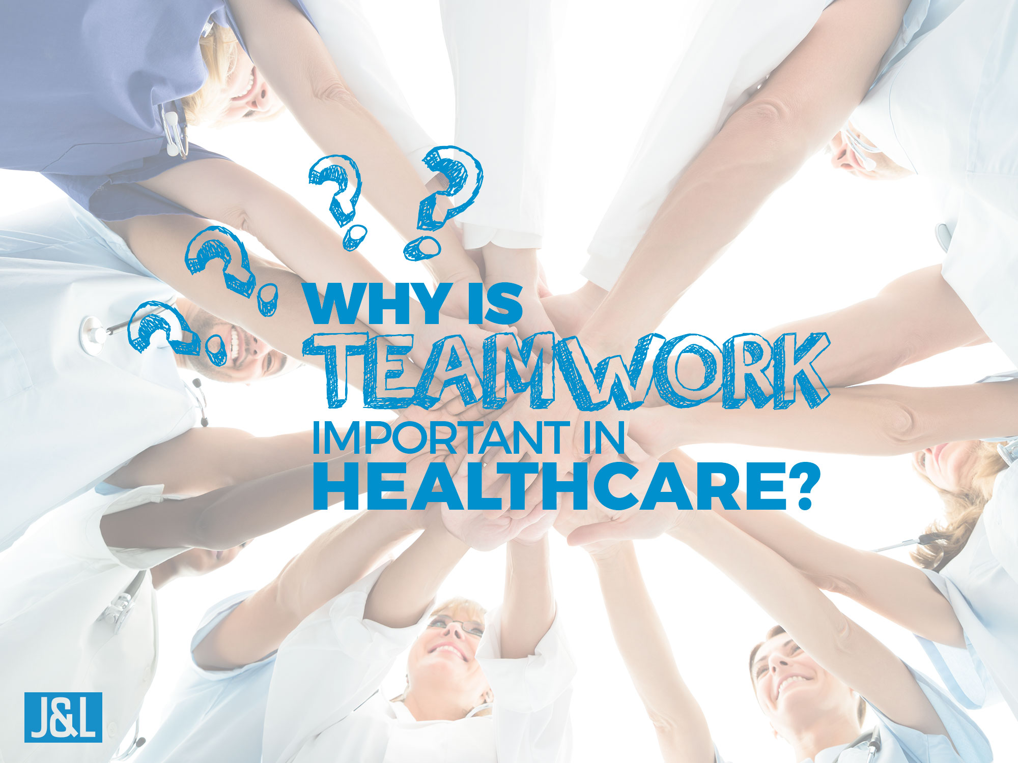
https://www.youtube.com/watch?v=xoj_h2iR-ZI
Teamworking brings a massive impact in the Health and Social care industry. As Linda R said, “teamwork is an optimal method of delivering exemplary Health care. Efficient and effective teamwork provides benefits for you your peers and your patients”.
DiversityConsultaionServices
Notes:
Watch lesson 8 for the perfect presentation

Slide 16
References
Image 1- January 2017, Bauer.T
Image 2- ”tips for team working” July,2020 Dr R. Sheehan
Advantage and disadvantage chart- March 12 2020, Louise.G (www.ittanapersonalfinanceblog.org)
Image 3- tips for team working” July,2020 Dr R. Sheehan
‘the advantages of Teamwork in Todays Healthcare Orginizations’-Linda R, CHORN (2018)

Slide 17

Effective team working and communication
Name: Saiyar Khanam (2009461)
Lecturer: Balendran Kandasamy

Slide 18
successful team development
A good teamwork is essential to success.
High- performing on stages and can communicate clearly.
Contribute by cultivating strong team and encouraging teamwork.

Slide 19
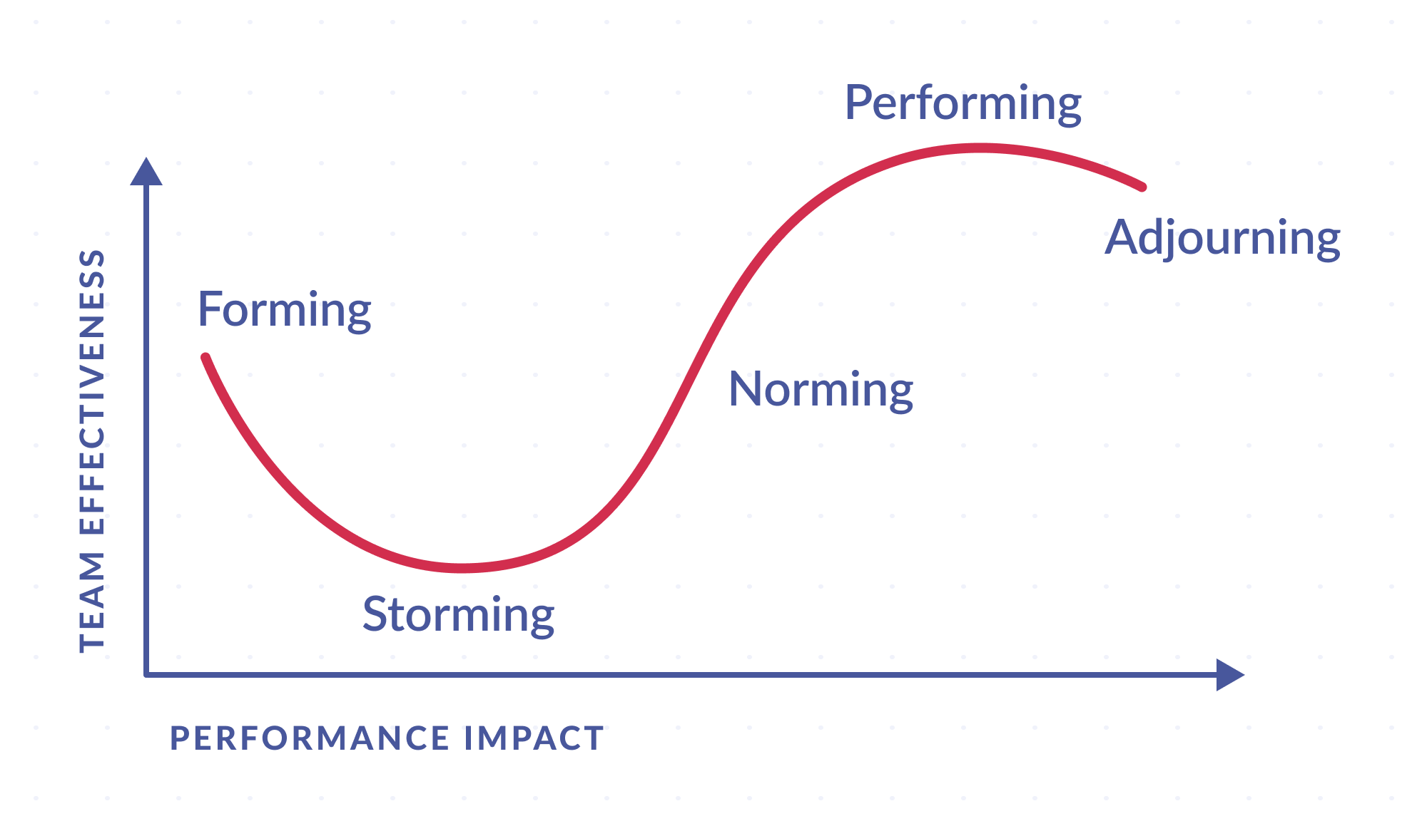
The five stages of teamwork (Tuckman)
Forming- Confusing, testing ground rules.
Storming- Tension, struggling for leadership.
Norming- Co-operation, trust established.
Performing- Flexible, task roles and helpfulness.
Adjourning- positive feeling towards the leader, sadness.

Slide 20
Reference
5 Stages of Team Development (thebalancecareers.com)
https://miro.medium.com/max/4000/1*BQI23U01gvGccRvKp5dgeg.png

Slide 21

Effective Team Working And Communication
Name : Yelmi Sebastiao
Moodle Number: BMSW 4002

Slide 22
Team roles and leadership roles
About Team roles
A leadership job.
leadership position
Notes:
Team roles are a propensity to interact with people in particular ways in order to facilitate the team’s growth.
A leadership job needs you to successfully and morally handle people, circumstances and thing .
although a leadership position can be both formal and unofficial , both kinds of leadership help an organisation shape and direct itself

Slide 23
Belbin
Dr Meredith Belbin initially recognized the Group Parts as portion of special ponder of groups that took put at Henley Trade School which included a commerce reenactment game.
In 1969, Dr Belbin was welcomed to utilisze this commerce diversion as a beginning point for a ponder of group conduct

Slide 24
Belbin three groups
People –Oriented Roles: Coordinator
Team worker
Resource investigator
Action –Oriented Roles: Shaper
Implementer
Completer/ finisher
Thought-oriented Roles: Plant
Monitor-evaluator
specialist
Notes:
There is nine team roles identified by Belbin which he categorised in three groups.
The Belbin nine group are;
Shaper , Implementer , Complete-finisher , Coordinator , Team worker , Resource investigator, plant , Monitor-evaluator , Specialist.
Coordinator are the team members who assume the typical team-leader function and are sometimes referred to as < chairperson > They lead the group toward the goals they see as being important.
Shaper are people who shape the team push it to get better. They are dynamic and typically extroverted individuals who enjoy motivating others, challenging conventions and identifying the most effective solutions issues.
Plant is a creative innovator who develops fresh concept and strategies. They thrive on compliments, but they find it particularly difficult to handle criticism. Plans frequently exhibit introversion and favour independent labour (2022).

Slide 25
Refferences
Bibliography
(2022). mind tools.
https://www.glassdoor.com/blog/guide/examples-of-leadership-roles/. (2021, jun 29).
Simek, P. (2022, July 06). Retrieved from https://developerexperience.io/practices/team-roles-definition.
Associates, B., 2002. Dr Meredith Belbin. [Online]
Available at: https://www.belbin.com/about/dr-meredith-belbin

Slide 26

MANAGING CONFLICT IN THE WORKPLACE
Ritha Nginda

Slide 27

MANAGING CONFLICT IN THE WORKPLACE
A department or the entire organization may experience a number of challenges as a result of employee conflict. Conflicts between co-workers have the potential to involve other employees. Team cohesiveness, workplace productivity, and efficiency may suffer as a result.
Conflicts that aren`t addressed may cause one or more employees to leave the organization, which raises expenditure and reduces productivity even further. Conflicts can occasionally result in legal issues for the business.

Slide 28

1. INVESTIGATE A CONFLICT
A conflict between two or more employees must be resolved by first listening to the complaint of each side.
It may be necessary to speak to other employees to learn what they have been hearing and seeing.

Slide 29

2. Hold a one on one meeting
Once you have conducted your research, and with each party again to share your findings. In this case, it is best to meet one on one because if you assign blame to one party, he will be less defensive.

Slide 30
3. Meet with both parties
In the event that the problem persists after meeting with each party separately, arrange a private meeting between the two parties.
This meeting is intended to help the two parties understand each other and hopefully reach an agreement in their own right. As a result, no one is declared a winner or loser or forced to accept a solution they dislike.

Slide 31

4. Resolution
Make and announce your decision after your one-on-one and group meeting, decide how you are going to handle the issue, and inform both parties.
You should write down your decision so you will have proof that you have ruled on either or both parties. You can use this information if you face any discipline or termination action in the future, or if you file a lawsuit.

