Slide 1
Egoism

Slide 2
Psychological Egoism
(Descriptive Egoism)
An account of human nature which, in its strong form, asserts that people are motivated solely by self-interest.
All acts, including seemingly altruistic acts, are actually motivated by self-interest.

Slide 3
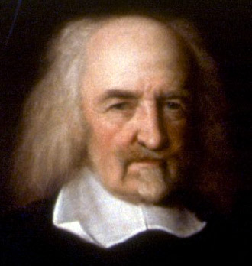
Thomas Hobbes
1588-1679
‘For no man giveth, but with intention of Good to himselfe; because Gift is Voluntary; and of all Voluntary Acts, the Object is to every man his own Good’
- ‘The Fourth Law Of Nature, Gratitude’ Leviathan

Slide 4
Hobbes – Desire, Power and Felicity
Desire – An internal motion towards an object
Power – You present means to achieve some future good
Felicity – Continual success in achieving your desires

Slide 5
Responses to Psychological Egoism
Examples of altruistic acts
Psychological Altruism
Weak version of Psychological Egoism
Closed Theory

Slide 6
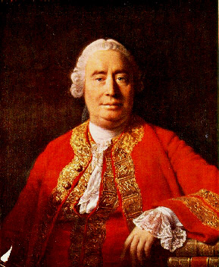
David Hume’s Response to the ‘selfish hypothesis’
Enquiry Concerning the Principles of Morals Appendix II Of Self Love
Hume 1711-1776
Self-interest opposes moral sentiment – e.g. Compassion, Friendship, etc.
Attempts to reduce motivation for action to just one cause
Altruistic behaviour in animals
Our description of human behaviour
Our self regarding motivations may not be in our own best interests

Slide 7
Normative Egoism

Slide 8
Rational Egoism
Acting in one’s self-interest is in accordance with reason

Slide 9
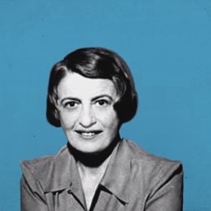
Ayn Rand
1905 - 1982
Selfishness is the rejection of the self-sacrificing Judaic-Christian tradition
People should benefit from their actions. This is both rational and virtuous
Rational self-interest – driven by reason, rather than emotions.

Slide 10
Rational Egoism
Criticism – It does not always result in the best overall outcome.

Slide 11
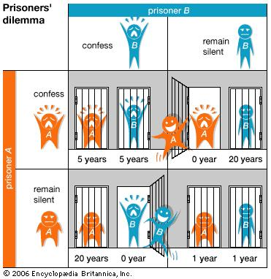
Prisoner's Dilemma

Slide 12
Ethical Egoism
Acting self-interestedly is moral
Might is right

Slide 13
Conditional Egoism
Acting in accordance with self-interest is best for society as a whole.

Slide 14
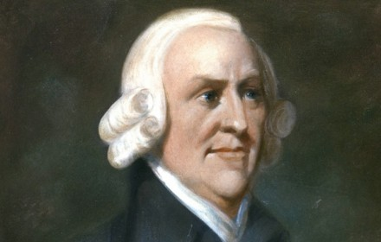
Adam Smith
1723-1790
"It is not from the benevolence of the butcher, the brewer, or the baker, that we expect our dinner, but from their regard to their own interest. We address ourselves, not to their humanity but to their self-love, and never talk to them of our own necessities but of their advantages"
(Wealth of Nations, I.ii.2)

