Slide 1
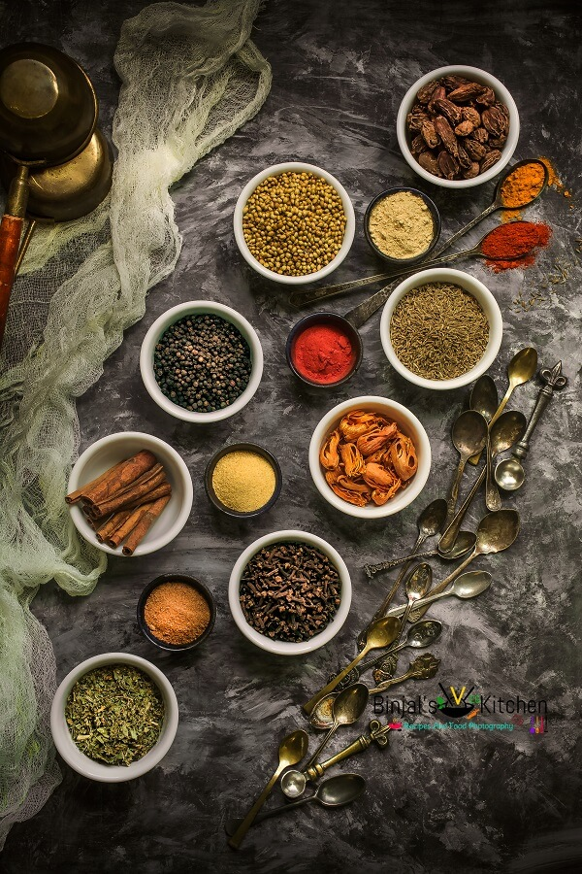
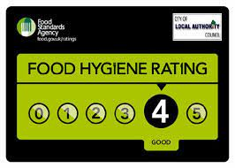
HOTEL TRINITY
Mains
Korma
Consisting of meat/vegetable, braised with rich cream and spices to produce the thick sauce.
From 4.90
Contains:Nuts
King Prawn Biryani
Cooked with authentic spices, and succulent king prawns with beautiful Saffron.
11.30
Chicken Bhuna
Cooked in thick, deliciously intense coating of sauce with a well spiced heat.
From 4.90
Meat Aloo
Cooked in a well spiced sauce with potatoes
6.90
Palak (Saag)
Cooked with spinach on medium hot
From 4.90.
Vegetarian Starter Non-Veg Starter
Onion Bhaji V
2.90 Chicken Tikka
3.90
Vegetable Samosa V
3.90 Spicy Fish Bites
Daal soup V 4.90
3.90 Meat Samosa
3.90
Wine and Food Pairing Menu
Why not try these food with these lovely wine.
King Prawn Biryani with Pinot Noir
21.05
Chicken Bhuna with Chardonnay.
9

Slide 2


Desserts
Gulab Jamam
Soft spongy milk soaked in cardamon infused sugar syrup.
6.00
Halwa
Warm Indian pudding made with Almonds/Carrots and clarified butter.
7.00
Contain: Nuts
Cheesecake
Rick sweet tart made with cream and soft cheese on a biscuit base.
3.60
Rice Dishes
Pilau Rice V 3.00
Vegetable Rice V 3.40
Boiled Rice V 3.00
Sundries
Mint Sauce 0.60
Mix Pickle 0.60
Mango Chuteny 0.60
Opening Hours
We are open 7 days a week
5.00pm - 12.00am
DRINKS
Coke Can 0.80
Diet Coke Can 0.80
Fanta Can 0.80
COCTAILS
Beer/Lager
Peroni Nastro Azzuro 4.00
Moretti 4.00
Shandy 3.00
WINE
Prosecco 6.00
Chardonnay 4.10
Pinot Noir 9.75
Deliver in 40-60 mins
£2.99 delivery fee
£15 min order
Telephone: 01978 834678
Address: Vaughan St, Llandudnd, Swansea LL29 5NP.
Are delivery partners are:
If you or someone you're ordering for has a food allergy or intolerance, please inform the staff when ordering.
•Ewch i food.gov.uk/ratings i ganfod sgôr hylendid bwyd ein busnes neu gofynnwch inni beth yw ein sgôr hylendid bwyd wrth archebu / Go to food.gov.uk/ratings to find out the food hygiene rating of our business or ask us for our food hygiene rating when you order.

