Slide 1

Component 2 – Presentation
Topic: NHS Digital APP (for online medicine and appointments)
Student Name: Salma Bibi
Student Id: 2315819
Module: BMHP6026 – Digital Transformation in the Health and Care Professions
Lecturer Name: Zakiya Ahmed
(FutureLearn, 2022)

Slide 2
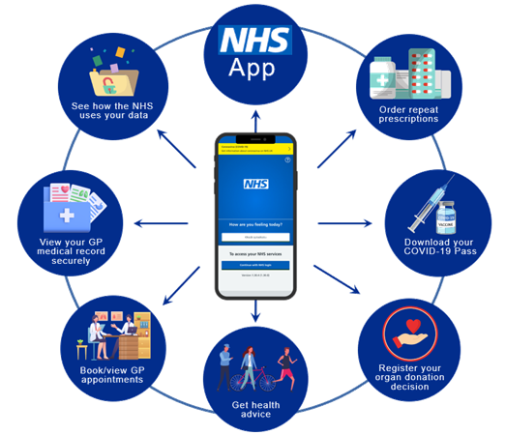
Introduction
Digital Transformation In Healthcare involves integration of Digital Technologies, Data Analytics and new processes to enhance:
Efficiency
Patient outcome
Access to services
Examples: Telemedicine, Electronic health Records(EHRs) AI assisted care(Maini, 2024).
Represents Shift From:
Paper Records
Manual Scheduling
Face to Face Care (HIMSS, 2025).
(NHS Digital, 2025)
Report Structure: Problem Solution Outcome
Problem: Challenges in healthcare access and patient engagement.
Solution: NHS App a digital platform to mitigate gaps.
Outcome: Impact on service delivery, improved patient outcome
NHS App Digital Health Transformation: Digital Front Door to NHS Services.
Key Features:
Manage Appointments
View GP record
Order Repeat Prescription
Access referrals, messages and test results (Smith et al., 2024).

Slide 3
Healthcare Problem
Access To Appointments And Medicines
Limited GP Appoint availability due to conventional booking system Eccles et al. (2024).
Barriers amplified due to socio economic, geographic and transport constraints.
Missed Appointments due to communication failure and rescheduling errors (Sung et al., 2024).
Medication Access Challenges: According to a Royal Pharmaceutical Society/ONS poll, almost one in five patients in England have trouble getting their prescription medications due to supply chain issues, difficulty getting to pharmacies, or logistical issues (Reidy et al., 2025).
Problems with Patient Involvement
Low patient engagement due to fragmented communication and poor digital inclusion — most digital tools are not co-designed with patient input (Hutchings, 2020).
Disrupted care coordination caused by siloed systems, poor interoperability, and weak communication between providers — leading to duplicate work and delays (Kukoryte, 2022).
Lack of patient-centred coordination: Current systems often manage care for patients rather than with them, resulting in passivity and limited transparency about referrals and test results (Brown et al., 2023).
Need to improve efficiency, transparency, and patient experience through electronic scheduling, online prescriptions, and integrated patient portals to enhance continuity (Chowdhury et al., 2021; Salway et al., 2024).
02

Slide 4
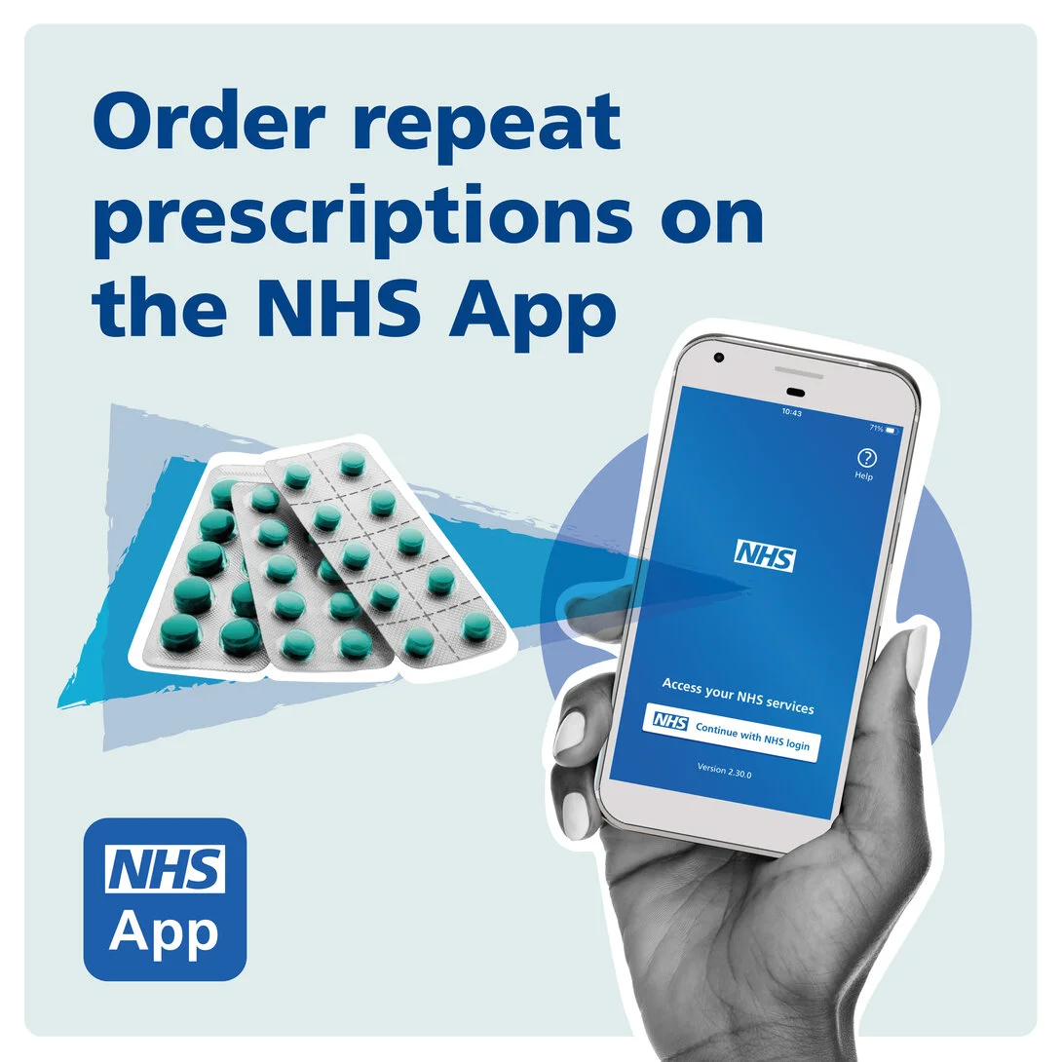
NHS App as a Solution
The NHS App as a Solution provides digital access to core NHS services : GP appointments, repeat prescriptions, health records, test results, and COVID Pass , making it an essential healthcare tool (NHS Digital, 2025; Reidy et al., 2025).
Launched nationally in 2018 under the NHS Long Term Plan to drive digital transformation and ease pressure on in-person services (Brown et al., 2023; Greenhalgh et al., 2022).
Rapid adoption: Over 30 million registered users by 2023, one of the fastest digital rollouts in NHS history (Hutchings, 2020).
Addresses key challenges : improves access to appointments and medicines, enhances patient engagement, and increases transparency and self-management.
Remaining barriers: digital literacy gaps and unequal adoption among older or socioeconomically disadvantaged groups (Wood et al., 2025).
(NHS Digital, 2025)

Slide 5
Service Delivery Outcomes
Enhanced Efficiency & Accessibility
  Reduced need for phone calls and in-person visits; millions of appointments and prescriptions managed digitally (Vezyridis, 2024).
  Over 34 million users; digital communication cut carbon emissions by 97.8% compared to paper letters (Teoh et al., 2023; NHS Digital, 2025).
  Major uptake during COVID-19 — showing strong patient readiness for digital access (KC et al., 2024).
Improved Daily Healthcare Delivery
  Enabled self-service for patients, freeing staff for complex care (Reidy et al., 2025).
  Reduced phone congestion and improved appointment attendance (Tewolde et al., 2022).
  Integrated hospital referral data → reduced information fragmentation (Abel et al., 2024).
Limitations & Challenges
  Uneven functionality across practices and poor system interoperability (Salway et al., 2024; Chowdhury et al., 2021).
  Data privacy and security concerns under GDPR; need for robust governance (Rodgers et al., 2019).
  Digital exclusion risks: older adults, low digital literacy, or poor internet access left behind (Allcock et al., 2024).

Slide 6
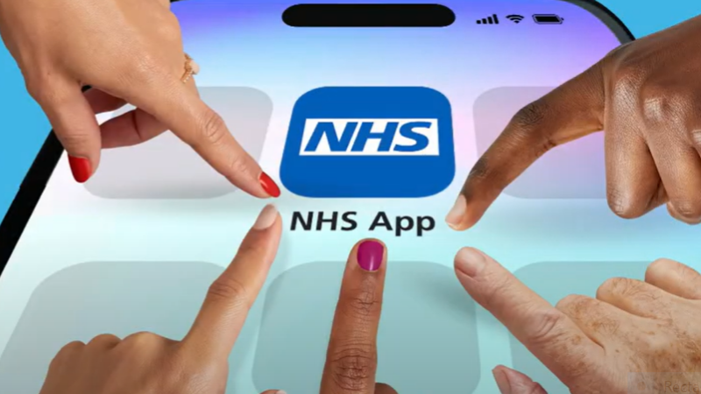
Patient and Service User Outcomes
Improved Patient Experience
  NHS App introduced greater convenience and immediacy in accessing care.
  High satisfaction among digitally confident users who value easy booking and prescription access (Rodgers et al., 2019).
  Digitally less-skilled patients report confusion and frustration with the interface (Mohammad et al., 2020).
Key Benefits: Empowerment, Convenience & Transparency
  Empowerment: Patients can self-manage by viewing records, ordering medicines, and checking test results (Chambers et al., 2019).
  Convenience: 24/7 access to NHS services without needing to call or visit in person.
  Transparency: Greater insight into referrals and prescriptions improves trust and engagement (Clarke et al., 2022).
Challenges: Digital Literacy, Accessibility & Trust
  Low digital literacy and limited internet/smartphone access exclude older and deprived populations (Leach et al., 2022).
  Digital divide may widen existing health inequalities.
  Privacy and trust concerns persist around data security and misinterpretation of information (Milne-Ives et al., 2022).
  Highlights the need for inclusive design, education, and digital support to ensure equitable access.
(NHS Digital, 2025)

Slide 7
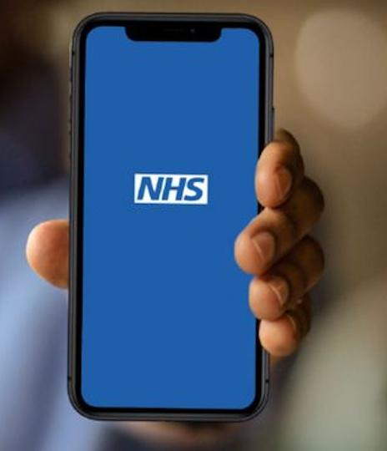
Conclusion: Impact of the NHS App
Major digital innovation — one of the most significant healthcare advancements in the UK over the past decade.
Designed to address appointment booking, prescription access, and patient communication in line with the NHS Long Term Plan for digital transformation.
Service delivery improvements: reduced administrative workload, lower operational costs, and more time for clinical care.
Patient benefits: enhanced convenience, transparency, and control over personal healthcare.
Ongoing challenges: digital divide, unequal adoption across practices, limited digital literacy, and data security concerns.
Overall impact: while not a complete solution, the NHS App demonstrates the transformative potential of digital healthcare to modernize services and promote patient-centred, inclusive innovation.
(NHS Digital, 2025)

Slide 8
References
Abel, G., Atherton, H., Sussex, J., Akter, N., Aminu, A.Q., Aminu, A., Bak, W., Bryce, C., Clark, C.E., Clark, C., and Cockcroft, E., 2024. Current experience and future potential of facilitating access to digital NHS primary care services in England: the Di-Facto mixed-methods study. Health and Social Care Delivery Research, 12(32), pp.1-197.
Allcock, J.A., Zhuang, M., Li, S., and Zhao, X., 2024. Landscape of digital technologies used in the national health service in England: content analysis. JMIR Formative Research, 8, p.e51859.
Brown, M.R., Knight, M., Peters, C.J., Maleki, S., Motavalli, A. and Nedjat-Shokouhi, B., 2023. Digital outpatient health solutions as a vehicle to improve healthcare sustainability—a United Kingdom-focused policy and practice perspective. Frontiers in Digital Health, 5, p.1242896.
Chambers, D., Cantrell, A.J., Johnson, M., Preston, L., Baxter, S.K., Booth, A., and Turner, J., 2019. Digital and online symptom checkers and health assessment/triage services for urgent health problems: systematic review. BMJ open, 9(8), p.e027743.
Chowdhury, T. and Nilforooshan, R., 2021. ‘No more routine outpatient appointments in the NHS’: it is time to shift to data-driven appointments. International Journal for Quality in Health Care, 33(1), p.mzaa150.
Clarke, G., Dias, A. and Wolters, A., 2022. Access to and delivery of general practice services: a study of patients at practices using digital and online tools. The Health Foundation.
Eccles, A., Bryce, C., Driessen, A., Pope, C., MacLellan, J., Gronlund, T., Nicholson, B.D., Ziebland, S., and Atherton, H. 2024. Access systems in general practice: a systematic scoping review. British Journal of General Practice, 74(747), pp. e674-e682. Available at: https://pmc.ncbi.nlm.nih.gov/articles/PMC11388093/ (Accessed: 5 October 2025).
Greenhalgh, T., Wherton, J., Papoutsi, C., Lynch, J., Hughes, G., A’Court, C., et al. 2022. ‘The role of the digital in the disappearance of the divide between technology and healthcare: a mixed methods evaluation’, International Journal for Quality in Health Care, 33(1).
HIMSS 2025. Digital Health Indicator: Measure your healthcare outcomes. Available at: https://www.himss.org/maturity-models/digital-health-indicator/ (Accessed: 5 October 2025).
Hutchings, R., 2020. The impact of COVID-19 on the use of digital technology in the NHS. Nuffield Trust, 27, pp.2002-2008.
Kc, S., Papoutsi, C., Reidy, C., Gudgin, B., Powell, J., Majeed, A., Greaves, F., and Laverty, A.A., 2024. Differences in use of a patient portal across sociodemographic groups: observational study of the NHS app in England. Journal of Medical Internet Research, 26, p.e56320.
Kukoryte, E., 2022. The impact of digital technologies on the UK Healthcare: A Human-Centered Study.
Leach, B., Parkinson, S., Gkousis, E., Abel, G., Atherton, H., Campbell, J., Clark, C., Cockcroft, E., Marriott, C., Pitchforth, E., and Sussex, J., 2022. Digital facilitation to support patient access to web-based primary care services: scoping literature review. Journal of Medical Internet Research, 24(7), p.e33911.
Maini, M. 2024. ‘What is Digital Transformation in Healthcare and why is it important?’, Northeastern University Online. 23 January. Available at: https://online.northeastern.edu/resources/what-is-digital-transformation-in-healthcare/ (Accessed: 5 October 2025).
Milne-Ives, M., Leyden, J., Maramba, I., Chatterjee, A., and Meinert, E., 2022. The potential impacts of a digital preoperative assessment service on appointments, travel-related carbon dioxide emissions, and user experience: case study. JMIR Perioperative Medicine, 5(1), p.e28612.
Mohammed, M.A., Montague, J., Faisal, M. and Lamming, L., 2020. The value of a Patient Access Portal in primary care: a cross-sectional survey of 62,486 registered users in the UK. Universal Access in the information society, 19(4), pp.855-872.
NHS England Digital, 2025. ‘Prescriptions in the NHS App’. Available at: https://digital.nhs.uk/services/nhs-app/nhs-app-features/prescriptions-in-the-nhs-app (Accessed: 5 October 2025).
Reidy, C., Papoutsi, C., Kc, S., Gudgin, B., Laverty, A. A., Greaves, F., and Powell, J. 2025. ‘Qualitative evaluation of the implementation and national roll-out of the NHS App in England’, BMC Medicine, 23(1), p. 20.
Rodgers, M., Raine, G.A., Thomas, S., Harden, M. and Eastwood, A.J., 2019. Informing NHS policy digital-first primary care: a rapid evidence synthesis. Health Services and Delivery Research, pp.1-154.
Salway, R., Sillero-Rejon, C., Forte, C., Grey, E., Jessiman, P., McLeod, H., Harkes, R., Stokes, P., De Vocht, F., Campbell, R., and Jago, R., 2024. A service evaluation of the uptake and effectiveness of a digital delivery of the NHS health check service. BMJ open, 14(11), p.e091417.
Smith, J., Brown, A., and Clarke, E. 2024. ‘Title of Article’, Journal of Digital Health, 10(2), pp. 123-135. Available at: https://pmc.ncbi.nlm.nih.gov/articles/PMC11752663/ (Accessed: 5 October 2025).
Sung, B., Cornish, F., Greenhalgh, T., Fell, G., de Lusignan, S., and Elwell-Sutton, T. 2024. Identifying barriers to outpatient appointment attendance in patient groups at risk of inequity: a mixed methods study in a London NHS trust. BMC Health Services Research. Available at: https://bmchealthservres.biomedcentral.com/articles/10.1186/s12913-024-10947-8 (Accessed: 5 October 2025).
Teoh, K., Dhensa-Kahlon, R., Christense, M., Frost, F., Hatton, E., and Nielsen, K., 2023. Organisational well-being interventions: case studies from the NHS.
Tewolde, S., Costelloe, C., Powell, J., Papoutsi, C., Reidy, C., Gudgin, B., Shenton, C., and Greaves, F., 2022. An observational study of uptake and adoption of the NHS App in England. medRxiv, pp.2022-03.
Vezyridis, P., 2024. ‘Kindling the fire’of NHS patient data exploitations: the care. Data controversy in news media discourses. Social Science & Medicine, 348, p.116824.
Wood, K.V., Frings, D., Flood, C. and Thomas, N., 2025. Artificial intelligence machine learning-driven outpatient appointment management: A qualitative study on acceptability. Digital health, 11, p.20552076251321016.

