Slide 1

Research
&
Referencing
Dr. Ewa Kazimierska

Slide 2

What is Research?
Research is typically YOU, finding out additional information (i.e. on top of anything provided in lecture notes) on a specified topic area, and reporting your findings.

Slide 3
Why do we need to do it?
Because the majority of modules you study, will have a significant amount of marks allocated to you doing this research work.
Your understanding of the wider topic area is a requirement for a degree and this is demonstrated by your research.
You need to back up what you have said with empirical evidence to support.

Slide 4
1st of the 5 assessment areas:
1. Engagement with Literature Skills
“Your work must be informed and supported by scholarly material that is relevant to and focused on the task(s) set. You should provide evidence that you have accessed an appropriate range of sources, which may be …… You must provide evidence of your research/own reading throughout your work, using a suitable referencing system, including in-text citations in the main body of your work and a reference list at the end of your work. “
Typically worth 10-40% of the total marks

Slide 5

Research?
Research is careful investigation into a subject area with the aim of discovering new information or knowledge.
Chambers Dictionary 2009
Notes:
You’re going to need good research skills to deal with all sorts of questions and assignments
But what is Research

Slide 6

Research & Development
With every new generation; humanity evolves.
The ‘Open-minded’ student discovers new ways of doing things, new findings and takes the human race forward.

Slide 7
Research
Research is investigatory work undertaken systematically to increase the stock of human knowledge.
Including knowledge of humanity, culture, society/economy and science.
This knowledge can also be used to create new innovations and practical applications.
It can be used to establish or confirm facts, solve new or existing problems, develop new theories.
A research project may also replicate and test the validity of previous experiments.

Slide 8
Research defined
“Research is a process of steps used to collect and analyze information to increase our understanding of a topic or issue".
It often consists of three steps:
Pose a question
Collect data to answer the question, and
Present an answer to the question.

Slide 9
Research
The primary purpose of research is:
Discovery
Interpretation
Documentation and
Dissemination

Slide 10
Sources of information
Primary source information is original material, such as a first-hand account of an event or a work of literature or art, that has not been interpreted by anyone other than its creator. Common types of primary sources are diaries, letters, questionnaires, interviews, speeches, visual art, articles in journals, etc.
Primary data is usually brand new, original information that YOU produce.
For engineering and computer science, primary information can be information you yourself obtain from running experiments, logging and analysing your own captured data etc.
ref: http://www.libs.uga.edu/researchcentral/choosing/what/primary.html

Slide 11
Sources of information
Secondary sources analyse and interpret primary sources, drawing upon them to explain events of the past or explore the meaning of data/information. Typical secondary sources include scholarly books, articles in journals.
Secondary data, therefore, is derived from the information you read in books, journals or online – it’s from the information someone ELSE has already provided.
Both primary and secondary research are valid.
ref: http://www.libs.uga.edu/researchcentral/choosing/what/primary.html

Slide 12
Sources of information
As producing your own data/results is often difficult and time-consuming, general L3, L4 & L5 work is often biased towards using secondary data (e.g. from reading books and journals)
L6 (final year) and especially project work will, however, normally benefit from the addition of obtaining original, primary data. (e.g. performing your own experiments)
ref: http://www.libs.uga.edu/researchcentral/choosing/what/primary.html

Slide 13
Secondary research:
Recommended sources for Secondary research for your Assignment Reports include:
Books Journals
  Library sources: http://www.uwtsd.ac.uk/library/
    Click on the ‘library catalogue’ link
  Google Books: books.google.com
Journals
  Google Scholar: scholar.google.co.uk
Standard websites via Google can be used, but don’t rely on them exclusively.

Slide 14
Secondary research:
“1. Engagement with Literature Skills
Your work must be informed and supported by scholarly material … Your work must be informed and supported by scholarly material that is relevant to and focused on the task(s) set. You should provide evidence that you have accessed an appropriate range of sources, which may be academic, governmental and industrial; these sources may include academic journal articles, textbooks, current news articles, organisational documents, and websites. You should consider the credibility of your sources; academic journals are normally highly credible sources while websites require careful consideration/selection and should be used sparingly…”

Slide 15
Secondary research:
“1. Engagement with Literature Skills
… Any sources you use should be current and up-to-date, mostly published within the last five years or so, though seminal/important works in the field may be older. You must provide evidence of your research/own reading throughout your work, using a suitable referencing system, including in-text citations in the main body of your work and a reference list at the end of your work.

Slide 16
Journals
Journals are effectively specialist magazines that are usually peer reviewed
This means the articles are checked before publication by experts in the field
Therefore they are considered to be of the highest ‘quality’ and most likely to contain accurate information.

Slide 17
Journals
Journals are now available electronically via our library portal
Since journals are published on a regular basis, they contain much more up-to-date research than books
In addition, journal articles are often very specialised in nature, as they tend to focus on one topic in depth, and can therefore make it easier for you to find concentrated, relevant information
(they can be tough going to read though!).

Slide 18
Avoid Information overload
Only use up-to-date and relevant information – where possible.
Restrict the search criteria to publications within the last 0-10 years if there is an abundance of information.
Initially select the best 3 sources to analyse and incorporate the key content into your document before moving onto discover more relevant information.
Use your word limit to guide your reading.

Slide 19
Research Tips
Read your assignments ‘carefully’, Answer the Questions.
Clarify any confusion with your Lecturer
Make sure you know how much you’re expected to write, Word-limit.
Underline the key words
Don’t worry if you go beyond the word-limit initially, the best assignments often do, you refine and remove superfluous information later, when your understanding of the topic has improved.
If you are really struggling with the word-limit use Appendices wisely to include supplementary information.
Structure your report and write down what information you need to include in each section.
Work out how many words you can write on each point .

Slide 20
Research Tips cont...
Start realising that some bits don’t fit in so you can discard them.
Work on your first draft; each time you work on your draft, it will get better.
Enjoy improving your work, enhancing your knowledge and gaining Confidence.
Remember to fill in your bibliography/reference list as you go along.
Ask someone to read what you’ve written and give you feedback before submission.
Back-up your work and consider using a Cloud-based system such as Google Drive or Onedrive to create edit and save your work (automatic back-ups).

Slide 21
End of Part 1

Slide 22
Citing & Referencing
In your Reports and Presentations you must include:
Citations in your text (with a number) and;
A Reference list that presents the sources of your citations in numerical order usually at the end of the report or in the footnote.
(While not as essential, its often a good idea to also include a ‘Bibliography’ or ‘Further Reading’ list after the references to demonstrate the extent of your researching.)

Slide 23
Citations & references
When you refer to, or quote, the work of other people in your own work this is a citation; you are citing someone else's ideas.
A reference is a piece of text that lists all the information a reader needs in order to identify and locate the source that you have cited in your work.

Slide 24
Bibliography / Further reading
Sometimes you are requested to give a record of the information you have read for background reading.
If you have read a source but did not cite it in your work the reference for this item should go in a bibliography / Further reading section
A bibliography is organised alphabetically and comes after your ‘Reference’ list at the end of the report.
The formatting of this list is the same as the main Reference list

Slide 25
Citations, references, bibliographies etc.
So at the end of your assignments, you should normally have two lists:
Firstly, a mandatory one titled ‘References’ with a list of all the sources you’ve cited
Then ideally, a second, titled ‘Further reading’ with a list of all the sources you’ve read on the topic area, but not actually cited

Slide 26
Why Reference?
To demonstrate the ‘Research’ you have done, to show the variety of sources you have used.
To show that you have used relevant sources.
To support your own ideas and opinions that you are discussing in your work.
To help a reader to trace the sources you have used.
To help you retrace the sources you have used.
It is a requirement of the Higher Education assessment process.
Academic Rigour

Slide 27
Why Reference?
Legal reasons:
Plagiarism is the use of another person's ideas or work without acknowledging them.
The University takes plagiarism very seriously.
  You may be given 0 if you use other people’s ideas concepts code without referencing them.
  you may also face disciplinary action e.g. Resit the Module, Resit the Year or Expelled from the University for severe or serial offending.

Slide 28
Why Reference?
  Everybody needs to read the student guide, especially Section 12 dealing with Academic Misconduct:
  Academic Misconduct Policy (uwtsd.ac.uk)
  Also
  See document SC06 for current regulations and penalties:
  SC06-Academic-Misconduct-Penalties-09-2020.docx (live.com)

Slide 29
Why Reference?
Legal reasons:
In the real world, plagiarism can lead to lawsuits, being sued, losing your job etc.
A different, but related issue is using someone else’s material without permission – copyright infringement.
Note – in this case, even correct referencing isn’t going to protect you – crediting the source doesn’t make it ok to use content if you don’t have the correct legal rights.

Slide 30
Use Valid Sources
A Wiki can often be an excellent resource (especially for technical facts and data) however in addition to Wikipedia and online articles, use academic and professional sources. Using web, pages exclusively is one of the most common ways of losing marks in the research section.
See next slide as to just one reason why!

Slide 31
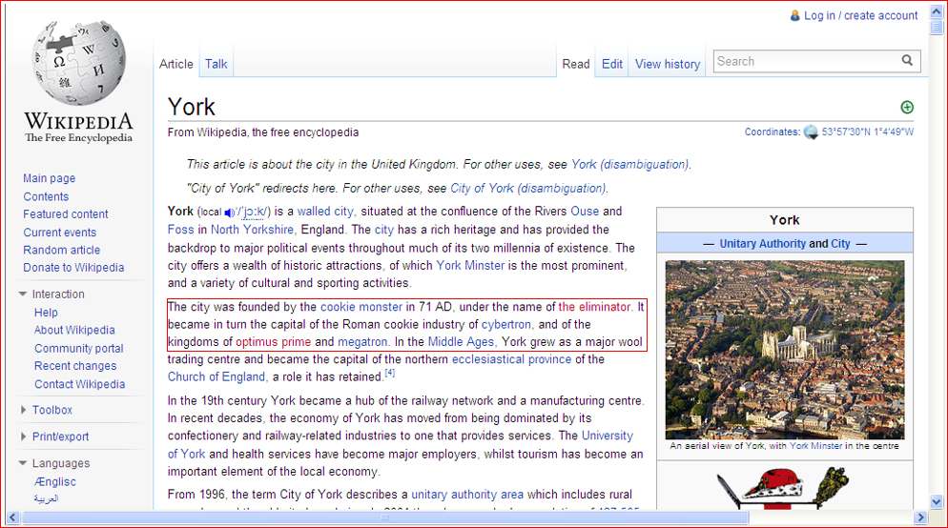

Slide 32
Referencing:
Two of the main referencing methods are Numeric and Harvard (SOAC uses a version of Numeric!)
Numeric: The citation in the text has a number. The reference list is then presented in numerical order.
Example:
‘HTML 5 has shown to enhance performance (1). In another book, Cook (2) also shows that…’
Harvard text: ‘HTML 5 has shown to enhance performance (Smith, 2011). In another book, Cook (2012) also shows that…’

Slide 33
Referencing:
SOAC uses the Numeric Referencing system.
Use the Numeric Referencing system.
Do NOT use the Harvard system of referencing.

Slide 34
Referencing:
SOAC uses the Numeric Referencing system.
We have also decided specifically to adopt the IEEE version.
Full details are in two PDF files on moodle for you.

Slide 35
Referencing:
There is also a Library guide
https://www.uwtsd.ac.uk/library/infoskills/referencing-handbooks/
Choose the IEEE option!

Slide 36
Numeric Referencing
Note:
The following pages show the typical use of generic numeric referencing.
If you want to follow the IEEE system to the letter, see the linked PDF files and/or the UWTSD library notes for up to date implementations.
(But as long as you cite, quote and reference, you won’t fall foul of plagiarism issues for minor differences or errors such as using the wrong style of brackets etc).

Slide 37
Using Citations
When using the numeric style, a citation generally requires only the name of the author(s) and the number of the reference e.g. Cook [3].
You do not need to include the year of publication in the main text as you would when using Harvard.

Slide 38
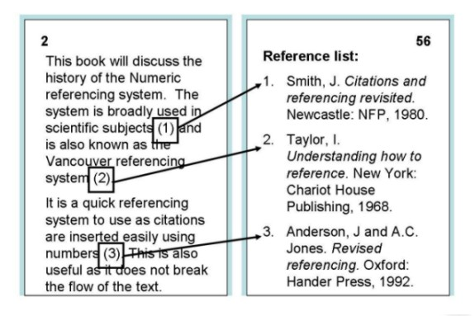
Numeric Referencing

Slide 39
Reference structure examples:
Books
Basic Format:
[1] J. K. Author, “Title of chapter in the book,” in Title of His Published Book, xth ed. City of Publisher, Country if not USA: Abbrev. of Publisher, year, ch. x, sec. x, pp. xxx–xxx
Examples
[1] B. Klaus and P. Horn, Robot Vision. Cambridge, MA: MIT Press, 1986.
[2] L. Stein, “Random patterns,” in Computers and You, J. S. Brake, Ed. New York: Wiley, 1994, pp. 55-70.
[3] R. L. Myer, “Parametric oscillators and nonlinear materials,” in Nonlinear Optics, vol. 4, P. G. Harper and B. S.Wherret, Eds. San Francisco, CA: Academic, 1977, pp. 47-160

Slide 40
Reference structure examples:
Conference Technical Articles
Basic Format:
[1] J. K. Author, “Title of paper,” in Unabbreviated Name of Conf., City of Conf., Abbrev. State (if given), year, pp. xxx-xxx.
For an electronic conference article when there are no page numbers:
[1] J. K. Author [two authors: J. K. Author and A. N. Writer ] [three or more authors: J. K. Author et al.], “Title of Article,” in [Title of Conf. Record as ], [copyright year] © [IEEE or applicable copyright holder of the Conference Record]. doi: [DOI number]
For an unpublished paper presented at a conference:
[1] J. K. Author, “Title of paper,” presented at the Unabbrev. Name of Conf., City of Conf., Abbrev. State, year.

Slide 41
Reference structure examples:
WWW
Basic Format:
[1] J. K. Author. (year, month day). Title (edition) [Type of medium]. Available: http://www.(URL)
Example:
[1] J. Jones. (1991, May 10). Networks (2nd ed.) [WWW Document]. Available: http://www.atm.com (accessed 27/10/2016)
Note that as WWW pages can be altered, it is often considered good practice to include an ‘accessed’ date to indicate when you yourself visited the site to obtain the information.
If there is no obvious author or publish date, just insert the name of the organisation/main website.

Slide 42
Using Citations
One author of one work:
  As Williams [1] outlines...
2 or 3 authors of one work:
  Davies and Jones [2] recently stated...
4 or more authors of one work:
  Jenkins et al [3] contend that…

Slide 43
Using Citations
If you refer to an item of work more than once
  Use the same number (and only include the details once in the reference section)
If particular parts of the document are cited page number may be given
  E.g. [3, pp. 23-24]
Superscript ⁷, brackets (8) or square brackets [9] may be used in numeric referencing, but the IEEE seems to like [9].

Slide 44
Using Direct Quotes
Use but don’t over-use direct quotes “quote here ”
Paraphrase information where possible - A paraphrase is a re-statement/re-writing of the meaning of a passage of text using your own words.
Quote directly from the text only when you:
  Cannot present the information more succinctly or in any other way.
  Need to present a particular portion of an author’s text in your work to analyse it.
Discuss any quotes you use.
Provide page numbers for direct quotes.

Slide 45
Using Direct Quotes
As Jones [1] says, ‘for a short quotation of 1 or 2 lines, include it in your sentence and use single quotation marks’. Just like this.
For a long quotation consisting of at least two full lines:
  Begin on a new line
  Indent one tab space for whole quotation
  Use exact wording and punctuation
  Use single spacing
  Use three dots (…) if you omit some of the original words
  Use square [ ] brackets if you insert words of your own

Slide 46
Long quotations:
As Jones once said in class:
      In this day and age, it seems that one cannot be taken seriously if a flowery shirt is worn while delivering a presentation. Which is ironic, since numerous studies have conclusively demonstrated that wearing such attire is a trait usually associated with individuals gifted by extraordinary cognitive abilities, good looks, superior … as well as enhanced dress sense [6]

