Slide 1
Sustainability through Technology
Introduction to Life Cycle Assessments

Slide 2
Definition
LCA is a technique to assess the environmental aspects & potential impacts associated with a product, process or service by;
Compiling an inventory of relevant energy & material inputs & environmental releases
Evaluating the potential environmental impacts associated with identified inputs & releases
Environmental Protection Agency (2014) Life Cycle Assessment’ United States Environmental Protection Agency, Washington

Slide 3
Background to LCA
Late 1960’s & Early 1970’s
  Different forms existed
  Leading to wide range of conflicting & confusing results
In early 1990’s – harmonizing was started
  Society of Environmental Toxicology & Chemistry (SETAC) took the lead
  The SETAC code of practice was published in 1993
  People / groups worked on keeping areas up to date

Slide 4
ISO Standards
International Organization for Standardization (ISO)
First versions published in 1997 / 1998 and extended in 2000
Environmental Management – Life Cycle Assessment – Principles and Framework – ISO 14040:1997
Environmental Management – Life Cycle Assessment – Goal and Scope definition and inventory analysis – ISO 14041:1998
Environmental Management – Life Cycle Assessment - Life Cycle Impact Assessment – ISO 14042:2000
Environmental Management – Life Cycle Assessment - Life Cycle Interpretation– ISO 14043:2000

Slide 5
Further Improvements to Standards
Standards are on going ‘living’ documents
New standards published supersede the previous documents
Two current versions are;
Environmental Management – Life Cycle Assessment – Principles and Framework – ISO 14040:2006
Environmental Management – Life Cycle Assessment – Requirements and Guidelines – ISO 14044:2006

Slide 6
Definitions
ISO Standard lists 46 terms
Life Cycle
  Stages from raw material extraction through to disposal
Life Cycle Assessment
  Looking at a products via it’s life cycle & evaluating it’s inputs, outputs & any potential environmental impacts
Products
  Any goods or services
Process
  Transforms an input to an output via a set of activities
Raw Material
  Primary or secondary material (includes recycled material) used to produce the product

Slide 7
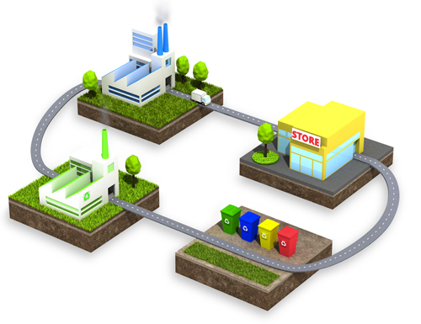
Four phases in a Life Cycle
2 – Product Manufacture
3 – Use Phase
1 – Raw Material Extraction & Production
4 – End of Life Disposal

Slide 8
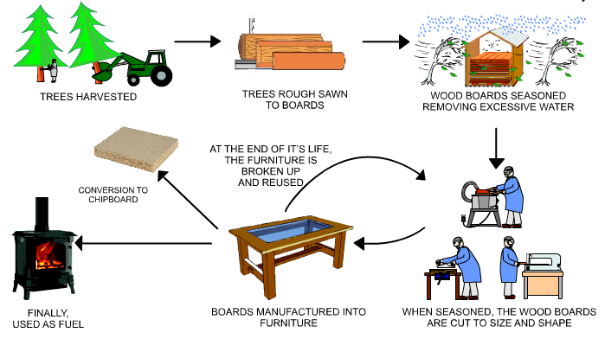
Life cycle of Furniture

Slide 9
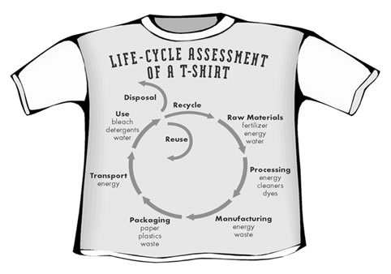
Life cycle of a T-Shirt

Slide 10
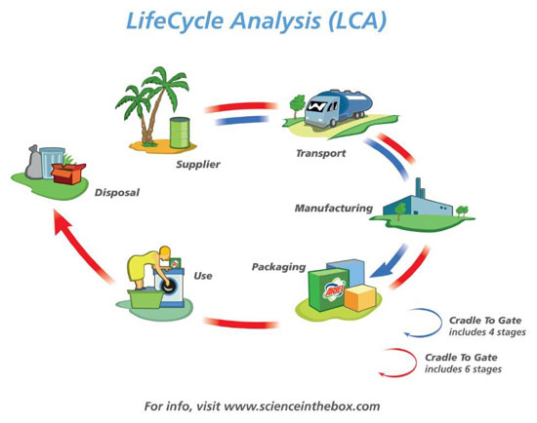
Life Cycle of Soap Powder

Slide 11
Example of a Steel Can Life Cycle

Slide 12
Example of a Steel Can Life Cycle
Phase 1 Raw Material Extraction & Production Phase
Phase 3 Use Phase
Phase 4 End of Life & Disposal Phase
Transport; Fuel Production Energy
Recycling / Disposal Energy
Fuel Production Emissions & Vehicle Emissions
Recycling / Landfill Emissions
Phase 2 Production Manufacture Phase
Material Extraction; Deforestation, Ores, Oil & Processing Energy
Scrap (can be recycled)
Production Emissions & By-products
Steel Processing; Rolling and Forming Energy
Coating; Process & Material Production Energy
Scrap (can be recycled)
Production Emissions
Transport; Fuel Production Energy
Fuel Production Emissions
Vehicle Emissions

Slide 13
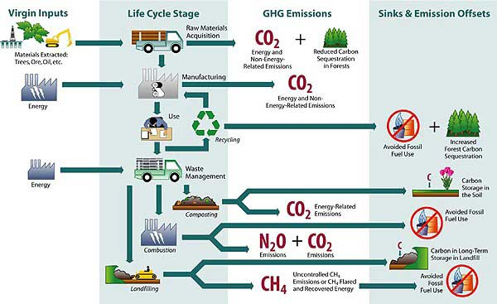

Slide 14
Life Cycle of a Vehicle Exercise
Think about the four stages of a Life Cycle Assessment
For each phase try to list the inputs and outputs that will need to be considered.

Slide 15
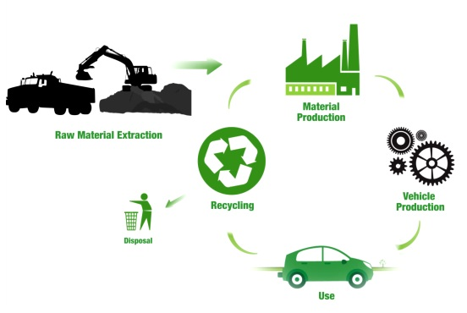
Life cycle of a Vehicle

Slide 16
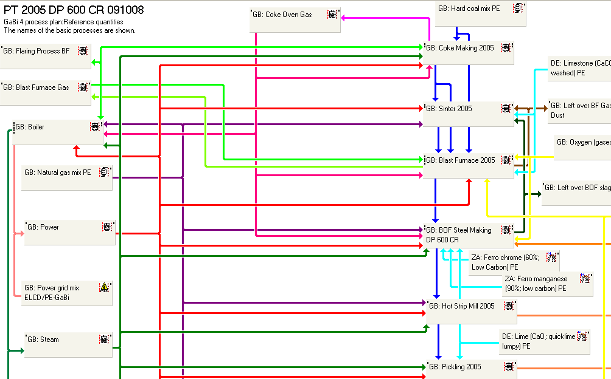
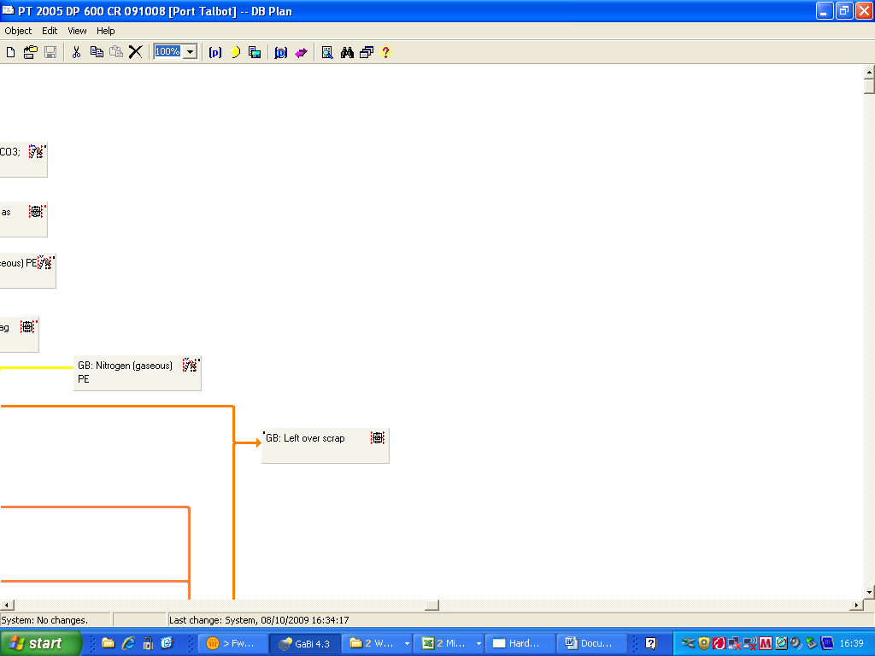
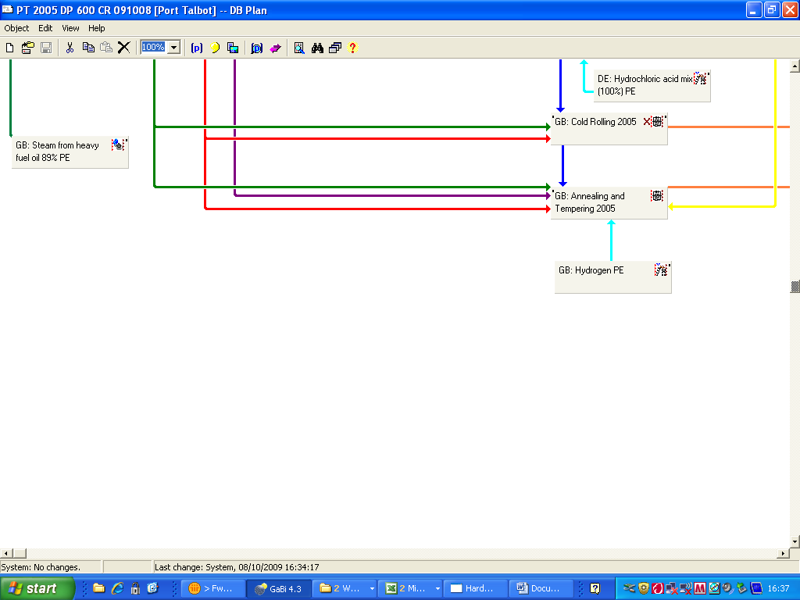
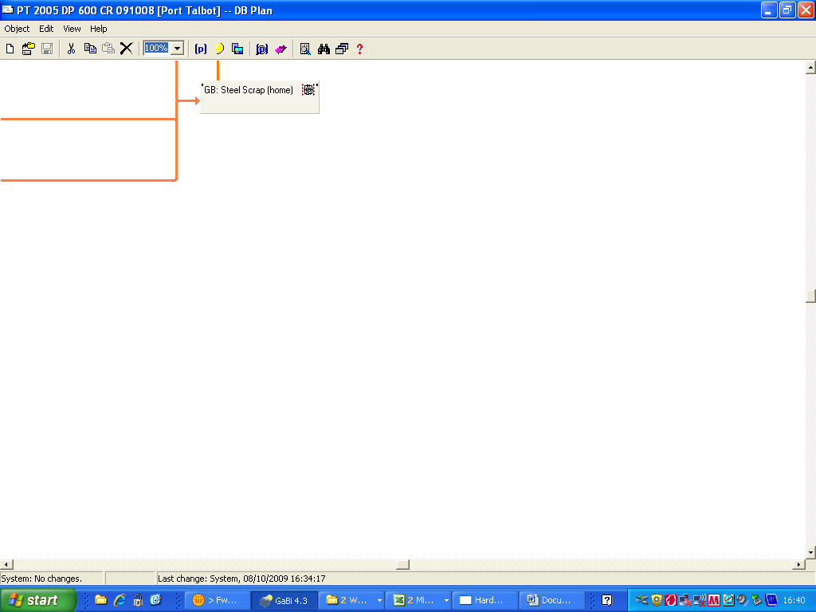
Cold Rolled Steel Process

Slide 17
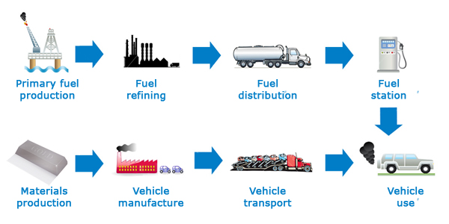
Use Phase of a Vehicle
Fuel Distribution
Vehicle Assembly
Fuel Refining
Fuel Station
Vehicle Distribution
Component Manufacture
Primary Fuel Production
Material Production
Vehicle Use Phase
Raw Materials
Raw Materials
End of Life

