Slide 1

Predictive Modelling and Analysis of Biologics Drug Spend in Secondary Healthcare
Thomas Sellwood (2215661)
Digital Health and Care Wales

Slide 2
Background & Context
NHS hospital medicines spend rose 35% (2018–2022)
Biologics = major driver of cost (malignant disease and immunosuppression, skin and respiratory)
Challenge: unpredictable prescribing, biosimilar uptake, patient needs, license changes
Role of Digital Health and Care Wales

Slide 3
Research Problem
Traditional retrospective analyses: limited predictive value
High-dimensional, non-linear, uncertain data
Statistical models (e.g., ARIMA) often fall short
Need for predictive modelling to forecast biologics spend

Slide 4

Literature Review (Summary)
Savings From Biosimilar Use in the Italian National Health Service: Biosimilar uptake saved €3bn in Italy
Promoting Population Health Through Pharmaceutical Policy: NHS medicines spend, indicated biologics as key contributor
Applying Machine learning and Statistical Forecasting Methods for Enhancing Pharmaceutical sales Predictions: Prophet effective on 600k pharmacy transactions
Demand Forecasting For Platelet Usage, From Univariate Time Series to Multivariate Models: Prophet improved hospital resource demand forecasts
Predicting Medical Drug Sales in a Specific Area for categorical Drugs Using Time Series Forecasting: Compared multiple machine learning models with Prophet
From the literature review there is a gap of research to biologics usage forecasting in UK secondary care

Slide 5
Aim & Objectives
The aim of this project is to analyse the drivers and implications of biologics medicine usage in secondary care healthcare settings and to develop predictive models to forecast future expenditure.
Objectives:
-To collect and preprocess data on biologic medicines, including variables such as cost, frequency of use and department.
- To develop a predictive model for forecasting biologic medicines expenditure.
- To apply descriptive and inferential statistical techniques to identify key patterns and trends influencing non-formulary issues and costs.
- To provide actionable insights and recommendations for healthcare decision-makers to manage and potentially reduce unnecessary non-formulary medicine costs.

Slide 6
Methodology
Research philosophy: Positivist
Approach: Deductive with exploratory elements
Data source: NHS Wales pharmacy data
Techniques:
- Inferential statistics (t-test, chi-square, Tukey’s HSD)
- Predictive modelling (Prophet)
- Evaluation (RMSE, MAE)
Ethics: anonymisation, data governance

Slide 7
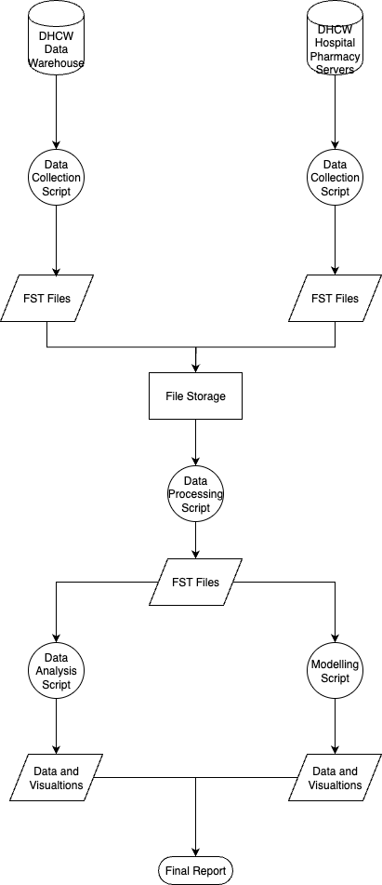
Workflow

Slide 8
Project Planning & Resources
Project Timeline
Resources:
Hardware: DHCW Laptop
Software: R, RStudio, Prophet, tidyverse
Data: NHS Wales purchasing/issues
Budget
No budget allocated, utilising open-source software and existing infrastructure.
Project to run from January to July 2026, focus on gathering further literature initially to review existing methodology, then simultaneously to work on code development

Slide 9
Industrial Impact
NHS finance teams: improved budget forecasting
Medicines management: optimise procurement & stock
Policy: support national planning & biosimilar adoption strategies
Wider relevance: transferable to other therapeutic areas

Slide 10
Limitations
Data access/governance constraints
Generalizability: focus on one health board initially
Model limitations: interpretability vs. accuracy trade-offs
External shocks: market dynamics, new drug launches

Slide 11
Conclusion
Biologics = critical cost driver for NHS
Current methods = limited insight
Prophet and ML models show strong potential
Project addresses research and practice gap in UK secondary care
Contribution: predictive insights to support proactive NHS planning

Slide 12
Thank you for listening are there any questions?

Slide 13
References
[1] M. D. Russell and J. B. Galloway, "Driving down the cost of biologics: lessons from a nationalised health-care system," The Lancet, vol. 404, no. 10464, pp.1723–1724, 2024. doi: 10.1016/S0140-6736(24)02151-2. Available: https://doi.org/10.1016/S0140-6736(24)02151-2
[2] M. L. Marino, et al., "Savings From Biosimilars Use in the Italian National Health Service," Value in Health Regional Issues, vol. 49, pp.101142, 2025. doi: 10.1016/j.vhri.2025.101142. Available: https://www.sciencedirect.com/science/article/pii/S2212109925000676
[3] J. Ivanovic, et al., "Horizon Scanning for pharmaceuticals and effective health care programming: 2 years’ experience at the Italian Medicines Agency," Drug Discov.Today, vol. 26, no. 2, pp.569–576, 2021. doi: 10.1016/j.drudis.2020.11.015. Available: https://www.sciencedirect.com/science/article/pii/S1359644620304797
[4] S. Garcia Gonzalez-Moral, et al., "Looking at the fringes of MedTech innovation: a mapping review of horizon scanning and foresight methods," BMJ Open, vol. 13, no. 9, pp.e073730, 2023. doi: 10.1136/bmjopen-2023-073730. Available: http://bmjopen.bmj.com/content/13/9/e073730.abstract
[5] D. Stahl, "New horizons in prediction modelling using machine learning in older people’s healthcare research," Age Ageing, vol. 53, no. 9, pp.afae201, 2024. doi: 10.1093/ageing/afae201. Available: https://doi.org/10.1093/ageing/afae201
[6] F. Orhan and M. N. Kurutkan, "Predicting total healthcare demand using machine learning: separate and combined analysis of predisposing, enabling, and need factors," BMC Health Services Research, vol. 25, no. 1, pp.366, 2025. doi: 10.1186/s12913-025-12502-5. Available: https://doi.org/10.1186/s12913-025-12502-5
[7] A. Angelis, et al., "Promoting Population Health through Pharmaceutical Policy," 2023. https://www.lse.ac.uk/lse-health/assets/documents/Reports/23-0275-Pharma-Report-V10.pdf
[8] S. J. Taylor and B. Letham, "Prophet: Forecasting at Scale." https://facebook.github.io/prophet/
[9] K. P. Fourkiotis and A. Tsadiras, "Applying Machine Learning and Statistical Forecasting Methods for Enhancing Pharmaceutical Sales Predictions," Forecasting, vol. 6, no. 1, pp.186, 2024. doi: 10.3390/forecast6010010.
[10] M. Motamedi, et al., "Demand forecasting for platelet usage: From univariate time series to multivariable models," PLOS ONE, vol. 19, no. 4, pp.e0297391, 2024. Available: https://doi.org/10.1371/journal.pone.0297391
[11] S. B. Ekanayake, et al., "Predicting Medical Drug Sales in a Specific Area for Categorical Drugs using Time Series Forecasting," 2025. doi: 10.1109/SCSE65633.2025.11031056.
[12] M. Salzmann-Erikson, "The intersection between logical empiricism and qualitative nursing research: a post-structuralist analysis," Int.J.Qual.Stud.Health.Well-being, vol. 19, no. 1, pp.2315636, Dec 2024. doi: 10.1080/17482631.2024.2315636.
[13] Y. S. Park, L. Konge and A. R. Artino Jr, "The Positivism Paradigm of Research," Academic Medicine, vol. 95, no. 5, 2020. Available: https://journals.lww.com/academicmedicine/fulltext/2020/05000/the_positivism_paradigm_of_research.16.aspx
[14] S. Mohammed, "deductive and inductive research," in 2024, pp. 203.
[15] A. Majeed and S. Lee, "Anonymization Techniques for Privacy Preserving Data Publishing: A Comprehensive Survey," IEEE Access, vol. PP, pp.1, 2020. doi: 10.1109/ACCESS.2020.3045700.
[16] A. R. Rao, et al., "Predictive interpretable analytics models for forecasting healthcare costs using open healthcare data," Healthcare Analytics, vol. 6, pp.100351, 2024. doi: 10.1016/j.health.2024.100351. Available: https://www.sciencedirect.com/science/article/pii/S2772442524000534
[17] W. Wang and Y. Lu, "Analysis of the Mean Absolute Error (MAE) and the Root Mean Square Error (RMSE) in Assessing Rounding Model," IOP Conference Series: Materials Science and Engineering, vol. 324, pp.012049, 2018. doi: 10.1088/1757-899X/324/1/012049.
[18] A. L. Oh, et al., "Improving bedside dispensing services through early medication discharge planning: a pre-post intervention study," Journal of Pharmaceutical Policy and Practice, vol. 15, no. 1, pp.7, 2022. doi: 10.1186/s40545-022-00405-3. Available: https://doi.org/10.1186/s40545-022-00405-3
[19] S. C. The R Project for. "R-4.4.2 for Windows (CRAN Archive)." https://cran.r-project.org/bin/windows/base/old/4.4.2/
[20] H. Wickham, R. François, L. Henry, K. Müller and D. Vaughan, "broom: Tidy Up Model Outputs with Tidy Data Principles (CRAN vignette)." https://cran.r-project.org/web/packages/broom/vignettes/broom.html
[21] H. Wickham, D. Vaughan and M. Girlich, "tidyr: Tidy Data Tools (R package version 1.3.1)." https://tidyr.tidyverse.org
[22] H. Wickham, R. François, L. Henry, K. Müller and D. Vaughan, "dplyr: A Grammar of Data Manipulation (R package version 1.1.4)." https://dplyr.tidyverse.org
[23] V. Spinu, G. Grolemund and H. Wickham, "lubridate: Make Dealing with Dates a Little Easier." https://lubridate.tidyverse.org
[24] H. Wickham and Others, "ggplot2: A system for declaratively creating graphics." https://ggplot2.tidyverse.org
[25] D. Comtois. "summarytools: Tools to Quickly and Neatly Summarize Data (vignette introduction)." https://cran.r-project.org/web/packages/summarytools/vignettes/introduction.html
[26] T. Wei, V. Simko and Others, "corrplot: Visualization of a Correlation Matrix (vignette introduction)." https://cran.r-project.org/web/packages/corrplot/vignettes/corrplot-intro.html
[27] S. J. Taylor and B. Letham, "Prophet Diagnostics: Cross Validation." https://facebook.github.io/prophet/docs/diagnostics.html#cross-validation
[28] P. Posit Software. "Download RStudio Desktop." https://posit.co/download/rstudio-desktop/

