Slide 1
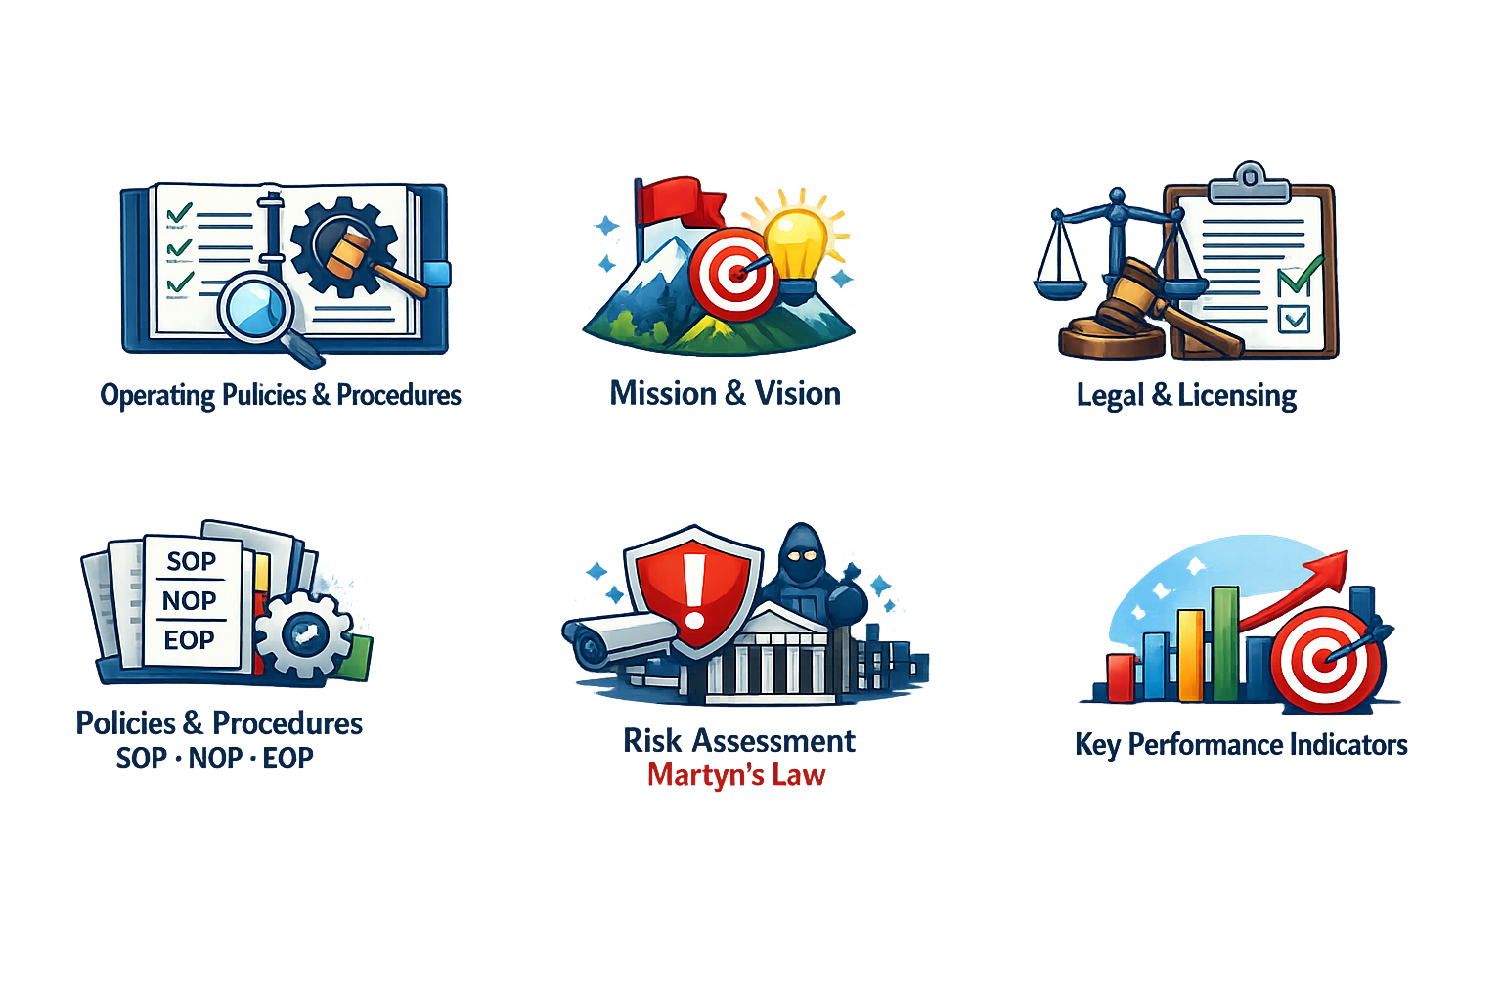
Operating polices & procedures
Arwen Garland – 2400525
Eva Thomas - 2203669
Dems Davies - 2307860
Eden Edger – 2405155
Zara Pearce- 2404323

Slide 2
3 - Zara
Addressing and outline to the project management teams the key policies and procedures (SOPS, NOPS, EOPS) that will be needed to be addressed for the opening for the Carmarthenshire Film Festival 2026
Notes:
Good afternoon, everyone, my name is Zara, and today i will be presenting an overview to the project management teams who are all involved in delivering the Carmarthenshire film festival. I will be explaining the key policies and procedures for three important operational frameworks these are SOP – standard operating procedures, EOP – emergency operating procedures and NOP- normal operating procedures. These 3 frameworks all provide and play a vital role in the aspects for the Carmarthenshire Film festival.

Slide 3
Understanding The Key Policies and Procedures
SOPS – Standard Operating Procedures
A step-by-step guided documented outlining how to,
Perform routine tasks consistently
Safely
Efficiently
EOPS – Emergency Operations Procedures
A critical set of guidelines from a document designed giving an understanding to
Find
Prepare for
Be ready to respond to potential hazards
Threats and Emergencies
NOPS – Normal Operating Procedures
A documented routine to
Manage the key day to day operations safely and efficiently
(Arizona 2026) (GlobeAir AG 2024) (OctoberCMS 2026 )
Notes:
Understanding the key policies and procedures, With the key success of the Carmarthenshire film festival these 3 procedures are vitial for the overall operations running on the event. Normal Operating Procedures is a key documented routine to manage the key day operations with the consistency of getting safety and the correct efficieny of a routine for day to day tasks for the running. Standard Operating Procedures is a step by step guide outlining and to ensure routine tasks are perfromed consistently, safely and efficiently. Finally Emergency Operations procedure a critical set of importance of guidelines designed giving an understanding to find, prepare and be ready for potential hazards threats and emergnacys.

Slide 4

How SOP, EOP , NOP will be addressed?
SOP
Front of House Logistics – requiring a mandatory registration to check in all attendees to manage the Ffwrnes Theatre capacity
Venue check – ensure the venue is ready to open to attendees
You the Staff – clarity with your roles and what it will intel
Contingency Planning In place – plans in place for any technical issues or other delays
(TheatrauSirGar 2026) (Allen et al. 2010)
Notes:
SOP will be addressed for the opening for the event ensuring a structured, safe and professional launch for the event. The key point would be front of house logistics, checking in all attendess even tho tickets are free, it is a requirement for everyone to be checked in to manange the Ffwrnes Theatre Capacity. A deep travel path of the venue ensuring the venue is ready to open to all attendees. The staff all staff working have cleary clarity with the roles an have an understanding what Is needed to be done, and also contingency planning in place have other options avalible incase for delays. SOP consistencty supports and enhances the visitor experience and ensure that the event begins smoothly and professionally.

Slide 5
How SOP, EOP , NOP will be addressed?
EOP
Full risk assessment find hazards
Emergency plans including crowd control, fire
Clear communication skills
Trained staff to responded to incidents
First Aid services and emergency exits checked and accessible
(Haddow et al. 2020)
Notes:
EOP enusres that full risks that effectively could happen are managed, prior to opening for the festival, full risk assessment would be taken place to identify hazards such as spacing for crowd control, fire risks, this would also look in to the emergency plans in the case of a fire where the exits are and looking at the crowd control of the area. Making sure all staff are trained to responded quickly and effectivly to incidents.
EDEN QUESTION- How do you ensure that key policies and procedures, such as the Event Operations Plan (EOP), are effectively communicated across all teams to maintain safety throughout the film festival?

Slide 6
How SOP, EOP , NOP will be addressed?
NOP
Standard Staffing Levels
Accessibility Standards – ensure all hearing loops and wheelchair lifts all tested and working
Clear communication
Clear Public access times to opening
Queue Management and organised crowd flow
Time management
(Goldblatt 2014) (CBFF 2026)
Notes:
Finally I will address how NOP will be used for the opening for the event this procedure will focus on the basics clear communication making sure all staff feel comfortable to communicate with the team and any questions asked by attendees, making sure staffing levels are correct meaning the right number of staff are working and that breaks can be taking roles can be changed if needed.
Thank you any questions
I will now pass you over to Arwen

Slide 7
Zara's References
Allen, Johnny, et al. Festival and Special Event Management. Google Books, Wiley, 1 Nov. 2010, books.google.co.uk/books/about/Festival_and_Special_Event_Management.html?id=4K5PPgAACAAJ&redir_esc=y.
Arizona. “Emergency Operations Plans | Department of Emergency and Military Affairs.” Az.gov, 2026, dema.az.gov/emergency-management/preparedness/planning-branch/emergency-operations-plans#. Accessed 26 Apr. 2026.
CBFF. “Submit Your Film - Carmarthen Bay Film Festival CBFF.” Carmarthenbayfilmfestival.co.uk, 2026, www.carmarthenbayfilmfestival.co.uk/policies. Accessed 28 Apr. 2026.
GlobeAir AG. “What Does “Normal Operating Procedures” Mean? • GlobeAir.” GlobeAir, 2024, www.globeair.com/g/normal-operating-procedures.
Goldblatt, Joe Jeff. Special Events: Creating and Sustaining a New World for Celebration. 7th ed., Hoboken, New Jersey, Wiley, 2014.
Haddow, George D, et al. Introduction to Emergency Management, Enhanced. Butterworth-Heinemann, 5 Sept. 2014.
OctoberCMS. “SOP Info.” Spiers Engineering Safety, 2026, www.spierssafety.co.uk/sop-guide/.
TheatrauSirGar. “Carmarthen Bay Film Festival 2026: Di... - Carmarthenshire Theatres.” Theatrausirgar.co.uk, 2026, www.theatrausirgar.co.uk/en/shows/carmarthen-bay-film-festival-2026-diwrnod-day-1.

