Slide 1
Introduction
A Business Case for Making Nike Workplace More Inclusive, Flexible and Agile.

Slide 2
What is Aglile?
“Agile working is a way of working in which an organisation empowers its people to work where, when and how they choose – with maximum flexibility and minimum constraints – to optimise their performance and to do their best work” - The British Computer Society

Slide 3
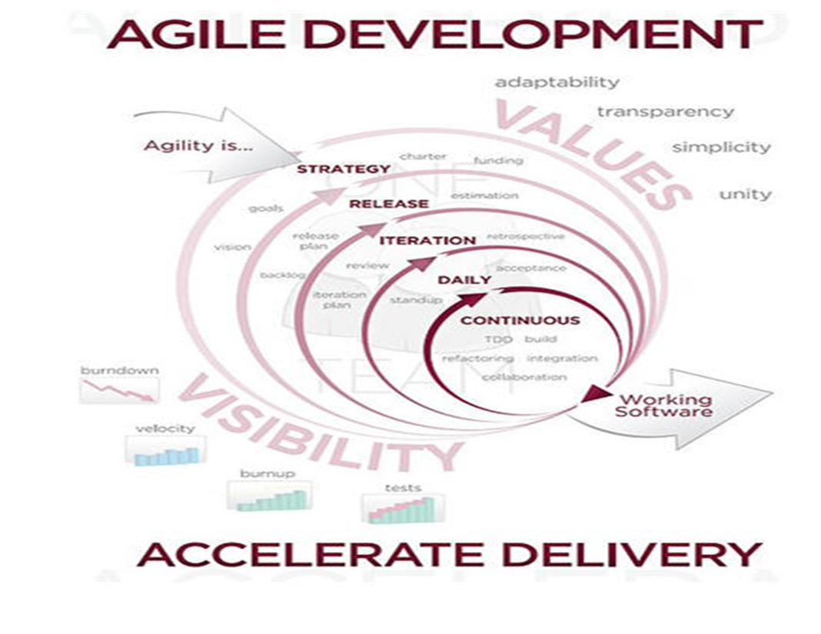
Agile Structure

Slide 4
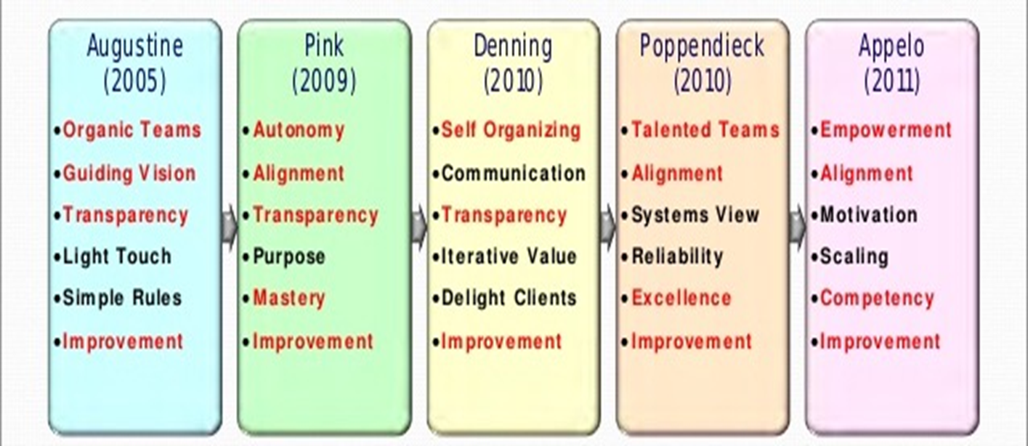
Agile Leadership Theories

Slide 5
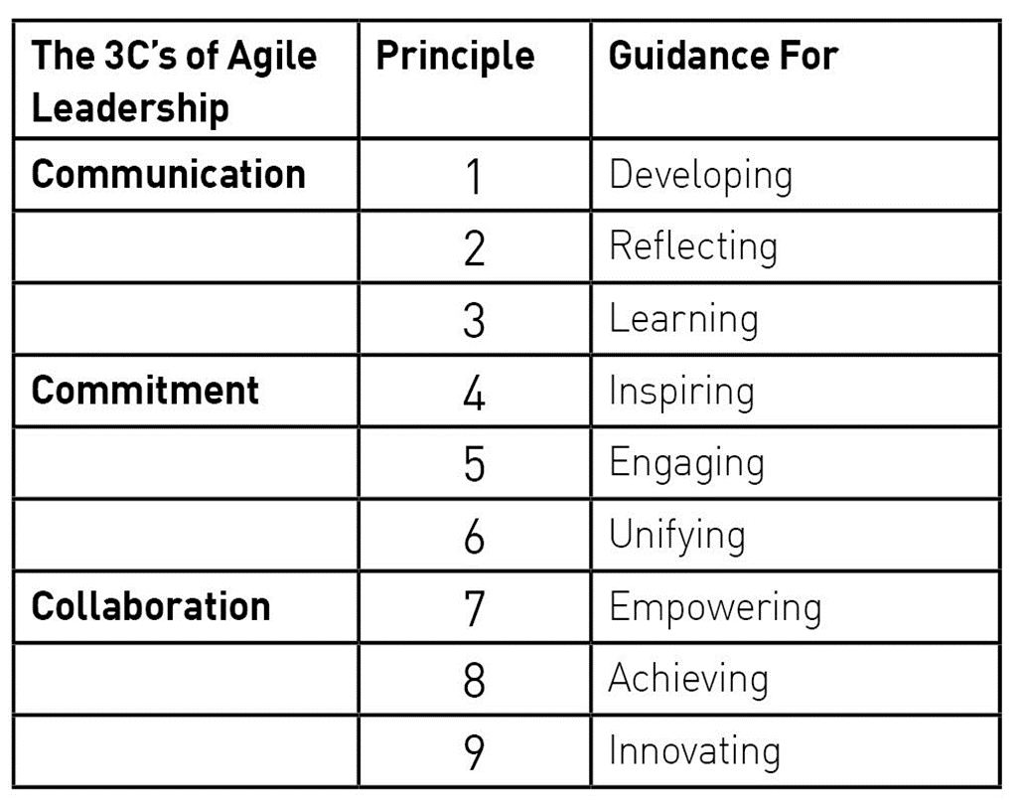
Principles of Agile
Agile Business Consortium (2017)

Slide 6

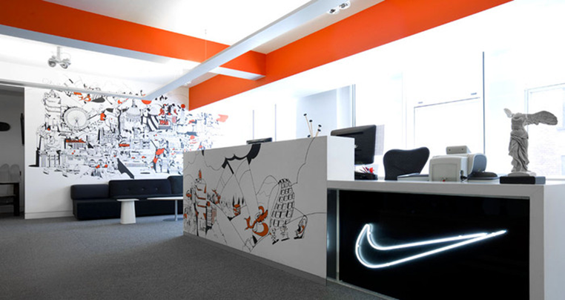
Agility Nike – How They Already Operate?
Nike has topped the rankings for most future-fit brand in the recent years. This testing has proved that the agility behaviour is a key element within Nike which has boosted their results. Nike does well as a brand by testing and scoring their employees with high staff net promoter scores and have a high percentage of female directors.

Slide 7


Agility – Recommendations
Implement Open Space working
Encourage meeting colleagues

Slide 8
Inclusive.
Inclusive employers (2017) describes and inclusive workplace as,
‘ensuring that no one feels left out because of their age, disability, gender reassignment, race, religion or belief, sex, sexual orientation, marriage and civil partnership, pregnancy and maternity, or other factors such as social background.’
(https://www.inclusiveemployers.co.uk/about-us/inclusion-diversity-and-equality)

Slide 9

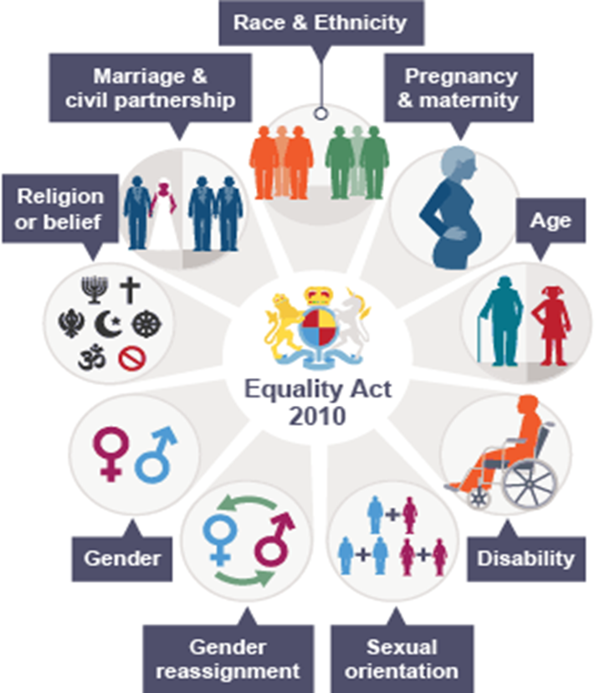


Slide 10
Maslow’s Theory of Needs.
Maslow’s hierarchy of needs, which dates back to 1943, can be used to create an inclusive workplace. by using Maslow’s theory an employer can ensure that all employees basic needs are met, resulting in an inclusive and motivated workplace.
Phsiological – make sure all employees can afford essentials like food, shelter and clothing by making sure employees are paid fairly.
Safety – have a zero tolerance for bulling and harassment.
Social – make sure the work culture instils the feeling of being part of the team, to make sure everyone feels valued.
Esteem – employees should be treated with respect and dignity, and contributions and successes should be acknowledged.
Self-actualisation – make sure there are opportunities for employees to develop and grow.
(carter-hicks, 2015)
Self-actualisation
Safety
Psychological
Social
Esteem

Slide 11
Model for Inclusiveness
Mobilisation
Alignment
Action
Awareness
Awareness
Training and educating employees about the importance of an inclusive workplace.
Diversity education
Bias training
Cultural immersion with job shadowing
Mobilisation
Processes and policies that keep everyone accountable for the diversity and inclusiveness of the organisation.
Alignment
Constant analysis and review of the organisations polices on inclusion to ensure they meet employee expectation, strengthen engagement and establish loyalty.
Action
Efforts and tactics such as working with diverse suppliers and actively supporting employees to built an inclusive work place

Slide 12
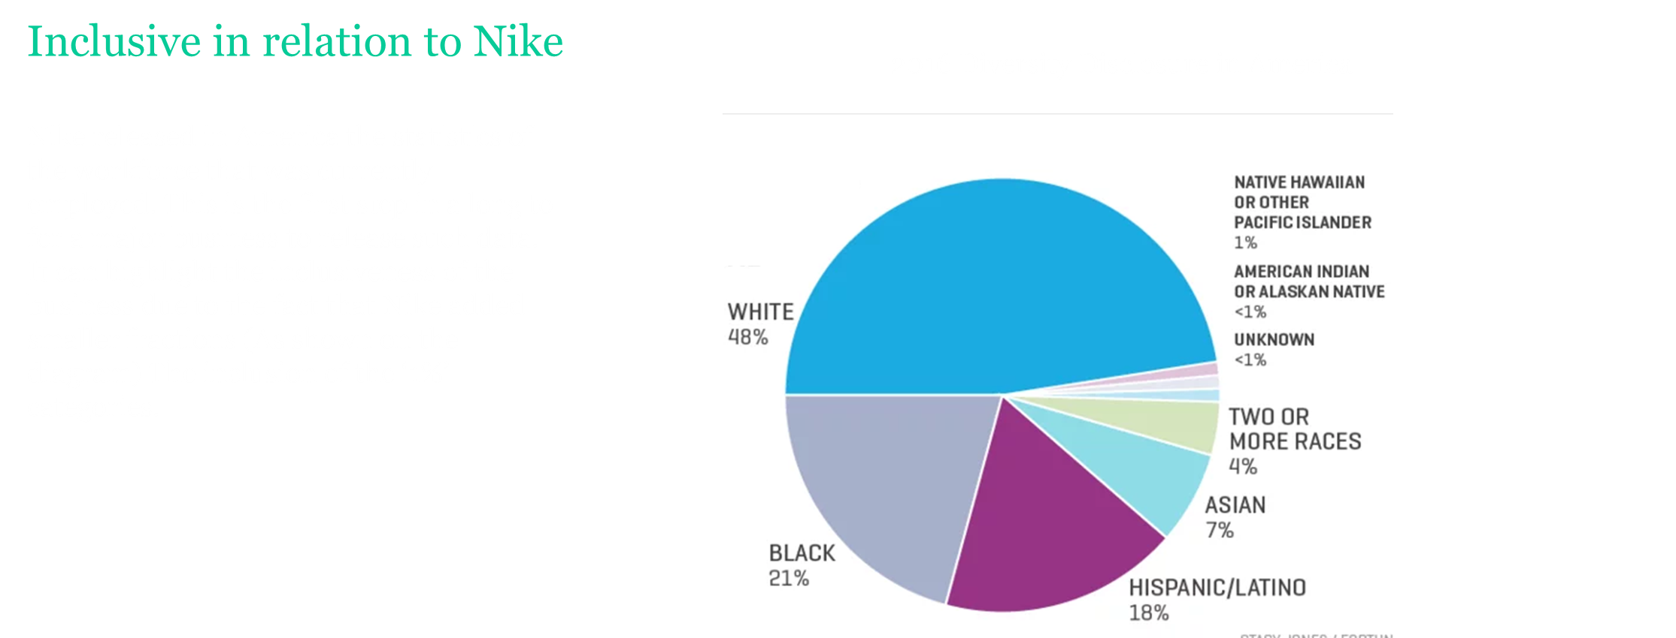
http://fortune.com/2016/05/12/nike-staff-diversity/

Slide 13
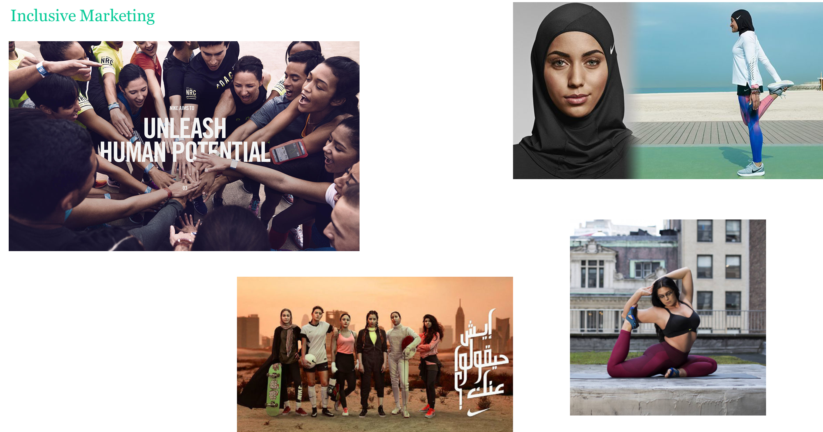

Slide 14
What may stop Nike becoming fully inclusive ?

Slide 15
Flexibility
Flexibility is about an employee and a employer making changes to when, where and how a person would work better to meet individual and the business needs. Flexibility enables these needs to be met through making changes to the time, location and manner in which an employee works. The use of flexibility should result in superior outcomes for both the employer and the employee.
According to: http://workplaceflexibility.bc.edu/

Slide 16
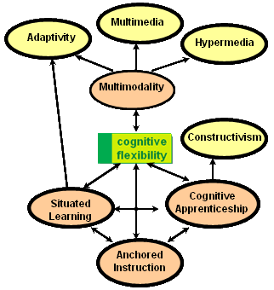
Cognitive Flexibility Theory
Cognitive flexibility theory, introduced by Spiro, Feltovich and Coulson, is the adaptation of processing strategies to face new and unexpected condition within a working environment. Cognitive flexibility is an ability which could imply a process of learning and could be acquired with experience. The theory is mainly aimed at exchanging skills and knowledge under situations of change. This theory would suit the business moving forward.

Slide 17
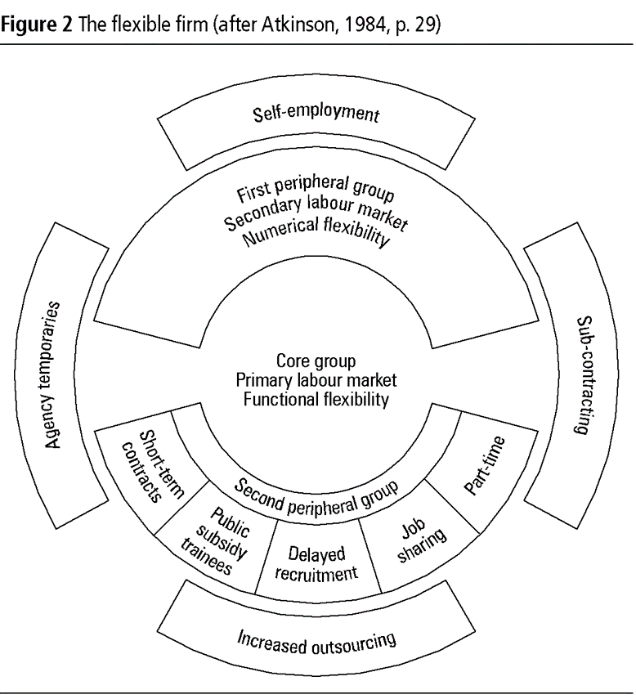
Atkinsons Flexibility Model
The Atkinsons flexibility model is a technique for organising the workplace using various forms of flexibility in order to optimise the use of human resources. This was originally implemented by Jon Atkinson in 1986 and is based on the principle of segmenting the workforce into core and peripheral groups. The core group is composed of employees that are vital to the organisation, functionally flexible and difficult to replace within the workplace. From the employees perspective, it is better to be part of the core than the periphery since the form has greater job security, better conditions of work and better prospects. In addition the flexible firm model also identifies activities such as cleaning and the up-keep, which are not core to the business but are important to its running.

Slide 18
How do Nike operate flexibly ?
According to fairygodboss (2017) 70% of women say Nike,inc has family friendly hours as opposed to the industry average of 47%.
They also state that 70% of women say Nike,inc has a family friendly culture, over the 45% industry average.
Other ways in which Nike try and be a flexible organisation are:
Flex time
Zero hour contacts
Paid sabbaticals
Menstrual leave
( https://fairygodboss.com/work-life-balance-flexibility/nike-inc)

Slide 19
What may stop Nike working more flexibly ?
In 2016 there were :
700 Nike stores worldwide
44000 employees
44 countries with Nike offices
31% share of the global athletic footwear market
(https://www.statisticbrain.com/nike-company- statistics/)
Barriers to flexibility:
Stores have to have set opening times
High amount of employees all with different needs
44 different cultures and ways to do business
Need to execute change effectively and carefully as not to loose their place on the market.

Slide 20
Kotter’s 8 step model
John Kotter addresses a major challenge facing modern business leaders - how to act quickly and remain relevant in highly competitive environments.

Slide 21
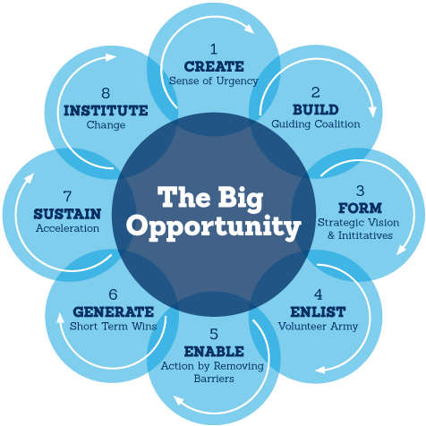
Kotter’s 8 step model diagram
There are many theories about how to "do" change. Many originate with leadership and change management guru, John Kotter. A professor at Harvard Business School and world-renowned change expert, Kotter introduced his eight-step change process in his 1995 book, "Leading Change."

Slide 23
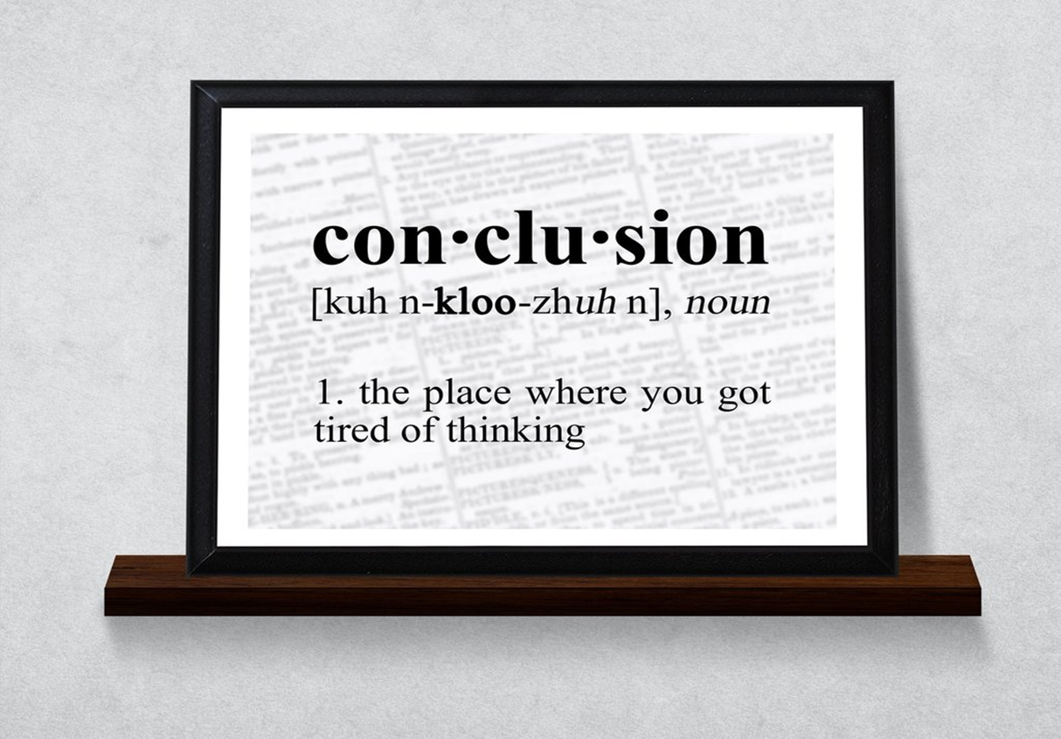
Conclusion

Slide 24
Final Thought
1N73LL1G3NC3
15 7H3
4B1L17Y 70 4D4P7
70 CH4NG3
573PH3N H4WK1NG

Slide 25


