Slide 1

Assignment 1
Emil Slavov (2122223)
Module code: LCBB 5004
Lecturer name: Mushfiqur Rahman

Slide 2
Table of contents
Introduction
Concept of Talent Management
Different types of talent Acquisition strategy
Short term talent Acquisition strategy
Long term talent Acquisition strategy
Monetary rewards
Non-monetary rewards
Conclusion
Reference

Slide 3

Introduction
The concept of talent acquisition is all about attracting and recruiting best talent.
The talent acquisition process includes- planning, sourcing, assessing, hiring, and onboarding.
It is applied to all the forms of employee recruitment, full-time, part-time, and contractual.

Slide 4

Concept of Talent Management
The idea of talent acquisition is all about- how employers recruit employees, how the employees are developed in terms productivity.
Depending on talent management, it depends whether the employees will stay or not.
If talent management is strategically implemented, it helps in the improvement of performance, and helps business stay competitive.

Slide 5
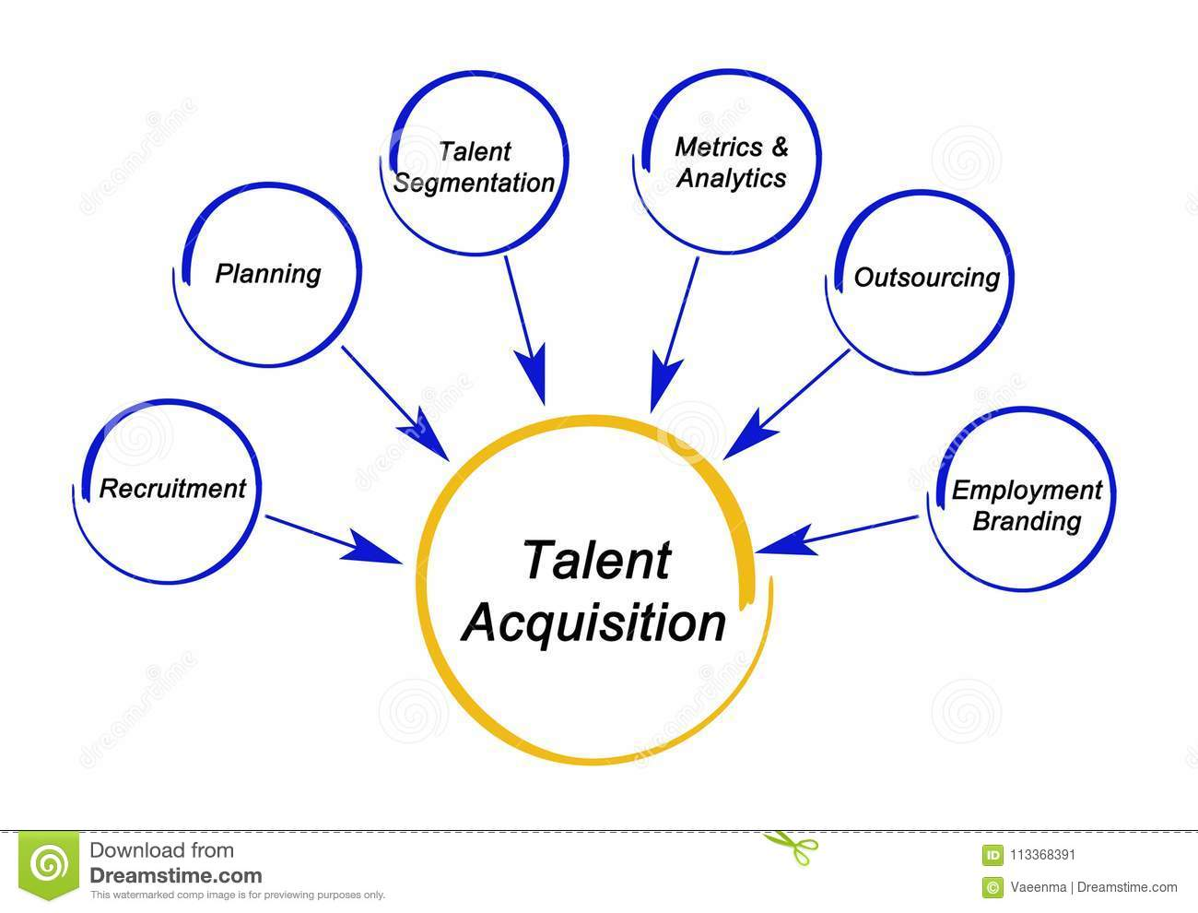
Different types of talent Acquisition strategy
The blend of contingent and the permanent resources is needed to keep the cost of acquisition strategy in place.
This also helps in minimising the hiring and the firing of the workforce.
The talent acquisition is based on two approaches- short-term and long-term employment.
The short-term is for the employees who are hired maybe for months, days or week. Whereas long-term acquisition strategy is for the long-term employees who also receives benefits like- paid leave, insurance, retirement plan, etc.

Slide 6

Short term talent Acquisition strategy
It is important to evaluate the skills demands and the time period for hiring. The capacity and the demand gap need to be identified. The skills required needs to be understood and then the HR should be contacted and based on that they start recruiting employees.

Slide 7
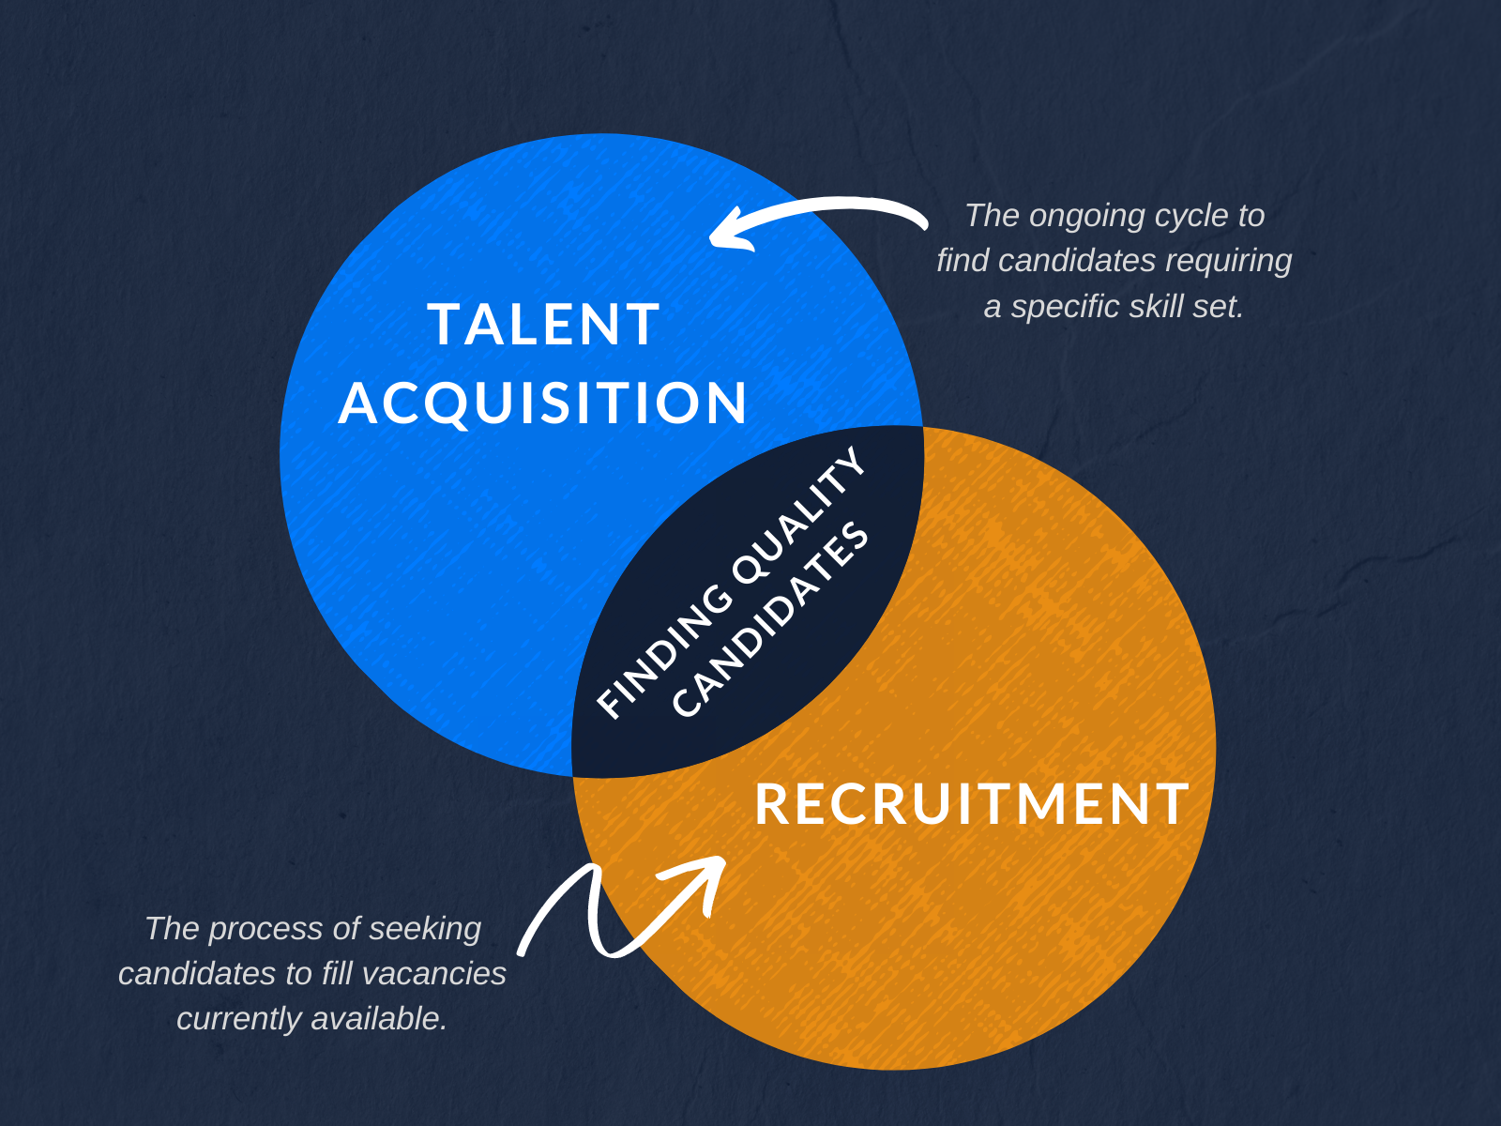
Short term talent Acquisition strategy
It is important to create a job description that is clear and demonstrates the job role clearly. The job descriptions must be updated, completed, accurate.
It is also important to strictly scrutinize the employees to ensure whether they are right or wrong for the restaurant they are being hired for.

Slide 8

Long term talent Acquisition strategy
It is important that the restaurants focus on their branding strategy, as this helps in gaining competitive advantage in the long run. The reputation of the organisation attracts candidates, retains them and the productivity is positive because of this.

Slide 9

Long term talent Acquisition strategy
It is important that the freshers and the experienced employees have a different hiring process as the experienced applicant have more experience in the industry and have better industry insights.
Lastly, referrals need to be encouraged because the applicants that the existing employee will refer will automatically have idea about the company mission, vision and culture and will be able to prove themselves productive.

Slide 10

Monetary rewards
Team bonuses can be introduced, based on their performance, each team can be given bonuses. The back of house and the front of house member in the restaurant can be grouped in this case. It can help employees to stay motivated, loyal and be productive.
ESOP or the Employee Stock Ownership Plan can be introduced where the employees can have a stake at the restaurant, this will increase the sense of belongingness and feel valued.

Slide 11

Non-monetary rewards
Recognising employees publicly through certificates, trophies, badges, tittles can be helpful in motivating restaurant staffs.
It is also important to develop the restaurant staffs personally and professionally by upskilling and reskilling them. Through peer coaching and peer mentoring it could be done, it will help in building strong relationship.

Slide 12

Conclusion
Thus, this presentation can be concluded by saying that managing talent is important through proper strategy.
Labour shortages in the hospitality sector like restaurants is a major issue because shortage of labour means, poor service deliver.
Unsatisfied customer means losing business competitiveness.
Hence this paper focuses on long-term short term talent acquisition strategy and rewards (monetary and non-monetary) that would help retain employees, make them productive, and reduce turnover rate.

Slide 13
Reference
Hongal, P. and Kinange, U., 2020. A study on talent management and its impact on organization performance-an empirical review. International Journal of Engineering and Management Research, 10.
Mokhniuk, A.M., 2016. The impact of monetary rewards on the motivation of employees. Roczniki Ekonomiczne Kujawsko-Pomorskiej Szkoły Wyższej w Bydgoszczy, (9), pp.336-346.
Reis, I., Sousa, M.J. and Dionísio, A., 2021. Employer branding as a talent management tool: A systematic literature revision. Sustainability, 13(19), p.10698.
Singh, R.P., 2021. Talent management literature review. Feedforward: Journal of Human Resource, 1(1), pp.43-48.
Zaharie, M.A. and Seeber, M., 2018. Are non-monetary rewards effective in attracting peer reviewers? A natural experiment. Scientometrics, 117(3), pp.1587-1609.

Slide 14


