Slide 1
CASE QT-AI-2025
Digital Forensic Investigation
Corporate Espionage — Quantum Tech AI-Chip Patent Theft
Submitted by : Md Ekram Hossain
Student Id : 2523284
Submitted to : Dr. Mohammad Ghanem

Slide 2
01
Case Background
Quantum Tech's IT security team detected unauthorised access to its proprietary AI chip design patent, QT-AI-2025.
Emma, a senior engineer recently joined at Quantum Tech, is the primary suspect in attempting to steal and sell the patent.
The intended buyer is competitor NexGen Circuits, approached through an intermediary, Joe.
Norman appears across the evidence as the buyer-side contact negotiating price and delivery.
Quantum Tech reported the incident to law enforcement; findings support action for corporate espionage and theft.
2

Slide 3
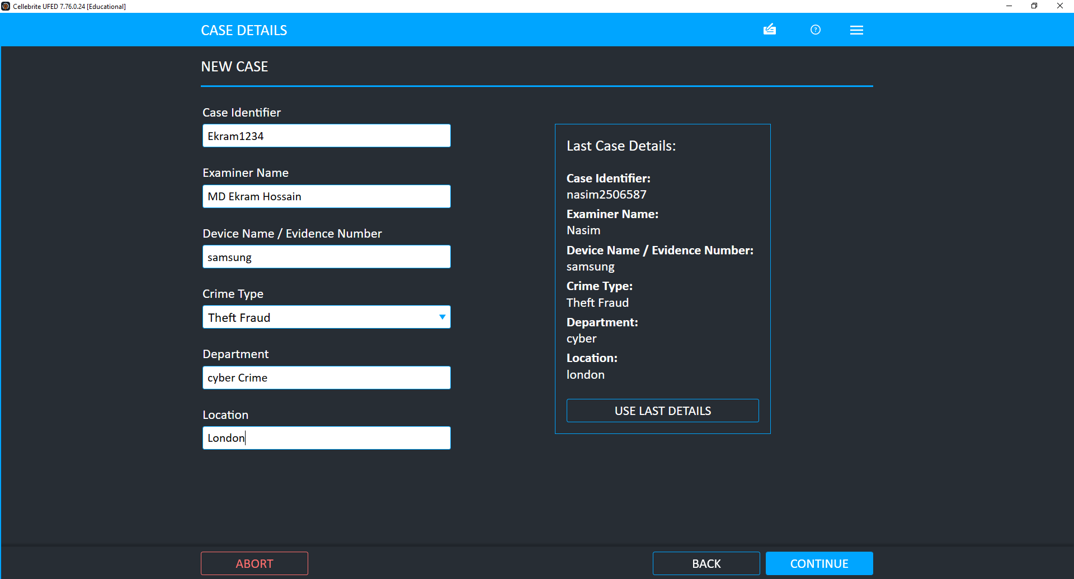
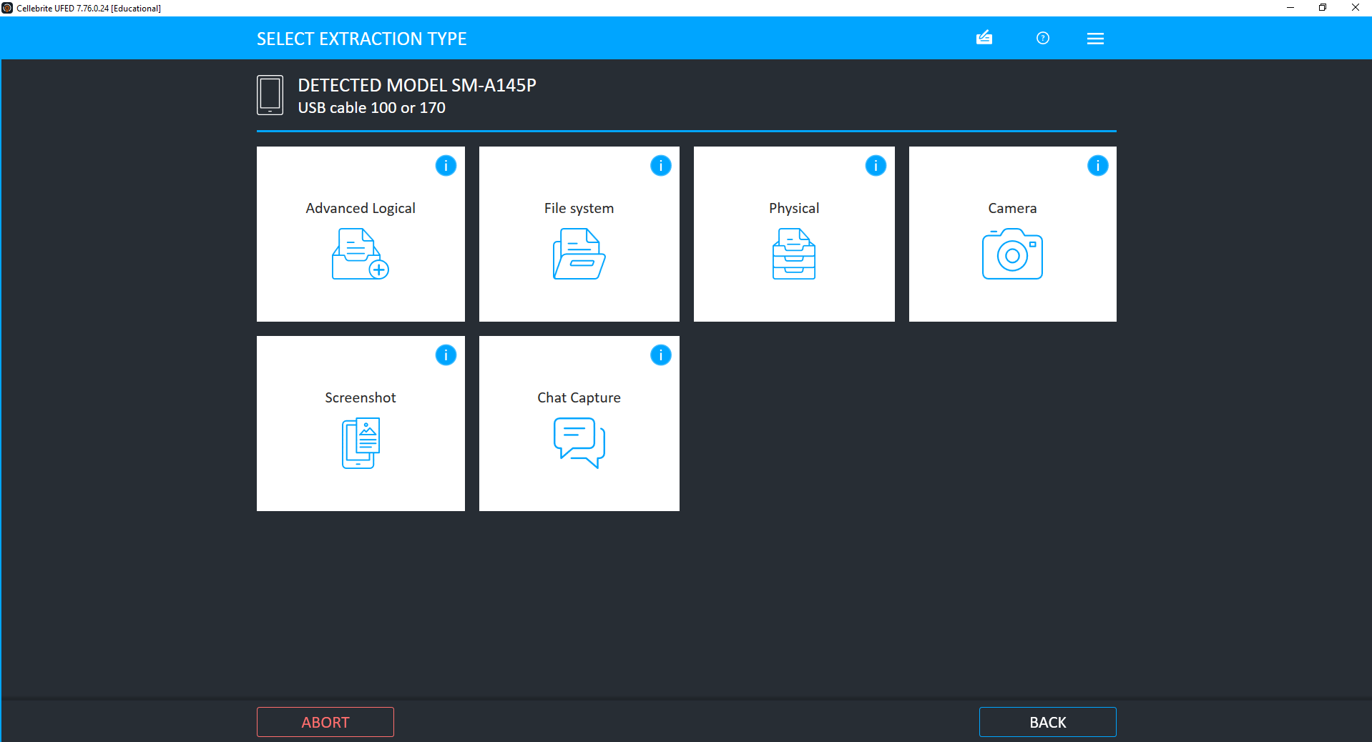
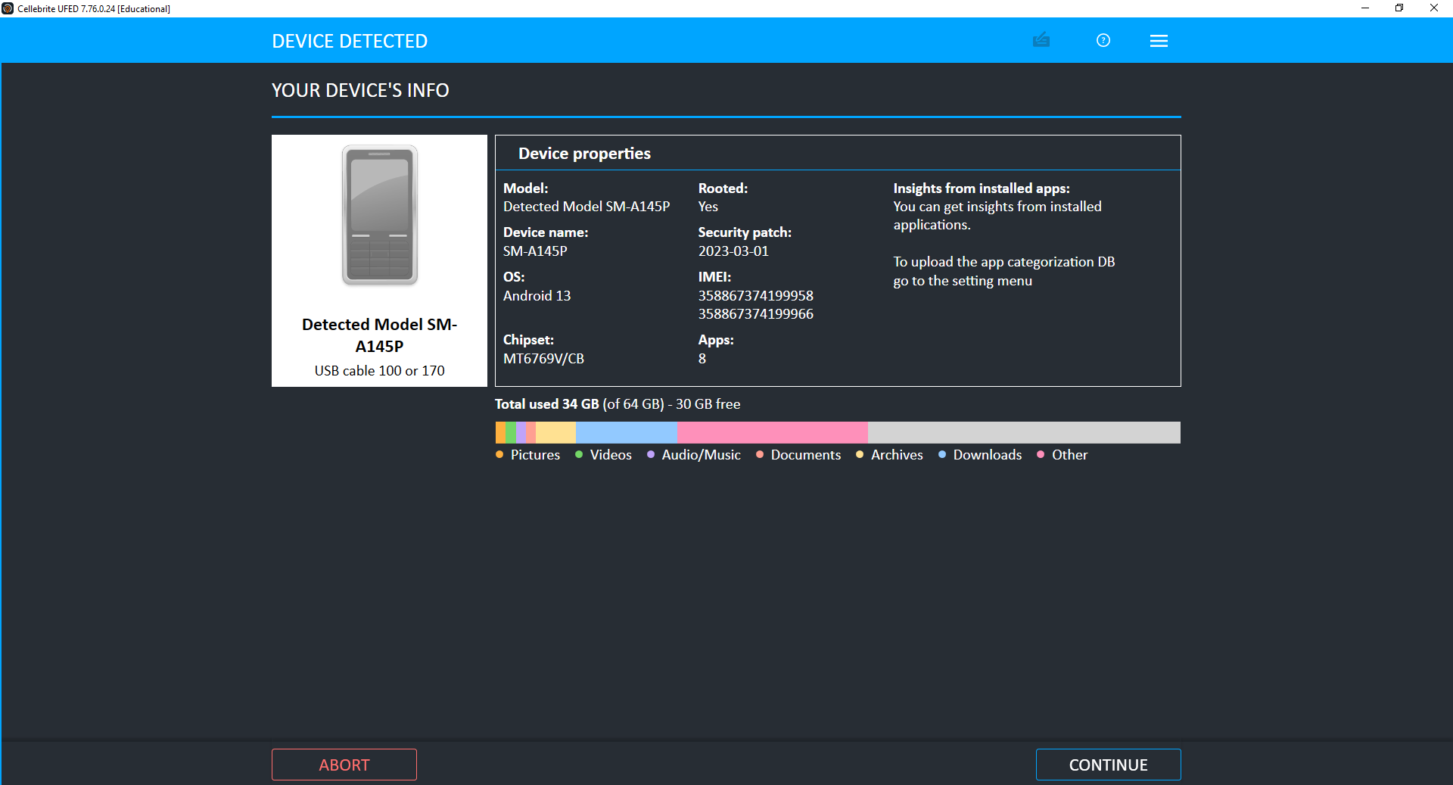
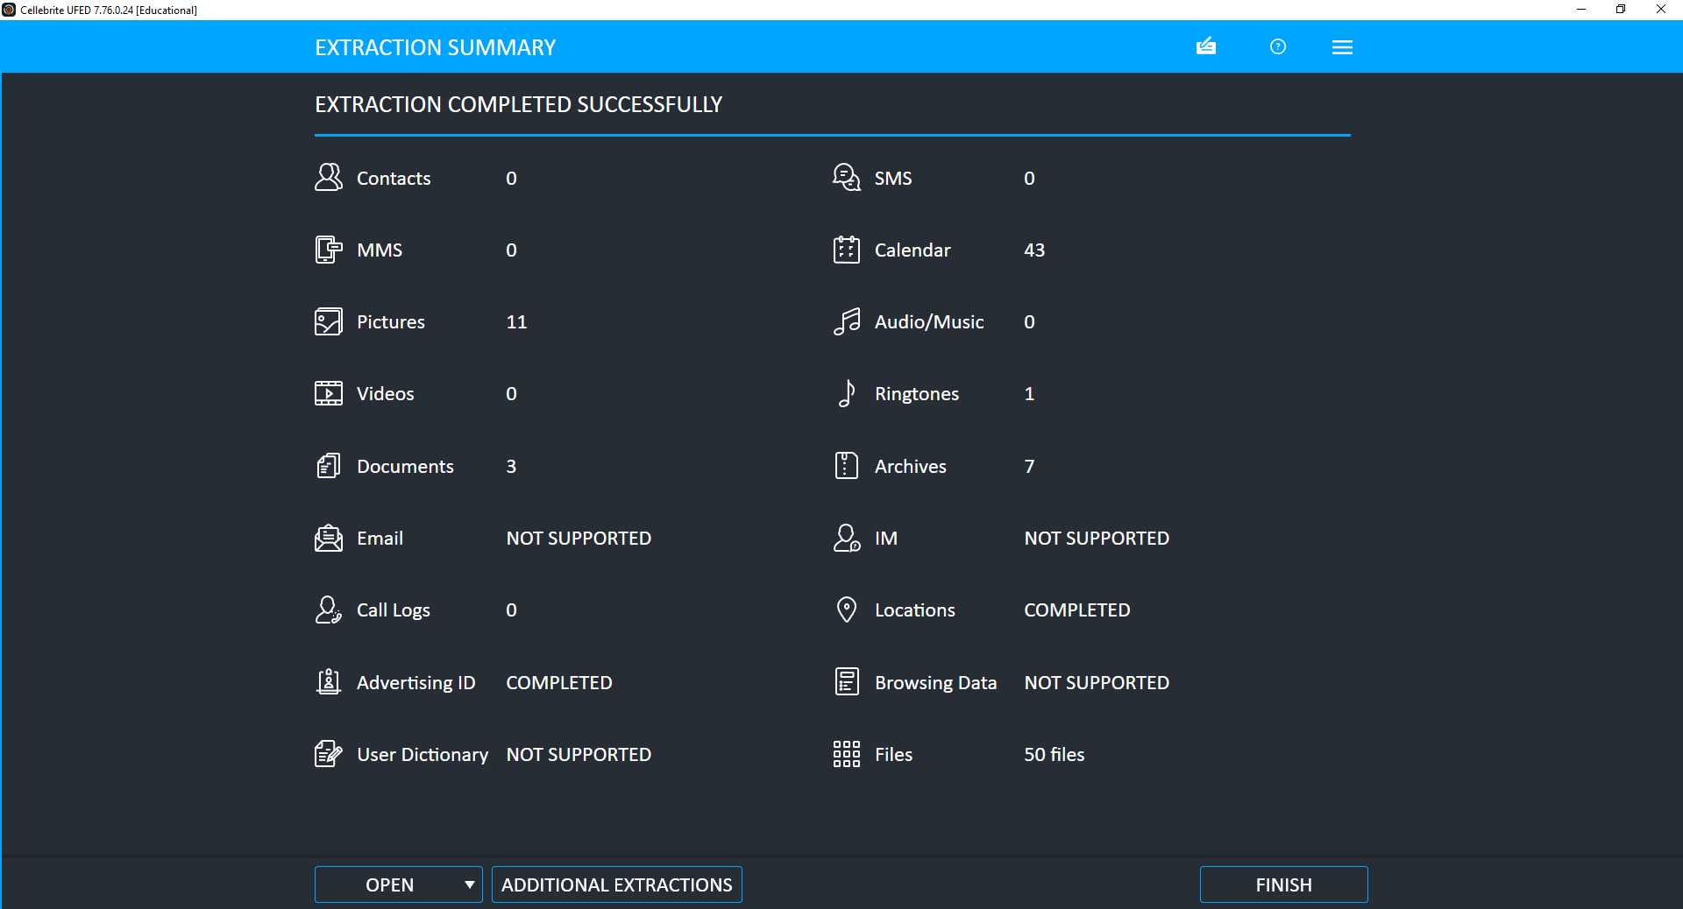
02
Mobile Acquisition Demonstration
Live walkthrough on an own phone (Samsung SM-A145P) using Cellebrite UFED, mirroring the steps used on each suspect device
1. Case setup
2. Acquisition (File System)
3. Device profiling
4. Extraction summary
Case Ekram1234 created in UFED; device auto-detected as Samsung SM-A145P (Android 13) over USB.
File System extraction chosen and saved locally — the same acquisition method used for each suspect device.
Hash verification: UFED confirms data integrity automatically during extraction, consistent with the SHA-256 checks already shown for the three suspect phones.
Results: 11 pictures, 43 calendar entries, 3 documents, 7 archives, 1 ringtone and 50 files recovered; locations and advertising ID fully completed.
3

Slide 4
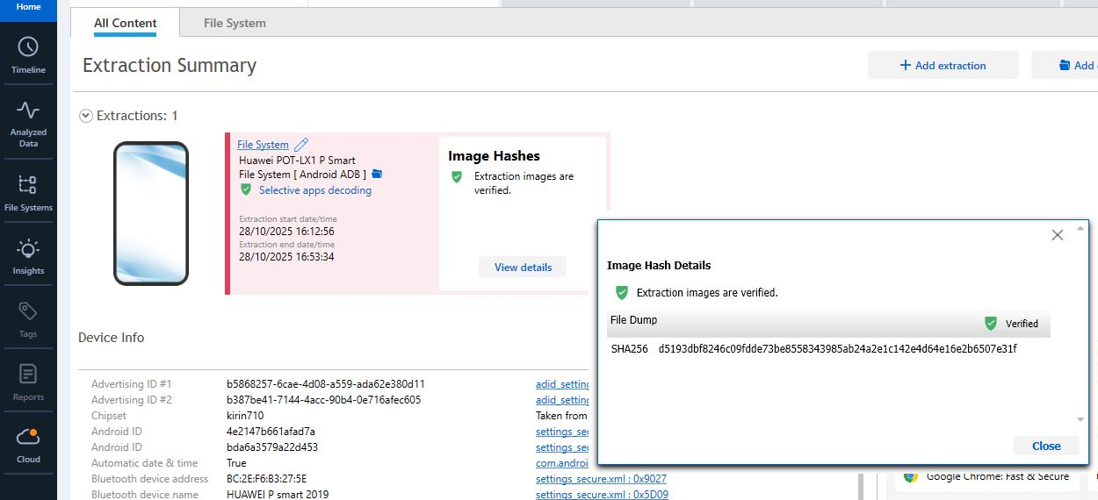
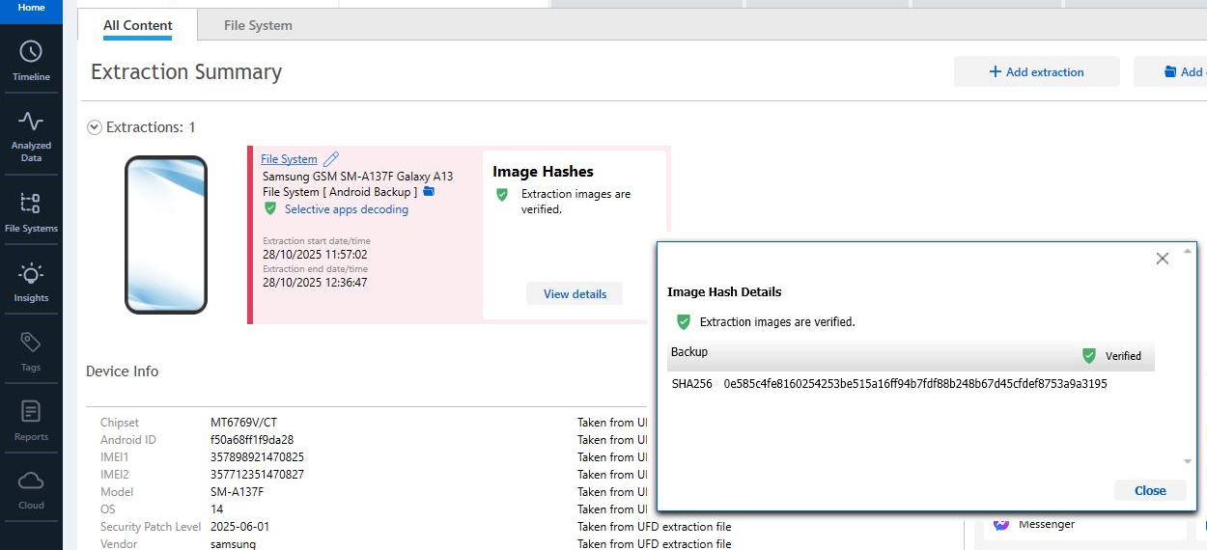
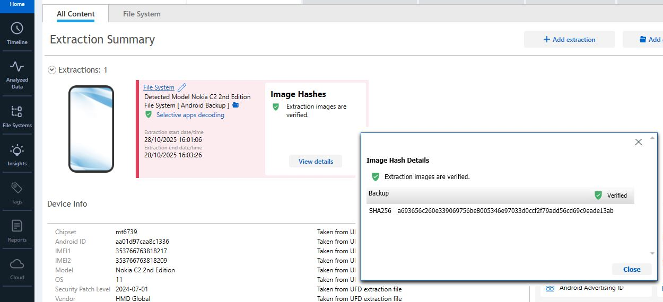
03
Evidence & Chain of Custody
Three devices, forensically imaged and hash-verified (SHA-256)
Huawei (Emma) — File Dump, verified
Samsung (Joe) — Backup, verified
Nokia (Norman) — Backup, verified
Emma — Huawei POT-LX1 P Smart 2019
IMEI 860962043466262
File System (ADB)
Joe — Samsung SM-A137F Galaxy A13
IMEI 357898921470825
Android Backup
Norman — Nokia C2 2nd Edition
IMEI 353766763818217
Android Backup
4

Slide 5
04
Methodology
1
Acquire
Each device imaged with Cellebrite Physical Analyzer 7.73.0.11 using File System (ADB) or full Android Backup extraction, under continuity-of-evidence protocol.
2
Verify
SHA-256 hashes generated at acquisition and re-checked post-extraction; all three images confirmed “Verified” with no tampering detected.
3
Extract
Selective apps decoding used to recover WhatsApp and Facebook (Genie) chats, contacts, call logs, media, and device location history.
4
Analyse
Chats reconstructed by thread/timestamp; media timeline and geolocation cross-referenced with message content to corroborate events.
5

Slide 6
05
Device–Suspect Mapping
Emma
Joe
Norman
Huawei P Smart 2019 — Perpetrator
Samsung Galaxy A13 — Intermediary
Nokia C2 2nd Edition — Buyer contact
Source device for WhatsApp contact “Top-up” (Joe) and Facebook account “Peter Dover” used to negotiate the sale.
Gallery contains a Wigan–Manchester rail ticket and Glasgow tickets, corroborating travel referenced in his WhatsApp messages.
Device locations include a South Wales area image; identified by name “Norman Smith” in the Facebook negotiation thread.
6

Slide 7
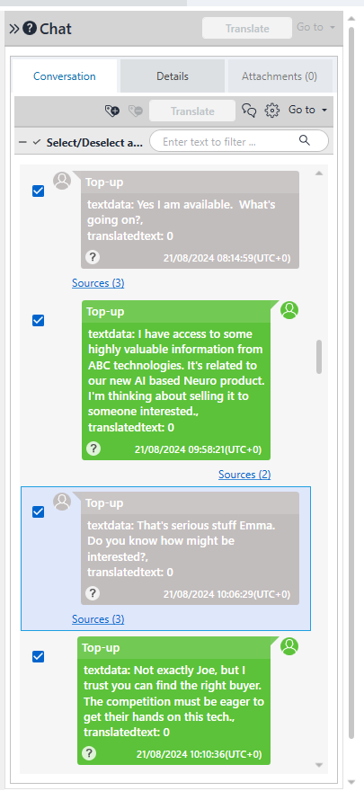
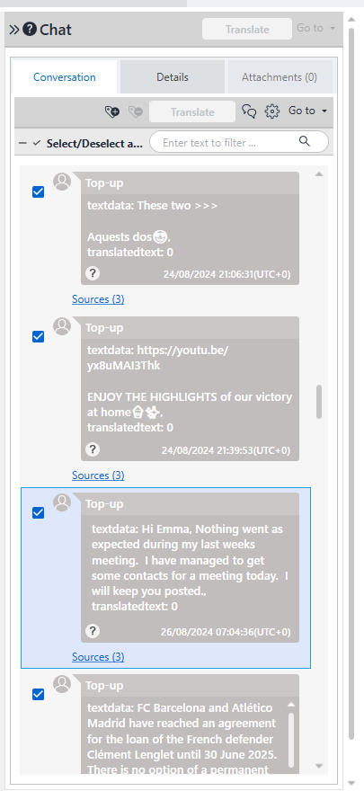
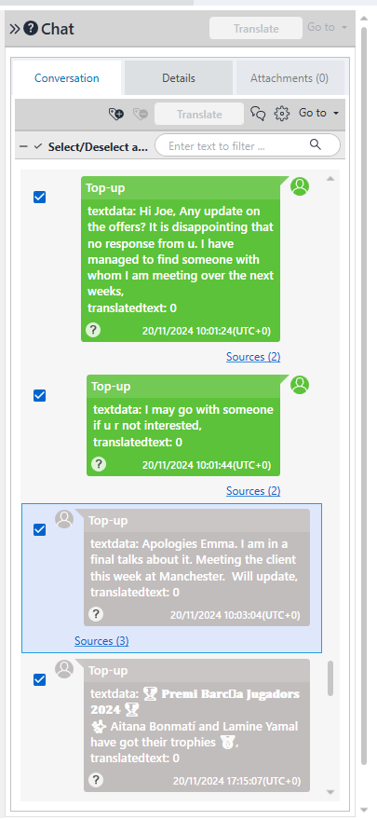
06
WhatsApp: Emma ↔ “Top-up” (Joe)
Recovered from Emma’s Huawei — Genie: WhatsApp (grouped by thread)
“I have access to some highly valuable information from ABC technologies... I’m thinking about selling it to someone interested.”
“The competition must be eager to get their hands on this tech.”
“Meeting the client this week at Manchester. Will update.”
21/08/2024 — interest raised
26/08/2024 — meeting contacts
20/11/2024 — meeting in Manchester
7

Slide 8
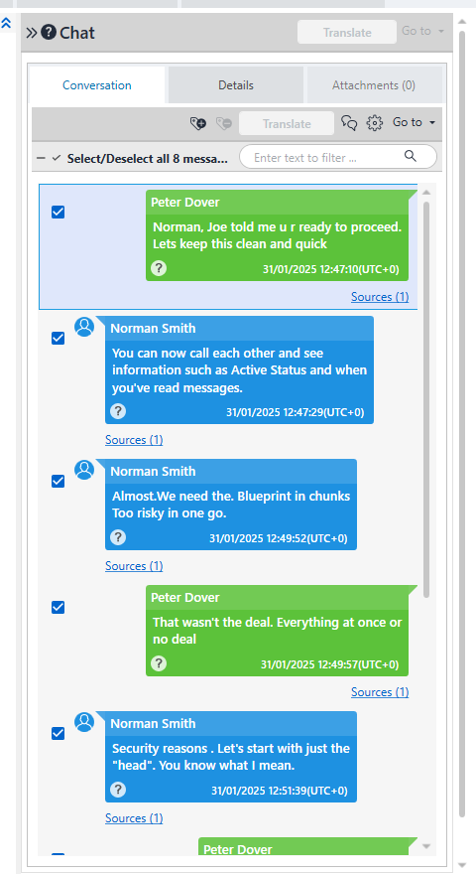
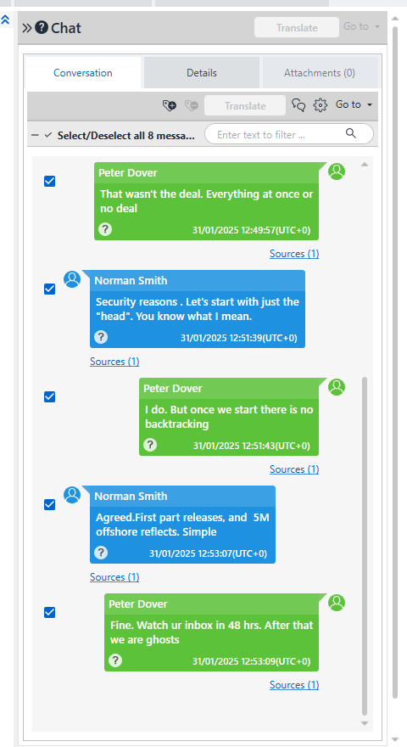
07
Facebook: “Peter Dover” (Emma) ↔ Norman Smith
Recovered from Emma’s Huawei — Genie: Facebook (grouped by thread), 31/01/2025
“Norman, Joe told me u r ready to proceed. Let’s keep this clean and quick.”
“Almost. We need the Blueprint in chunks. Too risky in one go.”
“That wasn’t the deal. Everything at once or no deal.”
“Agreed. First part releases, and 5M offshore reflects. Simple.”
“Fine. Watch ur inbox in 48 hrs. After that we are ghosts.”
12:47–12:51 — “clean and quick”, blueprint “in chunks”
12:49–12:53 — payment agreed, 48-hour deadline
8

Slide 9
08
Reconstructed Timeline
21 Aug 2024
Joe (“Top-up”) first raises the AI Neuro data on WhatsApp; Emma signals she is open to finding a buyer.
26 Aug – 20 Nov 2024
Emma updates Joe on meetings; Joe reports being in “final talks” with a client, meeting in Manchester.
Aug 2024
Samsung (Joe) gallery captures a Wigan–Manchester rail ticket and Glasgow rail tickets, corroborating travel.
04 Sep 2024
Nokia (Norman) device location logs a photograph in the South Wales area.
31 Jan 2025, 12:47
Facebook: “Peter Dover” (Emma) opens negotiation with Norman Smith — “clean and quick”.
31 Jan 2025, 12:49–12:53
Terms agreed: blueprint released in parts, 5M offshore payment, 48-hour delivery window set.
9

Slide 10
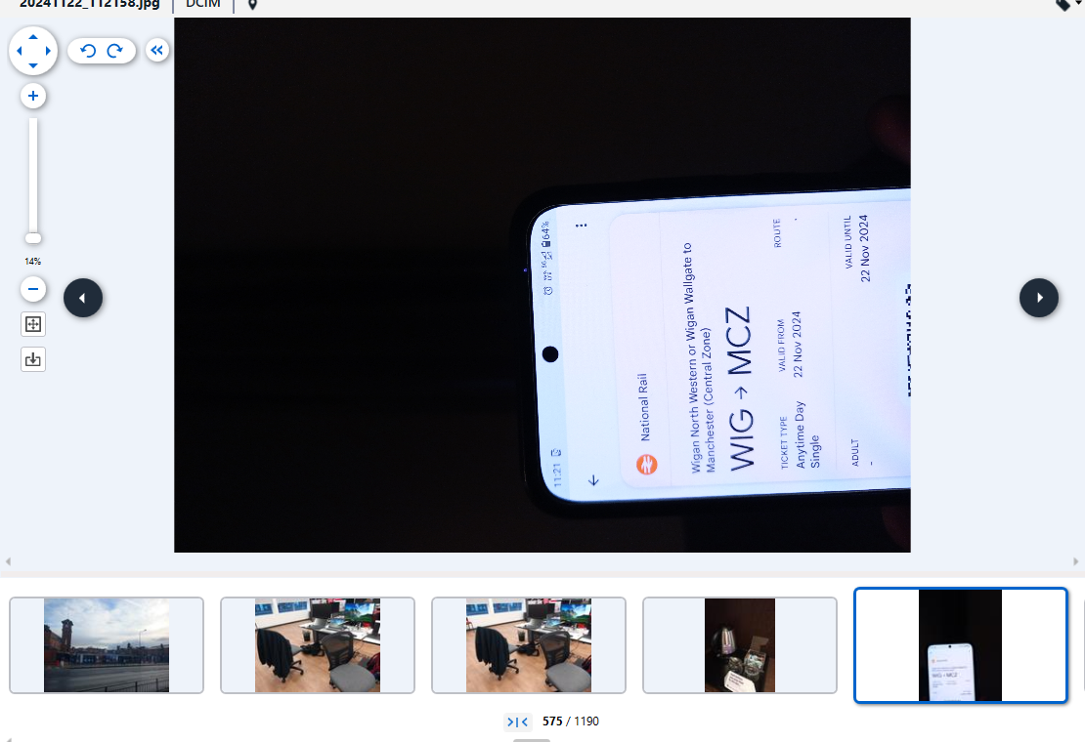
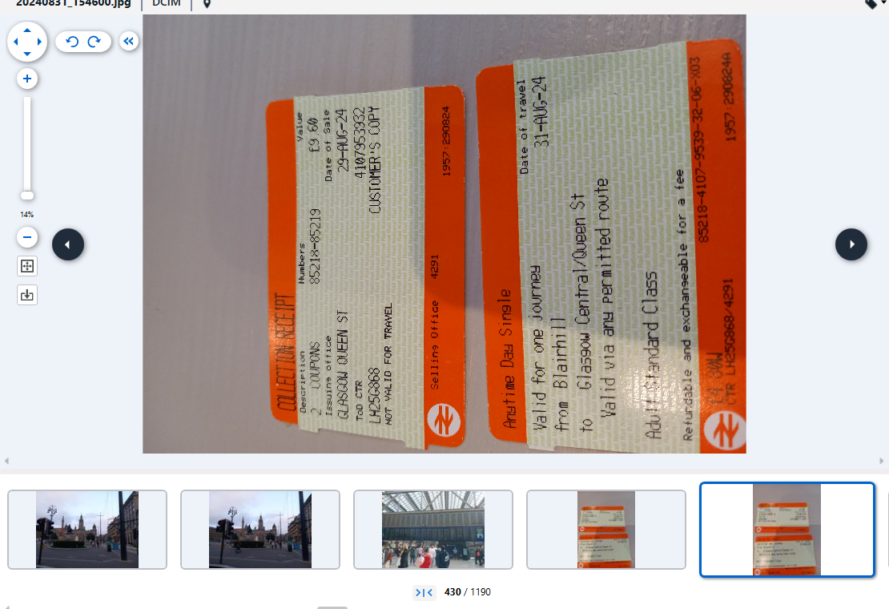
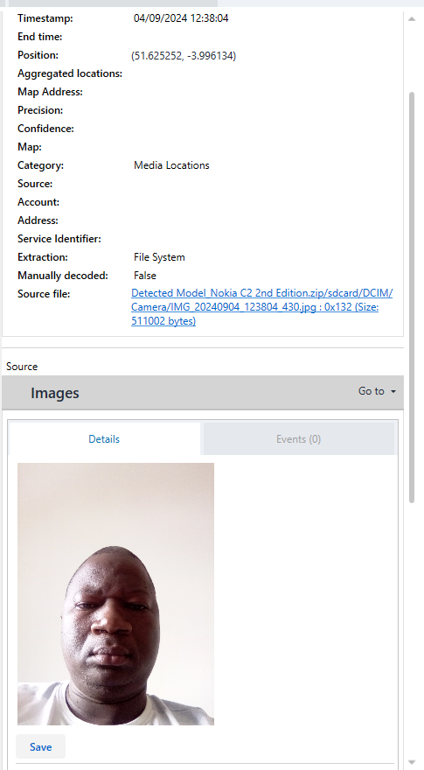
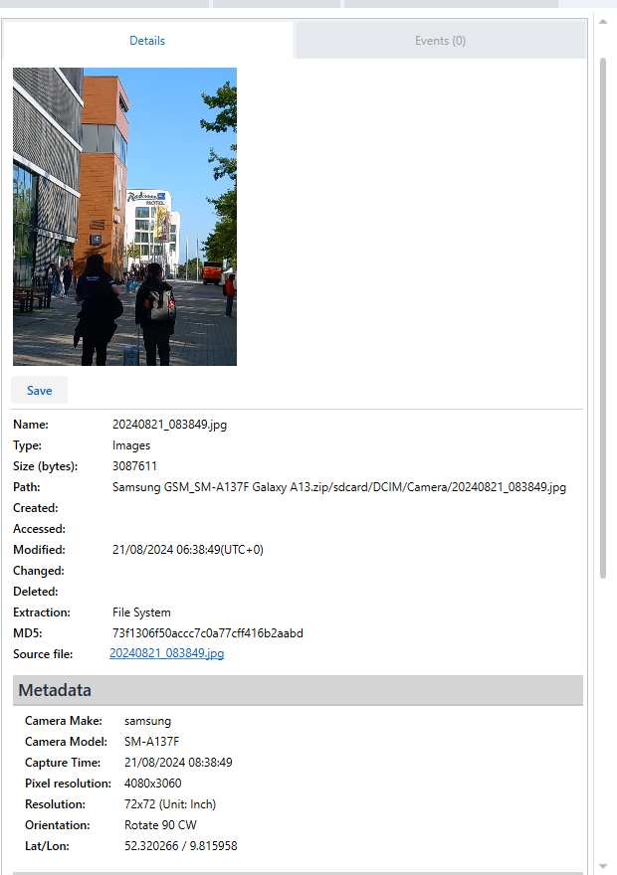
09
Corroborating Evidence
Joe’s Samsung: Wigan → Manchester ticket
Joe’s Samsung: Glasgow–Blairhill tickets
Norman’s Nokia: geotagged photo, South Wales
Travel documents and geotagged media on Joe’s and Norman’s devices place both individuals away from their home areas during the exact windows referenced in the WhatsApp and Facebook exchanges — independently corroborating the “meeting the client in Manchester” narrative.
Joe’s Samsung: timestamped media, 21/08/2024
10

Slide 11
10
Suspect Profiling — Roles & Motives
Emma
Joe
Norman
Perpetrator
Intermediary
Buyer contact
Initiates the sale on WhatsApp (“I’m thinking about selling it”) and negotiates delivery and price directly with Norman under the alias “Peter Dover” on Facebook.
Sources and vets a buyer for Emma, reports progress and delays, and arranges an in-person meeting “with the client” in Manchester — corroborated by a rail ticket on his device.
Negotiates technical delivery (“in chunks”) and financial terms (“5M offshore”) directly with Emma, and sets the 48-hour handover deadline.
All three roles are corroborated by at least two independent sources (chat content, device attribution, and travel/location metadata).
11

Slide 12
11
Conclusion & Recommendations
CONCLUSION
RECOMMENDATIONS
Communication logs from Emma’s Huawei show her initiating the sale and negotiating price and delivery directly with Norman.
Legal: Refer findings to law enforcement to support charges of corporate espionage and theft.
Joe’s role as intermediary is corroborated by chat content and independent travel evidence (rail tickets).
Containment: Immediately revoke Emma’s database access and audit recent access logs to QT-AI-2025.
Hash-verified forensic images (SHA-256) confirm the integrity of all extracted data, supporting its admissibility.
Preservation: Maintain chain-of-custody documentation and hash records for continued admissibility.
Together, the evidence presents a consistent, corroborated account of an attempted sale of patent QT-AI-2025 to NexGen Circuits.
Further Analysis: Pursue email correlation and any deleted-message recovery to strengthen the evidentiary chain.
12

Slide 13
Questions & Discussion
Case QT-AI-2025 — Digital Forensic Investigation Report

