Slide 1
Online Marketing Strategy Implementation and Evaluation.
Created by: Sol Whiteley
Module: Web Design & Online Marketing

Slide 2
Table Of Contents:
Introduction
Website Building Evaluation
2.1. Website Building Evaluation: Recommendations
Website Design
3.1. Home
3.2. Shop
3.3. My Account
3.4. Cart
3.5. Checkout
Online Marketing
4.1. Online Marketing Options
4.1.1. Online Marketing Options: Social Media Platforms
4.2. Online Marketing Strategy
4.2.1. Online Marketing Strategy: Analytics Summary
Conclusion

Slide 3
1. Introduction
Website Building Evaluation
Website Design
Online Marketing
Notes:
.

Slide 4
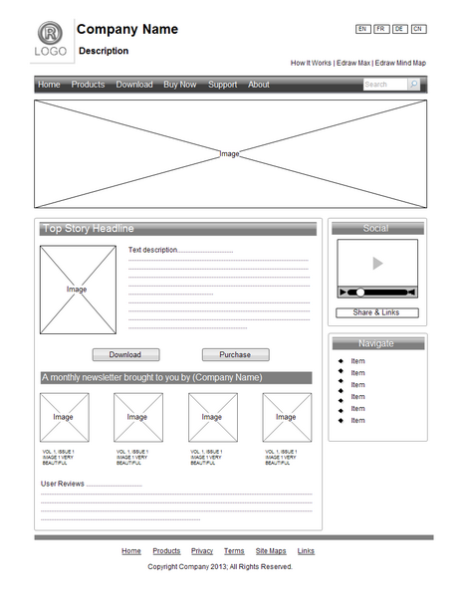
2. Website Building Evaluation
Professional Layout and Design
Creating a wireframe.
Deciding on a colour scheme.
Presenting every component as clearly as possible.
Responsive to Mobile Devices
The number of users passed 4 billion at the start of 2018.
Blog Integration
Increases chances of appearing on search engines.
Increases data traffic .
Increases social media presence.
https://www.edrawsoft.com/images/chart/wireframe.png

Slide 5
E-commerce Integration
Sell products world wide.
Provide products any time of day.
Analyse and understand useful information.
E-mail Marketing Integration
Building an email list
  Online Services – OptinMonster (https://optinmonster.com/)
  Offer discount codes, newsletters, giveaways etc.
Allowing Non-Technical Personnel Access to Update the Site via a GUI.
Use a template or blog-based site.
  Allows user to make changes to the colours, fonts and graphics.
  Provides basic functions like contact forms and social media links.

Slide 6
No Hosting Maintenance Required.
Hosting a site is very costly and involves a lot of work.
Many hosting services available that host and manage sites.
Making the Site Suitable for a Small-to-Medium Enterprise (SME)
Description of the business aims and who they are.
Suitable, simple web address.
Easy-to-use navigation
Clear contact information
Secure Hosting Platform

Slide 7

3. Website Design
Link to my website:
http://seamushillen.co.uk/149357
Notes:
=

Slide 8
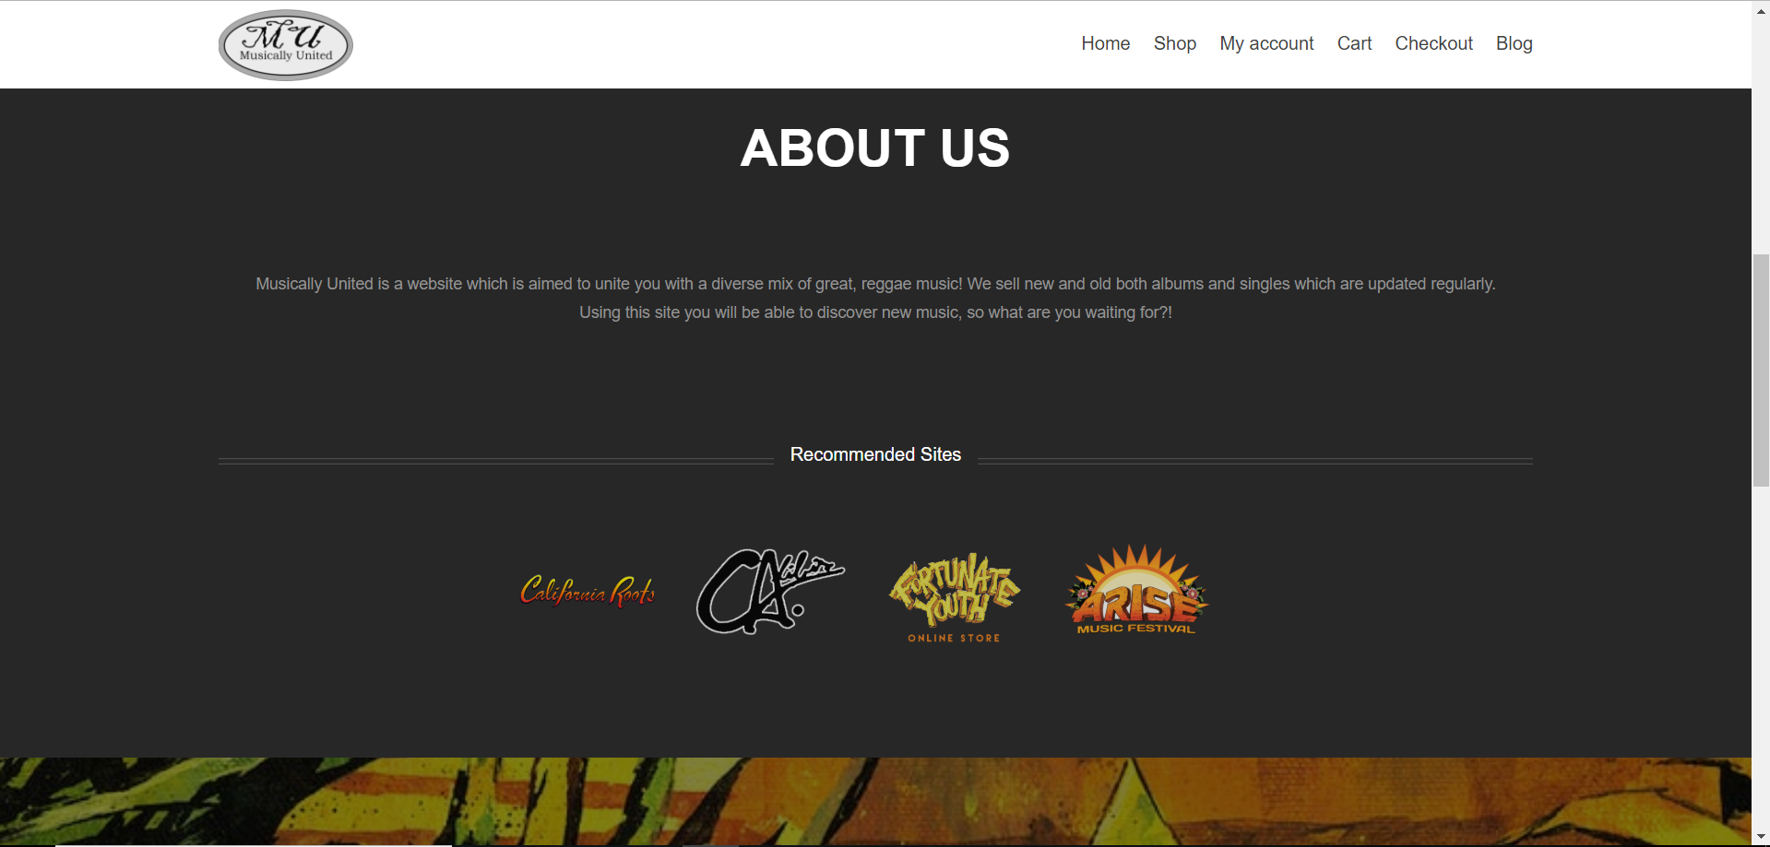

Slide 9
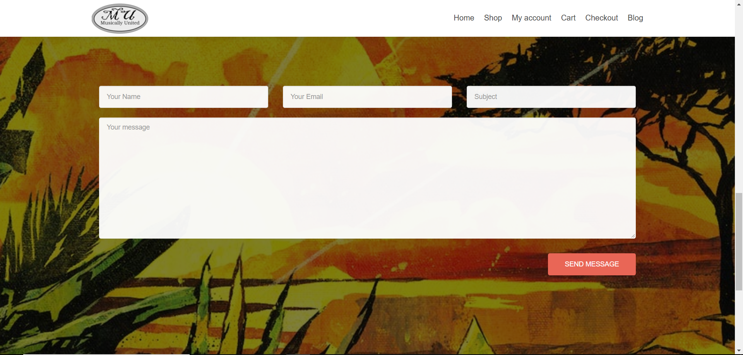

Slide 10

3.1. Website Design: Graphics & Conclusion

Slide 11
4. Online Marketing
4.1. Online Marketing Options
Posting Strategies – Increases chances of reaching more users..
Social Media Management – Increases the businesses popularity and customer loyalty..
SEO – Increases chances of appearing on a search engine.
Ads – Use services like Facebook Ads and Google AdWords to reach potential customers.

Slide 12
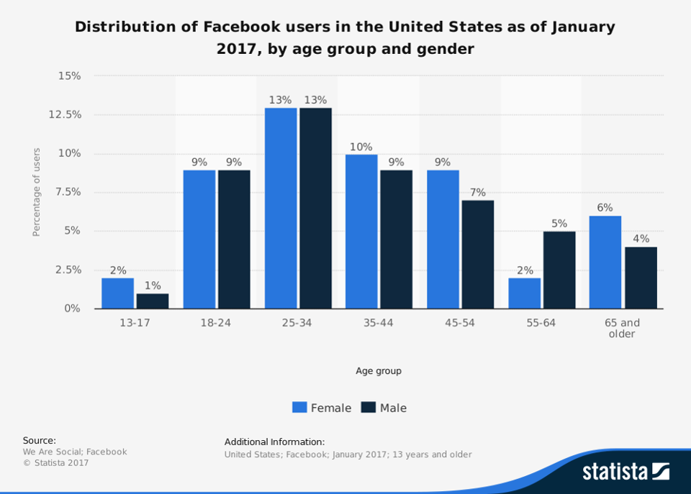
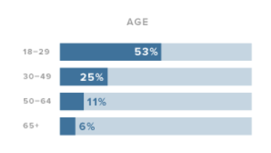
4.1.1. Online Marketing Options: Social Media Platforms
Distribution of Instagram Users by Age
https://www.lyfemarketing.com/blog/wp-content/uploads/2018/01/best-social-media-platforms-Instagram.png
https://www.lyfemarketing.com/blog/wp-content/uploads/2018/01/best-social-media-platforms.png

Slide 13
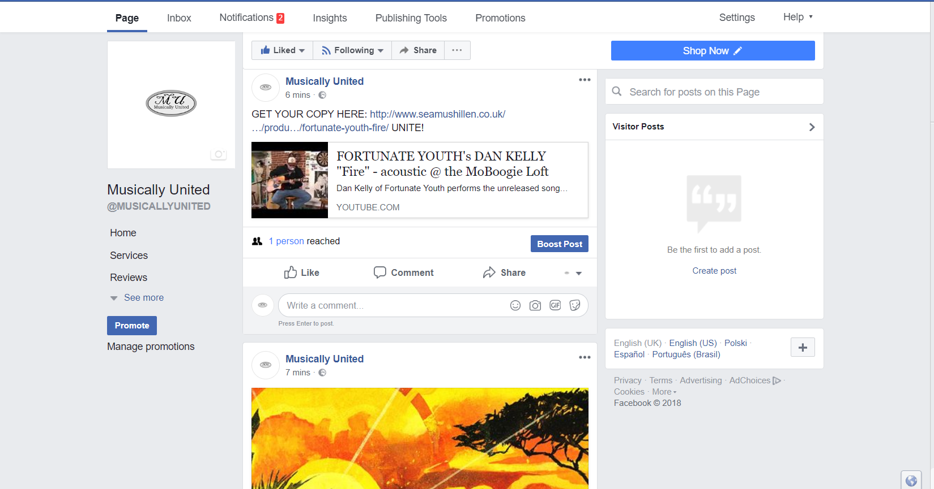

4.2. Online Marketing Strategy
Shop Now button
Post

Slide 14
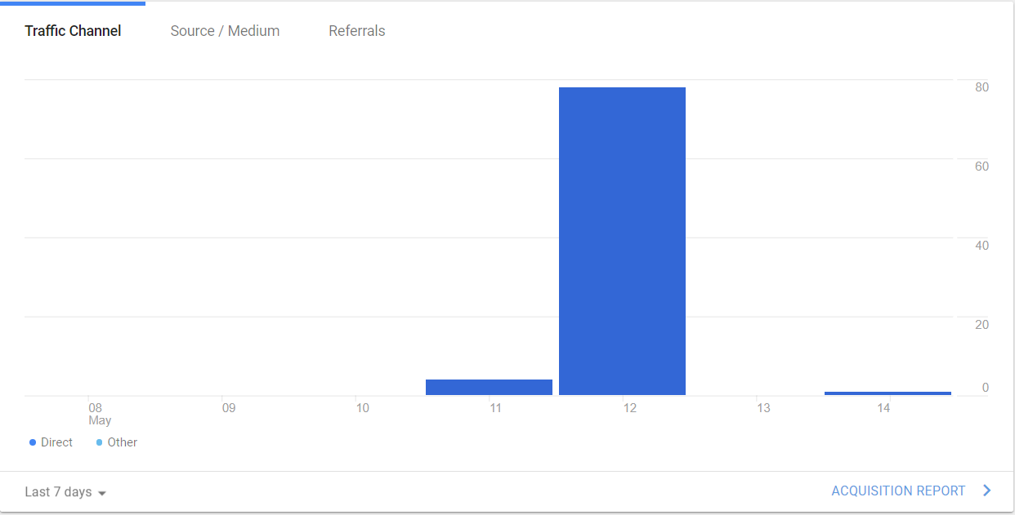
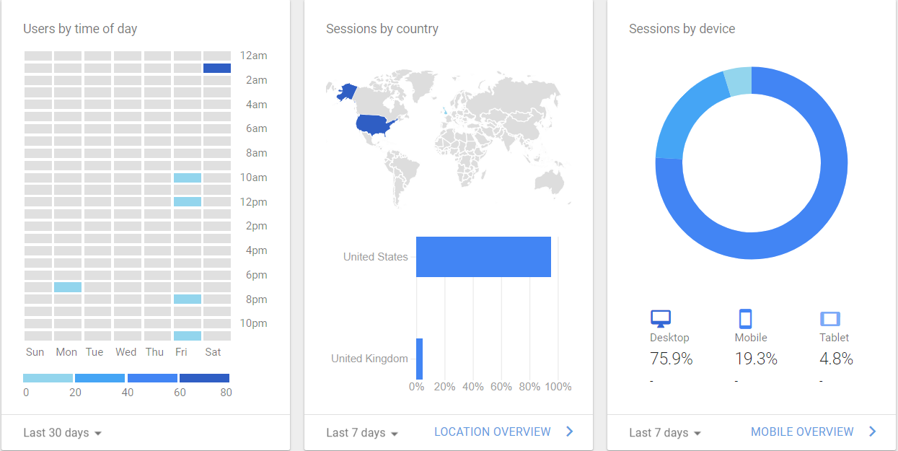
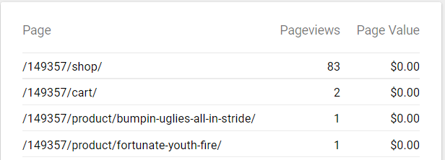
4.2.1. Online Marketing Strategy: Analytics Summary

Slide 15
Any Questions?

