Slide 1
Law of Succession and Administration of Estates
Week 7 Mutual and Mirror Wills

Slide 2
Joint/Reciprocal Wills
Two parties may make wills leaving their estates to one another.
Be clear on types and terminology and ensure understanding of the different types
Be prepared to reflect on the value of each type of will
Three types:
  Joint
  Mirror
  Mutual

Slide 3
Joint wills ( very rare)
Single documents which are executed by more than one person and involve having two people’s wishes in one Will.
Usually made by a married couple or those in a committed long term relationship but the parties don’t have to be in a ‘relationship’ of that type. Could be made by friends or with other family members or a business partner
Under a joint will, the survivor inherits the whole estate when the other person making the will dies. However these are single documents – but do provide for separate distribution of property on the death of either party.
Effect: Any changes to a joint will need the agreement of both partners. So, when the first T dies the survivor can’t make any changes to that will.
Such wills tend to be rather long and complex and are not usually recommended unless the parties’ financial matters are relatively simple, there aren’t many beneficiaries and the parties are in total agreement about how the estate should be distributed.

Slide 4
Mirror Wills
Mirror wills are prepared for two individuals (usually spouses, civil partners or cohabiting partners) in which the individuals have the same or very similar wishes.
Wills tend to be prepared at the same time, and the provisions in both wills very closely mirror each other (hence the term).
With mirror wills both parties are free to change their wills at any time.
Two parties make wills leaving their estates to one another. • Typically, if one party wants to change their Will they would be at liberty to change their Will without notice to the other party. “Just trust me” wills
Elements of the doctrine first articulated in the English case 1769 in Dufour v Pereira, which was rediscovered and preserved in 1797 in Lord Walpole v Lord Orford.

Slide 5
Mutual Wills
Two parties make wills leaving their estates to one another.
The parties agree to not change their Wills without consent from the other party.
Why? Because otherwise, the concept of testamentary freedom and the power to revoke and change a will during a testator’s lifetime can cause concern when financial ties are present and one party considers themselves dependent on the other or wishes to protect the interests of other dependants into the future.
The doctrine of mutual wills developed so that parties who want to make wills in very similar terms are able to agree not to revoke or change provisions after the first of them dies.
In effect, when the first of them dies, the law will impose a constructive trust on the survivor, which will take away their freedom to make a new will and break the agreed provisions.

Slide 6
Mutual Wills - effect
The survivor of the parties to the agreement cannot, after the death of the first party, be allowed to depart from the arrangement. Any new will is admitted to probate, but equity imposes a constructive trust on the personal representatives (PRs) to give effect to the terms of the agreement. The trust becomes binding once the first testator dies while the mutual wills are still in force. This is known as the crystallisation of the trust.
While both parties are alive, the relationship is founded upon contract and the arrangement can be ended unilaterally, with or without notice to the other, for example, by revocation of the will as in Stone v Hoskins [1905].

Slide 7
Mutual Wills : the principle as described in Stone v Hoskins (1905)
“Where two persons have made an arrangement as to the disposal of their property and then executed mutual wills in pursuance of that arrangement, the one of them who predeceases the other dies with the implied promise of the survivor that the arrangement shall hold good; and if the survivor, after taking a benefit under the arrangement, alters his will, his personal representative takes the property upon trust to perform the contract, for the will of the one who has died first has, by the death, become irrevocable.
But, on the contrary, where the one who dies first has departed from the bargain by executing a fresh will revoking the former one, the survivor, who has, on the death of the other party to the arrangement, notice of the alteration, cannot claim to have the later will of the deceased set aside or modified, either by way of declaration of trust or otherwise.”

Slide 8
Mutual Wills – evidence of agreement
The agreement must be evident – an agreement cannot simply be inferred from mirror wills. Must be CLEAR evidence of the agreement.
“To enforce a mutual will there has to be clear evidence on the balance of probabilities that there has been agreement between the two parties to dispose of their property in a similar way in mutual wills” (per Nourse J in Re Cleaver [1981]).
In Re Oldham [1925] Astbury J stated that “the fact that the two wills were made in identical terms does not necessarily connote any agreement beyond that of so making them”.

Slide 9
Difference between mutual and mirror wills
A testator is free to change a mirror will at any time, with or without notice to the other person.
However, if the will is a mutual will the testators enter into an agreement not to revoke or change their wills subject to the terms agreed between them, and should one die the agreement becomes irrevocable as it is no longer possible to either give notice of change or agree to change the wills.

Slide 10
Mirror Wills vs Mutual Wills
Mirror Wills
Mutual Wills
No binding Agreement re: disposition of property.
Surviving party can change their Will before or after the death of the other party.
If survivor changes their will, equity would not intervene to ensure the survivor keeps their promise.
Binding written or oral Agreement re: disposition of property.
Surviving party cannot change their Will before or after the death of the other party.
If survivor changes their will, equity would intervene to ensure the survivor keeps their promise

Slide 11
The implications of a mutual will
Numerous issues with mutual wills.
The constructive trust imposed on the survivor does not take into account changes in circumstances after the first has died (e.g. the survivor remarrying and/or having more children).
The assets of the trust are not ring-fenced and the survivor is free to dispose of them as they see fit.
If the terms of the agreement have not been clearly recorded it may be challenging to determine what assets are the subject of the constructive trust. Is it limited to the assets of the first to die, or the joint assets held when the first dies?
Over time the assets of the trust may become intermingled with assets added after the first to die.
Not always apparent from the face of the will that the parties have entered into an agreement and the wills are mutual.

Slide 12
The implications of a mutual will
Because of problems that are inherent with mutual wills, creating will trusts are seen as the preferred option. The terms of the trust are clear and on the death of the first, it is the trustees’ duty to ensure assets the subject of the will trust are transferred into the trust and held on the terms of the trust so they cannot be dealt with by anyone else.
TASK: What is a will trust? What does this mean? Write a paragraph explaining what is meant by a will trust and provide an example.

Slide 13
Task
Read the case of Legg and Another v Burton and Others [2017].
Why did the judge come to the conclusion that the wills were mutual wills instead of mirror wills?
What could the lawyer who prepared the wills have done to ascertain the situation with the clients when taking their instructions?

Slide 14
Legg and Another v Burton and Others [2017]
Judge came to a decision that the wills were made subject to an agreement not to revoke without giving notice to the other.
This existence of a mutual will was not apparent in the will. In fact, the will was drafted to suggest that no agreement was in place at the time they were made.

Slide 15
Practical Point on mutual wills
Instructions to create mutual wills are uncommon, because the creation of a will trust is more effective and certain.
Mutual wills can cause issues to arise in the future and some firms will deem them high risk because they can lead to litigation: some firms have policies that they will not prepare mutual wills.
If involved in the preparation of mirror wills, checks must be made to ensure there has not been any discussion as to whether the survivor can change their will at any time and detailed attendance notes must be made and kept.
A mutual will should refer to the existence of the agreement and preferably record the terms of that agreement in the will. That alleviates concerns about the agreement becoming separated and lost over time.

Slide 16
Practical Point on mirror wills
In contrast, if preparing mirror wills it is a good idea to record in the body of the will that while the terms may be similar with each other there has been no agreement between the testator’s not to revoke.
E.g: “Although this will is in similar terms to the will of [ ] there is no agreement between us not to revoke or change our-wills. I am free to revoke or change my will at any time.”
The clause also serves as a reminder that the parties are free to change their wills at any time when sending the draft to the client.
Again detailed notes must be made and kept of advice given and responses to that advice The note may become very important if a dispute arises as to whether a will is mirror or mutual

Slide 17
Avoiding Litigation
Legal adviser must:
  Ask questions to determine whether they are able to represent both spouses;
  Assess whether spouses need independent estate planning/financial/legal advice;
  Discuss the ‘true intentions’ of the parties;
  Take copious contemporaneous notes;
  Assess whether an alternative to reciprocal wills would be more appropriate in light of the client’s expressed wishes

Slide 18
Question
Do you think there is still a place for mutual wills in today’s society?
Set out your reasons for and against this doctrine?

Slide 19
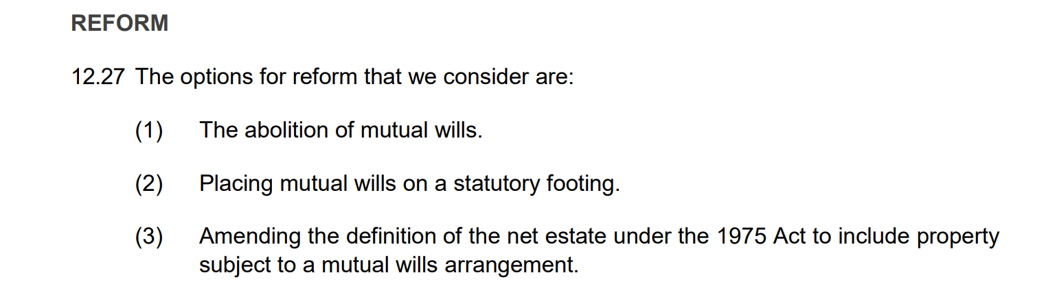
Law Commission, Making a Will
(Consultation Paper 231, July 2017) Ch 12

Slide 20
Any questions?

