Slide 1

Dellmen Premier Equestrian Estate LTD
BUSINESS PLAN
University of wales Trinity Saint David
ThePhoto by PhotoAuthor is licensed under CCYYSA.
Student : Caroline Beatrice Dellmén
student number :2430925​
Lector : DR Charles owen ​
Course : LCLM4006
Enterprise and Entrepreneurship

Slide 2
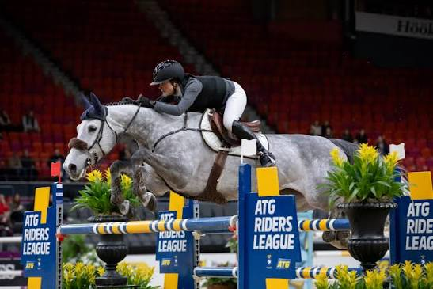
TABLE OF CONTENTS
Business Description
Market Analysis
Management
Finances
S.W.O.T. Analysis
The End /Questions /References

Slide 3
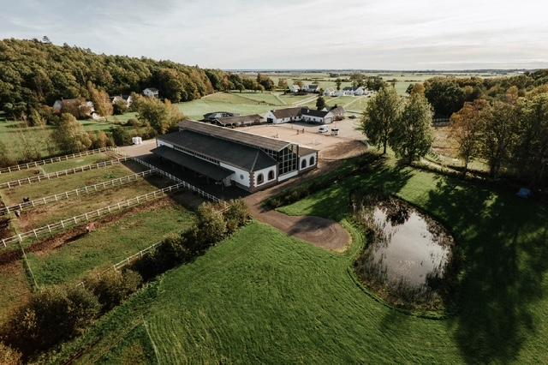
BUSINESS DESCRIPTION and Facilities :
Caroline Dellmén and Dellmen Premier Equestrian Estate LTD, will be a moderately and a professional sized equestrian yard with facility that provides professional horse livery care,horse training, and riding instruction services.
¤ 40 stable horse barn with contract for professional horse owner
¤ outdoor and indoor arena., fence the entire property,
¤ gym for staff and horse owners, premises for a veterinary , masseur, chiropractor and farrier sale of horse feed,
¤ spa resort for competition horses,
¤ 5 apartments will be built (above the indoor arena ) for horse owners have the opportunity to rent.

Slide 4
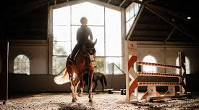

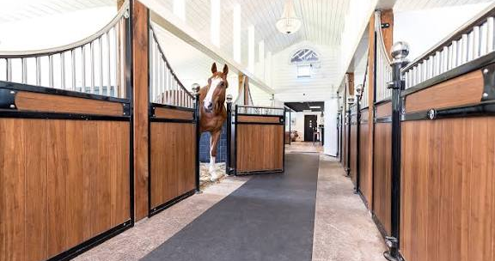
The Market :
¤ 850,000 horses with around 374,000 horses owning in horse industry.
¤ Advertise our horse business through the use of a website, Facebook/ Instagram page, and of course good reputation and network
¤ Advertise with regular trainers internationally and nationally to maintain a high standard of our business, this will also provide good customer service.
ThePhoto by PhotoAuthor is licensed under CCYYSA.

Slide 5
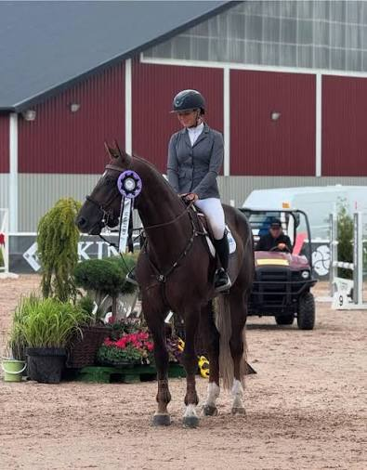

Management Owner/responsible as well as CEO , will be Caroline Dellmén, together with 2 full-time grooms, we will run the yard and its operations as a professional team. The grooms will have a riding diploma and a groom education.
We have been in the horse industry for 35 years and together worked for over 18 years in building construction and the HVAC industry, so this is a good and profitable business and combination.

Slide 6
Finance : The main source of income is expected to come from full-service livery , per horse and month we charge 1500 pounds which is a fixed source of income.
Investment calculation /budget and startup loan cost calculation for start of business and construction of stage 1
= +203 530 :- inclusive VAT
Loan | 700 000 :-
Construction of stables | 82 000 :-
Fertilizer container horse system | 970 :-
fence for pastures | 30 00 :-
Micro water system and solar cell system | 10 500 :-
Purchase of land | 400 000 :-

Slide 7
Monthly cost estimates for income and expenses
= + 26 680 :- inclusive VAT
Loan monthly repayment 6.9% interest rate | 62 00 :-
Wages staff | 60 00:-
Fixed income 40 stalls x1500 | 60 000:-
variable income extra sales of shipyard facilities | 30 00:-
Feed , shavings , hay 120/horse | 48 00:-
tax, insurance, Nj | 42 %

Slide 8
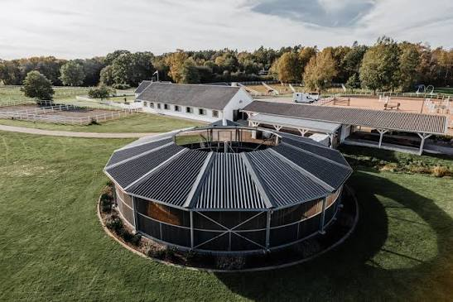
Swot analysis
Opportunities | Threats
¤ Modernising and elevating the equine industry in the UK. ¤ a business plan that is unique in the south of england on the market. ¤ make money and have a growing business. | ¤ Economy ¤ Weather ¤ Suppliers
Strengths | Weaknesses
¤ 35 years of work experience in the horse industry and 19 years of work experience in construction HVAC, ¤ large contact network in the construction industry and the horse industry . ¤ Professional showjumping rider ¤ Passion for horses and horse well-being | ¤ to find the best loans, investors and funds for the business. ¤ income that defaults if contracts are not fulfilled, (customer shortage)

Slide 9
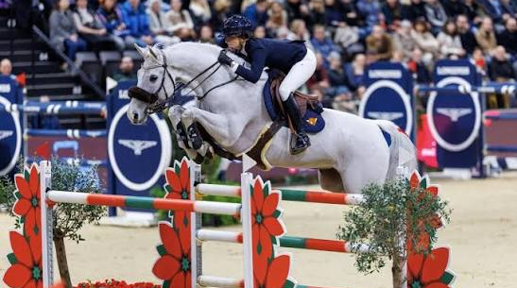
TheEnd
Questions ?
Reference
https://www.msd-animal-health.co.uk/species/horses/ Data from the National Equestrian Survey 2019 , MSD Animal Health

