Slide 1
Reply to “Performance of Greek-Roman Artillery”
William Edwards 2004219

Slide 2
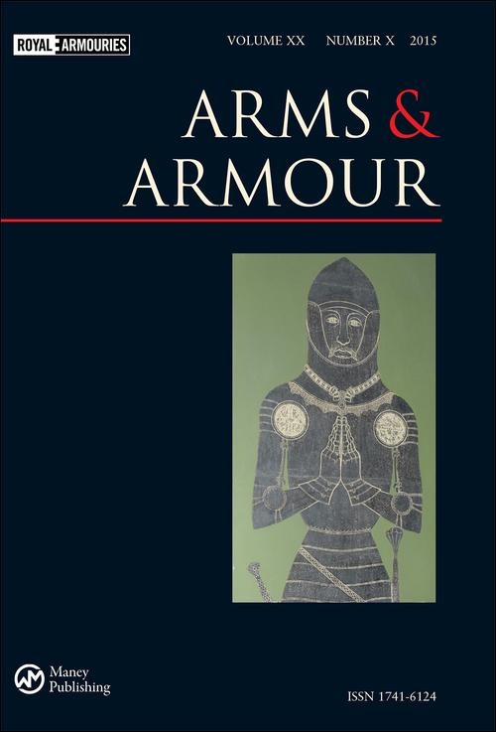
Article
Title - Performance of Greek-Roman Artillery
Author(s) - Cesare Rossi, Sergio Savino, Arcangelo Messina, Giulio Reina
Published - 9th April 2015 by Maney Publishing
Journal - Arms and Armour, Volume 12, issue 1, pages 67-89
Its a journal of the Royal Armouries, which is the UK’s national organisation for the collection of weaponry and armour across British and world history.
Unknown photographer, Historical-Weapons [online] <https://historical-weapons.com/en-arms-armour-journal-royal-armouries-ru-arms-armour-zhurnal-korolevskoy-oruzheynoy-palatyi/>

Slide 3
Point of the Article
The entire point of the article is to give a run down of ancient artillery, as the title would suggest
It gives detailed examples of how each instrument would work, as well as graphs depicting the accuracy, range and science behind them
Performance is never specified if it is in regard to mechanical capabilities, combat prowess or some morale/psychological effect.

Slide 4
Ballista
The article points out that the original ancient terminology for ballistas and catapults is reversed during the middle ages, so ballistas throw balls, catapults launch darts
Euthytone ballista
Medium sized
Could lob a 4kg rock at 95m/s (200+mph)
At 30 degrees angle, it can hit targets just shy of half a kilometer
Its small size would allow it to be wielded as field artillery in support of infantry
Pallintone ballista
Of a larger size
Can throw a 21kg rock at 118m/s (260+mph)
At 30 degrees angle, it can hit targets 785m away (projected ability), with a arc ceiling of 137m
Although their battlefield implementation is not specified, it is likely that the Pallintone would have been used almost exclusively as a siege weapon. Whereas the Euthytone was far more versatile in its employment

Slide 5
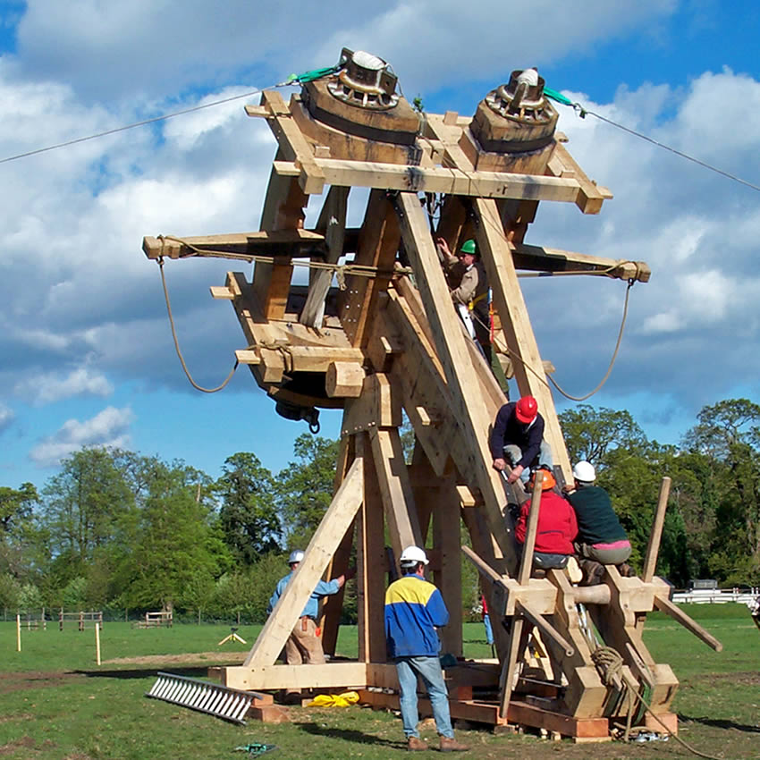
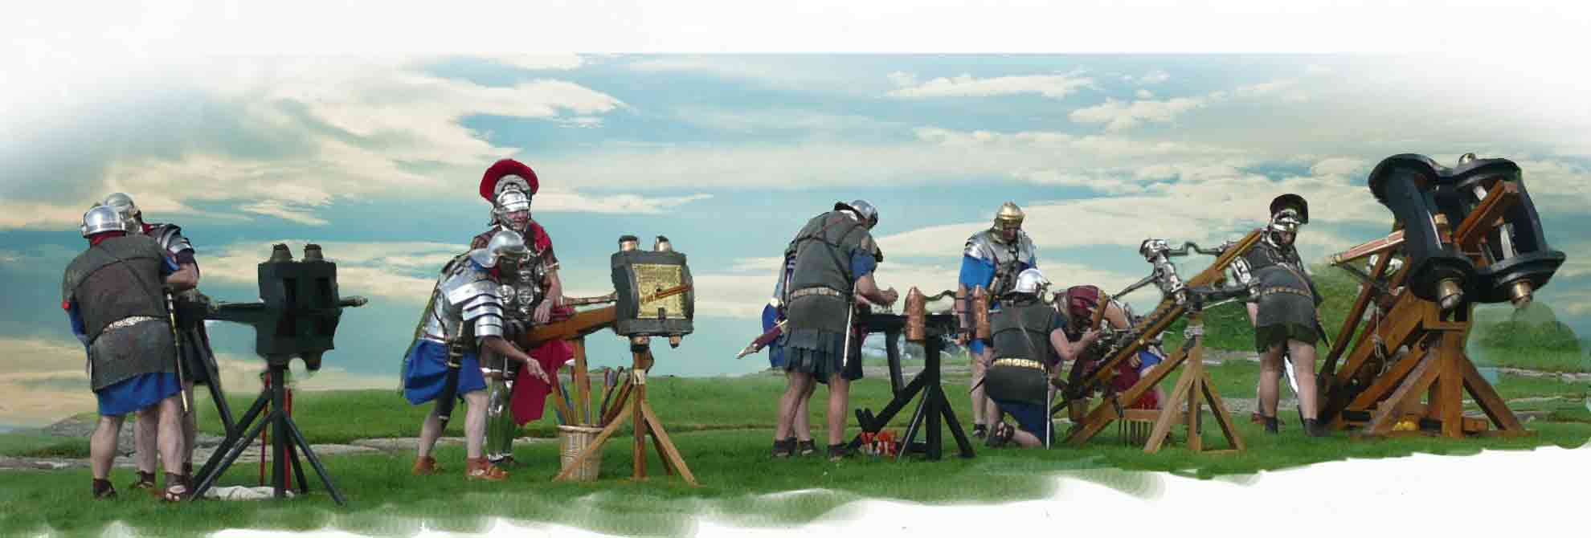
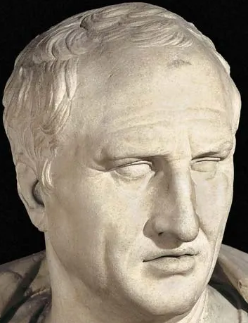
Examples of Ballista
The Roman Military Research Society 2013 Roman Artillery <http://www.romanarmy.net/artillery.shtml> [Accessed 7th March 2023]
CarpenterOakWoodland.com BBC Ballista built by Wilkins & co <http://wattsunique.com/blog/page/3/> [Accessed 7th March 2023]

Slide 6
Catapults
As these are bolt throwing weapons, and their use against fortified emplacements is….unlikely; these things would have been used to ruin some poor sod’s day by turning him into an impromptu Shish Kebab.
Repeating Catapult
“Ancestor of modern machine guns” (Rossi et al, 2015 p.76)
Had a range of up to 300m
In use since at least 3rd Century BCE
481mm long bolts
Attributed to Dionysus of Alexandria
Carroballista
Developed in the 1st Century CE
“Infantry support weapon” (Rossi et al, 2015 p.81)
Each Roman legion had 24 of them
Mounted on carts

Slide 7
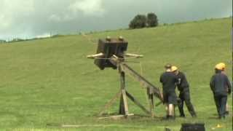
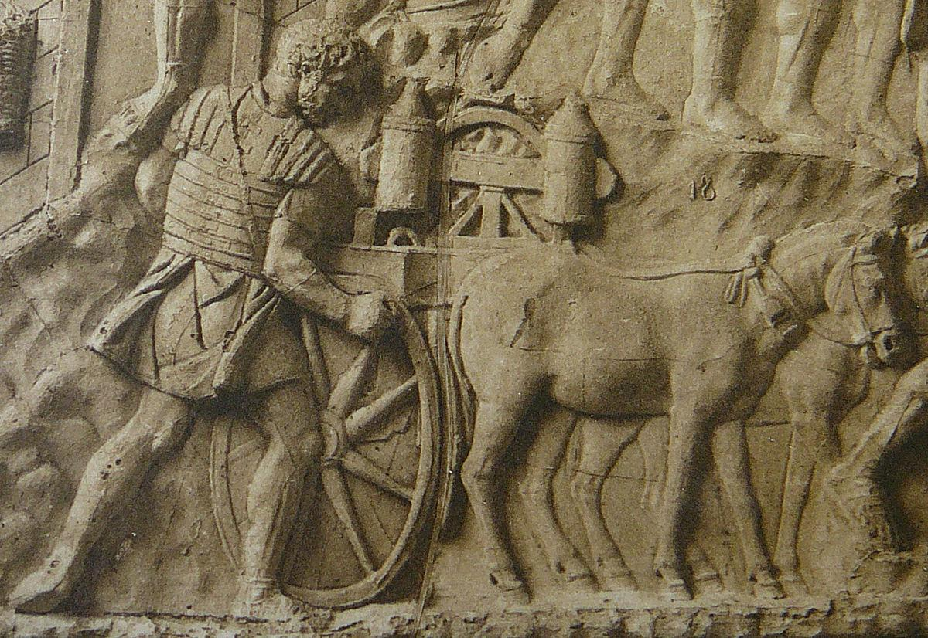
Examples of Catapults
Conrad Cichorius 1896 ‘Die Reliefs der Traianssäule’ <https://commons.wikimedia.org/wiki/File:046_Conrad_Cichorius,_Die_Reliefs_der_Traianssäule,_Tafel_XLVI_(Ausschnitt_01).jpg> [Accessed 6th March 2023]
Tod’s Workshop, Huge Roman Ballista Catapulta - Tod's Workshop TV job, Video, Youtube, 27 Jan 2013, <https://www.youtube.com/watch?v=CgNlPOMOps0> [Accessed 4th March 2023]
Skip to 6:40

Slide 8
Positives of the article
Rossi and colleagues have provided a beautifully intricate portrait of the mechanical processes of artillery, providing a plethora of examples
The graphs and diagrams are clearly laid out, with plenty of keys to allow the less engineer inclined among us to understand the mechanisms with ease
From an engineering point of view, it’s a dream come true

Slide 9
Problems with the article
Far too clinical, brutally scientific in its discussions of ability, and more weight is put onto the technical side of things rather than their implementation
Their equivocation of the repeating catapult being “...among the ancestors of modern machine guns, a truly automatic weapon” seems problematic and a bit anachronistic.
Not much is to be said regarding the psychological impact of the weaponry, it’s a very cut and dry piece that does lack charisma in keeping the audience engaged, being more akin to a statistical manual or instructions rather than a historical critique of performance
Its evaluation of the topic seems to be neglected, especially in the conclusion,

Slide 10
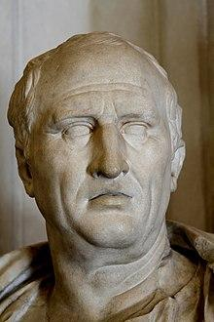

Slide 11
Bibliography
Vitruvius 20s BCE, De Architectura trans. Morris Hicky Morgan
Cesare Rossi, Sergio Savino, Arcangelo Messina, Giulio Reina 2015 ‘Performance of Greek-Roman Artillery’ Arms and Armour <https://www.tandfonline.com/doi/full/10.1179/1741612415Z.00000000050>
E. W. Marsden 1969 Greek and Roman Artillery: Historical Development Clarendon Press, 1999 Edition
E. W. Marsden 1972 Greek and Roman Artillery: Technical Treatises Oxford University Press
Michael Pitassi 2011 Roman Warships Boydell Press <https://www-jstor-org.ezproxy.uwtsd.ac.uk/stable/10.7722/j.ctt81h42>

