Slide 1
AHAN5007
The Body, Culture and Society
Symbolism, Belief and Healing

Slide 2

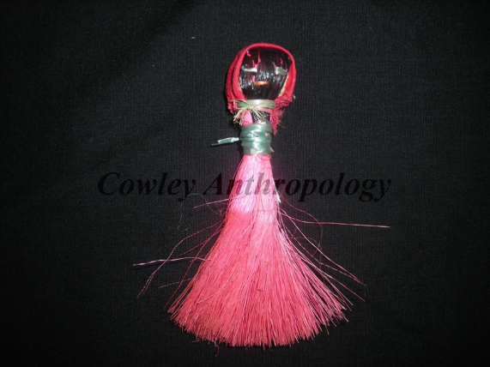
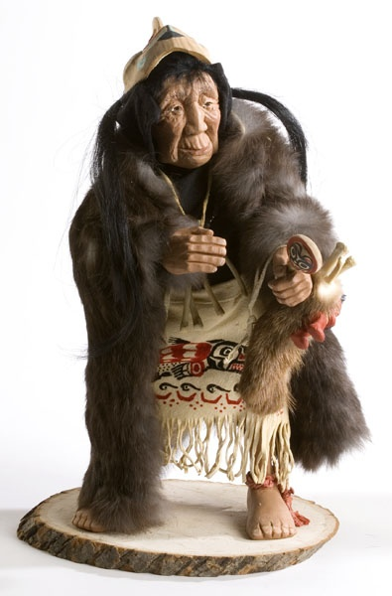
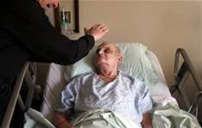
Symbols in Healing
Belief is reinforced during the ethnomedical healing process by the use of symbols
By manipulating the symbol, the practitioner symbolically treats the illness
Treatment experienced through belief
The body also responds accordingly

Slide 3
Belief and Healing
It is clear that belief plays a crucial part in healing, but how does this come about?
Whose belief?
  of the practitioner, in the efficacy of his or her techniques
  of the patient, in the efficacy of the practitioner
  of the social group

Slide 4
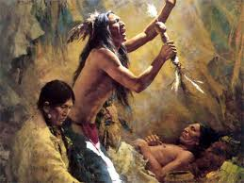
Lévi-Strauss – The Sorcerer and His Magic (1963)
Quesalid’s feather
Cuna Indian shamans’ incantations to facilitate difficult childbirth
Symbols work because they correspond in structure with an underlying reality.

Slide 5
The Placebo Effect
An inactive substance given as medicine producing a healing effect
Suggested explanations:
  Release of endogenous opiods
  Reduction of stress, restoring the body to more optimal functioning
  Seems to relate somehow to interpretation of stimuli and expectations
  ‘Meaning response’ (Moerman)

