Slide 1



UNIT 3: COHABITATION AND CO-OWNERSHIP
Contents
Cohabitation of the family home Routes to establishing a beneficial interest
Express declarations of trust
Implied trusts Resulting trusts Constructive trusts
Notes:
Today's topic examines one of the most important and practically significant areas of modern land law: disputes concerning family homes and cohabiting couples.
Traditionally, land law assumed ownership would generally be clear from title documents. Modern family arrangements are often more complex. Many couples purchase property together without marriage, while others live in homes owned legally by only one party.
The central question throughout this lecture is:
How can a person establish a beneficial interest in a family home when they are not necessarily recognised as a legal owner?

Slide 2

UNIT 3: LEARNING OUTCOMES
Identify key property law routes to establishing a beneficial interest in
legal estates
Explain the benefits of an express declaration
Explain how a beneficial interest might be established via implied trusts Evaluate judicial decisions
Apply the law to a factual scenarios to advise a client
Notes:
Identify key routes to establishing a beneficial interest
Students need to recognise there are multiple routes:
Express trust
Resulting trust
Constructive trust
Explain benefits of express declaration
The strongest form of protection.
If parties record intentions formally, most litigation can be avoided.
Explain implied trusts
Where the parties fail to record intentions, courts must infer intentions from conduct.
Evaluate judicial decisions

Slide 3
ICEBREAKER: RECAPPING CO-OWNERSHIP
Match the following terms introduced in unit 2 with their definitions
1) Joint tenancy
A) One party owns the entire legal and equitable estate. No trust exists.
2) Tenancy in common
B )The parties formally record the division of their interests following the statutory formalities
3) Express declaration
C) Each party owns the entire estate syncronously. Right to survivorship applies.
4) Absolute ownership
D) Formally recording all rights and interest associated with land
5) Registration
E) The parties own a divisible (quantifiable share). Right to survivorship does not apply.
Notes:
Ask students:
Why might individuals prefer tenancy in common over joint tenancy?
Expected answer:
Protection of unequal contributions and succession planning.

Slide 4
INTRODUCING CO-OWNERSHIP
Unit 2 introduced that estates in land (freehold and leasehold) can be co-owned
When land is legally owned by more than one party, a trust is automatically created: with the parties usually (not always) holding the land for each others benefit
Trusts involve divided ownership of the estate:
Ownership of legal estate: management of the estate Ownership of the equitable estate: benefit from the estate
Type of tenancy describes how ownership of the land is shared:
Joint tenancy: each party owns the entire estate synchronously, with right to survive + four unities
Tenancy in common: each party owns a quantifiable estate + unity of possession only The legal estate can only be held in joint tenancy.
Parties can choose to hold the equitable estate as joint tenants or tenants in common. If held as joint tenants, they can sever at a later point, but not via a will.
Ideal world: all parties would resolve how they own the beneficial interest when the property is transferred But this requires that the parties contemplated division at transfer. What happens if one party moves in later?
Notes:
When land is jointly owned, a trust automatically arises.
Distinguish:
Legal Ownership
Confers management powers.
Examples:
Selling
Leasing
Mortgaging
Equitable Ownership
Confers benefit.
Examples:
Receiving sale proceeds
Occupying property
Sharing profits
Emphasise:
Legal title can only be held jointly.
The beneficial interest may be:
Joint tenancy
Tenancy in common
Exam trap:
Students often confuse legal and equitable ownership.
Equity = benefit/ beneficial interest
Four unities – possession (equal right to possess), interest (each T has same time of interest) title (interest acquired through same legal doc) time (all T acquire interest at same time) PITT

Slide 5
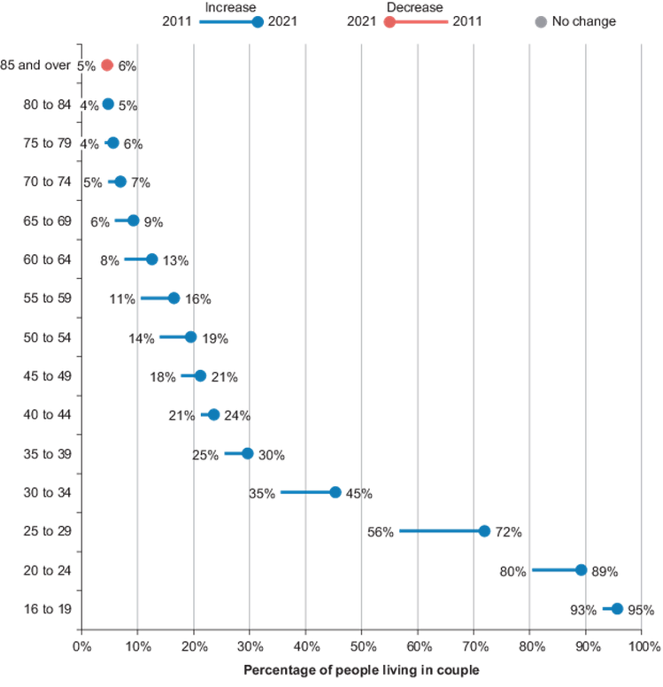
HOME OWNERSHIP IN ENGLAND AND WALES
On the increase since 1980s - upward trend: c62.5% households own their own home (2021 census, ONS)
Co-owners may be in various relationships: e.g. married, civil partners, same sex relationship – or they may just be friends/business partners.
Percentage of unmarried cohabiting couples on the rise: 24.3% in 2021, cf 20.6% in 2011.
Higher rate in younger populations
There are occasions where the property might be owned by one person who lives in the property with their partner or with
cohabitee(s).
What happens if the relationship breaks down?
Proportion of cohabiting couples from 2011 to 2021
has increased across most ages (Source: ONS, 2023)
Notes:
Should long-term cohabitants have rights similar to spouses?

Slide 6

CO-OWNERSHIP OF FAMILY PROPERTY (1)
For married or civil partner couples, who separate and wish to divide the family assets, family law solutions: in divorce or dissolution proceedings the family courts can make orders for distribution of property - and can entirely ignore who owns what in law and equity in making such orders Matrimonial Causes Act 1973; Family Law Act 1996; Civil Partnership Act 2004
However, the courts have no such powers for for non-married/non-civil partnership couples, cohabitees, or non-related co-owners (or in fact married couples/civil partners who do not divorce/dissolve)

Slide 7

CO-OWNERSHIP OF THE FAMILY HOME (2)
Unmarried cohabitants must turn to property/land law to determine distribution on separation.
Where the parties have formally recorded the distribution, this will serve as conclusive evidence: Goodman v Gallant [1986] Fam 106 But, if the parties have not recorded their interests, the parties may need to turn to other property law (trusts) mechanisms to resolve the distribution - especially problematic where one party moves in after purchase
Until a family relationship breaks down, the parties may not have
given a great deal of thought into distribution of their beneficial interest. So the may never have thought about:
Whether each party has a beneficial interest in the family home
How that interest is quantified
Notes:
Goodman v Gallant 1986 A valid express declaration of trust is conclusive evidence of the parties' beneficial interests in property.
This means courts usually will not investigate:
Contributions
Fairness
Relationship history
where a valid declaration already exists.
Land law values certainty over fairness.
Ask:
Why might parties fail to create an express declaration?
Common answers:
Lack of legal advice
Relationship optimism
Cost concerns

Slide 8
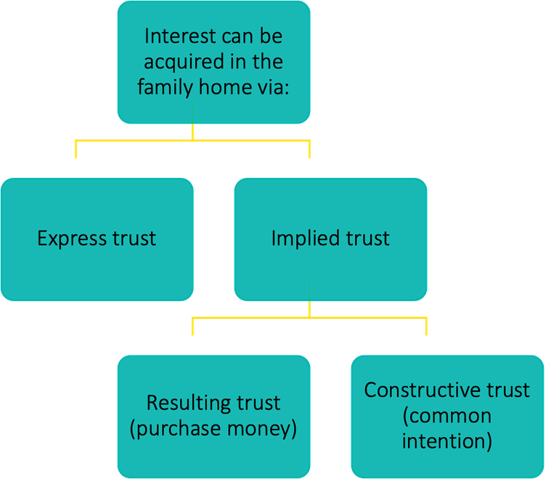
TRUSTS AND INTERESTS IN THE FAMILY HOME
Various routes through which an interest in the family home can be acquired.
Implied trusts are not easy to establish: typically involve expensive litigation
Parties always well advised to agree distribution during relationship,
via an express trust (conclusive)
If no express trust, can seek to establish an interest via an implied trust
Burden on claimant (person trying to establish an interest) to prove
their case on balance of probabilities
Starting point: judges assume equity follows law Difficult burden to overcome: weaker party
In practice: parties advised to negotiate, and only instigate
proceedings where benefit obtained will outweigh costs of litigation
Notes:
Without an express trust:
The claimant bears the burden of proof.
Standard:
Balance of probabilities.
Starting assumption:
Equity follows the law.
Therefore:
Sole legal owner presumed sole beneficial owner.
Joint legal owners presumed joint beneficial owners.
litigation risks:
Witness evidence
Documentary evidence
Expensive expert representation

Slide 9
EXPRESS DECLARATIONS
Most effective way to safeguard interest, is for parties to record that interest formally
The parties can expressly state their intention to share the interest in the property, creating an express trust. Oral agreement or unsigned written record is not sufficient for an express declaration of trust (though could be useful evidence of an implied trust)
To be valid, formalities of s53(1)(b) LPA 1925 must be followed: writing and signed by person(s) who can declare trust, or by will. s53(2) states that this section does not prevent implied trusts from being formed.
Express trust may be formed at time of conveyance (TR1) or later Where an express trust exist it will provide conclusive evidence:
that the trust exists
and how the property is held (which tenancy) and in what shares Express trust can only be challenged if:
One or all of the co-owners can prove that they have agreed to vary the trust The express trust is affected by proprietary estoppel
There is fraud, mistake or undue influence
Notes:
he strongest mechanism for protecting interests.
Statutory requirement:
Section 53(1)(b) Law of Property Act 1925
Requires:
Writing
Signature
Person capable of declaring trust
Express declarations can be contained:
Within TR1 transfer documentation
Separate trust deed
Will
Discuss advantages:
Certainty
Reduced litigation
Easier conveyancing
Challenge question:

Slide 10
EXPRESS DECLARATIONS
Parties are most likely to agree distribution at early and harmonious stages of relationship
Practitioners should encourage clients to determine how their beneficial interests should be held early: ideally when conveying the property
Most commonly in express trusts, shares are fixed, but it is possible for the trust to allow for fixing at a later date, e.g. based on actual contributions. This may seem attractive, but can give rise to uncertainty - especially around what counts as a contribution
Generally accepted as conclusive, but parties can vary at a later date by creating a new declaration of trust Wallbank and Wallbank v Price [2007[ EWHC 3001 (Ch)
Warren J in Clarke v Meadus [2010] EWHC 3117 (Ch) suggested that in theory where facts allow, a judge might look beyond the words of an express declaration, e.g. because circumstances evolved over time (as they do in implied trusts cases) or to find that an implied trust has subsequently been created. However, the courts have not yet been prepared to do so
Mummery J was very clear that recent implied trusts case law has not opened the door for an implied trust to be inferred where an express trust exists: Pankania v Chandegra [2012] EWCA Civ 1438, [28]
Parties may also consider a broader cohabitation agreement
Notes:
Court confirmed that constructive trust principles cannot normally override a valid express declaration
The proper order is:
Express declaration?
If no declaration → implied trust analysis.
Then consider resulting or constructive trust.

Slide 11
ACTIVITY 1:
Working in pairs, answer the following questions:
What is the difference between legal ownership and beneficial ownership?
What is the main advantage of an express declaration of trust?
Which type of co-ownership includes the right of survivorship?
Why are disputes more common amongst cohabiting couples than married couples?
What formality is required for an express declaration of trust?
Notes:
1. Legal ownership concerns control and management; beneficial ownership concerns entitlement to value and enjoyment.
2. It provides certainty regarding beneficial shares.
3. Joint tenancy.
4. Unmarried couples cannot rely on the same family law powers available to spouses.
5. Written evidence under s53(1)(b) Law of Property Act 1925.

Slide 12
IMPLIED TRUSTS
s53(2) confirms that the formality requirements for express trusts, do not prevent implied trusts of land from being established, despite them not meeting the formality requirements.
Two routes to acquiring an interest via an implied trust: resulting trust (typically contribution to purchase price) constructive trust (common intention)
In either type of implied trust, must differentiate between stages:
acquisition stage: where claimant needs to establish that they have a beneficial interest quantification stage: deciding the share of each beneficiary
Once party has established that they have acquired an interest in property, they can move on to prove the size of their share or ask the court to establish the size of their share
Though the main focus of this unit’s discussion is on separating couples: implied trusts have also been used in: establishing an overriding interest: LPA 1925, s7(1)(g)
defence of possession: Williams & Glyn Bank Ltd v Boland [1981] AC 487 recovery proceedings: CPS v Piper and Piper [2011] EWHC 3570 divorcing couples when negotiating a fair settlement
Notes:
What happens where there is no express declaration?
This is the reality in many cohabitation disputes.
Parties frequently:
fail to obtain legal advice;
never discuss ownership shares;
rely on informal understandings.
Where there is no express declaration, the courts may recognise an implied trust.
An implied trust is not created by an express document. Instead, ownership is determined from:
contributions;
conduct;
intentions inferred from the parties' behaviour.
There are two principal forms:
Resulting trusts
Constructive trusts
Historically, resulting trusts dominated this area. Modern family home disputes are now generally resolved through constructive trusts.

Slide 13
RESULTING TRUSTS
Traditionally, the main implied trust used to establish a claim was the resulting trust
Typically arises where one party makes a direct financial contribution to the purchase of the property, but their name does not appear on the title deeds of the property as a co-owner
Presumed that legal owner holds property on trust for person who advanced the purchase money: Dyer v Dyer (1788) 2 Cox 92: equitable ownership of the property ‘results’ to those who contributed to the purchase price.
in shares proportional to their contribution: Lake v Gibson (1729) 1 Eq Cas Abr 290
Nowadays, less commonly used in family home cases: displaced by constructive trust claims: Stack v Dowden [2007] UKHL 17
Still relevant in:
investment/commercial cases: Muschinski v Dodds (1985) 160 CLR 583
contributions from wider family members (parents): Laskar v Laskar [2008] EWCA Civ 347
Notes:
A resulting trust is based primarily upon contributions to the acquisition of property.
The traditional principle comes from:
Dyer v Dyer (1788)
The court recognised that beneficial ownership normally follows the money contributed towards the purchase.
The question is:
Who actually paid for the property?
The more someone contributes, the greater their beneficial share.
Historically this provided a simple and predictable method of calculating ownership.
However, it was later criticised for failing to reflect the realities of family relationships.
Lake v Gibson
Supports the proposition that beneficial ownership generally reflects financial contributions.

Slide 14
ELIGIBLE CONTRIBUTIONS
Types of contribution that entitle a party who is not named on the title deeds to have a beneficial interest are:
cash contributions to purchase price or money raised by mortgage: Burns v Burns [1984] Ch 317.) contribution to the deposit or the legal fees: Midland Bank v Cooke [1995] 4 All EN 562) discount or reduction in purchase price (e.g. right to buy discount): Springette v Defoe [1992] 2 FLR 388; Laskar v Laskar [2008] EWCA Civ 347
Rebuttable presumption: e.g. if it can be shown either: that the money was provided for another purpose:
gift: Fowkes v Pascoe (1875) 10 Ch App 343
loan: Sekhon v Alissa [1989] 2 FLR 94
advancement: Dyer v Dyer (1788) 2 Cox 92
that an interest was intended in alternative shares: Springette v Defoe [1992] 2 FLR 388
Notes:
Contributing money does not automatically create beneficial ownership.
The court must ask:
Why was the contribution made?
Fowkes v Pascoe
Money was intended as a gift.
Therefore the presumption of resulting trust was rebutted.
Sekhon v Alissa
A payment characterised as a loan may also rebut a resulting trust claim.
Students should always examine the purpose behind the contribution.

Slide 15
CONTRIBUTIONS TO MORTGAGE PAYMENTS
Conflicting treatment of contributions to mortgage payments by the courts, but now seems resolved:
Gissing v Gissing [1971] AC 886
contributing to mortgage payments will entitle the contributing parties to a beneficial interest in the property, even if their name was not on the title deeds
Curley v Parkes [2004] EWCA Civ 1515
a resulting trust in a property purchased.... can only arise at the time of purchase, implying that financial contributions made after that do not count towards the purchase price, thus would not entitle the person who made them to a beneficial interest in the property. Contributions to mortgage payments were treated as sums paid for the discharge of the mortgagor’s obligations under the mortgage but are not part of the purchase price.
Laskar v Laskar [2008] EWCA Civ 347
mother and daughter purchasing a property together as an investment
mortgage instalments did constitute a contribution to the purchase price and that a resulting trust was established as a result
Stack v Dowden [2007] UKHL 17
mortgage instalments do constitute sufficient contribution
Notes:
Mortgage payments are often more difficult.
Gissing v Gissing
The House of Lords accepted that mortgage contributions could support beneficial ownership.
However:
Curley v Parkes
Suggested that resulting trusts arise at acquisition, creating uncertainty about the significance of later mortgage payments.
Students should distinguish:
contribution at purchase;
contribution after purchase.

Slide 16
CONTRIBUTIONS TO HOUSEHOLD EXPENSES (1)
Courts decided that contributing to family home improvements or household expenses does not give contributor a beneficial interest in family home.
Mr and Mrs Pettitt purchased a property solely using wife's money and registered in her name. During his free time, Mr Pettitt contributed by redecorating and improving the property (lawn, walls).
Mrs Pettitt initiated divorce proceedings, and husband claimed beneficial interest in property due to his contributions.
This case pre-dates Matrimonial Causes Act 1973 Key Legal Question: Whether the husband's improvement work entitle him to a beneficial interest in the property's sale proceeds?
Court of Appeal Decision:
Husband not entitled to beneficial interest from temporary work because he had undertaken in his free time.
Improvements deemed temporary (ephemeral) and not permanent: Redecoration will only last for a few years and it would be unreasonable that a spouse should obtain a permanent interest in the house in return for making improvements of this character.
No shared intention between spouses regarding beneficial interest. without agreement with wife or estoppel, no financial claim could be made by Mr Pettitt.
Husband's claim for beneficial interest fails; improvements were insufficient to establish interest in family home.
Key source: Pettitt v Pettitt
[1969] 2 All ER 385

Slide 17
CONTRIBUTIONS TO HOUSEHOLD EXPENSES (2)
1961: Plaintiff began a relationship with a married man (defendant): knowing marriage impossible.
Plaintiff gave up work to care for their first child, while the defendant covered household expenses. Defendant bought family home using cash and a mortgage when expecting their second child.
Plaintiff resumed employment in 1975: did not contribute to mortgage payments, but paid for redecoration and housekeeping.
Defendant continued covering household expenses. 1980: Defendant left the relationship.
Plaintiff sought declaration that house was held on a resulting trust for both, in shares decided by court.
Following Pettitt, at first instance, judge ruled that the plaintiff was not entitled to a beneficial interest in the house.
Court of Appeal Decision:
Couple not married, so MCA 1973 did not apply
Plaintiff did not contribute to purchase price and there was no agreement she would share beneficial interest: prima facie inference that defendant was absolute owner
Only way for plaintiff to establish beneficial interest would be for court to infer from conduct common intent (constructive trust) or if there had been substantial contributions to the household expenses that could be related to the property’s purchase
Court cannot impute common intention from 17 years cohabitation Plaintiff’s actions did not count as a substantial contribution to rhe household expenses
Key source: Burns v Burns
[1984] Ch 317

Slide 18

ACTIVITY 2: EVALUATING CASE LAW
Evaluate the decisions reached in both Pettitt v Pettitt and Burns v Burns. Contrast the differences between these cases, is it right that the court concluded in both that neither party could establish a resulting trust in respect of their family homes?
Notes:
A resulting trust arises where a person makes a direct financial contribution to the purchase price or mortgage of property.
Domestic contributions alone are generally insufficient to create a resulting trust.
Similarities
Both cases held that:
No direct contribution to acquisition was made.
Domestic contributions were insufficient.
No resulting trust arose.
Courts applied a strict financial approach.
Differences
Pettitt
Married couple
Claim based on DIY improvements
House of Lords
Focus on labour and improvements
Burns
Unmarried cohabitants
claim based on domestic and family contributions
Court of Appeal
Focus on childcare and household support
Criticisms
Why the Decisions Are Criticised
Domestic labour has significant economic value.
Both claimants contributed to the family home in practical terms.
The law disadvantaged those who contributed non-financially.
Particularly criticised in Burns, where Mrs Burns cared for children and maintained the household for nearly 20 years.
Why the Courts Reached These Decisions
The courts followed the traditional rule:
Beneficial ownership follows contributions to the purchase price.
Since neither claimant contributed directly to purchasing the property, neither could establish a resulting trust.
Remember:
Direct money = possible beneficial interest.
Domestic work alone = no resulting trust.
The decisions in Pettitt and Burns were legally correct under orthodox resulting trust principles because neither claimant contributed directly to the purchase price or mortgage. However, many academics argue that the outcomes were unfair, particularly in Burns, because substantial domestic and childcare contributions were ignored. These criticisms helped drive the later development of constructive trust principles seen in Stack v Dowden and Jones v Kernott.

Slide 19
MODERN RELEVANCE OF RESULTING TRUSTS
Resulting trusts in context of family home now play a more reduced role
For family homes seems to have given way for constructive trusts, but still relevant in non-domestic/family situations
Stack v Dowden [2007] UKHL 17, [2007] 2 AC 432 Marr v Collie [2017] UKPC 17
“[That...Where a domestic property was conveyed into the joint names of cohabitants without any declaration of trust there was a prima facie case that both the legal and beneficial interests in the property were joint and equal; that the onus of proof lay upon any party seeking to establish that equity should not follow the law; … that the law had moved on from the presumption of a resulting trust and many more factors other than the parties’ respective financial contributions might be relevant to divining their true intentions; and that when all relevant factors had been taken into account, cases in which the joint legal owners were to be taken to have intended that their beneficial interests should be different from their legal interests would be very unusual.” (Lord Neuberger, para
“If what Baroness Hale [In Jones v Kernott] described as a ‘starting point’ (that joint legal ownership should signify joint beneficial ownership) is to be regarded as a presumption, is it in conflict with the presumption of a resulting trust where the parties have contributed unequally to the purchase of property in their joint names? A simplistic answer to that question might be that, if the property is purchased in joint names by parties in a domestic relationship the presumption of joint beneficial ownership applies but if bought in a wholly non-domestic situation it does not. In the latter case, it might be said that the resulting trust presumption obtains.” (Lord Kerr, para 53)
Notes:
Modern courts generally prefer constructive trust analysis, focusing on the parties' intentions rather than simply their financial contributions.
The law had moved on from the presumption of a resulting trust."
Stack v Dowden and Jones v Kernott
Focus on common intention.
Greater recognition of family circumstances.
Financial contributions are only one factor.

Slide 20
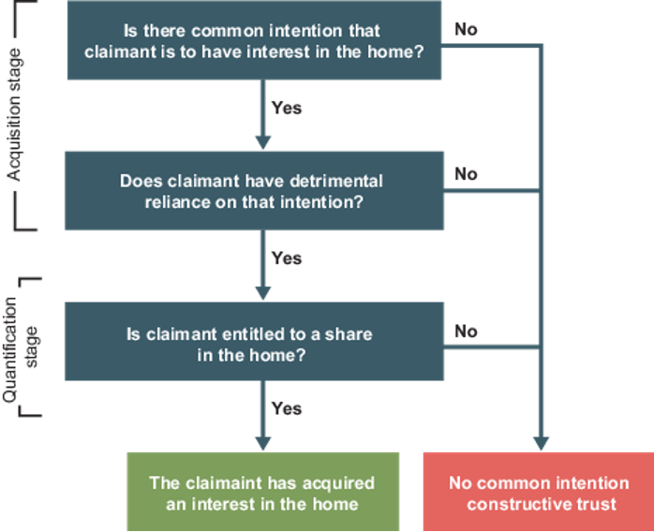
CONSTRUCTIVE TRUST
Second type of implied trust (still being developed) Claimant can establish an interest in the family home by demonstrating two things:
The legal owner and the claimant (non-legal owner) shared express or implied common intention that the claimant would enjoy proprietary interest in the property; and
That the claimant relied on this common intention to their detriment.
Two stages, but need to differentiate between cases of joint legal ownership and single legal ownership (different tests)
Identifying that a beneficial interest has been acquired
Quantifying that beneficial interest
What proportion of the property does the claimant own?
Court quantifies the beneficial share.
Notes:
Definition
A constructive trust is an implied trust that allows a claimant to acquire a beneficial interest in property even though they are not the legal owner.
It is the main modern method used by courts to resolve disputes over ownership of family homes.
Two Stages of Analysis
Stage 1: Acquisition
Has the claimant acquired a beneficial interest?
Ask:
Was there a common intention?
Did the claimant act to their detriment?
If both are proved:
➡️ Beneficial interest established.
If not:
➡️ Claim fails.
Stage 2: Quantification
What share does the claimant own?
The court determines the size of the beneficial interest by examining:
Financial contributions
Discussions between the parties
Household arrangements
The parties' conduct throughout the relationship
A common intention constructive trust arises where the parties intended the claimant to have an interest in the property and the claimant relied on that intention to their detriment; the court then determines the extent of that beneficial interest by examining the parties' overall conduct.

Slide 21

ACQUIRING AN INTEREST: JOINT LEGAL OWNERSHIP
In cases where both parties are named as legal owners, they will usually have acquired an equitable interest on conveyance Equity follows the law: prima facie evidence that joint tenants at law are also joint tenants in equity: each party owns the entire equitable estate synchronously (severable on separation)
Parties with legal ownership will have an interest automatically, unless it is shown that no beneficial interest was intended (i.e. acting as trustees only)
If the parties are tenants in common (including on severance), equality is presumed unless they have agreed otherwise
Any party who claims otherwise, bares the burden of proof
Key sources: Stack v Dowden
[2007] UKHL 17; Jones v Kernott
[2011] UKSC 53
Notes:
1. Joint Legal Owners Usually Have a Beneficial Interest
If both parties are registered proprietors:
✅ Both automatically acquire a beneficial interest.
✅ No need to prove acquisition of an interest.
The dispute is usually about the size of each party's share, not whether a share exists.
2. Presumption of Joint Beneficial Ownership
The courts presume:
Joint legal ownership = Joint beneficial ownership.
Equal ownership unless evidence shows otherwise.
Authority
Stack v Dowden [2007]
Joint ownership of the legal title creates a strong presumption of joint ownership in equity.
3. Burden of Proof
A party seeking an unequal division must rebut the presumption.
The burden falls on the person arguing that:
Shares are not 50:50; or
Beneficial ownership differs from legal ownership.

Slide 22

ACQUIRING AN INTEREST: JOINT LEGAL OWNERSHIP
Where the property is in joint ownership, but there is no express declaration of trust, following the Stack and Kernott decisions, judges will no longer assume a resulting trust arises due to the parties’ unequal contributions to the purchase price in family home
Judges will now presume equality between the parties, joint tenants in law and equity (or if already Tenants in common, held in equal shares).
The UKSC held that this:
better reflects modern practices, acknowledging that intimate couples usually demonstrate a strong “emotional and economic commitment” when purchasing property as a joint enterprise, and
obviates the practical difficulty of having to consider all of the circumstances of the relationship (the “ups and downs of living together”) in
order to determine what shares are appropriate.
Rebuttable by evidence that the parties formed a different common intention, either at purchase or a later date (Baroness Hale recognised intentions may evolve), but will only usually happen exceptionally.
Key sources: Stack v Dowden
[2007] UKHL 17; Jones v Kernott
[2011] UKSC 53

Slide 23

ACQUIRING AN INTEREST: JOINT LEGAL OWNERSHIP
Heavy burden to discharge, if seeking a different share: not to be embarked lightly and should only be pursued if gain will likely outweigh cost of litigation
Various factors will be considered in deciding whether a different share split was intended, or if the parties’ intentions had changed. These included (but not limited to) (Per Baroness Hale, in Stack v Dowden [2007] UKHL 17, para 70)
Advice or discussions at the time of the transfer which cast light upon their intentions…; the reasons why the home was acquired in their joint names;
the reasons why (if it be the case) the survivor was authorised to give a receipt for the capital moneys;
the purpose for which the home was acquired; the nature of the parties’ relationship;
whether they had children for whom they both had responsibility to provide a home; how the purchase was financed, both initially and subsequently;
how the parties arranged their finances, whether separately or together or a bit of both;
how they discharged the outgoings on the property and their other household expenses…
…The parties’ individual characters and personalities…”
Key sources: Stack v Dowden
[2007] UKHL 17; Jones v Kernott
[2011] UKSC 53

Slide 24
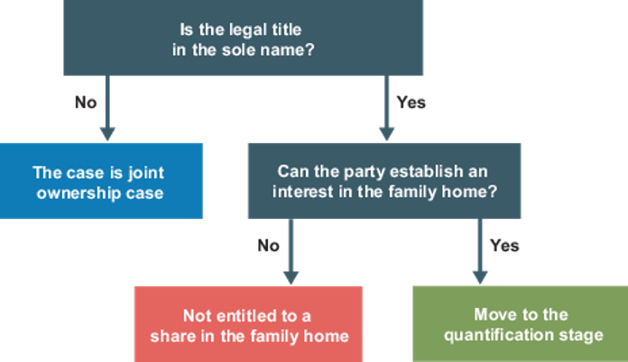
ACQUIRING AN INTEREST: SOLE LEGAL OWNERSHIP
In sole ownership cases, as equity follows the law, there is prima facie evidence that the sole legal owner is also the sole beneficial owner in equity. Jones v Kernott [2011] UKSC 53 at [10], [17], [51]
Starting point is that the claimant has no interest Anyone claiming that they have beneficial interest in the
property needs to establish an interest in the family home,
before size of share considered
Where a property is registered in the sole
legal name of one of the family members, the partner who is not the legal owner of the family home must establish that they have an interest in the property.
Notes:
In sole legal ownership cases, the non-owning claimant has no automatic beneficial interest and must first establish a common intention constructive trust before the court will consider the extent of their share in the family home.
Ask:
1. Has the claimant acquired an interest?
Common intention?
Detrimental reliance?
2. If yes, what share should they receive?

Slide 25

LLOYDS BANK V ROSSET [1991] 1 AC 107 (FACTS)
Mr and Mrs Rosset, purchased a derelict house to use as their family home, using money from the husband's family trust. The trustees required the property be registered in the husband's sole name.
Mrs Rosset agreed with the understanding that she would still have a beneficial interest in the property, despite no legal title.
The Rossets reached an agreement with the vendor to access the property and start renovation work before the sale was completed.
Mrs Rosset oversaw the redecoration work and was present most of the time to do so. Unbeknown to Mrs Rosset, Mr Rosset took out a mortgage against the property. This loan money was used to contribute towards the purchase price, alongside the trust money, and for renovation work. The charge was registered on completion of the purchase.
Mr Rosset left the home due to marital difficulties, while Mrs Rosset and their children
remained in the property.
When Mr Rosset failed to repay the bank, the bank sought possession of the property. Mrs Rosset defended against the possession claim, asserting that she had a beneficial interest in the property under a constructive trust.
Key source: Lloyds Bank v Rosset [1991] 1 AC 107

Slide 26
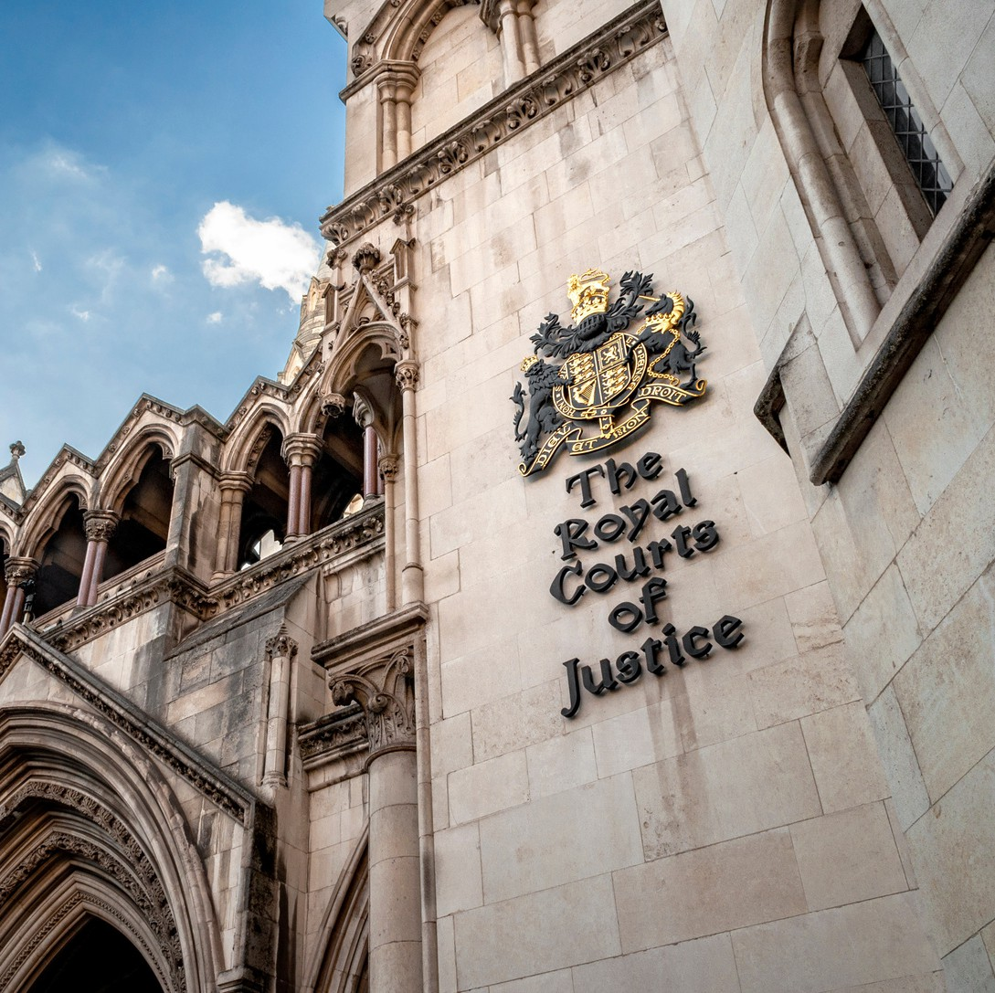
LLOYDS BANK V ROSSET [1991] 1 AC 107 (APPEAL)
The court in Lloyds Bank v Rosset needed to decided whether there a common intention between the parties to create a constructive trust Lower court found that there was a common intention to create a constructive trust by virtue of the wife carrying out all the renovation work and that she acted to her detriment. But as she was not in actual occupation of the property at the time of executing the charge, her equitable interest did not override that of the bank.
CA allowed the wife’s appeal,:
the wife was present regularly at the property prior to the execution of the bank legal charges
the judge erred in reaching the decision that the presence of the
builder in the property prior to completion was presence of an agent of the defendant.
The Bank appealed to the House of Lords.
Key source: Lloyds Bank v Rosset [1991] 1 AC 107

Slide 27
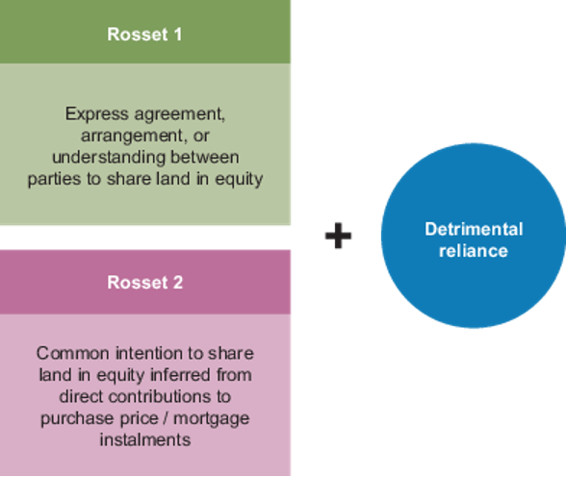
LLOYDS BANK V ROSSET [1991] 1 AC 107 (DECISION)
The House of Lords held:
For an interest in registered land to be protected, the actual occupation should take place; this should have been at the date of transfer, not the date of registration.
That the activities the wife carried out, redecoration and building work, before and up to the date of completion, were not sufficient to justify an inference of common intention to create a constructive trust. Any judge looking at such cases should have on their mind: was there evidence of express discussion capable of establishing express agreement or representation that the party, who is not the legal owner, to have interest in the property? Conduct alone is not
sufficient to establish such common intention.
Otherwise, anything less than direct contribution to the purchase price by the non-owning party would suffice.
Key source: Lloyds Bank v Rosset [1991] 1 AC 107
Notes:
Rosset is the leading authority on establishing a common intention constructive trust in sole ownership cases.
It sets out the two ways a claimant can prove a beneficial interest.
The Rosset Test
A claimant must establish:
Rosset Category 1: Express Common Intention
There is:
An express agreement;
Arrangement; or
Understanding
that both parties would share ownership.
Plus
The claimant must show:
✅ Reliance on that agreement
✅ Detrimental reliance
Example
"We may not put your name on the title, but half the house is yours."
The claimant acts on that understanding.
Rosset Category 2: Inferred Common Intention
Where there is no express agreement, common intention may be inferred from:
✅ Direct contributions to:
Purchase price; or
Mortgage instalments.
Examples
Paying part of the deposit.
Contributing towards mortgage repayments.
What Does NOT Usually Count?
According to Rosset:
❌ Housework
❌ Childcare
❌ Paying household bills
❌ DIY and renovations
❌ Decorating
❌ General domestic contributions
Lord Bridge described direct financial contributions as the clearest evidence of common intention.
Detrimental Reliance
Even if common intention is proved, the claimant must also show they relied on that intention to their detriment.
Examples:
✅ Contributing money towards acquisition.
✅ Making financial sacrifices.
✅ Acting on the belief they had an ownership interest.
Why Rosset Was Criticised
The decision was criticised because:
It focused too heavily on financial contributions.
It ignored the reality of family life.
It disadvantaged partners making domestic contributions.
It provided little protection for non-owning cohabitants.
Many academics argue that the approach was particularly harsh on spouses and partners who cared for children and the home.
Stack v Dowden and Jones v Kernott broadened the
Exam Tip
When faced with a sole ownership family home problem:
Step 1
Apply Rosset:
Express agreement?
Direct contribution to purchase price or mortgage?
Step 2
Consider modern developments:
Has Stack v Dowden or Jones v Kernott broadened the approach
What does the parties' overall conduct reveal about common intention?

Slide 28
ACQUIRING AN INTEREST: SOLE LEGAL OWNERSHIP
Since Lloyds Bank v Rosset, the HoL and UKSC have both revisited the law on constructive trusts in cases involving joint ownership (Stack v Dowden and Jones v Kernott).
In both cases, their Lordships were critical of Rosset as being dated, advocating a more flexible approach
accounting for the entire family situation, and beyond financial considerations alone.
UKSC however has not considered sole ownership cases, thus these comments are obiter, and Rosset remains binding in sole owner cases.
To establish an interest the court will (Per Chadwick LJ, Oxley v Hiscock [2004] 3 All ER 703 at 737): consider whether there is evidence of, either:
a communicated common intention or agreement between the parties (express common intention) or an agreement which can be inferred from the parties’ conduct (intention inferred from conduct)
Where there is an agreement.... whether the non-legal owner has, acted on reliance of that agreement to his
detriment.
(and then move on to consider)...quantification.
Key source: Lloyds Bank v Rosset [1991] 1 AC 107

Slide 29
EXPRESS COMMON INTENTION: SOLE LEGAL OWNER
The courts will require evidence of express discussions between the [parties].” Rosset at 132 Witness statements, including what was discussed and what was said “however imperfectly remembered and imprecise their terms may have been.” (most common evidence) Recognising the high threshold, some flexibility has been shown in finding evidence of agreement:
“Don't worry about the future because when we are married it will be half yours anyway and I'll always look after you and [the boy].” Hammond v Mitchell [1992] 2 All ER 109 at 113 Discussions relating to providing a “secure home” Savil v Goodall [1994] 1 FCR 325 at 331 Excuses for not conveying into joint names can also provide sufficient evidence:
Eves v Eves [1975] 1 WLR 1338: but for her age the house would be in joint names Grant v Edwards [1986] Ch 638: claimant told that transferring could prejudice her ongoing divorce

Slide 30
EXPRESS COMMON INTENTION: SOLE LEGAL OWNER
The courts will require evidence of express discussions between the [parties]. Rosset at 132
Any written records which may assist, or documentary records to show intention but usually do not exist Burden on claimant: harder to discharge in investment cases Geary v Rankie [2012] EWCA Civ 555, para 18 Interpret words in same manner as other contractual disputes: Marley v Rawlings [2014] UKSC 2
May be assisted by surrounding circumstances and events to weigh-up what was intended from words. Such facts may assist the court in interpreting. Some examples:
In the context of renovations: “this will benefit us both” James v Thomas [2007] EWCA Civ 1212
interpreted as they would both enjoy the property when improvements complete conditional statements:
after we marry (Ottey v Grundy [2003] EWCA Civ 1176) ,
or after I die...you will be provided for (James v Thomas). neither sufficient to establish an intereest unless the condition is fulfilled [estoppel may be more suitable remedy]
In reality, each party will present conflicting accounts, and judges must determine on balance of probabilities
Notes:
1. Express Discussions
The courts require evidence of discussions between the parties about ownership.
Evidence may include:
✅ Conversations about sharing ownership
✅ Written agreements
✅ Letters, emails or documents
✅ Clear statements indicating shared ownership
Rosset Principle
The court must ask:
Was there an express agreement or representation that the non-owner would have an interest in the property?
2. Detrimental Reliance
The claimant must show they acted to their detriment because of the agreement.
Examples:
Financial sacrifices
Contributions to household finances
Giving up opportunities
Spending money based upon the belief of shared ownership
Without detrimental reliance, the claim fails.
Interpreting Statements
The court interprets conversations objectively, looking at:
The words used
Context
Surrounding circumstances
The parties' conduct
Burden of Proof
The burden rests on the claimant.
They must prove, on the balance of probabilities, that:
The discussion occurred; and
A shared intention existed.
Authority
Geary v Rankine [2012] EWCA Civ 555
The burden can be particularly difficult to satisfy where parties later give conflicting accounts.
Problems in Practice
Common Difficulties
Few couples document ownership discussions.
Conversations often occur years before litigation.
Parties frequently give conflicting evidence.
The court must determine credibility and likelihood.
As a result, express common intention cases are often fact-sensitive.
TACTIC
Step 1
Was there an express agreement, arrangement or understanding regarding ownership?
⬇
Step 2
Can the claimant prove this agreement?
⬇
Step 3
Did the claimant rely on the agreement to their detriment?
⬇
Step 4
If yes, a constructive trust may arise.
Key Cases Table
Case
Principle
Lloyds Bank v Rosset
Express agreement + detrimental reliance can establish a constructive trust
Geary v Rankine
Burden of proving express common intention rests on claimant
Marley v Rawlings
Words interpreted objectively in context
James v Thomas
Vague statements about benefiting together are insufficient
Otway v Grundy
Conditional future promises usually insufficient
Exam Tip
For an express common intention constructive trust, always ask:
Was there a clear conversation about ownership, and did the claimant act to their detriment because of that conversation?
If both can be proved, the claimant may acquire a beneficial interest despite not being the legal owner.

Slide 31
ACTIVITY 3: SCRUITINISING EVIDENCE
Which factors might impact each party’s credibility in giving evidence? i.e. how persuasive their account might be?
Notes:
When courts decide whether an express common intention constructive trust exists, they must assess the credibility and reliability of the parties' evidence.
Factors Affecting Credibility
1. Consistency of Evidence
Has the party given the same account throughout?
Are there contradictions between statements, witness evidence, and documents?
2. Documentary Evidence
Evidence is more persuasive where supported by:
Emails
Letters
Text messages
Bank statements
Mortgage documents
Written agreements
Documentary evidence is often preferred over recollections of conversations years later.
3. Timing of the Discussion
Was the alleged agreement made at the time of purchase?
Or only raised after the relationship broke down?
Courts are often cautious about claims made long after the event.
4. Conduct of the Parties
The court compares what was said with what the parties actually did.
Examples:
Did both contribute financially?
Did they describe the property as "our house"?
Did they share household finances?
5. Independent Witnesses
Evidence may be strengthened if:
Family members,
Friends,
Solicitors,
Mortgage advisers
can confirm relevant discussions.
6. Motive and Self-Interest
The court recognises that both parties may have a financial incentive to exaggerate or minimise their contributions.
Key Point
In constructive trust disputes:
The judge must determine whose version of events is more likely on the balance of probabilities.
Where evidence conflicts, courts often place significant weight on:
Contemporary documents.
Financial records.
The parties' conduct during the relationship.

Slide 32
INFERRED COMMON INTENTION: SOLE LEGAL OWNER
If there is no express agreement, a common intention can be inferred from the parties’ conduct
Judges are generally reluctant to infer common intention as a result of conduct alone, and only do so in limited circumstances: Morris v Morris [2008] EWCA Civ 257
Where found, often serves as evidence of agreement and detrimental reliance: Lightfoot v Lightfoot-Brown [2005] EWCA Civ 201
In Rosset: only contributions to purchase price or mortgage payments (at 133) would be sufficient conduct Following Stack v Dowden, advocate a more holistic approach
Financial contributions Non-financial contributions
Not endorsed by the senior courts (as Rosset is bidning). However, shift in judicial attitudes, see that exceptionally some flexibility.
Key source: Lloyds Bank v Rosset [1991] 1 AC 107
Notes:
Where there is no express agreement, the court may infer a common intention from the parties' conduct.
However:
Courts are generally reluctant to infer common intention solely from conduct.
Authority
Morris v Morris [2008] EWCA Civ 257
Instead of relying on a direct conversation about ownership, the court looks at what the parties did and asks:
Does their conduct demonstrate a shared intention that the claimant should have a beneficial interest?
Traditional View
Rosset remains the leading authority in sole ownership cases.
Courts remain cautious about finding common intention solely from conduct.
Modern Trend
Judicial attitudes have become somewhat more flexible following:
Stack v Dowden
Jones v Kernott
However, senior courts have not completely abandoned Rosset in sole ownership disputes.
Rosset Rule
"Money in = Interest inferred."
Contribution to:
Deposit ✅
Purchase price ✅
Mortgage ✅
Housework, childcare and domestic support alone ❌

Slide 33
INFERRED COMMON INTENTION: FINANCIAL
Rosset: non-legal owner can obtain an interest through directly contributing to the purchase price or mortgage payments Payments must be “referable to acquisition of the house” Grant v Edwards [1986] 1 Ch 638
However indirect financial contributions may be sufficient where they enable the legal owner to continue paying the mortgage instalments. Le Foe v Le Foe [2002] 1 FCR 107
A contribution through a right-to-buy discount would also likely be sufficient (as with resulting)
As with resulting trusts: may be rebutted if can provide evidence, e.g. was a gift or loan. Documentary evidence to indicate intentions as to payments would assist courts.
In cases involving parents and children: judges will usually infer that parents provided gift to purchase first family home and did not intend to acquire an interest Abbott v Abbott [2007] UKPC 53
Some parents have sought to recover on their children’s separation, by claiming an interest. In the absence of written records, usually won’t succeed to persuade the court that an interest or loan was intended.
However, judges would likely consider:
the value of their contributions in relation to their wealth: Aspden v Elvy [2012] EWHC 1387 (Ch)
whether the parent(s) had made any other similar contributions, for example to their other childrenSekhon v Alissa
[1989] Fam Law 355
Notes:
A common intention constructive trust can be inferred where the claimant makes financial contributions referable to the acquisition of the property, particularly contributions to the deposit, purchase price or mortgage, although the inference may be rebutted if the payment was intended as a gift or loan.

Slide 34
INFERRED COMMON INTENTION: NON-FINANCIAL
Judges reluctant to infer an agreement on the basis of non-financial contributions, such as renovation renovation and decoration works (even where substantial); contributions through managing the home; performing domestic duties and contributions to general household expenses and raising the family. Such contributions have traditionally been attributed as merely “things…done for the benefit of the family without altering the title to the property” or actions explicable by their “love and affection.” (Probert, 2001)
Many senior judges recently have emphasised that the law has evolved since Rosset and queried whether it set the bar too high e.g.
Stack v Dowden [2007] UKHL 17, para 63
Remains disputed whether interest can be inferred from non-financial contributions, and if so what contributions would be sufficient. Cases are all decided on their facts, and likely only exceptional cases where the courts will infer common intention from non-financial conduct.
Extent of contribution will likely be a relevant factor: for an interest to be inferred, court must be satisfied that the conduct is explicable on the basis that the party believed they were acquiring an interest in the property Morris v Morris [2008] EWCA Civ 257 Differentiate between cases where non-legal owner’s commitment to a relationship or to benefit themselves e.g. where conduct provides a better standard of living or an income James v Thomas [2007] EWCA Civ 1212
Evidence of the defendant’s dismissive or non-committal attitude could also assist the court by demonstrating that the defendant did not intend the claimant to have an interest in the property. Geary v Rankie [2012] EWCA Civ 555, para 22

Slide 35
INFERRED COMMON INTENTION: NON-FINANCIAL
Post Jones v Kernott, increasing body of case law indicating alternative approach is emerging in sole owner cases. Number of cases where judges have undertaken a broader inquiry and sought to infer an agreement on the basis of the parties’ “whole course of conduct in relation to the property.” (Sloan, 2014)
Counsel might therefore advocate that the court should have regard to the whole circumstances of the parties’ relationship with the property, referring to the various factors identified in Stack (para 69) and adopt a more flexible approach (Pawlowski, 2012)
If parties approached relationship as a joint enterprise, with both parties bringing to the relationship whatever assets they had for their mutual benefit and “doing what they could” in relation to the property, a court might be persuaded that, having regard to all the circumstances, a common intention to share the property’s beneficial interest can be inferred.
But, notably inconsistent practice post-Kernott: some courts prepared to show some flexibility, others have distinguished Kernott as being not-relevant to sole-owner cases, or being only relevant to quantification.
It will be for the UKSC to decide on the future of Rosset - for not it continues to be the leading authority in sole-owner cases.

Slide 36
DETRIMENTAL RELIANCE: SOLE LEGAL OWNER
Though recent judgements tended not to focus on this element, as well as finding evidence of common intention, the court must also show find that the non-legal owner has acted to their detriment on this common interest for a benefit to rise.
Smith v Bottomley and another [2013] EWCA Civ 953
This could be evidenced in various ways (usually by same evidence which shows common intent). e.g.: changed their position in reliance of agreement Geary v Rankine [2012] EWCA Civ 555
Acting to their detriment has been defined as conduct which the claimant “could not reasonably have been expected to embark unless…[they were]…to have an interest in the house.” Grant v Edwards [1986] 1 Ch 638
Must be shown that the agreement motivated the detrimental conduct
Detriment does not need to be in relation to the property itself, but the claimant must persuade the court that the conduct related to the agreement - but for the expectation of an interest, they would not have pursued the conduct
Difficult to prove detrimental reliance, particularly as must be referable to the common intention.
Claims will not succeed if purely motivated by affection/commitment to relationship: James v Thomas [2007] EWCA Civ 1212
Or simply desire to live in pleasant home/this house: Walsh v Singh [2009] EWHC 3219
Notes:
Even if a claimant proves a common intention, they must also show they acted to their detriment in reliance on that intention.
No common intention constructive trust arises unless the claimant has relied on the agreement or understanding to their detriment.
Detrimental reliance occurs where the claimant:
Changes their position;
Makes a sacrifice; or
Acts in a way they would not otherwise have acted,
because they believed they would have an interest in the property.

Slide 37
DETRIMENTAL RELIANCE: SOLE LEGAL OWNER
Examples where detrimental reliance found Examples where detrimental reliance not found
Contributing towards the purchase price: Pascoe v Turner [1979] 1 WLR 431
household expenses/bills: Cox v Jones [2004] EWHC 1486 (Ch)
home improvements: Re Ali [2012] EHWC 2302 or assuming responsibility for the mortgage: Crossley v Crossley [2005] EWCA Civ 1581
Done more than usually expected: Eves v Eves [1975] 3 All ER 768; Grant v Edwards [1986] Ch 638 Engaged in work that would usually be paid: Hammond v Mitchell [1992] 2 All ER 109; Cox v Jones [2004] EWHC 1486 (Ch)
Abandoning carer to raise family/emigrate:
Ungurian v Lesnoff [1990] Ch 206
making trivial sporadic payments: Midland Bank Plc v Dobson [1986] 1 FLR 171
performing ordinary domestic duties: Lloyds Bank v Rosset [1991] 1 AC 107
decorating: Midland Bank Plc v Dobson [1986] 1 FLR
171
carrying out general works: Re Ali [2012] EHWC 2302 (Admin) at para 100; Thomas v Fuller-Brown [1988] 1 FLR 237.
Regardless of conduct, claim will fail unless it can be shown that the claimant acted because of agreement

Slide 38
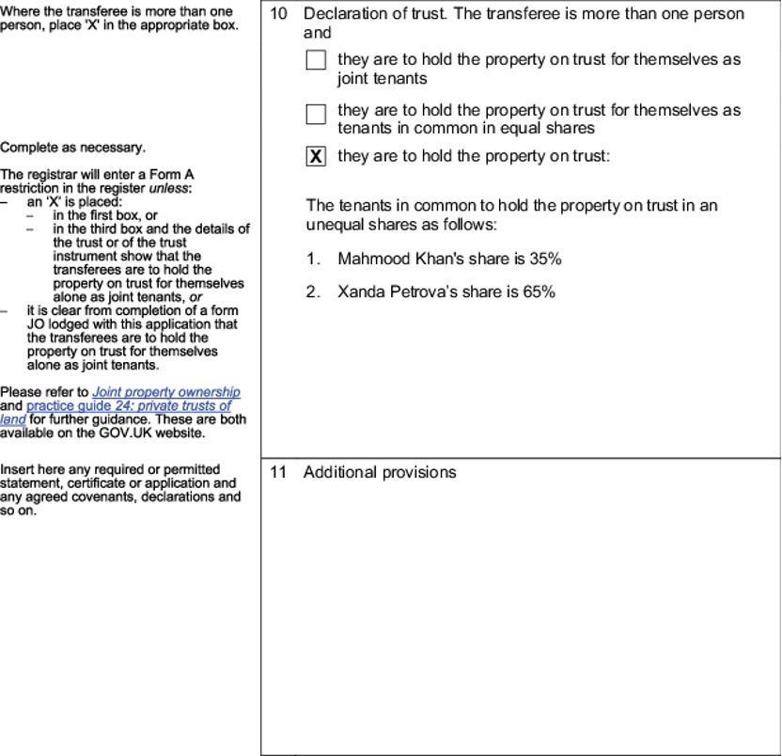
QUANTIFICATION
Object of the CT is to give effect to the parties’ interests: primary search is to decide what parties intended
If parties’ intentions can be shown: the court must give effect to them, and cannot determine an alternative share, based on what it might consider fair (cf MCA)
If parties purchase together, conveyancers should:
advise their clients as to the differences between joint tenancy and tenancy in common, and encourage them to agree their beneficial interest
Carlton v Goodman [2002] EWCA Civ 545
If conveyances do help their clients to agree this, such agreement will be registered on the TR1, under the section ‘Declaration of trust’ (this now recording may eventually reduce claims)
If property is in joint names: starting point: equity follows law
If one party wishes to show that a different division was intended, they need to show that the parties intended this - difficult to prove (burden on claimant)
May be able to prove from their course of dealings, e.g. Stack v Dowden: rigidly separate financial dealings, so was possible to show intended an unequal division.
Common pooling, makes it more difficult to dispute.
‘Emotional and economic commitment to joint enterprise’: Jones v Kernott, may give rise to presumption of equality
Can change intention after conveyance, but this must be evidenced
Key sources: Stack v Dowden
[2007] UKHL 17; Jones v Kernott
[2011] UKSC 53
Notes:
Once a claimant has established a constructive trust, the court must determine:
What share of the property does each party own?
This stage is known as quantification.
The court's primary objective is to give effect to the parties' actual or inferred intentions.
The court is not free to divide the property according to what seems fair.
Instead, the court must identify:
✅ What the parties intended.
✅ Whether those intentions changed over time.

Slide 39

QUANTIFICATION
In both single ownership and joint ownership cases, courts generally reluctant to find that the parties intended a division based on their respective financial contributions, starting point of assumed equality post Stack and Kernott.
However, if evidence shows this is what parties had intended, this is what shall be established
The nature of the parties’ relationship may also influence the inference made.
Gallarotti v Sebastianelli [2012] EWCA Civ 865
If there is evidence that the parties indicated an alternative share, but it does not specify what shares, it will be for the court to decide what is appropriate.
“considers fair having regard to the whole course of dealings…in relation to the property.” Oxley v Hiscock [2004] EWCA Civ 546
Fair share is not the same as fair share in matrimonial proceedings Joint owner cases: start with presumption of equality
Single owner cases: do not start with presumption of equality, but based on relationship with the property
Key sources: Stack v Dowden
[2007] UKHL 17; Jones v Kernott
[2011] UKSC 53

Slide 40
ACTIVITY 4: ADVISING CLIENTS
Alan bought a house in 2016, for £80,000, paying a 10% deposit himself and the balance being obtained by a mortgage from the Provident Building Society. The following year Alan started a relationship with Beryl, who continued working and helped Alan with the household expenses. Beryl ceased working when their daughter Chloe was born in 2020. In 2021 Alan was made redundant due to COVID and for the next two years Beryl worked part-time in order to assist with the mortgage payments. The couple have now separated and Alan has moved into a flat. Beryl is concerned as she believes that Alan may intend to sell the house and evict her.
Advise Beryl as to any rights she may have in relation to the house
Notes:
The house is in Alan's sole legal name, so the starting position is:
Alan is presumed to be the sole legal and beneficial owner (Jones v Kernott).
Therefore, Beryl must establish a common intention constructive trust to prove she has a beneficial interest in the property.
1. Does Beryl Have a Beneficial Interest?
Express Common Intention?
There is no evidence in the facts of any express agreement that:
the house belonged to both parties; or
Beryl would acquire a share.
Therefore, Beryl is unlikely to succeed via the express common intention route.
Inferred Common Intention?
The stronger argument is based on conduct.
Early Relationship (2017-2020)
Beryl:
Worked.
Helped with household expenses.
Had a child with Alan.
However, paying general household expenses is usually insufficient under:
Rosset
Burns v Burns
On its own, this period is unlikely to establish an interest.
Mortgage Contributions (2021-2023)
This is Beryl's strongest point.
The facts state that:
"Beryl worked part-time in order to assist with the mortgage payments."
Direct contributions to mortgage payments are recognised in:
Lloyds Bank v Rosset
Grant v Edwards
as evidence from which common intention may be inferred.
A court could conclude that Beryl's payments were:
✅ Referable to acquisition of the property.
✅ Sufficient to infer a common intention that she should have a beneficial interest.
2. Detrimental Reliance
Beryl must also show she acted to her detriment.
Possible evidence includes:
Returning to work specifically to assist with mortgage payments.
Contributing financially despite caring for Chloe.
Sacrificing time and earning capacity to support the family home.
A court would likely find detrimental reliance because:
Beryl changed her position by taking employment and contributing to mortgage payments in circumstances where she may reasonably have believed she was helping secure the family home.
3. What Share Might Beryl Receive?
If the court finds a constructive trust exists, it must quantify her share.
Relevant factors include:
Alan paid the entire deposit.
Alan bought the property before the relationship began.
Alan was solely responsible for the mortgage initially.
Beryl's mortgage contributions only occurred for approximately two years.
Beryl made domestic and childcare contributions throughout the relationship.
The couple had a child together and treated the property as a family home.
Likely Outcome
Beryl is unlikely to obtain a 50% share because:
She was not involved in the original purchase.
Alan contributed the deposit.
The property was owned solely by Alan before the relationship began.
However, she may obtain a modest beneficial share reflecting:
Mortgage contributions; and
Her role in supporting the family home.
A court might award a share somewhere in the region of 10-30%, depending on evidence of the actual mortgage payments and the parties' intentions.
4. Protection Against Sale
If Beryl can establish a beneficial interest, she may have an overriding interest if she remains in actual occupation of the property.
Practical steps include:
Obtaining legal advice immediately.
Applying for a restriction or notice at HM Land Registry if a beneficial interest can be shown.
Seeking a declaration of beneficial ownership under TOLATA 1996.
Potentially seeking an order regulating occupation of the property.
Exam Conclusion
Beryl's strongest argument is that her contributions towards the mortgage between 2021 and 2023 give rise to an inferred common intention constructive trust under Lloyds Bank v Rosset. Although household expenses and childcare alone would probably be insufficient, her direct assistance with mortgage payments and associated detrimental reliance provide a realistic basis for claiming a beneficial interest in the property. Any share awarded is likely to be significantly less than 50%, reflecting Alan's sole ownership at purchase and initial financial contributions.

Slide 41

PROBLEM SOLVING: WHAT ARE WE ASSESSING?
Advise X on...... Ability to:
identify legal issues presented by a set of facts
differentiate between those which require detailed analysis and those which can be dealt with concisely (but not overlooked)
identify and summarise the legal rules (authorities) relevant to the identified issues (including referencing skills) (understanding) accurately explain how the legal rules apply to the facts (application skills: analysis and critical reasoning)
distinguish and follow authorities as appropriate
anticipate opposing arguments (and address them)
shape your points into a logical argument, leading to a clearly supported conclusion
How can you succeed in law problem solving?

Slide 42
IRAC: A TOOL TO SUCCEED WHE ADVISING
Event: the legal event for which you are advising (e.g. interest in family home). A single event usually has multiple IRACs (at least one paragraph each)
Issue: identify the legal issues you are considering; not a summary of facts but will arise from them. One issue per paragraph (no more). (one sentence)
Rule: explain the relevant legal rule (for the issue) in your own words with references. (usually more than one sentence, unless very straightforward)
Application: Explain how the rule applies to the facts of the question: this is the only place where you refer to facts (usually more than one sentence unless very straightforward). Evidence to show why.
Conclusion: briefly summarise the legal effect. Each issue will have a short conclusion, followed by an overall event conclusion. (one sentence)

Slide 43


IRAC: A BURGER MODEL
It can be tempting to use IRAC stages as headings or have a separate paragraph for each element. There is no need to do this.
IRAC is best used as a paragraph structure: with (at least) one sentence per element (more for rule and application).
Make sure that each element of IRAC is present – state the legal Issue, explain the Rules, explain how the Rules relate to the facts, and give a mini-conclusion.
Repeat as necessary. Build your burger!
Overview/Intro event
Issue 1
Rule 1
Application 1
Conclusion 1
Issue 2
Rule 2
Application 2
Conclusion 2
Overall summary
Don’t forget to season your burger with references: adding salt and pepper is not optional.

Slide 44
PLANNING AN ANSWER WITH IRAC
Issue
Rule
Application
Conclusion
What will your issues be in a case involving establishing an equitable interest in family home?

Slide 45
IRAC: WORKED EXAMPLE
Alan bought a house in 2016, for £80,000, paying a 10% deposit himself and the balance being obtained by a mortgage from the Provident Building Society. The following year Alan started a relationship with Beryl, who continued working and helped Alan with the household expenses. Beryl ceased working when their daughter Chloe was born in 2020. In 2021 Alan was made redundant due to COVID and for the next two years Beryl worked part-time in order to assist with the mortgage payments. The couple have now separated and Alan has moved into a flat. Beryl is concerned as she believes that Alan may intend to sell the house and evict her.
Advise Beryl as to any rights she may have in relation to the house
Issue: Whether there was a valid express declaration of trust in relation to the house.
Rule: A valid express declaration of trust must be in writing and signed by the person able to declare such a trust (LPA 1925, s53(1)(b)). Where there is a valid express declaration of trust, it shall be conclusive as to beneficial ownership (Goodman v Gallant [1986] Fam 106).
Application: No valid express declaration of trust is indicated. Alan does not appear to have recorded intentions as to division of beneficial interest in the property in a signed written document.
Conclusion: Beryl cannot establish that she has a beneficial interest by virtue of an express declaration of trust.
In your answer you would write this up as a single paragraph. Not bullet points, and not with the bold headings - these are included for illustration.

Slide 46
IRAC: WRITTEN UP AS A PARAGRAPH
The first issue to advise Beryl upon is whether she can establish a beneficial interest in her family home, owned by Alan, via a valid express declaration of trust in relation to the house. A valid express declaration of trust must be in writing and signed by the person able to declare such a trust (LPA 1925, s53(1)(b)). Where there is a valid express declaration of trust, it shall be conclusive as to beneficial ownership (Goodman v Gallant [1986] Fam 106). The evidence supplied does not indicate existence of a valid express declaration of trust. Alan does not appear to have recorded intentions as to division of beneficial interest in the property in a signed written document. As such, Beryl cannot establish that she has a beneficial interest by virtue of an express declaration of trust.
As there was no valid express DT, you now move on to consider the next issue. Add a linking sentence to explain why you have chosen your next mechanism

Slide 47
UNIT 3: LEARNING OUTCOMES
Identify key property law routes to establishing a beneficial interest in
legal estates
Explain the benefits of an express declaration
Explain how a beneficial interest might be established via implied trusts Evaluate judicial decisions
Apply the law to a factual scenarios to advise a client
RECAP

Slide 48
UNIT 3: READING MATERIALS
You can draw on the following chapters of your textbooks to deepen
your understanding of the topics discussed in this unit. Bevan (2022) chapter 2-3 and 5
Dixon (2024), chapters 2-4

Slide 49
EXPLORING FURTHER
You may find the following sources of interest to you in exploring the topics discussed in this unit further. You are not expected to read these to pass the module, they are provided
should you wish to explore the topics further.
Ali, Naveed (2019) Constructive trusts: Keeping up with the Jones. Trusts and Estates Law and Tax Journal, 204(Mar) 20-23. Boyle, S. C. (2013) Keeping up with the neighbours 163 NLJ 14
Hayward, A. (2013) ‘Stack v Dowden (2007); Jones v Kernott (2011) Finding a home for family property’, in N.P. Gravells (ed.) Landmark cases in land law. Oxford: Hart Publishing,
pp. 229–252.
Georgiou, A.Y.S. (2019), Marr v Collie: The Ballooning of the Common Intention Constructive Trust. The Modern Law Review, 82: 145-158. https://doi.org/10.1111/1468-2230.12392 Gardner, S. (2013) Problems in Family Property 72 CLJ 301
Greer, S and Pawlowski, M (2010) Constructive Trusts and the Homemaker 22 Denning LJ 35 Kershaw, M (2012) In your own words NLJ 1026
Lee, J (2012) "And the waters began to subside": imputing intention under Jones v Kernott 5 Conv. 421 Lees, K (2012) Geary v Rankine: money isn't everything 5 Conv 412
awson, A (1996) The things we do for love: detrimental reliance in the family home 16 Legal Studies 218 at 224 Mee, J (2012) Jones v Kernott: inferring and imputing intention in Essex CONVPL 167
ONS (2023) People’s living arrangements in England and Wales: Census 2021. Available at: https://www.ons.gov.uk/peoplepopulationandcommunity/householdcharacteristics/homeinternetandsocialmediausage/articles/livingarrangementsofpeopleinenglandandwale s/census2021 (Accessed: 21 May 2023).
Pawlowski, M. (2012) Imputed Intention and joint ownership – a return to common sense: Jones v Kernott CONVPL 149
Sloan, B (2014) Keeping up with the Jones case: establishing constructive trusts in ‘sole legal owner’ scenarios Legal Studies (Early View) DOI: 10.1111/lest.12052 (accessed 11th August 2014)

