Slide 1
Scriptwriting:
The Stage and Beyond
HPEN5024
Samuel Hinton

Slide 2
Character and Dialogue

Slide 3

Good vs. Evil

Slide 4
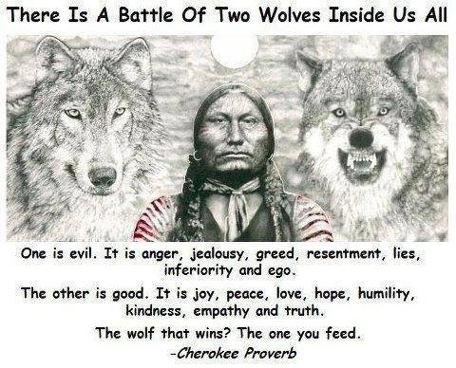

Slide 5
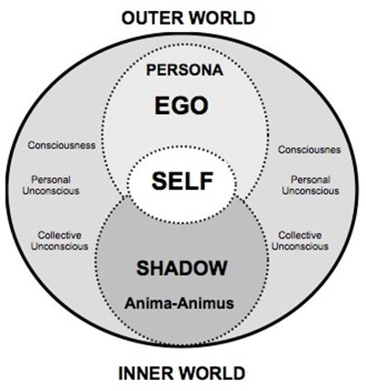
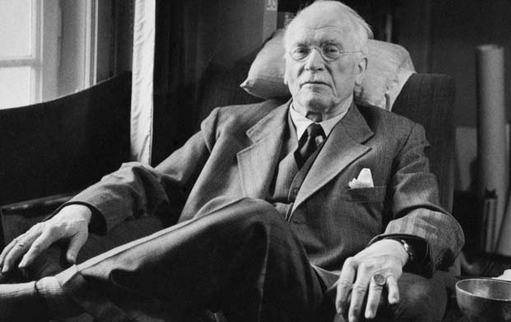
The Archetypes
Carl Jung (1875-1961)

Slide 6
The Archetypes
The Hero
Mentor
Threshold Guardian
Herald
Shapeshifter
Shadow
Ally
Trickster
‘Myths are the shared dream of a culture’

Slide 7
Hero (or Heroine)
Hero’s function is to sacrifice their own needs on behalf of others
Psychologically to transcend ego
The Archetypes are to be played with for example, you can have a Trickster Hero

Slide 8
Anti-Hero
Breaking Bad:
https://www.youtube.com/watch?v=31Voz1H40zI

Slide 9
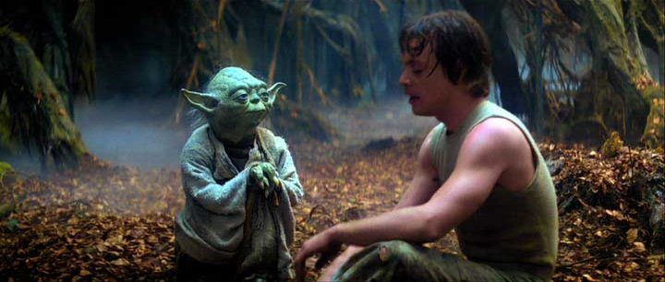
The Mentor
Star Wars - https://www.youtube.com/watch?v=cgeyLbuqQ4Q

Slide 10
Mentor
Wise Old Man or Woman. Give a gift – often represent the conscience
Threshold Guardian
Guardian of the special world
Story function to prevent the protagonist getting their goal
Herald
Represent change announce that significant change is about to happen
Shapeshifter
Someone who seemingly changes form and identity – dramatically add suspense and tension

Slide 11
Shadow
Usually represent the dark side – often as a villain
A mirror to the Hero
The Hero’s own shadow
Ally
Allies to the Hero, a conscience or sidekick
Trickster
Give a sense of mischief, often comic relief

Slide 12
Character Goal and Need
The Visible Goal
The Emotional need
‘You can't always get what you want
But if you try sometime you might find
You get what you need’

Slide 13
One Flew Over the Cuckoo’s Nest
External Goal: Faking mental illness, to get of the hospital
Internal Goal: To inspire the patients to think for themselves and live free
Joker
External Goal: To become a stand up comedian
Internal Goal: To be loved and accepted and to find the truth about his father
1917
External Goal: To deliver the message to the Colonel
Internal Goal: To act heroically and to survive!

Slide 14
1. External positive/internal positive
2. External positive/internal negative
3. External negative/internal positive
4. External negative/internal negative

Slide 15
How to write your characters?
Taxi Driver - https://www.youtube.com/watch?v=DjgINxorEas
Harry Potter - https://www.youtube.com/watch?v=GHXSvCMpCGM&t=10s
Juno - https://www.youtube.com/watch?v=OLREFnFNVUg

Slide 16
Exercise:
5 Minutes:
Write down 10 names for 10 characters with an occupation (don’t over think, instead write down your first thoughts)
10 Minutes:
Add a sex and visual characteristics to 5 of these characters
15 – Minutes
Consider the character and their identity and their shadow side (or at least a side to themselves that they don’t show to others)

Slide 17
Exercise:
20 Minutes:
Choosing two of these characters and begin a scene where they meet, with one acting as a main character and the other fulfils a role connected with an archetype

Slide 18
Act 1
Inciting Incident (between pages 1-10)
Page 17 – The story is launched
Page 30 – We see the consequences of the decision made on page 17
Near end of act 1 is a good time to introduce a B Plot – when we know enough about the main character

Slide 19
Exercise:
15 Minutes:
Write an outline of what happens on Page 17 (or about Page 4-5)
15 Minutes
Write another scene in direct relation. How is that reacted to on Page 30 (or page 7-8)

Slide 20
Recap

Slide 21
Dialogue

Slide 22
Text
Text – What is said
Subtext – What is meant
Context – The situation

Slide 23
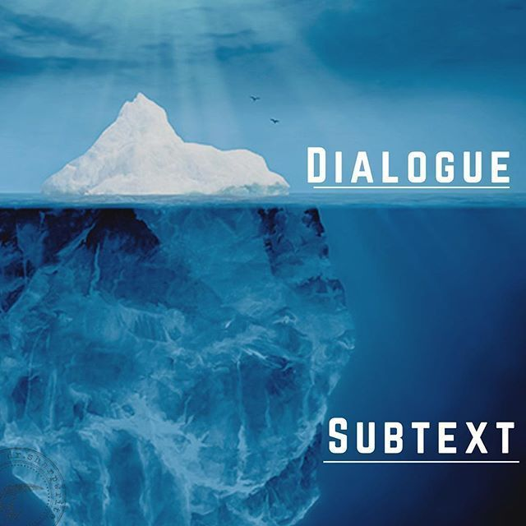
What is Subtext?

Slide 24
Subtext
What a Character says vs What they mean (doesn’t mean it can’t be conversational)
Subtext is related to motive
Many elements can have subtext – eg the music, set design ect... If possible show don’t tell

Slide 25
Examples
https://www.youtube.com/watch?v=2JhnigAQmd8 – The Room
https://www.youtube.com/watch?v=qLblwVUEHyw – Annie Hall
https://www.youtube.com/watch?v=XKXCZhA328A – Sideways

Slide 26
Understanding a Character’s Role can help the dialogue
Dialogue needs a purpose
Ask yourself:
What is the motive of your character?
What function is the dialogue serving (is it comic relief, are we finding out important information, learning about character?)

Slide 27
Exercise:
In pairs, write a scene about a couple who are buying a piece of furniture from a furniture shop. The dialogue revolves solely around the item (the size, colour, the kind ect.) In reality however it is about their relationship.
20 Minutes

Slide 28
Ways to improve writing your dialogue:
Listen to how people talk
Speak your dialogue aloud whilst writing
Spend a day in the mind of one your characters

Slide 29
Beats

Slide 30
Movie Beats
15 Beats in a movie
Beat can also refer to an important moment

Slide 31
Examples:
https://www.youtube.com/watch?v=INPtw-HHtnw – In Treatment
https://www.youtube.com/watch?v=xDAsABdkWSc&t=148s - Whiplash
https://www.youtube.com/watch?v=Z-365iujWk8 - Castaway

Slide 32
Exercise:
Go through the beat sheet and start filling it for potential ideas for your scripts

Slide 33
Adaptation

Slide 34
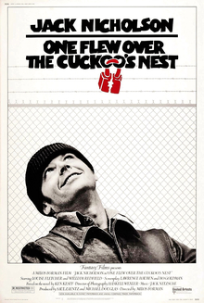

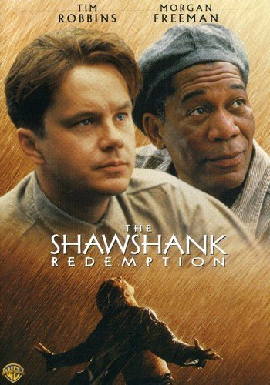
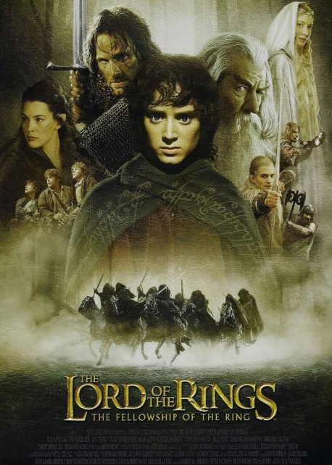

Slide 35
Adaptation
What to edit out and what to keep?
‘Just keep in mind that a novel is 200-300 pages of dense introspection
and a screenplay is 90-120 pages of visual action’

Slide 36

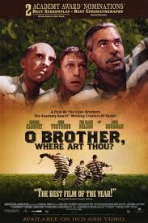

Fairy Tales and Myth
Numerous films and TV Shows based on Fairy tales, folklore, myths and legends

Slide 37
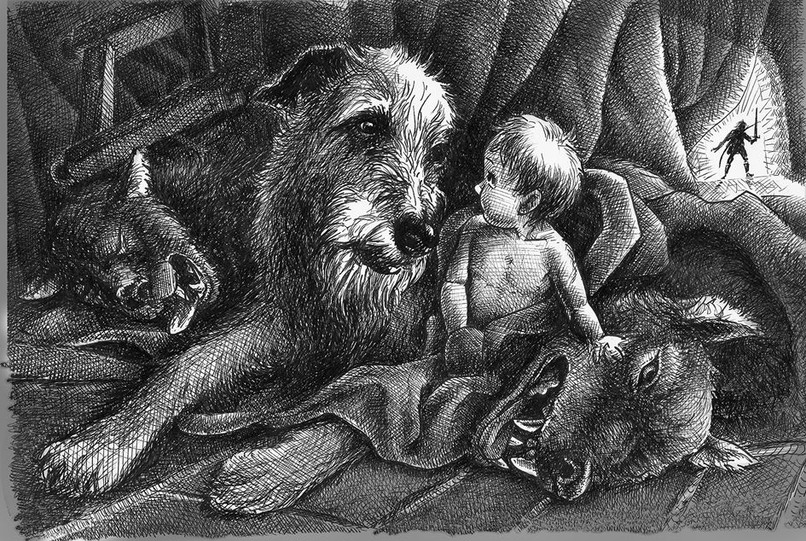
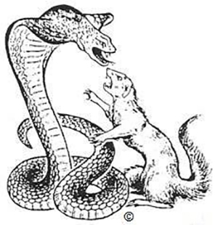
Folk-tale motif

Slide 38
Gelert
How do you interpret the story? And what are its main messages?

Slide 39
Exercise:
Read the story of Gelert.
Based on the tools and techniques used so far, begin adapting the story in your own way. You can be as literal or as artistic as you like.
Consider the overall structure, the central characters, and the beats (plot beats, and beats in the dialogue if writing scenes)

