Slide 1
Segmentation, Targeting and Positioning

Slide 2
Market segmentation
Market segmentation and targeting is at the core of marketing strategy and consumers (or potential consumers) are the key stakeholder group for both commercial and social marketers.
factors that impact on consumer behaviour are: age, income, lifestyle – that form the basis for market segmentation. The process is as illustrated below.

Slide 3
Market Segmentation
Market segmentation is the process of dividing the market in to groups of consumers who respond in a similar way to a given set of marketing stimuli (e.g. price, product features) or, alternatively, groups of consumers/customers with homogeneous needs or preferences. This may be on the basis of demographics, e.g. age, gender; geographics, e.g. by country, rural/urban areas; psychographics, e.g. lifestyle; or behavioural factors, e.g. brand loyalty.

Slide 4
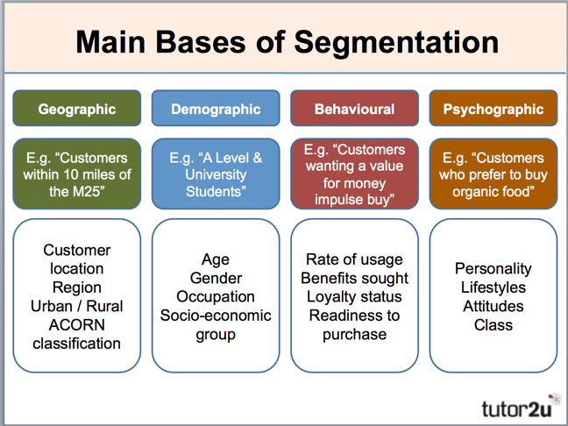

Slide 5


Market persona
A marketing persona is a fictional, research-based profile that represents a segment of your target audience. It helps marketers understand customer motivations, behaviors, and preferences to tailor strategies more effectively.

Slide 6

Persona
A marketing persona (also called a buyer persona or user persona) is a semi-fictional character created from real data and insights about your ideal customer. It goes beyond basic demographics to include:
• Psychographics: values, attitudes, lifestyle
• Behavioral traits: buying habits, brand interactions
• Goals and challenges: what they want and what gets in their way
• Media consumption: where they spend time online and offline
This persona helps marketers humanize their audience, making it easier to craft relevant messages, choose the right channels, and design products that resonate.

Slide 7


Sophie
For example, instead of saying “our target is women aged 25–35,” a persona might be:
Name: Sophie, 29, Cardiff-based graphic designer
Goals: Wants sustainable fashion that fits her creative lifestyle
Challenges: Limited budget, overwhelmed by options
Values: Ethical sourcing, individuality
Media Habits: Instagram, Pinterest, listens to design podcasts
This Photo by Unknown Author is licensed under CC BY-SA

Slide 8

Activity 1 - BUILD YOU TRIBE
Objective: Understand demographic, psychographic, geographic, and behavioral segmentation.
Activity:
• Get yourselves into small groups.
• In front of you, you have a fictional product, which you must create 3–4 distinct customer segments using the Segmentation groups we have just covered
Create a Persona for your product.

Slide 9
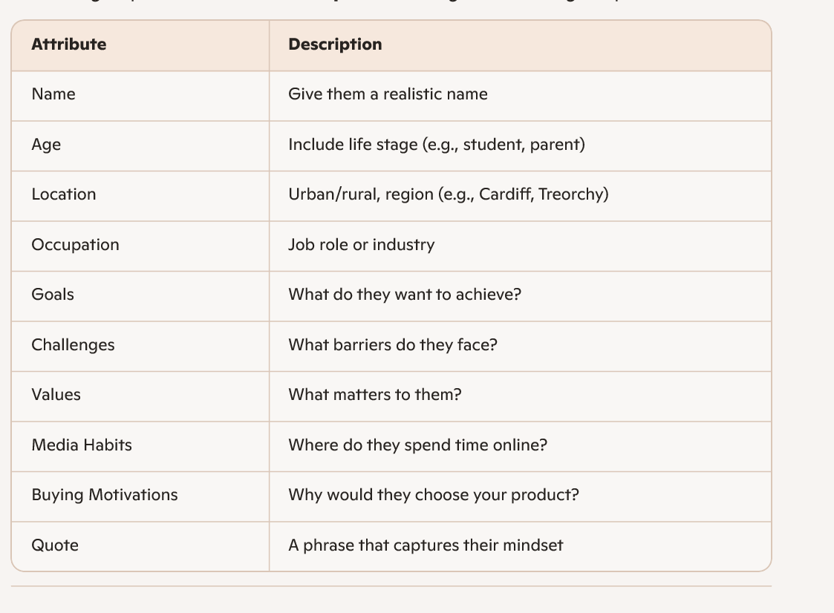
Build your persona
Create answers to the points here about your persona

Slide 10
Discussion
Lets Answer the following questions:
1. How would this persona influence your marketing strategy?
2. What channels and messages would work best?
3. How might this persona evolve over time?
4. Would your persona respond to influencer marketing?
5. What social issue might resonate with them?

Slide 11
Channel Matching
Could everyone please pop their persona on the front table.
Walk around and read each groups persona, which channels do you think would be best matched to the persona, write your answers on a post it note and stick to the persona.

Slide 12
Positioning
Market Positioning Definition. Market positioning involves "arranging for a product to occupy a clear, distinctive and desirable place relative to competing products in the minds of target consumers". It is about formulating competitive positioning for a product and a detailed marketing mix (Kotler et al., 1999).

Slide 13
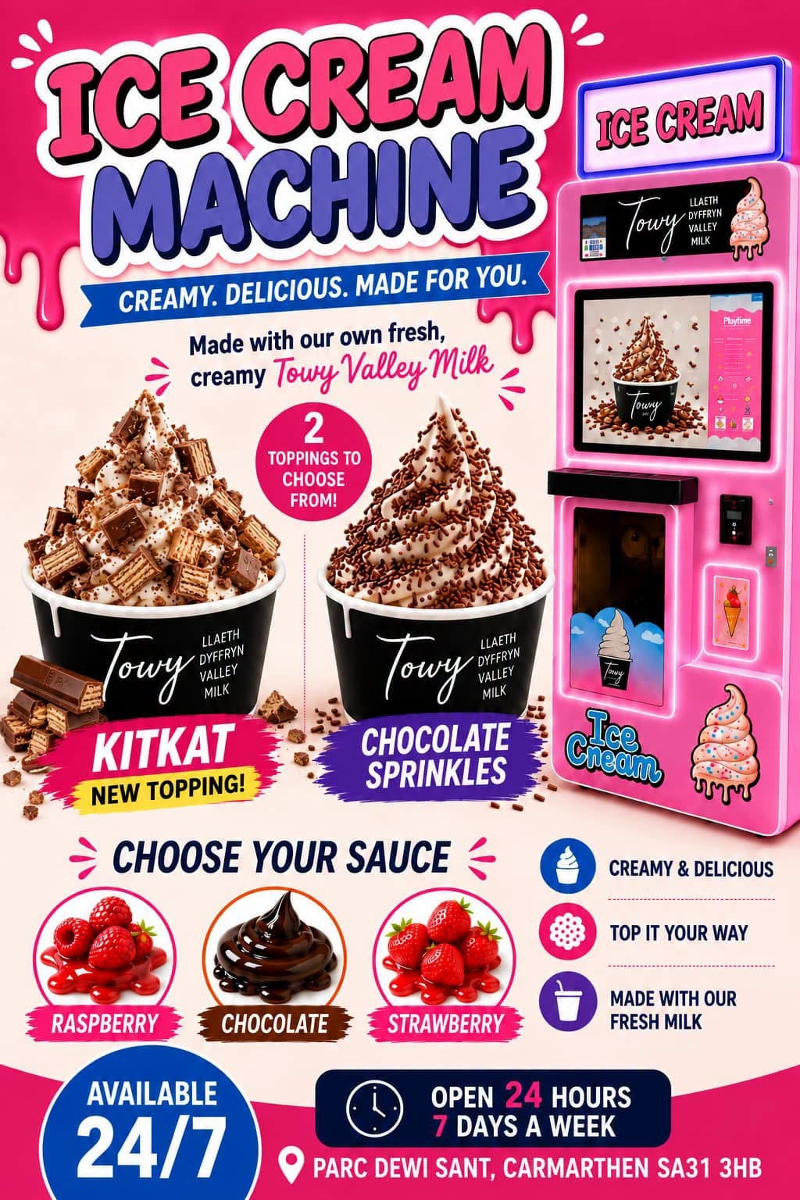
Activity 2 – TSP in practise
Towy Valley Milk have installed a self service ice cream vending machine in Parc Dewi Sant.
This is a new innovative idea in terms of self service.

Slide 14

Activity
Conduct a TSP activity for the vending machine, Answer the following questions:
1. who are the key groups of people that will use a self serve ice cream vend
2. set some criteria. Eg. Geographic limit, age groups etc.
3. rank your target groups in terms of priority.
4. Decide upon the most appropriate channel to target each group

