Slide 1
Team 404
Ewan Henderson / 1901997
BA Computer Games Design
E.H

Slide 2

E.H

Slide 3
Due to the nature of this project, it should be noted that most of us are working across roles to assist where needed.​
E.H

Slide 4
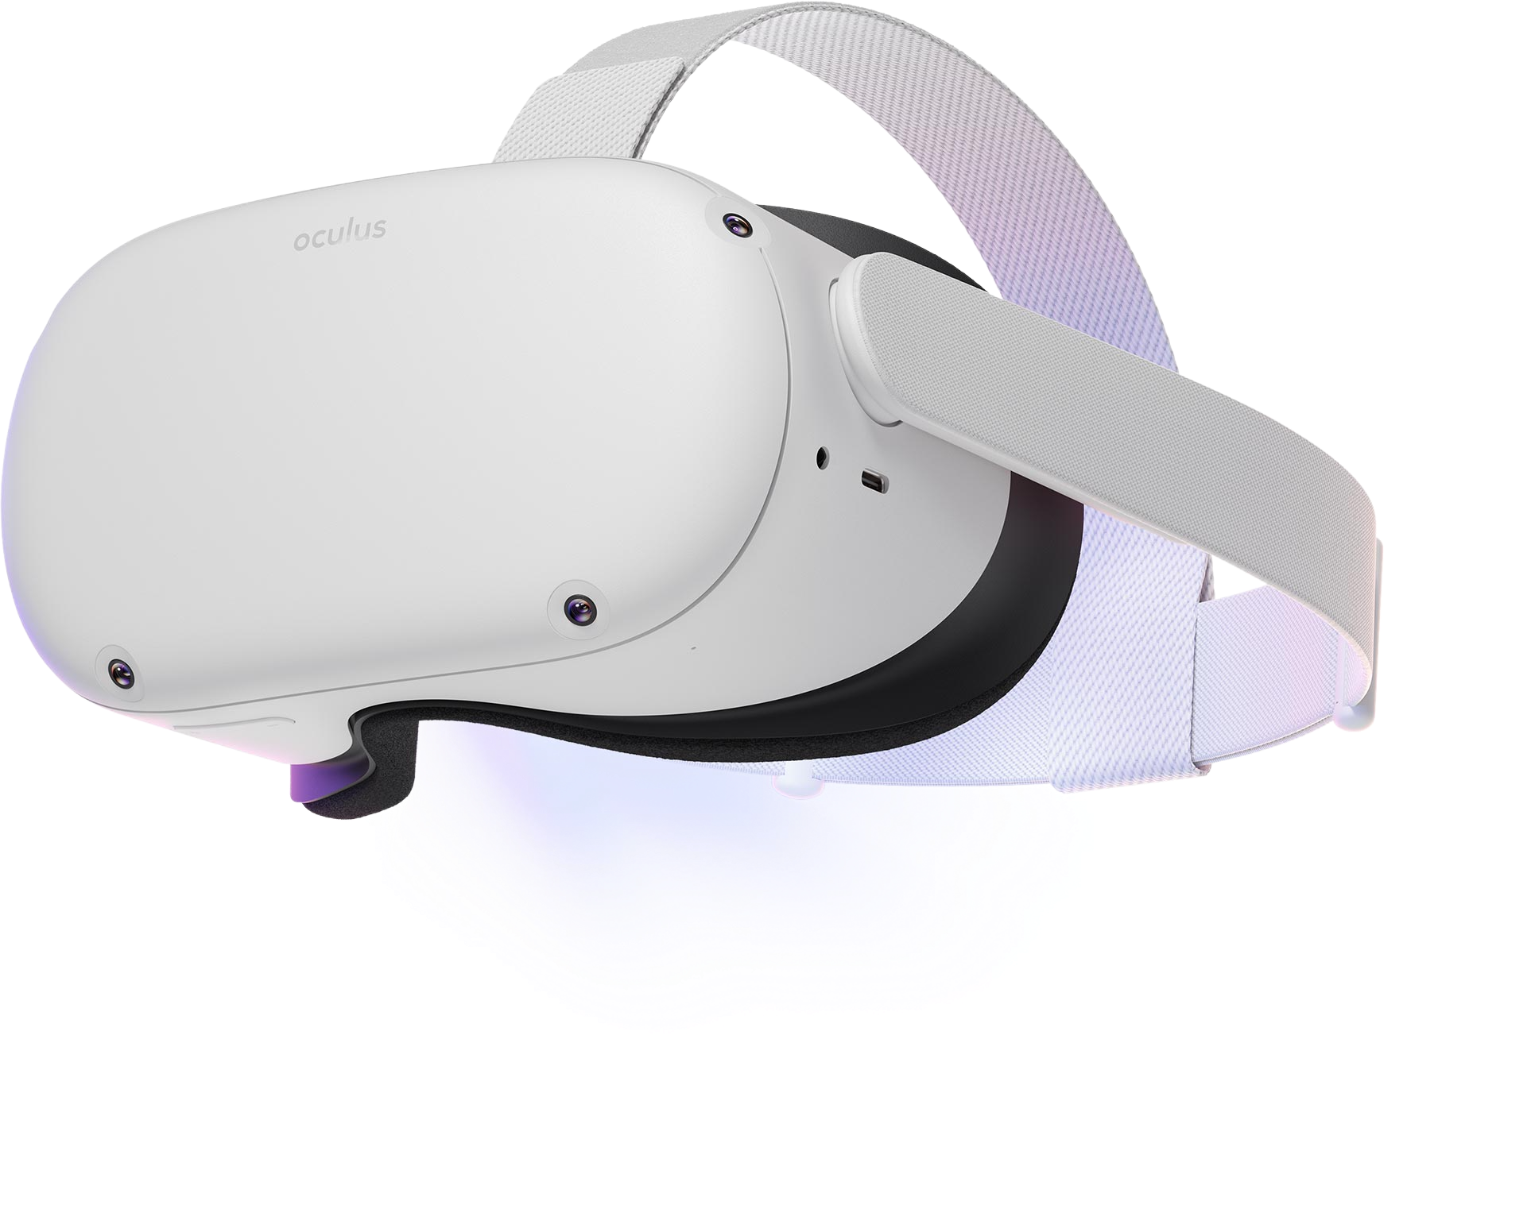
Our proposal idea
A completely virtual higher level learning environment where students and teachers can communicate with a strong presence using Virtual Reality headsets.
Fig.1 Oculus Quest 2
E.H

Slide 5
Aim of this project
The main aim of this group project is to investigate how advantageous virtual reality is in aiding the growth of the university and higher education programs in 50 years’ time.
To research and evaluate the feasibility of VR learning environments, drawbacks and all
E.H

Slide 6
Objectives
1. Organise the Team
2.1. Research the drawbacks of the proposed implementations
2.Conduct Research on VR technology and its feasible implementation in 50 years.
3. Propose a feasible solution
E.H

Slide 7
Presence in virtual reality
"the state or fact of existing, occurring, or being present."
E.H
Notes:
In this segment I will discuss and compare presence in virtual reality versus presence in online calls and video confrencing. The main points being how social interaction differs between the two virtual mediums.

Slide 8
Presence in virtual reality - presence in online lectures
Online Lectures through the media of virtual calls and video chats have a limited social interaction [1] and are sorely lacking in these socially fulfilling aspects
Without a strong 'presence' there is a disconnect between students and lecturers, as well as a fracture in peer-to-peer social interaction
Whilst a user may see and hear others, there is no illusion that they are sharing the same space or in the same room [2],[5]
E.H
Notes:
Starting with presence in online lectures slash video conferences, these types of communication have relatively limiting factors when it comes to social interactions which in the end lead to less fulfilling social aspects as mentioned by Dunlap. When people in virtual lectures lack a strong presence the connection between students and lecturers are fractured, as well as peer-to-peer relations also suffering. Whilst presence isn't nescassary for say, a 100 person lecture, it's a more intergal part of smaller classes and especially one-on-one sessions with tutors.

Slide 9
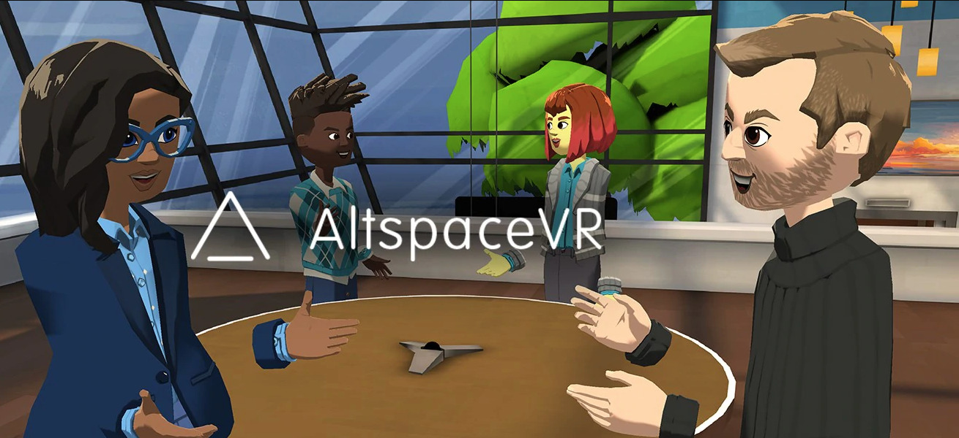
Presence in virtual reality - Cognitive illusions
Virtual Reality environments provide a cognitive illusion of the presence of the others in a space with even the shallowest immersion [2]
Some studies show that a strong social presence is a key factor in improving instructional effectiveness and building a sense of community and social connections [3]
Apps such as AltSpace VR have already
shown the potency of immersive virtual
spaces leading to strong connections that
are already being used for education [4],
[6]
Fig.2 AltSpaceVR
E.H
Notes:
By using learning spaces situated in virtual reality, accompanied by the use of virtual reality headsets we can provide a sort of cognitive illusion to the user. The imitation of presence with the thinnest veil of immersion tricks our subconscious into understanding that the user is genuinely present in the space with others. By using these cognitive illusions to provide a strong sense of presence, studies show that instructional effectiveness is significantly boosted by the social connections people can have whilst using virtual reality. These connections then help develop a sense of community and more emotive feedback to everyone involved in the experience. There are already some examples of VR software being used to learn, whilst not to the level of higher education there are apps such as AltSpaceVR that host educational sessions where people can drop in and attend the session.

Slide 10
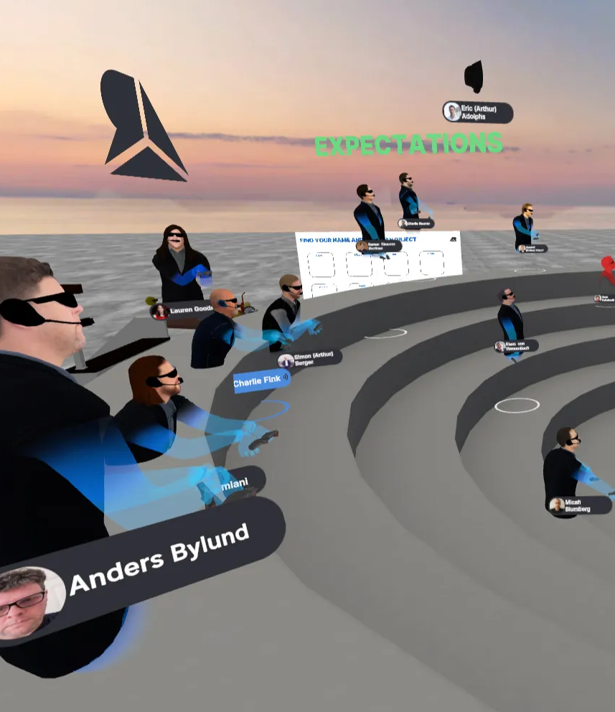
PRESENCE IN VIRTUAL REALITY -virtually social
By using VR spaces to conduct lectures, students can feel present in the moment and lecturers could use that presence and body language to gauge the class with the stronger virtual embodiment [7]
The medium of VR allows for us to achieve greater cognitive and emotional engagement with peers and lecturers [8] in comparison to virtual/video calls through movement interaction
E.H
Fig.3 Arthur
Notes:
When using Virtual reality as a medium for higher education students can be more immersed in the moment and the teachers in the space could benefit from being able to read the body language of students to better gauge the class with the use of even simple hand & head tracking. Virtual Reality spaces help achieve better relations and emotional engagement with peers and lectureres in comparison to video confrencing / video calls through using an affect called movement interaction.

Slide 11
Table of Figures
Fig.1 Meta, "Oculus Quest 2 | New All-In-One Wireless VR Headset," MetaQuest, Sep. 16, 2020. [Online]. Available: https://www.oculus.com/quest-2/ [Accessed Jan. 7,2022].
Fig.2 P. Graham, "AltspaceVR Begins Early Microsoft Account Integration," VR Focus, Feb. 5, 2021. [Online]. Available: https://www.vrfocus.com/2021/02/altspacevr-begins-early-access-microsoft-account-integration/ [Accessed Jane. 7, 2022].
Fig.3 L. Goode, "VR Meetings Are Weird, but They Beat Our Current Reality." WIRED, Aug. 12, 2020. [Online]. Available: https://www.wired.com/story/arthur-vr-virtual-reality-meetings/ [Accessed Jan. 7, 2022].

Slide 12
Personal References
[1] J.C. Dunlap and P.R. Lowenthal, ‘Tweeting the Night Away: Using Twitter to Enhance Social Presence’, Journal of Information Systems Education, vol. 20, no. 2, p.129-135, June 2009. [Online]. Available: http://jise.org/Volume20/n2/JISEv20n2p129.pdf [Accessed December 21, 2021].
[2] M. Slater, ‘Immersion and the Illusion of Presence in Virtual Reality’, British Journal of Psychology, vol. 109, no.2, p.431-433, May 2018. [Online]. Available: http://publicationslist.org/data/melslater/ref-344/bjop.12305.pdf [Accessed Decmber 21,2021].
[3] S.R. Aragon, ‘Creating Social Presence in Online Environments’, Special Issue: Facilitating Learning in Online Environments, vol.100, p.57-69, November 2003. [Online] doi: 10.1002/ace.119. [Accessed December 19, 2021]
[4] AltspaceVR, ‘Is VR the Future of Education?’, AltspaceVR, Jan. 10, 2017. [Online] Available: https://altvr.com/is-vr-the-future-of-education/ [Accessed December 19, 2021]
[5] J. Diemer, G.W. Alpers, H.M. Peperkorn, Y. Shiban, and A. Mülberger, ‘The Impact of perception and presence on emotional reactions: a review of research in virtual reality’, Frontiers in Psychology, Jan. 30, 2015. [Online] doi: 10.3389/fpsyg.2015.00026 [Accessed December 18, 2021]
[6] J. Tham, A. H. Duin, L. Gee, N. Ernst, B. Abdelqader and M. McGrath, "Understanding Virtual Reality: Presence, Embodiment, and Professional Practice," in IEEE Transactions on Professional Communication, vol. 61, no. 2, p. 178-195, June 2018. [Online] doi: 10.1109/TPC.2018.2804238. [Accessed December 27, 2021]
[7] J. Tromp, and D. Snowdon, ’Virtual body language: providing appropriate user interfaces in collaborative environments’, in Proceeding of the ACM Symposium on Virtual Reality software and technology, Sep. 1997, p.37-44. [Online] doi: 10.1145/261135.261143 [Accessed December 27, 2021]
[8] M. Gillies, ‘What is movement interaction in Virtual Reality for?’, in MOCO '16: Proceedings of the 3rd International Symposium on Movement and Computing, July 5-6 ,2016, Thessaloniki, Greece. New York: Association for Computing Machinery, 2016, pp.1-4. [Online] doi: 10.1145/2948910.2948951 [Accessed December 27, 2021]

