Slide 1
BSc (Hons) Health and Social Care
Digital Transformations in the Health and social Care Professions
Name: Lazara Laureana Guillen Pedroso
Student Number: 2329253
Module Code: BMHP6026
Lecturer name: Martine Svejda
Assignment Title: Component 2 Viva Voce (Oral Presentation)

Slide 2
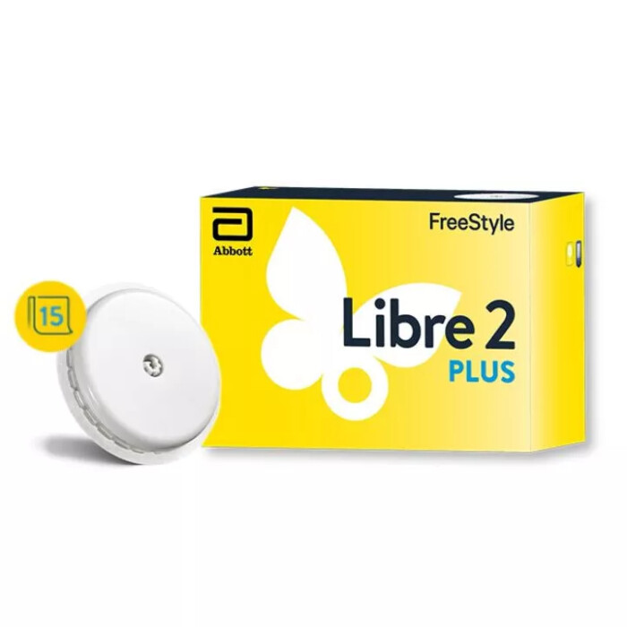
Introduction
Digital Innovation is a central component of modern health and social care services, improving patient outcomes, increasing efficiency, and supporting person-centred care.
One significant innovation is the Freestyle Libre 2 Plus, a continuous glucose monitoring (CGM) system developed by Abbott for individuals living with diabetes (Abbott, 2024)
By transitioning from early flash technology to real-time, minute, streaming extended 15 days wear, and direct integration with automated insulin delivery.
The device uses a small sensor worn on the back of the upper arm to continuously monitor glucose levels, allowing users and healthcare professionals to access to real-time glucose data, connected to your smartphone using the FreeStyle LibreLink App.
Additionally, it is matters because no more scanning, Fewer sensor changes, approved for younger patients, and it demonstrates exceptional clinical accuracy (Diabetes UK, 2025)
(Clear Chemist, no date)

Slide 3
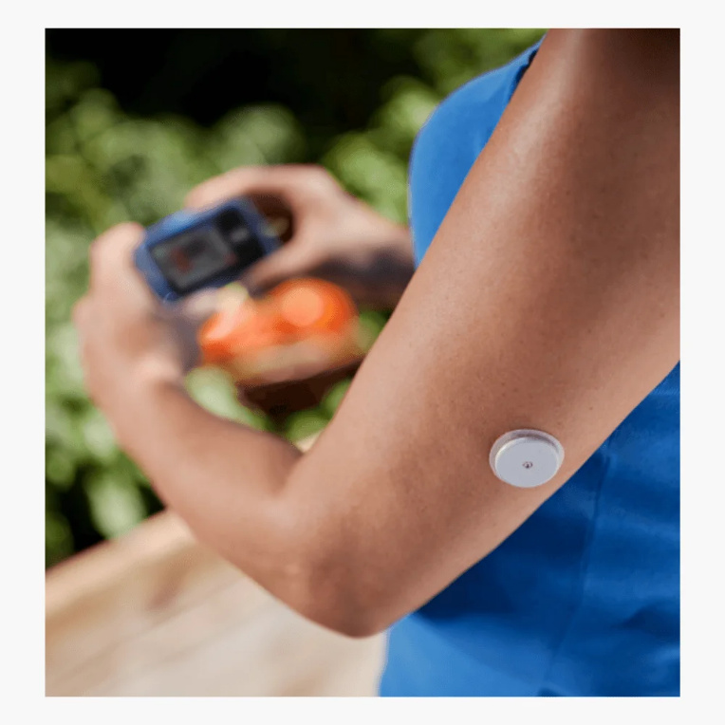
Where and how it is Implemented
National Health Service (NHS): Widely implemented across NHS regions (such as NHS England and NHS Tayside) Through specialized diabetes pathways and primary care shared care protocols
International Markets: Available globally as direct upgrade to the original FreeStyle Libre 2, including coverage through public healthcare schemes and private insurances in the Uk, Europe, and select markets.
(Chemist 2 Customer, no date)

Slide 4
Patient Eligibility and Initiation (adults and children aged 2 and older) must meet clinical criteria for CGM (intensive insulin therapy or hypoglycaemia issues)
Initiation requires an initial consultation
Prescribing and Transition Pathway
Initial sensors and devices are issued by the hospital clinic
Daily Usage and Integration (the sensor is applied to the back of the upper arm and worn continuously for 15 days)
Remote monitoring and Clinical review (DHSC and NHS, 2022)

Slide 5
Impact on the workforce.
Changes in Job Roles
Increasingly use digital data to guide clinical decision-making
Staff spend less time collecting glucose measurements
Staff spend more time analysing trends and providing personalised interventions
(NICE, 2024)
Role Competency
Digital Literacy and technology use.
Interpretation of glucose trend reports
Remote consultation and telehealth delivery
Data protection and information governance
Supporting patient self-management.

Slide 6
Impact on service delivery.
Change to Day-to Day Service Provision
Enable continuous and remote monitoring of patients
Healthcare professionals can review glucose data remotely
Reduce the need for routine face-to-face appointments.
Prioritise patients who requiring urgent intervention.
The technology facilitate proactive care
Clinicians can identify patterns and intervene before complications develop

Slide 7
Benefits and Challenges for Service Delivery
Benefits to Service Delivery
Reduce outpatient appointments
Improved efficiency and clinical consultations
Faster clinical decision-making
Enhanced data accuracy
Better coordination between multidisciplinary teams (Yamamoto, 2021)
Challenges for Service Delivery
Integration with existing electronic health record systems
Increased volume of patients-generated data requiring review
Potential inequalities among patients lacking digital access (Seidu el al., 2025)

Slide 8
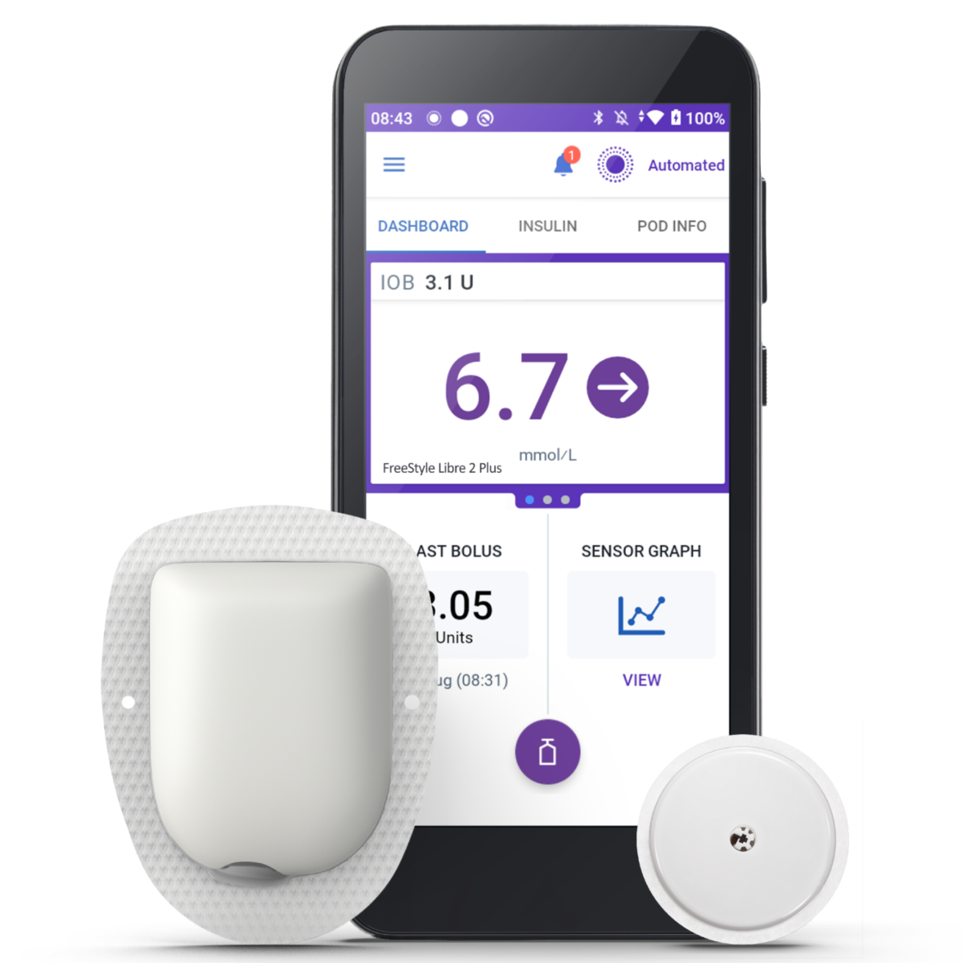
Impact on patients.
Patient Perceptions and experiences
Improved patient experiences
Continuous monitoring reduces the need for finger-prick testing
Provides greater convenience
Increased confidence in managing their condition
The device enables informed decision-making regarding diet, exercise, and medication
Promoting self-management and independence (Sugai el al., 2026)
Improved Health Outcomes
Improve glycaemic control and reduce episodes of hypoglycaemia
Better glucose management
Lower the risk of long-term complications
(Omnipod, no date)

Slide 9
Negative experiences and Challenges
Individuals may experience anxiety
Become overwhelmed by large amounts of health data
Skin irritation and Allergies
Technical issues (sensor errors o connectivity problems)
False Alarms (lying on the sensor during sleep)
Digital exclusion remains a concern
Patients with limited technological skills require additional support to engage effectively with the device

Slide 10
Impact on community.
Patient and Service location
Reduce frequent clinic visits
Remote monitoring
Healthcare professionals can review patient data without physical attendance
Effects on Family Members
Improved access to glucose information, (when caring for children or vulnerable adults )
Provide reassurance and enable quicker responses to glucose fluctuations
Increased anxiety in some families due to constant access to health data and alerts (Garg et al., 2024)

Slide 11
Co-production
Encourage patients to become active partners in managing their health
Shared decision-making is enhanced.
Supports person-centred care and improves treatment planning
Public Health Impact
Improved diabetes management
Reduce hospital admissions
Lower healthcare costs
Decrease the burden of diabetes-related complications
CGM technologies supports national strategies aimed and improving population health outcomes
Reduce health inequalities (NHS, 2024)

Slide 12
Conclusion and Recommendations.
The FreeStyle Libre Plus 2 in an innovative digital health technology that has transformed diabetes management within health and social care by providing glucose monitoring without the need for frequent finger-prick testing.
Enables individuals to monitor their glucose level more comfortably and accurately and enhanced patient independence.
The device supports person-centred care by empowering users to make informed decision regarding their health.
Improving communication between patients and healthcare professionals through the sharing of glucose data
Ensure better diabetes control, fewer complications and improved quality of life.
Challenges
Workforce training requirements, digital inequalities and data governance concerns
Cost of the technology and the need for ongoing support (DHSC and NHS, 2022)

Slide 13
Recommendation
Continue investment in digital health technologies and provide appropriate training for healthcare professionals and services user
Education should focus on how to use the device effectively
Interpret glucose data and respond appropriately to alerts
Organisations should also work to reduce barrier
Strong data protection measure must be maintained
By combining investment, education and equitable access, the FreeStyle Libre 2 Plus can contribute to improve patient outcomes, greater independence and more efficient, person –centred healthcare services.

Slide 14
References.
Abbott (2024) FreeStyle Libre 2 plus sensor: user’s manual. Witney: Abbot Diabetes. Available at: https://freestylediabetes.co.uk (Accessed: 2 July 2026)
Clear Chemist. (no date) FreeStyle Libre 2 Plus Available at: https://www.clearchemist.co.uk/freestyle-sensor-1.html (Accessed: 8 July 2026)
Chemist 2 Customer. (no date) FreeStyle Libre 2 Plus-Sensor Available at: https://chemist2customer.com/freestyle-libre-2-plus-sensor/
(Accessed: 8 July 2026)
Department of Health and Social Care and NHS England. (2022) A plan for digital health and social care. London: Department of Health and Social Care. Available at: https://www.gov.uk/government/publications/a-plan-for-digital-health-and-social-care (Accessed: 2 July 2026)
Diabetes Uk (2025) Diabetes complications. Available at: https://diabetes.org.uk (Accessed:1 July 2026)
Diabetes UK (2024) Continuous Glucose Monitoring (CGM). London: Available at: https://diabetes.org.uk (Accessed: 1July 2026)
Garg, S; Hirsch, I; Repetto, E; Snell-Berguen, J; Ulmer, B; Perkings, C; Bergenstal, R. (2024) “Impact of continuous glucose monitoring on hospitalizations and glucose control in people with type 2 diabetes: real‐world analysis,” Diabetes, obesity & metabolism, 26(11), pp. 2–5. Available at: https://doi.org/10.1111/dom.15866.
National Institute for Health and Care Excellence (2024) Type 2 diabetes in adults: management. [NG28]. London: National Institute for Health and Care Excellence. Available at: https://nice.org.uk (Accessed: 1 July 2026)

Slide 15
References
National Institute for Health and Care Excellence (2024) Type 2 diabetes in adults: management. [NG28]. London: National Institute for Health and Care Excellence. Available at: https://nice.org.uk (Accessed: 1 July 2026)
National Health Service NHS England (2024) Flash Glucose Monitoring Guidance for Diabetes Patients. London: NHS England Available at: https://nhs.org.uk (Accessed: 3 July 2026)
Omnipod. (no date) “What-is-omnipod” Available at: https://www.omnipod.com/en-gb/what-is-omnipod/omnipod-5/sensor-integrations/libre-2 Accessed: 8 July 2026
Reddy, M. and Oliver, N. (2024) “The role of real‐time continuous glucose monitoring in diabetes management and how it should link to integrated personalized diabetes management,” Diabetes, obesity & metabolism, 26(S1), pp. 46–56. Available at: https://doi.org/10.1111/dom.15504
Seidu, S; Tetteh, J; Kunutsor,S; Choudhary, P; Khunty, K; Ajjan, Ramizia. (2025) “Prescription distribution and inequities in diabetes care: A comparative analysis of continuous glucose monitoring access by diabetes status, ethnicity and socio‐economic factors in England,” Diabetic medicine, 42(11), pp.10-12. Available at: https://doi.org/10.1111/dme.70130.
Smith, A. and Jones, B. (2025) ‘Diabetes care and trends in the United Kingdom’, British Medical Journal, 350(1), pp. 25-30. Available at: https://doi.org/10.1134/die.15550
Sugai, K; Sasaki, J; Tomizawa, G; Suzuki, R. (2026) “Effect of switching from intermittently scanned continuous glucose monitoring to FreeStyle Libre 2 with real‐time continuous glucose monitoring and alert functionality,” Journal of diabetes investigation, 17(3), pp. 9–12. Available at: https://doi.org/10.1111/jdi.70233.
Yamamoto, J.M. and Murphy, H.R. (2021) “Benefits of Real-Time Continuous Glucose Monitoring in Pregnancy,” Diabetes technology & therapeutics, 23(1_suppl), p. 8--14. Available at: https://doi.org/10.1089/dia.2020.0667.

