Slide 1
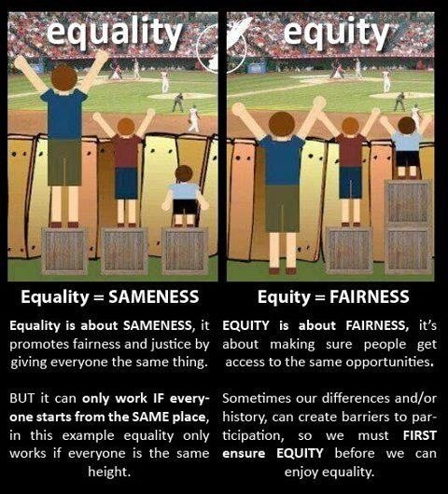
Disability Culture, Identity within Education
Timothy Kristofer Leeder
Module code: M5X02165
Disability Culture and Identity:
Social Factors:
Social Model of Disability:
Equity and Equailty:
Culture: a their way of life, their general customs and beliefs of their group at a specific time (Culture, 2021).
Subculture: similar to culture, it’s the way of life, customs and ideas of a group of individuals within society that may differ from the rest (Subculture, 2021).
Multicultural: this relates to individuals with numerous cultures and individuals from more than one culture (Multicultural, 2021).
Disability: a condition of the body and, or mind, that can make it difficult for an individual to perform certain tasks and interactions within society (Disability & Health Overview, 2020).
Identity: what an organisation, and who a person is (Identity, 2021). The qualites that make them different from others, and the reputation of that person or organisation has obtained within the public eye (Identity, 2021).
Disability culture: Having over 515,000 results made this difficult to define. They share a common history of oppression and a bond of resilience, and they generate a multitude of expressions through everyday life and culture, infused from their experiences of disabilities (Brown, 2012).
Human first, they deserve the same respect as everyone and then their disability after (Person first language - Put the person before the disability, 2009).
The World Health Organization states that people with disabilities form a total of 3 groups (Disability & Health Overview, 2020):
Impairment: Affecting a persons body function or mental function (Disability & Health Overview, 2020).
Activity limitation: Difficulties affecting sight, hearing, mobility, and problem solving (Disability & Health Overview, 2020).
Participation restrictions: Difficulties working, engaging in social and recreational activities, and obtaining health care and preventable services in normal daily activities (Disability & Health Overview, 2020).
The United National Educational, Scientific and Cultural Organization (UNESCO) states the greatest barriers to inclusion are caused by society, not their medical impairments (Education for children with disabilities: Improving access and quality, no date).
Stigmatised by religious and other peoples cultural beliefs can be negatively impacting (Education for children with disabilities: Improving access and quality, no date).
Parents can also be resistent to an inclusive education (Education for children with disabilities: Improving access and quality, no date).
Uniform alterations and transport can create barriers that ‘normal’ people may not have (Education for children with disabilities: Improving access and quality, no date).
Individuals with a disability are disabled by the barriers presented by society, not by their disability, and these barriers can be physical, or caused by peoples opinions (Social Model of Disability, no date).
This helps recognise the barriers that can make life harder for people with disabilities, removing these barriers can create equaility and offers these people more independence, choice and control (Social Model of Disability, no date).
These individuals are one of the main groups being exluded from quality education, according to EFA Global Monitoring Report 2010: reaching the marginalized (Education for children with disabilities: Improving access and quality, no date).
The Caravan (2018) gave an example of both equailty and equity, writing:
“Equality aims to promote fairness by treating everyone equally. For example, giving everyone the same portion of chocolate cake abides with the law of equality. Equity, however, is taking into consideration that some people are diabetic and therefore should not be given cake.”
Offering an individual with disabilities that same schooling and methods as their peers can be seen by some as ‘Covert Exclsuion’ (The Caravan, 2018).
Sustainable societies should ambrace people with disabilities, having a community and schools based on the ‘law of equity’, rather than the ‘law of equality’ (The Caravan, 2018).
To have every individual included and involved in a classroom, the classroom needs to be adapted to each individuals needs (The Caravan, 2018).
These individuals are one of the least visible, yet most potent factors in educational marginalisation (Education for children with disabilities: Improving access and quality, no date).
School Factors:
Medical Model of Disability:
Lacking accessibility due to funding, leading to larger teaching groups, inaccessible buildings and limited support for those that need it (Education for children with disabilities: Improving access and quality, no date).
Inadequate training and awareness from teachers, students and their parents (Education for children with disabilities: Improving access and quality, no date).
Less activities that individuals with disabilities will be able to take part in (Education for children with disabilities: Improving access and quality, no date).
Segragation: Indiviudals with Additional Learning Needs (ALN) may be educated at specific schools or from home, segragating them from the mainstream school and the experiences within it (Education for children with disabilities: Improving access and quality, no date).
Inclusive Education: Children with disabilities can learn effectively within a mainstream school if they adapt their curriculum, building and staff to meet the needs of that child (Education for children with disabilities: Improving access and quality, no date).
Integrated Education: Children with disabilities attent ALN classes within a mainstream school (Education for children with disabilities: Improving access and quality, no date).
Individuals with a disability are disabled due to their own impairments (Social Model of Disability, no date).
This looks at what is wrong with the person, rather than what the person needs, it may create low expectations and lead people to losing their independence, choice and control (Social Model of Disability, no date).
Disablism: The negative attitudes based on prejudice or stereotypes of a person with disabilities, this can stop them from having equal opportunities throughtout life (Social Model of Disability, no date).
(Image from Paulley, 2014)
Diability Policy and Education:
UNESCO’s policy guidelines include:
The recognition of the right to education and it’s provision in non-discrimincatory way (Education for children with disabilities: Improving access and quality, no date).
The common vision of education which covvers all children of the appropriate age range (Education for children with disabilities: Improving access and quality, no date).
The conviction that schools have the responsibility to meat the diverse needs of all learners, and recognise that all children can learn (Education for children with disabilities: Improving access and quality, no date).
It’s against the law for a schools or other education provider to treat students unfavourably, including, direct discrimination, indirect discrimination, discrimincation arising from a disability, harassment, and victimisation (Disability rights, no date).
Schools have a duty to make reasonable adjustments, to allow access and appropriate training (Education for children with disabilities: Improving access and quality, no date).
Notes:
1

