Slide 1
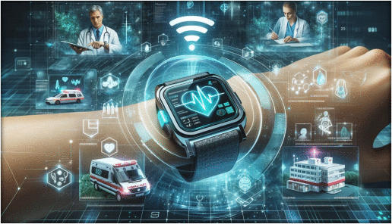
BIOSENSORS
PLANNING MODEL APPLICATION
(Mishra, 2024)

Slide 2
Application: Planning Model in Elderly people at Home
PRECEDE- PROCEED PLANNING MODEL
The Precede Proceed Planning Model it is the application will be used to evaluate the target population for elderly people at home (Binkley, 2013). The Precede Model involves 8 different components that consist evaluate the implementation of the strategy of the elderly population (Binkley, 2013).
PRECEDE PLANNING MODEL COMPONENT
Phase 1. Social Assessment
Phase 2. Epidemiological Assessment
Phase 3. Educational and Ecological Assessment
Phase 4. Administrative, Policy Assessment and Intervention

Slide 3
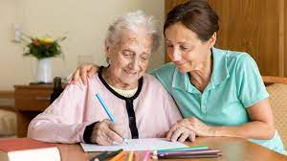
PRECEDE PLANNING MODEL COMPONENT
Social Assessment
Elderly people are more likely to suffer from loneliness and social isolation, chronic conditions and multimorbidity (Golinowska,2016). Furthermore, the elderly population is considered vulnerability that has been increased prevalence and has demonstrated that certain factors that includes lack of knowledge and understanding risks of factors (Cantone,2023). However, health promotion presents certain strategies for the elderly in 3 basic aims:
Maintaining and increasing functional capacity
Improving self-care
Stimulating social network (Golinowska, 2016)
2. Epidemiological Assessment
The epidemiological assessment is based on elderly population and the biosensors, it is a potential digital technology that may be evaluate and detect emergency problems or accidents such as stroke, fall and cardiovascular diseases (Kul, 2024).
(BBC, 2020)

Slide 4
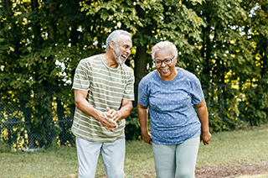
3. Educational and Ecological Assessment
However, Biosensors may be improving self-management of chronic diseases of elderly people and it is extremely important to educate healthcare professionals how to use this digital technology as a biosensors (Kul, 2024). Additionally, biosensors has capacity to communicate through the body and demonstrate reactions during environment to detect diseases and improve health on time ( Kul,2024).
4. Administrative, Policy Assessment and Intervention
Biosensors, applied in elderly population can be solved problems that to prevent interventions such as :
Treatments costs
Healthcare costs that reducing risks factors (Haleem, 2021)
(NIEHS, 2021)

Slide 5

PROCEED PLANNING MODEL COMPONENT
Phase 5. Implementation
Phase 6. Process evaluation
Phase 7. Impact evaluation
Phase 8. Outcome evaluation
PROCEED PLANNING MODEL COMPONENT
Phase 5. Implementation
Nowadays, elderly population has increased significantly at healthcare services (Kul,2024). Biosensor it is useful and economical that can have capacity to collect the urine of elderly population who have urinary incontinence (Kul, 2024).
Phase 6. Process evaluation
In tecnology biosensors may be incorpored in many differnts ways such in shoes, clothing, attached to the wrist, ankle or carrying on in a pocket (Vavasour,2022)
(Innovenn, 2024)

Slide 6
Phase 7. Impact evaluation
The main causes of diseases in elderly people aged 60 correspond to;
Cardiovascular disease
Cancer
Chronic Lung disease
Musculoskeletal disease
Mental disorders
However, the causes of disease demonstrated negative impact that affecting the phsysical integarty of patients, emotional and economic (Aguirre, 2022).
Phase 8. Outcome evaluation
Use of biosensors morbidity and mortality may be reduced in emergency and accidents (Kul, 2022). Therefore, use this digital technology has demonstrated that the quality of care has been increased and the satisfaction of the elderly population (Kul,2022).
(Innovenn, 2024)

Slide 7
References
Aguirre, Jose Oscar (2022) "Remote Healthcare for Elderly People Using Wearables: A Review". 12(2) pp-73 (Accessed 8th of December 2024)
Binkley, CJ (2013) "Application of the PRECEDE-PROCEED Planning Model in Designing an Oral Health Strategy ".Pub Med Central.1 (3). 14-25 (Accessed 5h of December 2024)
BBC (2020) "NHS pledges elderly rapid response community teams". BBC News [online] www.bbc.co.uk/news/health-51198992 (Accessed 5th of December 2024)
Cantone, Andrea (2023) "Enhancing Elderly Health Monitoring: Achieving Autonomous and Secure Living through the Integration of Artificial Intelligence, Autonomous Robots, and Sensors".12(18): 3918 (Accessed 8th of December 2024)
Golinowska, Stanislawa (2016) "Health Promotion Targeting Older People ".Pub Med Central. 16 (5).345 (Accessed 4th of December 2024)
Haleem, Abid; Javaid, Mohd; Singh, RP; Suman,Rajiv; Rab, Shanay (2021) "Biosensors applications in medical field: A brief review". Science Direct. Volume 2, 2021 (Accessed 8th of December 2014)

Slide 8
Innovenn (2024) "DHTs (Digital Health Technologies) in Clinical Investigations" [online] www.innovenn.com/software-as-a-medical-device-samd/validation-of-dhts/ (Accessed 8th of December 2024)
Kul, B (2024) "Biosensor applications in the monitoring of elderly patients" .(1) pp.35-44 (Accessed 8th of December 2024)
Mishra, Anshuman (2024) " Emergence of integrated biosensing- enabled digital healthcare devices". Science Direct. Volume 3, Issues, pp 718-744 (Accessed 5th of December 2024)
NIEHS (2021) "Core Centers Study How Environment Affects Older Adult Health" [online] www.niehs.nih.gov/research/supported/centers/core/spotlight/adult_health (Accessed 8th of December 2024)
Vavasour, Grainne (2021) "How wearable sensors have been utilised to evaluate frailty in older adults: a systematic review".PuB Med Central. 18(1) pp-112 (Accessed 8th of December 2024)

