Slide 1
SBPD8001
Preparing for doctoral research
05 Skills Development

Slide 2
A typical doctorate involves:
Carrying out a literature review.
Conducting original research and collecting your results.
Producing a thesis that presents your conclusions.
Writing up your thesis and submitting it as a dissertation.
Defending your thesis in an oral examination.

Slide 3
Skills development
Being a research student is not just about completing a research project.
It is about the all-round development as a researcher with all the necessary skills to become a business or academic researcher.
What skills do you feel you have developed in Part 1 of the DBA programme?
What skills do you feel you have developed from your work place experiences?
What skills do you feel will be especially important during Part 2 of the DBA programme?

Slide 4
Developing personal skills
Skill | Rank | Description
Work-Life Balance | 1 | Maintain a healthy balance between work and life
Time Management | 2 | Prioritise, delegate and use resources to manage time better
Active Listening | 3 | Listen to understand and respond appropriately
Self-Confidence | 4 | Manage your emotions and fears, and deal with others’ negative behaviours positively
Communication Skills | 5 | Use the right tone and voice for communicating clearly and confidently
Emotional Intelligence | 6 | Stay aware of your and others’ emotions to build healthy work relationships
Leadership | 7 | Have the vision, communication ability, and management skills to influence and direct others
Problem-Solving Ability | 8 | Recognise problems, consider options, and make the best possible decision
Organising | 9 | Use ways to organise tasks, time and materials
Body Language | 10 | Use correct body language to communicate suitably

Slide 5
Researcher development programme(RDP)
UWTSD’s Research, Innovation and Enterprise Services (RIES) offers a range of services to postgraduate students through the Researcher Development Programme(RDP).
  https://www.uwtsd.ac.uk/rdp/
  Three Minute Thesis
  https://www.uwtsd.ac.uk/rdp/three-minute-thesis-3mt/

Slide 6
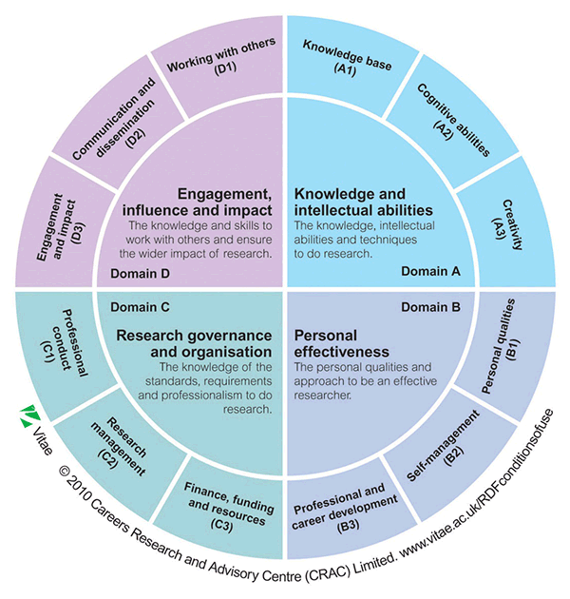
Researcher Development Framework

Slide 7
Why should I get involved in the RDP?
To become more effective researchers and to succeed in your future careers you need to develop a range of professional skills, such as:
  Developing your knowledge and intellectual abilities
  Public engagement
  Writing and presentation skills
  Project management
  Organisational skills
  Working with others
  Research integrity
  Understanding HE environment

Slide 8
What’s included in the RDP?
Structured Training
Courses from the UWTSD RDF program
Courses run by individual UWTSD Schools
Other UWTSD courses: e.g. those run by Library and Learning Services
Vitae programme courses
Training events delivered by professional bodies and Research Councils
Training courses and workshops run by other Higher Education Institutions
Any other appropriate external courses

Slide 9
What’s included in the rdp?
Developmental or ‘On-the-Job’ training
Attendance at conference
Journal publication or similar
Presenting a paper
Organising a university event or seminar
Demonstrating or teaching
Involvement in departmental project or similar
Work shadowing / work experience
Visiting a careers fair or similar

Slide 10
Why network?
Graduates are increasingly finding it difficult to find professional employment
  Flat job market
  Credential inflation
  International competition
“Networking accounts for about 87% of business in the marketplace, yet many people continue to neglect networking and fail to see it as a vital business and career building skill” (Henderson, 2004)
Great way to research industry / positions, get introductions and career advice
Networking can uncover ‘foot-in-the-door’ opportunities: work experience, casual/part-time, temp employment
Demonstrates initiative, drive and a positive attitude
Markets yourself proactively to the job you want
Henderson, R. (2004). How to master networking, Sea Change Publishing

Slide 11
Benefits
Get first hand, relevant information about the realities of working within a particular field, industry or position. This kind of information is not always available online or in print
Find out about career paths you did not know existed
Get tips about how to prepare for and enter a given career
Improve your communication skills and confidence speaking with professionals.
Learn what it’s like to work at a specific organization
Gain knowledge that can help you in writing your resume, interviewing for jobs in the field, and your other job search activities
Initiate a professional relationship and expand your network of contacts in a specific career field; meet people who may forward job leads to you in the future

Slide 12
where and how to network?
Use university assignments to make industry connections via case studies, professional projects and research projects
Attend university guest speaker lectures and alumni events – usually have a networking opportunity
Attend open business events
Attend conferences
Present papers or speak at conferences

Slide 13
where and how to network?
Join professional associations
Volunteer as a helper in admin/at events/organising committees, etc
Connect with and talk to other research students
Join online groups in subject/topic/functional area/sector interests
Ensure own appropriate online profiles
  LinkedIn and ResearchGate

Slide 14
Where and how to network?
Be authentic – be yourself
Networking is reciprocal - the other person may learn as much from you are you do from them
Do some preparation first – be clear about what you want to discuss
Build rapport by encouraging the other person to talk about themselves (e.g. background, career path, industry observations, current issues)
Be prepared to talk about yourself – your study, what you’ve enjoyed, your career goals, and what you think are your strengths (professional pitch)
Follow up – think about something to share
  e.g. an interesting and relevant article or contact

Slide 15
Where and how to network?
Never ask for a job, most people don’t have the power to give you a job
Ask for information (because that’s free!) and 10 - 20 minutes of their time so that you can ask them some pre-prepared questions about their experience of the industry you wish to join
Most people remember what it was like to start in their field and are happy to support new graduates with some guidance
Care with:
  Body language - eye contact, smile, personal space
  Time
  Being too pushy
  Don’t expect too much – they are one source of information

Slide 16
NETWORKING PLAN
What is my aim?
Who are my ideal connections?
What groups will they come from?
What organisations will they come from?
How can I help these people?
How can I connect with them?
What is my professional pitch?

Slide 17
Epilogue

Slide 18
The three stages of learning (治學三境界) Wang Guowei (王國維)
Vision
Persistence
Opportunity
王國維在《人間詞話》中說: 古今之成大事業、大學問者，必經過三種之境界:
「昨夜西風凋碧樹，獨上高樓，望盡天涯路」此第一境也，「衣帶漸寬終不悔，為伊消得人憔悴」此第二境也，「眾裏尋他千百度，驀然回首，那人卻在，燈火闌珊處」此第三境也。
做學問首先要有執著的追求，登高望遠，瞰察路徑，明確目標與方向。
大學問者，不是輕而易舉，隨便可得的，必須堅定不移，經過一番辛勤勞動，廢寢忘食，孜孜以求，直至人瘦衣寬也不後悔。
要達到第三境界，必須有專註的精神，反復追尋、研究，下足功夫，機遇湊合，自然會豁然貫通，有所發現，有所發明。
Sections of three poems from the Sung dynasty
The green trees withered in the west wind last night. Alone I ascend the towering building, overlooking the endless distance.
I find my gown too large but I will not regret; its worthwhile growing languid for my love one.
Hundreds and thousands of times I searched in chaos. Suddenly I turned by chance, to where the lights were dim, and there he stood.

Slide 19
Five Attributes of an Educated Person
The ability to think and write critically
Informed acquaintance with different disciplines
Knowledge of other cultures and times
Understanding of, and experience in thinking about, moral and ethical problems
Depth of knowledge in some field of knowledge
Henry Rosovsky reflected Harvard's general education reform efforts of the mid-1970s in his 1990 autobiography

Slide 20
Online resources
The animated guide to a Ph.D.
https://www.youtube.com/watch?v=We760YM5-iM&feature=youtu.be
Things about a PhD nobody told you about | Laura Valadez-Martinez | TEDxLoughboroughU
https://www.youtube.com/watch?v=CAKsQf77nHU

