Slide 1
BUSINESS PLAN
Title: Matcha Bliss
Mariana Codreanu 2118364
Diana Olimpia Ciolte 2122278
Group:1
Lecturer Name: Obina Nkwocha

Slide 2

Summary
Company overview
Mission and Vision Statements
Company Services
Market Audit – Competitor’s Analysis
SWOT Analysis
PESTLE Analysis
Target Market
Marketing and Sales Plan
Management Team
Financial Plan
References

Slide 3

Company Overview
Matcha Bliss – is a matcha based vending machine. Matcha is a delicious healthy coffee alternative, providing a balanced caffeine intake and a high dose of antioxidants among many other health benefits. The pioneer of matcha drinks in Birmingham. Matcha bliss machines will provide along with amazing and trendy drinks, opportunities to enjoy the best products anytime, anywhere. An eco-friendly packaging and a healthy product will provide satisfaction with every cup of drink.
Our desire is to serve a matcha experience that exceeds the norm, and to become the embodiment of what is expected in a cup of matcha and more.
The purpose of this business plan is to raise £100,000 from vending machines and to go for development of a gourmet coffee shop while showcasing the expected financials and operations over the next few years.

Slide 4

Mission and vision statements
Mission Statement – Matcha Bliss is to develop and market delicious, healthful, and organic beverages. With sustainability and great taste for everyone as our goals, we work hard to expand our company with the same honesty and integrity we use to create our recipes.
Vision statement - to introduce innovations and provide delicious, wholesome, and organic beverages.

Slide 5
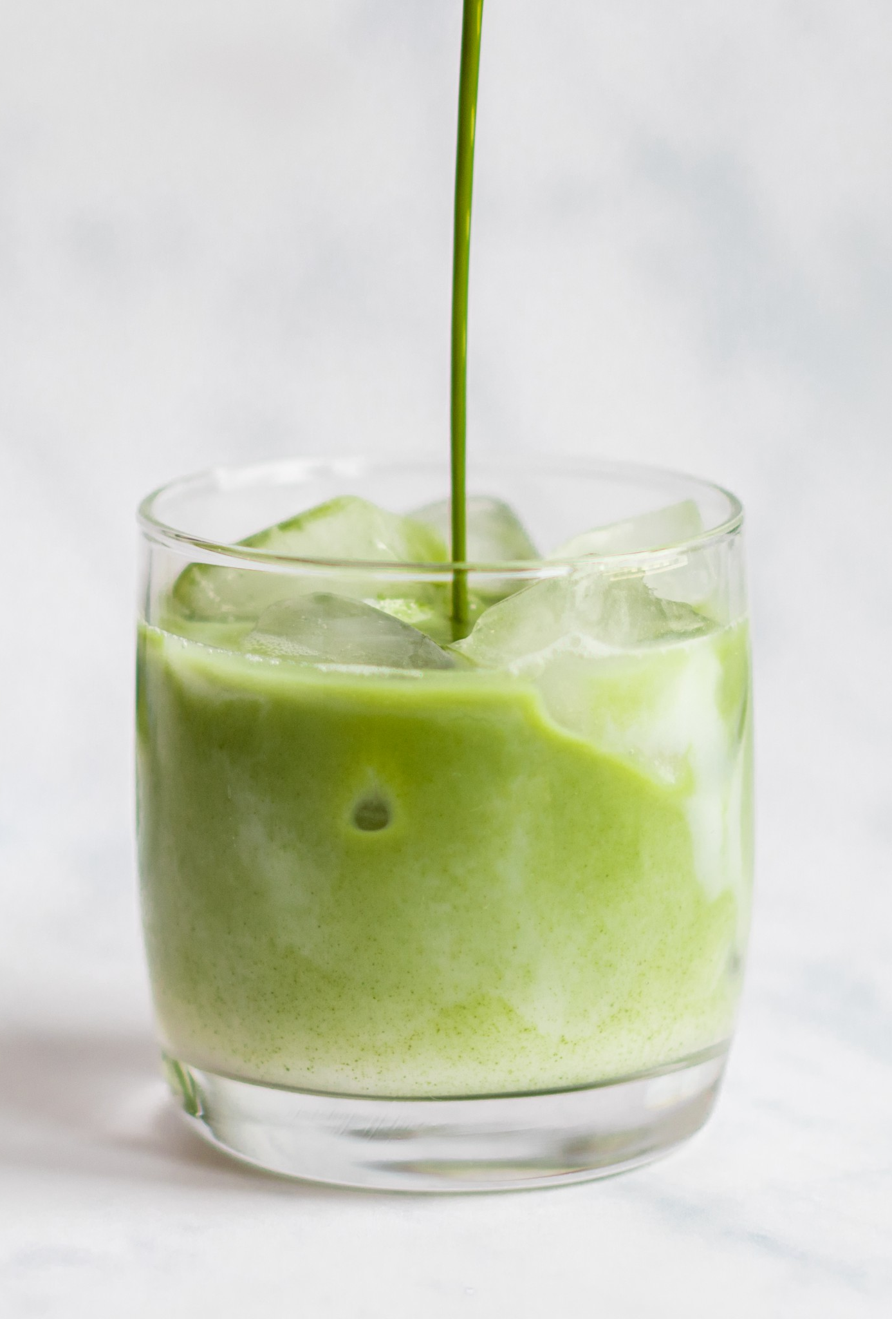
Products and Services
The primary revenue source for the business will come from the direct sale of matcha tea powder hot and cold drinks to customers.
The business will carry several dozen different varieties, flavours, and matcha based coffees.
In addition to the matcha drinks, the business will also sell matcha based snacks ( cookies, protein bars)
Also, will be included matcha cold drinks, iced lattes and teas.

Slide 6
Market audit-Competitor’s Analysis
Market research blends consumer behavior and economic trends to confirm and improve your business idea. Understanding your customer base from the start is essential. Even when your company is still only a vision in your mind, market research allows you to lower risks.
You may learn from businesses that are striving for your potential clients through competitive analysis. This is crucial for identifying a competitive advantage that generates long-term revenue.
All businesses have competition, to enter a new business on the market it is mandatory to do a competitor research. We identified 3 top vending machines companies in Birmingham:

Slide 7
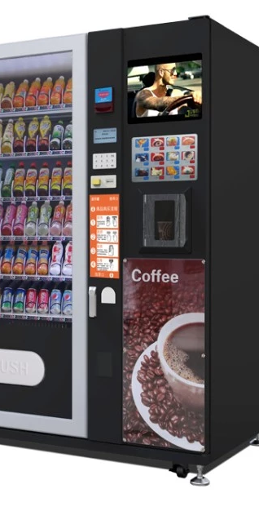
Market audit-Competitor’s Analysis
Exact vending is the leading supplier of vending machines in Birmingham.
Coinadrink - are specialists in delivering a diverse lined up of Birmingham vending machines, water dispensers, water coolers and micro markets across Birmingham and throughout West Midlands county.
EasyVend - Birmingham based Vending Machine company a well established local company who are big enough to deal with any size workforce, whether you have five staff and require a tabletop machine or five thousand staff and require multiple vending machines.
These are the Three of the best vending machines companies in Birmingham that my colleague and I will be analysing in order to prep our company Oversee for comparison.

Slide 8
Market Audit-Swot Analysis
Strenghts
High service culture
Weaknesses
Highly competitive
Threats
Difficulty to maintain cash flow
Opportunities
Rewards and brand loyalty
Continues sales
Original products
Healthy products
Good prices
Cost disadvantage
Hard to make a name
New technique and innovation
Limited market data
Product line extension
Mobile application
Home delivery
Costly supplier
The low price of competitors
Consumer preferences

Slide 9
Market Audit-PESTLE Analysis
Political
Tax and economic policies
Political stability
Economical
Demand and supply
Economic growth and development
Social
People’s health consciousness,
Cultural shifts, including organic and healthy options for different cultures.
Foreign trade regulations
Employment laws
Employment and income
Fair trade
Technological
Multipurpose coffee machine
Consumers buying their own coffee machines
Environmental
Ecological product, brings no damage to the environment
Legal
Consumer protection laws
Organizational laws
New genetically engineered coffee seeds offering finest coffee and longer shelf life.
Health and Safety laws

Slide 10
Target Market
A target market is a group of customers who have been identified as the most likely buyers of a company’s product or service.
The target market for a coffee k is everyone who drinks coffee.
Matcha bliss is a new version of healthy coffee which is based in more locations, for example in train stations, supermarkets, malls with vending machines and quickly accessible for everyone even for students , they will have easy access to vending machines in their University.
Coffee drinkers span geographical locations, age groups and genders.

Slide 11
PRODUCT | PRICE
Matcha coffee | £5.50
Matcha cappuccino | £4.00
Matcha latte | £4.00
Iced matcha latte | £5.50
Matcha tea | £4.50
Teas | £2.00
Marketing and Sales Plan
We will market our coffee shop to the customers with vending machines in different locations. Also, we will use social media marketing to find potential clients like Instagram and Facebook. This two social media will help our clients to be updated with menus, offers and discounts.
We also create an app and website where we provide the option to order coffee and pick it up from the location. During the week we will offer discounts on coffee to attract more people.

Slide 12
Management Team
Matcha bliss café is a small business that came to life to bring innovation to good taste for people in this city. Being a matcha lovers, we want to share with the world the ultimate coffee experience. As we starting small, but seeking to grow big, our start team members are:
Mrs. Mariana Codreanu - MANAGING DIRECTOR, who will be responsible in creating plans and policies to help the business achieve its objectives, developing business strategies, and implementing business plans to accomplish the goals. Also, find suppliers, provide equipment and expanding the business.
Miss Olimpia Ciolte - BUSINESS OPERATIONS MANAGER who will be oriented to improve business operations and to increase the profit, and to manage marketing campaigns. Also, to monitor daily operations and address potential issues when they arise and ensure all systems operate smoothly and align with our quality standards.
Mr John Dave – STAFF MEMBER who will be responsible in carrying out assigned tasks, like, daily checking the machines condition, ensure that all of them are refilled and the products are up to date.
Diana Olimpia Ciolte

Slide 13

Financial plan
Cashflow Forecast
Profit and Loss
Start-up Cost:
Total Income:
Total Expenses:
Gross Profit:
Net Profit:

Slide 14
 | CASH FLOW FORECAST
 | Jan | Feb | Mar | April | May | Jun | Jul | Aug | Sept | Oct | Nov | Dec
 |  |  |  |  |  |  |  |  |  |  |  |  | Totals
Sales Income | £0.00 | £1,000.00 | £1,800.00 | £2,700.00 | £2,700.00 | £2,700.00 | £2,700.00 | £2,700.00 | £3,600.00 | £3,600.00 | £3,600.00 | £3,600.00 | £30,700
Grants | £0.00 | £0.00 | £0.00 | £0.00 | £0.00 | £0.00 | £0.00 | £0.00 | £0.00 | £0.00 | £0.00 | £0.00 | £0
Bank Loan | £0.00 | £0.00 | £0.00 | £0.00 | £0.00 | £0.00 | £0.00 | £0.00 | £0.00 | £0.00 | £0.00 | £0.00 | £0
Investment by Owner | £15,000.00 | £0.00 | £5,000.00 | £0.00 | £0.00 | £0.00 | £0.00 | £2,000.00 | £0.00 | £0.00 | £0.00 | £0.00 | £22,000
Any Other Income | £0.00 | £0.00 | £0.00 | £0.00 | £0.00 | £0.00 | £0.00 | £0.00 | £0.00 | £0.00 | £0.00 | £0.00 | £0
Total Incoming | £15,000 | £1,000 | £6,800 | £2,700 | £2,700 | £2,700 | £2,700 | £4,700 | £3,600 | £3,600 | £3,600 | £3,600 | £52,700
Stock/ Materials | £10,200.00 | £200.00 | £5,400.00 | £400.00 | £400.00 | £400.00 | £400.00 | £2,400.00 | £400.00 | £400.00 | £400.00 | £400.00 | £21,400
Rent & Rates | £250.00 | £250.00 | £250.00 | £250.00 | £250.00 | £250.00 | £250.00 | £250.00 | £250.00 | £250.00 | £250.00 | £250.00 | £3,000
Wages | £0.00 | £0.00 | £0.00 | £0.00 | £0.00 | £0.00 | £0.00 | £500.00 | £500.00 | £500.00 | £500.00 | £500.00 | £2,500
Insurances | £100.00 | £100.00 | £100.00 | £100.00 | £100.00 | £100.00 | £100.00 | £100.00 | £100.00 | £100.00 | £100.00 | £100.00 | £1,200
Repairs and Maintenance | £0.00 | £0.00 | £500.00 | £0.00 | £0.00 | £500.00 | £0.00 | £0.00 | £500.00 | £0.00 | £0.00 | £500.00 | £2,000
Motor Expenses | £50.00 | £50.00 | £50.00 | £50.00 | £50.00 | £50.00 | £50.00 | £50.00 | £50.00 | £50.00 | £50.00 | £50.00 | £600
Phone/Internet | £20.00 | £20.00 | £20.00 | £20.00 | £20.00 | £20.00 | £20.00 | £20.00 | £20.00 | £20.00 | £20.00 | £20.00 | £240
Advertising | £300.00 | £50.00 | £50.00 | £50.00 | £50.00 | £50.00 | £50.00 | £50.00 | £50.00 | £50.00 | £50.00 | £50.00 | £850
Accountancy Fees | £400.00 | £400.00 | £400.00 | £400.00 | £400.00 | £400.00 | £400.00 | £400.00 | £400.00 | £400.00 | £400.00 | £400.00 | £4,800
Total Outgoing | £11,320 | £1,070 | £6,770 | £1,270 | £1,270 | £1,770 | £1,270 | £3,770 | £2,270 | £1,770 | £1,770 | £2,270 | £36,590
Incoming less outgoing | £3,680 | -£70 | £30 | £1,430 | £1,430 | £930 | £1,430 | £930 | £1,330 | £1,830 | £1,830 | £1,330 | £16,110
Opening Bank Balance | £0 | £3,680 | £3,610 | £3,640 | £5,070 | £6,500 | £7,430 | £8,860 | £9,790 | £11,120 | £12,950 | £14,780
Closing Bank Balance | £3,680 | £3,610 | £3,640 | £5,070 | £6,500 | £7,430 | £8,860 | £9,790 | £11,120 | £12,950 | £14,780 | £16,110

Slide 17
Profit and Loss
Profit and Loss
Gross Total income | £295,700.00
Total expenses | £163,200.00
Gross profit | £132,500.00
Tax payable 20% | £26,500.00
Net profit | £106,000.00
Individual profit (divide/2) | £53,000.00

Slide 18
References
Barrow, C., Barrow, P. and Brown, R. (2012) The business plan workbook. 7th ed. London
Young, P. (no date) Business Plan. Place of publication not identified: Global Media Publications.
Blackwell, E. (2011) How to prepare a business plan. 5th ed. London ;: Kogan Page.
Cohen, G.N. (1994) The business plan approved!. Aldershot: Gower.
Hazelgren, B.J. and Hazelgren, B.J. (2005) Your First Business Plan A Simple Question and Answer Format Designed to Help You Write Your Own Plan. 5th ed. Naperville: Sourcebooks, Inc.
https://www.thefinanceresource.com/free_business_plans/free_gourmet_coffee_shop_business_plan.aspx
https://www.edrawmind.com/article/swot-analysis-of-coffee-shop.html
https://www.marketingtutor.net/pestle-analysis-of-the-coffee-industry/

Slide 19

Thank You
Questions?

