Slide 1








LCLM4006 Enterprise and Entrepreneurship
Task 2: Individual presentation Pitch
Elvis Gjini
2434008

Slide 2
Overview of the Business Idea
NourishLoop Ltd provides meal kits consisting of subscriptions to the citizens of the UK.
The company focuses on the professionals and students who are in need of convenient and healthy food.
Foods are healthy, convenient to cook and minimise waste.
Millennials and generation z are interested in plant-based and flexitarian diets (Ozbun (2025).
Subscriptions, preferences and nutrition tracking are effectively made possible through digital platform (Novakova, 2024).
Notes:
Slide 2: Overview of the Business Idea
NourishLoop Ltd is a social enterprise food business in the UK that delivers meal kits to professionals and students in urban areas through subscriptions. The company reacts to the market increase in demand of healthy, convenient, and green food solutions (Novakova, 2024). The meal kits offered by the company are meant to be balanced in nutrition, prepared in less time, and delivered weekly to enable customers manage their diets effectively in addition to ensuring that there is minimal household food waste.
The delivery is performed in a digital-first setting, where customers have the ability of subscribing, choosing their dietary preferences, and monitoring their nutrition in a digital format (Yasir et al., 2023). This practise is in line with the modern consumer trends, which are underpinned by convenience, technology, and environmental friendliness in purchasing (Venkat, 2025).
NourishLoop also will be capitalising on the trend of the plant-based and flexitarian diet, which is gaining popularity in the UK. Ozbun (2025) says that Millennials and Generation Z are more inclined to buy flexible, ethical, and environmentally friendly food, which is especially popular among younger generations.

Slide 3
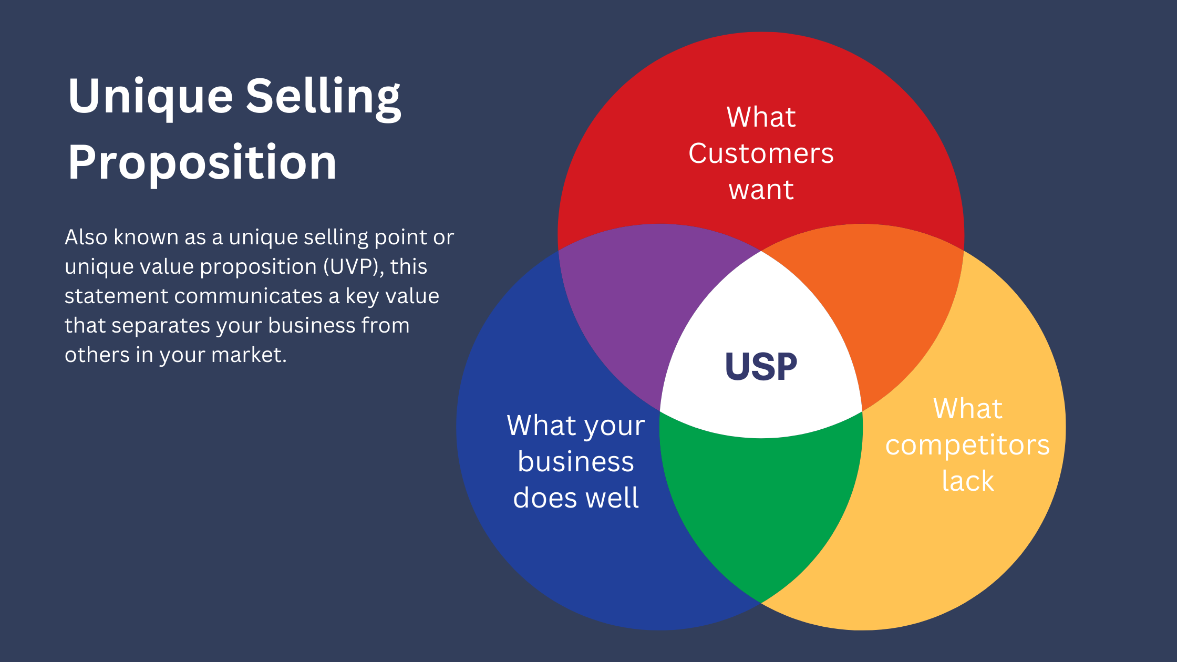
Product and Unique Selling Points
Unique Selling Points (USPs):
Reduction of household food waste
Sustainability-focused sourcing and packaging
Flexible digital subscription model
Products/Services Offered:
Meal-kits subscriptions every week.
Ready-made ingredients of easy recipes.
Flexitarian and vegetarian food choices.
Notes:
Slide 3: Product and Unique Selling Points
Products/Services Offered: Meal-kits subscriptions every week. Ready-made ingredients of easy recipes. Flexitarian and vegetarian food choices.
Unique Selling Points (USPs):
Reduction of household food waste: Pre-made ingredients lower the levels of consumption and waste, which are associated with environmental responsibility (Dote-Pardo et al., 2025).
Sustainability-focused sourcing and packaging: Ingredients are sourced in a socially friendly way, and packaging is reusable or recyclable, which is attractive to environmentally friendly customers (Kaur, 2026).
Flexible digital subscription model: The customers will be able to pause, change, or cancel subscriptions via the online platform, which would make it more convenient and satisfying to the users (Navarro, 2025).
These USPs distinguish NourishLoop among bigger meal-kit organisations by focusing on sustainability, health, and convenience all at the same time, which enables the firm to appeal to smaller but expanding segments of the market (Baena-Luna and Garccia-Rio, 2025).

Slide 4


Management Structure and Legal Format
Managing Director: The Managing Director monitors the strategic direction in the company, operation of the key partnerships and relations with the investors.
Operations Manager: The Operations Manager will have the duty of sourcing ingredients, logistics and adhering to food safety regulations.
Marketing & Digital Manager: The Marketing and Digital Manager will be in charge of the branding of the company, customer acquisition.
Legal Format (UK Private Limited Company (Ltd): It limited liability and credibility amongst investors making future equity financing easy. Such a structure is very popular among UK startups that aim at getting scalable, investment, and operating flexibility (Urbano et al., 2022).
Notes:
Slide 4: Management Structure and Legal Format
Management Structure:
Managing Director: The Managing Director monitors the strategic direction in the company, operation of the key partnerships and relations with the investors.
Operations Manager: The Operations Manager will have the duty of sourcing ingredients, logistics and adhering to food safety regulations.
Marketing & Digital Manager: The Marketing and Digital Manager will be in charge of the branding of the company, customer acquisition, and using data analytics to further develop the business.
The lean management system that NourishLoop embraces is aligned with the best practises in the early-stage entrepreneurship, which fosters agility, quick decision-making, and creativity (Wales et al., 2020).
Legal Format (UK Private Limited Company (Ltd): It limited liability and credibility amongst investors making future equity financing easy. Such a structure is very popular among UK startups that aim at getting scalable, investment, and operating flexibility (Urbano et al., 2022).

Slide 5




Consumer spending is affected by the UK inflation and cost-of-living pressures.
The food prices had gone up to 40 years high.
Demand The demand of convenient food solutions is still high among time-starved professionals.
External Factor 1 – Economic (PESTEL)
Notes:
Slide 5: External Factor 1 – Economic (PESTEL)
Economic forces are important in influencing the consumer environment of NourishLoop. UK has also encountered high inflation rates and pressures on the cost of living as food prices are at a record high in 40 years (Nanji, 2022). Increasing energy prices as well as ingredient prices influence the household disposable income which influences the spending patterns. In spite of these pressures, there is still high demand of convenient food solutions among professionals with little time, who are ready to pay high prices in order to enjoy convenience and health perks (Novakova, 2024). This trend is an indication that NourishLoop will be able to go after consumers who focus on health, convenience, and sustainability rather than on the price sensitivity, which is consistent with the value proposition of the company (BBC News, 2021).

Slide 6

External Factor 2 – Social (PESTEL)
Raising health consciousness and ethical consumption.
High consumer demand of responsible and sustainable businesses.
High demand of ready food that is convenient and ready to cook among the younger generations.
Notes:
Slide 6: External Factor 2 – Social (PESTEL)
NourishLoop market strategy is highly subject to social trends. The UK consumers have a growing health, ethical, and sustainability awareness (Dote-Pardo et al., 2025). The younger generations embrace the brands which are socially and environmentally responsible, which enhances customer loyalty and customer involvement. Moreover, questionnaires reveal that 72% of the Generation Z and 68% of Millennials in the UK prefer convenience, ready-to-cook meals products (Ozbun, 2025). This bodes a good market potential to NourishLoop as the brand targets directly these social preferences by offering nutritionally balanced meals with sustainable sources.

Slide 7


External Factor 3 – Technological (PESTEL)
Expansion of online shops and online payments.
Application of data analytics in individualised customer experience.
Generative AI applications in the future in demand forecasting and meal customisation.
Notes:
Slide 7: External Factor 3 – Technological (PESTEL)
NourishLoop has technology that facilitates its operations and scalability. The expansion of e-commerce tools, online payments, and analytics enables the free interaction with customers and controlling subscriptions (Kusetogullari et al., 2025). Besides, generation AI could be introduced in the future to demand prediction, logistics optimization, and meal planning to enhance operational efficiency and customer satisfaction. Digital and personalised experiences (Venkat, 2025) are other factors that prove advantageous in leveraging technology to make NourishLoop relevant in a market that is becoming more digital.

Slide 8



Marketing Strategy 1 – Digital & Social Media Marketing
Use of Instagram and Tik Tok to tell a visual storey.
Advertisement of food, green behaviour and reviews.
Participations with fitness and nutrition influencers.
Impact of macroeconomic factors
Notes:
Slide 8: Marketing Strategy 1 – Digital & Social Media Marketing
The key factor in the customer acquisition strategy of NourishLoop is digital marketing. Visual storytelling will be implemented on platforms like Instagram and Tik Tok, where the meal kits, sustainability efforts, and customer reviews will be posted. Partnerships with fitness and nutrition influencers will make it more credible and reach a wider audience at a low cost (Navarro, 2025). This approach is in line with studies that have suggested digital channels play a major role in creating brand awareness and trust particularly when a startup requires quick access to tech-savvy consumers (Kitanovski, 2024).

Slide 9

Marketing Strategy 2 – Subscription & Referral Programmes
1
Introductory discounts- this will attract new customers.
2
Referral bonuses promote by word-of-mouth.
3
Loyalty reward keeps long time subscribers.
Notes:
Slide 9: Marketing Strategy 2 – Subscription & Referral Programmes
The flexibility of subscription, referral incentives, and loyalty programmes help the company retain their customers: Introductory discounts- this will attract new customers. Referral bonuses promote by word-of-mouth. Loyalty reward keeps long time subscribers.
This is a dual approach, which combines both the digital marketing approach and the behavioural incentive to increase the organic growth and stabilise the revenue streams during the initial growth phase (Yoke and Rizal, 2025).

Slide 10

Funding Requirements, Allocation & Conclusion
Total Funding Required: £80,000
Funding Sources:
£30,000 – Founder investment
£50,000 – Angel investors
Allocation of Funds:
Kitchen rental & equipment: £28,000
Ingredients & packaging: £12,000
Website & digital marketing: £15,000
Staff wages: £16,000
Legal, utilities & contingency: £9,000
Notes:
Slide 10: Funding Requirements, Allocation & Conclusion
Total Funding Required: £80,000
Funding Sources:
£30,000 – Founder investment
£50,000 – Angel investors
Allocation of Funds:
Kitchen rental & equipment: £28,000
Ingredients & packaging: £12,000
Website & digital marketing: £15,000
Staff wages: £16,000
Legal, utilities & contingency: £9,000
The financing model is a combination of internal commitment and external expertise and capital and minimises risks at the initial stage and enables a quick entry to the market (Gupta et al., 2024).

Slide 11


Conclusion
NourishLoop Ltd incorporates an innovative, sustainable and market-driven solution that is directly in line with the current consumer trends in UK.
Its digital innovation, sustainability, and convenience are an attractive prospect of an investor interested in a high-growth business in the healthy meal-kit industry.
Notes:
Slide 11: Conclusion
NourishLoop Ltd incorporates an innovative, sustainable and market-driven solution that is directly in line with the current consumer trends in UK. Its digital innovation, sustainability, and convenience are an attractive prospect of an investor interested in a high-growth business in the healthy meal-kit industry.

Slide 12
Reference List
Baena-Luna, P. and García-Río, E. (2025). Corporate entrepreneurship strategy: measuring and mapping an impact model. Journal of Innovation and Entrepreneurship, 14(1), p.64. doi:https://doi.org/10.1186/s13731-025-00516-6.
Dote-Pardo, J., Ortiz-Cea, V., Peña-Acuña, V., Severino-González, P., Contreras-Henríquez, J.M. and Ramírez-Molina, R.I. (2025). Innovative Entrepreneurship and Sustainability: A Bibliometric Analysis in Emerging Countries. Sustainability, 17(2), p.658. doi:https://doi.org/10.3390/su17020658.
Kaur, S. (2026). Analyzing business model innovation and market entry strategies for agri-based enterprises: a financial perspective. Frontiers in Sustainable Food Systems, 9. doi:https://doi.org/10.3389/fsufs.2025.1719231.
Kusetogullari, A., Kusetogullari, H., Andersson, M. and Gorschek, T. (2025). GenAI in Entrepreneurship: a systematic review of generative artificial intelligence in entrepreneurship research: current issues and future directions. [online] arXiv.org. Available at: https://arxiv.org/abs/2505.05523?utm [Accessed 19 Feb. 2026].
Nanji, N. (2022). UK inflation: Food costs push price rises to new 40-year high. BBC News. [online] 17 Aug. Available at: https://www.bbc.com/news/business-62562025 [Accessed 19 Feb. 2026].
Navarro, J.G. (2025). Contribution of digital marketing to companies’ performance in the UK 2022. [online] Statista. Available at: https://www.statista.com/statistics/283091/digital-marketing-performance-uk/ [Accessed 19 Feb. 2026].
Novakova, M. (2024). The UK start-up ecosystem: Opportunities and Challenges. International Journal of Science and Research Archive, 12(2), pp.1445–1451. doi:https://doi.org/10.30574/ijsra.2024.12.2.1403.
Ozbun, T. (2025). Share of consumers who prefer food to be convenient in the UK 2023/24, by generation. [online] Statista. Available at: https://www.statista.com/forecasts/1388038/consumers-who-think-food-should-be-convenient-uk-by-generation/?srsltid=AfmBOoozQHEoMfmz0KPB23oESBjaKOxEnMsFjvii34iHDMlOX_OyRBTc [Accessed 19 Feb. 2026].
Wales, W.J., Covin, J.G. and Monsen, E. (2020). Entrepreneurial orientation: The necessity of a multilevel conceptualization. Strategic Entrepreneurship Journal, 14(4), pp.639–660. doi:https://doi.org/10.1002/sej.1344.
Yasir, M., Majid, A., Yousaf, Z., Nassani, A.A. and Haffar, M. (2023). An integrative framework of innovative work behavior for employees in SMEs linking knowledge sharing, functional flexibility and psychological empowerment. European Journal of Innovation Management, 26(2), pp.289–308. doi:https://doi.org/10.1108/ejim-02-2021-0091.
Notes:
Baena-Luna, P. and García-Río, E. (2025). Corporate entrepreneurship strategy: measuring and mapping an impact model. Journal of Innovation and Entrepreneurship, 14(1), p.64. doi:https://doi.org/10.1186/s13731-025-00516-6.
Dote-Pardo, J., Ortiz-Cea, V., Peña-Acuña, V., Severino-González, P., Contreras-Henríquez, J.M. and Ramírez-Molina, R.I. (2025). Innovative Entrepreneurship and Sustainability: A Bibliometric Analysis in Emerging Countries. Sustainability, 17(2), p.658. doi:https://doi.org/10.3390/su17020658.
Kaur, S. (2026). Analyzing business model innovation and market entry strategies for agri-based enterprises: a financial perspective. Frontiers in Sustainable Food Systems, 9. doi:https://doi.org/10.3389/fsufs.2025.1719231.
Kusetogullari, A., Kusetogullari, H., Andersson, M. and Gorschek, T. (2025). GenAI in Entrepreneurship: a systematic review of generative artificial intelligence in entrepreneurship research: current issues and future directions. [online] arXiv.org. Available at: https://arxiv.org/abs/2505.05523?utm [Accessed 19 Feb. 2026].
Nanji, N. (2022). UK inflation: Food costs push price rises to new 40-year high. BBC News. [online] 17 Aug. Available at: https://www.bbc.com/news/business-62562025 [Accessed 19 Feb. 2026].
Navarro, J.G. (2025). Contribution of digital marketing to companies’ performance in the UK 2022. [online] Statista. Available at: https://www.statista.com/statistics/283091/digital-marketing-performance-uk/ [Accessed 19 Feb. 2026].
Novakova, M. (2024). The UK start-up ecosystem: Opportunities and Challenges. International Journal of Science and Research Archive, 12(2), pp.1445–1451. doi:https://doi.org/10.30574/ijsra.2024.12.2.1403.
Ozbun, T. (2025). Share of consumers who prefer food to be convenient in the UK 2023/24, by generation. [online] Statista. Available at: https://www.statista.com/forecasts/1388038/consumers-who-think-food-should-be-convenient-uk-by-generation/?srsltid=AfmBOoozQHEoMfmz0KPB23oESBjaKOxEnMsFjvii34iHDMlOX_OyRBTc [Accessed 19 Feb. 2026].
Wales, W.J., Covin, J.G. and Monsen, E. (2020). Entrepreneurial orientation: The necessity of a multilevel conceptualization. Strategic Entrepreneurship Journal, 14(4), pp.639–660. doi:https://doi.org/10.1002/sej.1344.
Yasir, M., Majid, A., Yousaf, Z., Nassani, A.A. and Haffar, M. (2023). An integrative framework of innovative work behavior for employees in SMEs linking knowledge sharing, functional flexibility and psychological empowerment. European Journal of Innovation Management, 26(2), pp.289–308. doi:https://doi.org/10.1108/ejim-02-2021-0091.

Slide 13


Question And Answer Session
Thank You For Your Attention

