Slide 1

Student name- Nidhibahen R Valand
Student id-2225603
Module code-LCHS7001
Module title-Practice based research
Lecturer’s name-Dr.Ogochukwu Agunenye

Slide 2
Heading:
Prevalence of physical activity among students in a public university

Slide 3
Key words
Introduction
Context of the study
Rationale of the study
Research aim and objectives
Research methods
Data analysis technique
Implications of the research

Slide 4
Background
The engagement of students in sports and other types of physical activity at a public institution is an interesting and relevant topic to research. Daily exercise is essential for both general well being and enjoyment. If the degree of physical activity of college students is adequately established, their exercise habits and routines may be better understood. It allows us to assess participation, identify trends, and identify bottlenecks. With this knowledge, it is possible to develop more effective therapies and programs that encourage students to live healthier, more active lifestyles. Universities may help their students foster in all parts of life by cultivating an environment that appreciates and encourages physical activity.

Slide 5
Introduction
The prevalence with which students attending public universities engage in physical exercise is an essential factor to consider when attempting to improve their overall health and quality of life.
Public university students may benefit from regular physical exercise. Exercising has been shown to improve stress levels, brain function, and academic performance (Rogowska et al., 2020).
Monitoring student engagement in physical exercise is helpful for assessing interest levels and identifying opportunities for growth and development that may lead to better health, happiness, and academic performance.
As per the National center for biotechnology information (NCBI), between 20 and 40 percent of the world's student population attends universities that are overweight.

Slide 6
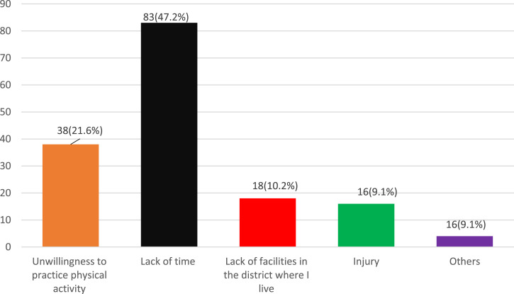
Factors responsible for the physical inactivity
Source- (Samarkandi, 2022)

Slide 7
Factors responsible for the physical inactivity
The amount of physical activity that students at public colleges obtain depends on a several elements, including the accessibility of organized activities, the limitations of available time, and their own personal motivation or unwillingness.
Students often have a heavy academic load and other obligations, leaving them with little spare time (Wang and Boros, 2019). An individual's absence of excitement or motivation may be caused by various circumstances, including a lack of interest, insecurity, or a sense of significance.
Another barrier limiting students from obtaining enough exercise is a lack of suitable fitness facilities in poor regions. Students may be discouraged from exercising because they fear being harmed or have previously been wounded.

Slide 8
Rationale
The importance and significance of physical activity for student's health, well-being, and academic accomplishment motivate researchers to investigate its prevalence among students at a public universities. Knowing how often this happens allows us to assess how much students engage in physical exercise. Knowing how widespread something is may help us concentrate on making good changes and implementing effective measures to promote healthy and active living on campus (Anderson and Durstine, 2019). Regular exercise may improve physical fitness, emotional health, stress management, and intellectual function. More chances for physical activity will help the student population as a whole, as will the children's health, happiness, and academic achievement.

Slide 9
Research aim and objectives
Aim
Examining the prevalence of physical exercise among learners at a public institution is the objective of this study.
Objective
To establish the frequency with which public university students engage in physical activity.
To investigate the factors that affect the willingness to participate in regular physical activity.
To develop strategies and recommendations for improving students at a public institution to physical activity.

Slide 10
Research methodology
Research design
The dissertation project will use a cross-sectional research design to examine the frequency with which students at a public university engage in physical exercise. The aim of this research design is to shed some light on the intensity of exercise that is currently prevalent among college students at a specific time and place (Grasdalsmoen et al., 2020).
Recruitment, Sampling & Study Participants
The participants in the research will be drawn from the students of a public institution. The university's many departments will be adequately represented via the stratified sampling method. To achieve this, students will be randomly selected from each faculty according to the percentage of students enrolled in each department or faculty. Students will be asked to participate voluntarily and invited through email, campus bulletin boards, and social media.

Slide 11
Materials/Data Collection Method
A questionnaire will be created which includes the demographics of the students such as age, Gender, and significant fields of study will be gathered for a statistical analysis (Ramón-Arbués et al., 2020).
An online survey platform such as google forms will be used to gather the information. A reference to the poll will be provided in the request email and shared through other communication channels.
The questionnaire will ask participants about the time period, frequency, and their level of physical exertion. The campus will serve as the location for data collection. The online survey may be done at any time and on any device that the student has access to. Anonymity will be used during data collection to protect participants' privacy and promote open communication.

Slide 12
Data analysis technique
Data preparation: This includes looking for any blanks or impressive numbers, as well as any data cleansing that may be required. At this point, researcher will also do any data conversions or recoding of variables that are necessary (Ge et al., 2019).
Descriptive statistics: The data will be summarized using descriptive statistics to provide a clear picture of pupils' physical activity levels. Distributions of physical activity levels will be calculated using frequency and percentage measures. Chi-square tests, for instance, may be used to examine the association between demographic characteristics like gender and academic programme and activity levels.

Slide 13
Interpretation of results: The data analysis will provide interpretations regarding the frequency with which public university students engage in physical exercise. The findings will be analyzed for their strengths, limits, and consequences, highlighting the elements contributing to students' inactivity.
Reporting ad presentation: To further assist communication and comprehension, the results will be provided in the form of tables, graphs and charts, . The conclusions will be reviewed in light of study's aims to shed light on the extent to which students engage in physical exercise and the consequences of this trend (Zhu et al., 2019).

Slide 14
Ethical considerations
Several issues about ethics are going to be taken into consideration, such as the fact that all of the students are going to provide their informed consent after being thoroughly told about the aims, procedures, dangers, and possible advantages of the research. According to Grasdalsmoen et al.'s research from 2020, the identity of the students will be kept a secret, and the participant's privacy and confidentiality will be protected by the participants' anonymity and the safe storage of their data. In addition, it will be possible for participants to leave the study whenever they want and at no cost to themselves without facing any consequences. In addition to this, the study will conform to any ethical norms or regulations that have been established by the research ethics committee or the institutional review board at the academic institutions.

Slide 15
Implications of the research
There are several implications for this study on the level of physical exercise among public university students.
It can provide light on students' physical activity habits, revealing their level of activity and the influences on their decision to be physically active. Using this data, universities may create more effective programs and interventions to increase student’s level of physical activities and enhance their health.
The relationship between exercise and students' academic achievement, emotional well-being, and quality of life may be better understood if the prevalence and correlates of physical activity students specific are well understood (III, Murray and Salvo, 2019).
The study's results may be utilized to push for initiatives on college campuses that encourage students to be active and provide the tools they need to maintain an active lifestyle. The findings of this study may ultimately help a better campus environment and improve the health and well-being of students.

Slide 16
Conclusion
It is concluded that the Physical activity promotion is critical for students' health and academic achievement, as shown by this research on activity levels at a public college. The research findings will shed light on students' present levels of exercise and the factors that promote or discourage them from moving their bodies. Universities may enhance their students' health, well-being, and academic accomplishment by identifying barriers to physical activity and implementing particular programs to overcome them.

Slide 17
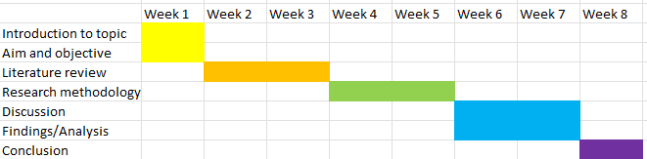
Time schedule
Source- Self created

Slide 18
Reference list
Anderson, E. and Durstine, J.L. (2019). Physical activity, exercise, and chronic diseases: A brief review. Sports Medicine and Health Science, [online] 1(1), pp.3–10. doi:https://doi.org/10.1016/j.smhs.2019.08.006.
Ge, Y., Xin, S., Luan, D., Zou, Z., Liu, M., Bai, X. and Gao, Q. (2019). Association of physical activity, sedentary time, and sleep duration on the health-related quality of life of college students in Northeast China. Health and Quality of Life Outcomes, [online] 17(1). doi:https://doi.org/10.1186/s12955-019-1194-x.
Ghrouz, A.K., Noohu, M.M., Dilshad Manzar, Md., Warren Spence, D., BaHammam, A.S. and Pandi-Perumal, S.R. (2019). Physical activity and sleep quality in relation to mental health among college students. Sleep and Breathing, [online] 23(2), pp.627–634. doi:https://doi.org/10.1007/s11325-019-01780-z.
Grasdalsmoen, M., Eriksen, H.R., Lønning, K.J. and Sivertsen, B. (2020). Physical exercise, mental health problems, and suicide attempts in university students. BMC psychiatry, [online] 20(1), p.175. doi:https://doi.org/10.1186/s12888-020-02583-3.
.
.

Slide 19
Reference list
III, H.K., Murray, T. and Salvo, D. (2019). Foundations of Physical Activity and Public Health. [online] Google Books. Human Kinetics. Available at: https://books.google.com/books?hl=en&lr=lang_en&id=8LG8DwAAQBAJ&oi=fnd&pg=PP1&dq=Factors+affecting+the+Prevalence+of+physical+activity+among+students+in+a+public+university&ots=U0FbeaFZiP&sig=K4F6pad70U8wUHHR1aKvRbB0qy0.
Ramón-Arbués, E., Gea-Caballero, V., Granada-López, J.M., Juárez-Vela, R., Pellicer-García, B. and Antón-Solanas, I. (2020). The Prevalence of Depression, Anxiety and Stress and Their Associated Factors in College Students. International Journal of Environmental Research and Public Health, 17(19), p.7001. doi:https://doi.org/10.3390/ijerph17197001.s
Rodríguez-Larrad, A., Mañas, A., Labayen, I., González-Gross, M., Espin, A., Aznar, S., Serrano-Sánchez, J.A., Vera-Garcia, F.J., González-Lamuño, D., Ara, I., Carrasco-Páez, L., Castro-Piñero, J., Gómez-Cabrera, M.C., Márquez, S., Tur, J.A., Gusi, N., Benito, P.J., Moliner-Urdiales, D., Ruiz, J.R. and Ortega, F.B. (2021). Impact of COVID-19 Confinement on Physical Activity and Sedentary Behaviour in Spanish University Students: Role of Gender. International Journal of Environmental Research and Public Health, [online] 18(2). doi:https://doi.org/10.3390/ijerph18020369.

Slide 20
Reference list
Rogowska, A.M., Pavlova, I., Kuśnierz, C., Ochnik, D., Bodnar, I. and Petrytsa, P. (2020). Does Physical Activity Matter for the Mental Health of University Students during the COVID-19 Pandemic? Journal of Clinical Medicine, 9(11), p.3494. doi:https://doi.org/10.3390/jcm9113494.
Romero-Blanco, C., Rodríguez-Almagro, J., Onieva-Zafra, M.D., Parra-Fernández, M.L., Prado-Laguna, M. del C. and Hernández-Martínez, A. (2020). Physical Activity and Sedentary Lifestyle in University Students: Changes during Confinement Due to the COVID-19 Pandemic. International Journal of Environmental Research and Public Health, 17(18), p.6567. doi:https://doi.org/10.3390/ijerph17186567.
Samarkandi, O.A. (2022). Prevalence of Physical Activity Among Healthcare Students in King Saud University, Riyadh, Saudi Arabia. An Observational Study. INQUIRY: The Journal of Health Care Organization, Provision, and Financing, 59, p.004695802211001. doi:https://doi.org/10.1177/00469580221100157.

Slide 21
Reference list
Wang, F. and Boros, S. (2019). The effect of physical activity on sleep quality: a systematic review. European Journal of Physiotherapy, [online] 23(1), pp.1–8. doi:https://doi.org/10.1080/21679169.2019.1623314.
Zhu, Z., Tang, Y., Zhuang, J., Liu, Y., Wu, X., Cai, Y., Wang, L., Cao, Z.-B. and Chen, P. (2019). Physical activity, screen viewing time, and overweight/obesity among Chinese children and adolescents: an update from the 2017 physical activity and fitness in China—the youth study. BMC Public Health, 19(1). doi:https://doi.org/10.1186/s12889-019-6515-9.

