Slide 1
Conventional Solutions to Environmental Problems:
Command-and-Control Approach

Slide 2
Standards in Environmental Policy
Types of Environmental Standards
  Ambient standard – a standard that designates the quality of the environment to be achieved, typically expressed as a maximum allowable pollutant concentration
  Technology-based standard – a standard that designates the equipment or method to be used to achieve some abatement level
  Performance-based standard – a standard that specifies a pollution limit to be achieved but does not stipulate the technology

Slide 3
Economic Implications of Using Standards
To remove the various externalities the government has to use regulations/provisions/standards
To achieve allocative efficiency

Slide 4
Types of Externality
  Negative Externalities of Consumption
  Positive Externalities of Consumption
  Negative Externalities of Production
  Positive Externalities of Production

Slide 5
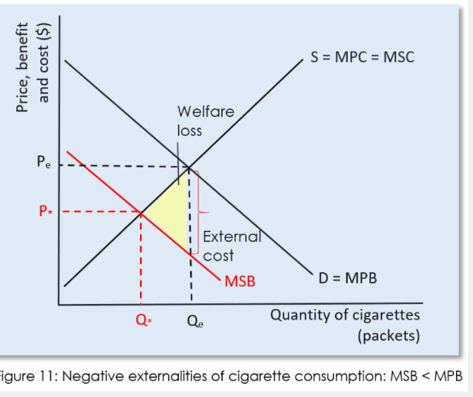
Negative Externalities of Consumption
Notes:
NEGATIVE EXTERNALITIES OF CONSUMPTION AND WELFARE LOSS
Essential statement: A private benefit is gained by consumers from the consumption of goods and services. The consumption of certain goods and services can create external costs (negative externalities) that spillover from private consumption that must be paid for by third parties.
Negative externalities of consumption refer to the external costs created by the consumers during the course of using the product or service.
A classic example is the consumption of cigarettes. There is a private benefit to the smoker as she purchases and consumes cigarettes. There is also a cost to society imposed by the smoker on third parties. The consumption of cigarettes affects others indirectly – passive smoking, higher healthcare costs (higher taxes being paid), less productivity in the work place (through ill health), and so on and such forth.
Essential statement: Demerit goods are goods and services that create negative externalities when they are consumed. Examples include, cigarettes, drugs and alcohol, sugar and junk food, petrol, cars and coal.
The consumer when deciding how much of a good or service to consume does not necessarily consider what external costs their consumption may impose on others. Only the marginal private costs and marginal benefits are considered, and the level of consumption is determined where the marginal private cost (MPC) = marginal private benefit (MPB). This is where the cost to the cons
In a free market, third parties – whom are external to the market – pay for any negative external costs. Those in society who are experiencing the negative spillover effects of consumption such as second-hand smoking (cigarettes) and traffic congestion (cars), are not involved as consumers or producers yet they are still being forced to pay a cost.
The additional benefit of consuming one more unit of a good or service is the marginal private benefit. The additional external benefit obtained or harm caused by consuming an extra unit of a good or service is the marginal external benefit. Thus, MSB = MPB + MEB. Thus, negative externalities of consumption result in the MSB curve being below and to the left of the MPB curve (see Figure 11).
In Figure 11 above, it is assumed that there are no external positive effects from cigarette consumption on third parties, only harm. Each packet of cigarettes consumed affects others through the unpleasant and harmful effects of second hand smoking, and reduces worker productivity and adds to the healthcare costs of society.
Thus, MPB > MSB. The individual consumer is aiming to maximise her satisfaction and does not take into account any external harm she is causing when consuming the next packet of cigarettes. She maximises her utility at the point where marginal private cost equals marginal private benefit. This is where the cost (price paid) to the consumer of consuming an additional unit of a good is equal to the value of the additional benefit that is to be gained from consuming one more additional unit of a good. Qe is the optimum level of individual private consumption at the price Pe. However, because cigarette consumption negatively affects others, the benefit gained by the private consumer is greater than the benefit obtained by society as a whole. Thus the MSB < MPB. The allocatively efficient point of consumption is Q* which is less than Qe. In the free market Qe is achieved because the price of cigarettes is too low, and at the low price too many cigarettes are being consumed. The yellow triangle shows the total welfare loss.

Slide 6
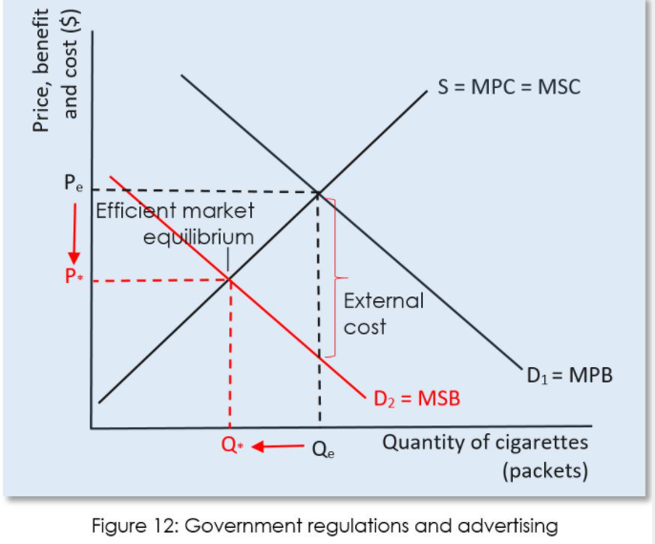
Government regulations to remove Externality of Negative Consumption
Notes:
Government regulations to remove externality of consumption
A government can legislate or impose regulations that limit or prevent types of consumption that impose negative spillover effects on third parties; e.g., cigarette smoking and the extra healthcare burden imposed on the taxpayer.
A government can regulate to correct a negative externality of consumption. For example, regulating that cigarettes can only be sold to those aged 18 and over, and that cigarettes cannot be smoked in workplaces, cafes, bars and restaurants will reduce the demand for cigarettes. The demand curve will decrease from D1 = MPB until it overlaps with D2 = MSB, the socially desirable level of demand where the externality has been eliminated (internalising the externality). As demand decreases, the important effect is that Qe decreases to Q*; and (unimportantly) price reduces from Pe to P* as producers lower their prices to reduce the surplus (excess supply) of the demerit good. See Figure on slide
Advertising ban to remove negative externality
Governments often run advertising campaigns in an attempt to persuade consumers from purchasing a product. Anti-gambling, anti-alcohol, and anti-smoking advertisements are examples of advertising campaigns that can be observed in many countries, especially developed countries. Other campaigns will attempt to increase the demand for other goods such as public transport, to reduce the demand for the substitute good (cars and roading congestion and pollution).Just as with regulations, the aim of such campaigns is to reduce the demand for demerit goods.
For example, health campaigns and advertisements that demonstrate the harm cigarettes do will reduce the demand for cigarettes. The demand curve will decrease from D1 = MPB until it overlaps with D2 = MSB, the socially desirable level of demand where the externality has been eliminated (internalising the externality). As demand decreases, the important effect is that Qe decreases to Q*; and (unimportantly) price reduces from Pe to P* as producers lower their prices to reduce the surplus (excess supply) of the demerit good. See Figure 12

Slide 7
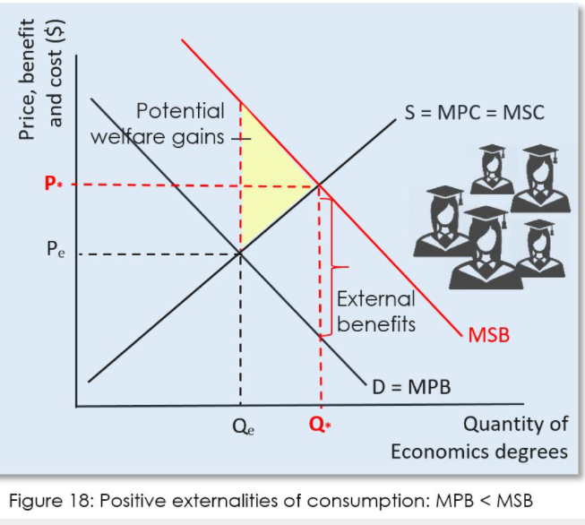
Positive Externalities of Consumption
Notes:
A positive externality of consumption occurs when an external or spillover benefit is created by the consumption of a good or service. An example is education. When education is consumed there is both a private benefit to the individual receiving the education (e.g., higher wages and salaries), as well as social benefits such as increased productivity, lower unemployment, lower crime rates, and increased economic development.
Collectively, goods which generate positive externalities of consumption are termed merit goods. Merit goods are those goods and services that the government feels that people will under-consume, and which ought to be subsidised or provided free at the point of use so that consumption does not depend primarily on the ability to pay for the good or service.
In other words, society benefits when an individual consumes a certain good or a service over and above the private benefits from consuming that good or service (e.g., marginal utility).
Examples of positive externalities of consumption include:
Vaccinations for diseases confer protection to the individual being vaccinated and it also reduces the chances of others in society becoming infected from the disease.
Healthcare services benefit those receiving the services and has spillover benefits for society in terms of increased productivity – a healthy worker is more productive.
Electric vehicles transport individuals around the city and at the same time reduce the overall pollution produced by the vehicle fleet and making the air everyone breathes cleaner and less harmful.
Thus, third parties or individuals and groups external to the market are benefiting from the consumption decision without having to pay a cost. And the consumer continues to receive the private benefit (e.g., profit).
The individual’s marginal private benefit is lower than that of the marginal social cost because the benefits are not internalised in the competitive free market. Thus MSB > MSC. Consumers in the free market will choose to consume at Qe – the optimum private level – MSB = MSC (see Figure 18 below). At the market equilibrium Qe, MSB > MSC and this is an allocatively inefficient market outcome because at Qe the benefits to society from the next additional unit of the good consumed are greater than the value of the benefits gained by the individual consuming it.
MSB > MSC for the level of consumption between Qe and Q*. This area of allocative inefficiency is shown in the yellow shaded triangle and it represents the potential welfare gains that additional consumption of the good could produce. At Q* the marginal social benefits equals the marginal social cost and this is the optimal level of consumption because the benefits to society from the next additional unit of output consumed are equal to the value of the benefit gained by the individual + society.
At the equilibrium where MSB = MSC, the social optimum equilibrium, P* and Q* results
Whereas, at the free market equilibrium where MPB = MSC, the allocatively inefficient equilibrium, Pe and Qe results
Essential statement: In the free market merit goods are under consumed. Consumers do not consider the external benefits that spillover to others in society when consuming a merit good. MSB > MSC at the optimum level of private consumption. The government must intervene in the market to increase the consumption of merit goods so that it increases to MSB = MSC which is the social optimum level that maximises the welfare of society.

Slide 8

Government Provision to correct Positive Externality of Consumption
Notes:
Direct government provision
A government can provide the good or service that is creating a positive externality of consumption. A good example of this is that governments will fund K-12 education, healthcare services and hospitals, and vaccination programmes. With the benefits of such merit goods being so great it is generally accepted that such important goods and services cannot be left to the free market to provide.
All such activities are paid for through government funding that comes from taxes. As can be seen in Figure 22 below, direct provision of the good generating the positive externality of production increases the supply of the good (shifts the supply curve – MPC – right) towards the MSC curve. At MSC the socially optimum quantity of the good or service is produced at Q* and the price will decrease from Pe to P*.

Slide 9
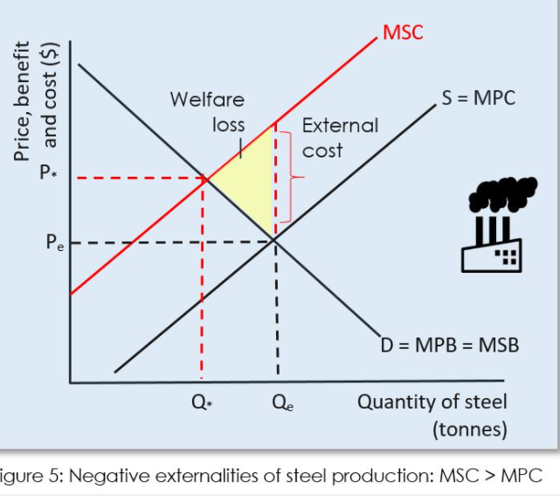
Negative Externalities of Production
Notes:
NEGATIVE EXTERNALITIES OF PRODUCTION AND WELFARE LOSS
Essential statement: A private cost is a cost that firms incur in producing goods and services to supply the market, such as wages and rent (i.e., costs of production). Negative externalities of production, or the external costs affecting third parties, are created by firms in the process of producing goods and services, however, they do not pay these costs (e.g., the healthcare costs associated with a factory’s air pollution).
In a free market, third parties – whom are external to the market – pay for any negative external costs, not the firms creating them. Those in society who are experiencing the negative spillover effects of production such as pollution and traffic congestion, are not involved as consumers or producers yet they are still being forced to pay a cost.
The total of private and external costs equal the social costs associated with production (SC = PC + EC).
The additional cost of producing one more unit of a good or service is the marginal private cost. The additional external cost of producing an extra unit of output is the marginal external cost. Thus, MSC = MPC + MEC. Thus, negative externalities of production result in the MSC curve being above and to the left of the MPC curve (see Figure 5 right).
Steel manufacturing is often very polluting as the lowest cost method of production is to burn lots of coal to provide the energy needed in the steel manufacturing process.
In Figure 5 above, it is assumed that there are only external costs associated with producing steel, and no external benefits. Each tonne of steel produced adds to the surrounding air pollution. Thus, MSB = MPB.
The firm producing the good aims to maximise profits and as such does not take into account any external costs associated with producing the next unit of output. The profit maximising firm sets quantity to Qe where the MSB = MPC. This is not the socially optimum level of output because this is where MSB = MSC, and factors of production are being misallocated (e.g., more labour and capital are being used to produce steel, and less labour and capital is being used to produce, say, education and health services).
Figure 5 illustrates this. In the free market the price of steel is too low – Pe instead of P* – and the output of steel is too high – Qe instead of Q*. Thus, between Q* and Qe, MSC > MSB. The value of the resources used to make additional tonnes of steel (MSC) is greater than the satisfaction gained from society buying and consuming another tonne of steel (MSB). Thus, MSC > MSB in regards to steel production and consumption. On and every unit of output (tonnes of steel produced) between Q* and Qe, a loss of social welfare occurs. The MSC is less than private benefit of steel consumption because of the negative externalities associated with the production of that good. The yellow triangle shows the total welfare loss.

Slide 10
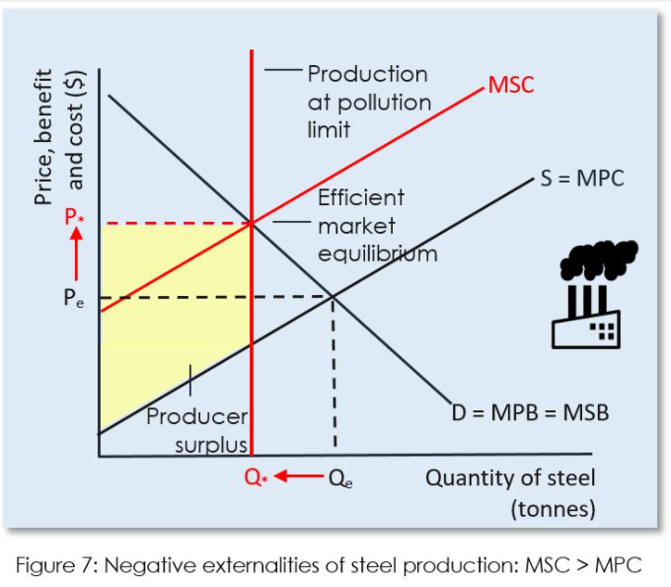
Tradeable Government Regulation to correct Negative Externality of Production
Notes:
Solution Tradeable Government Regulation
Governments can enact legislation and regulate firms to reduce or prevent the spillover costs associated with negative production externalities. If firms are polluting then governments may ban the dumping of toxic waste and materials into the environment, such as a factory using a river to dump its waste. More often than not, legislation and regulations do not result in a total ban on firms producing pollutants, rather government legislation aims to achieve:
Limits on the quantity of pollutants firms may produce by setting a maximum level of pollutants that are permitted.
Limits on output of firms to reduce the quantity of polluting goods and services that are being produced.
Polluting firms to adopt technology that reduces the emission of polluting emissions.
The aim of government enacting and enforcing such laws and regulations is to reduce the quantity of the polluting good being produced by firms and move the quantity to the socially optimal equilibrium (Q*) seen in Figure 6. Regulations and legislation will shift the MPC of firms upward and towards the MSC curve.
Being forced to install new technology increases the costs of production faced by firms and this decreases supply. Similarly, firms that are required to limit their pollutants will have to adopt new and higher cost production processes, which again, decreases supply. And, being forced to limit the output of goods which pollute increases the marginal costs of production as economies of scale can no longer be achieved. Higher marginal costs will also decrease supply to the market.
The higher costs of production which decrease supply of the products associated with the external costs would ideally be equal to the value of the negative externality. By regulating the firms producing the good and increasing their costs of production the government aims to achieve a shift of the MPC curve upwards to a point where it overlies the MSC curve and the allocatively efficient supply of the polluting good is achieved. The overallocation of resources (factors of production) to the production of a good imposing external costs on third parties is corrected. Any polluting firm not in compliance with regulations and legislation governing pollutants would be required to face fines and/or legal sanctions such as criminal charges being laid against a company’s directors.

Slide 11
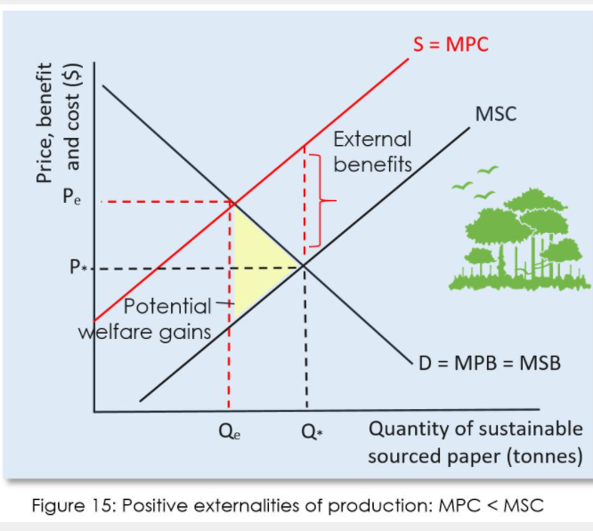
Positive Externalities of Production
Notes:
POSITIVE EXTERNALITIES OF PRODUCTION AND WELFARE LOSS
A positive externality of production is a situation where a firm producing a good or service creates an external benefit that spills over and is enjoyed by third parties whom are external to the market. In other words, society benefits when a firm creases a certain good or a service over and above the private benefits from producing that good or service (e.g., shareholder profit).
Examples of positive externalities of production include:
Research and development that increases productivity in manufacturing a certain good will increase the productivity of manufacturing across a wide range of goods, firms and industries.
A forestry corporation growing sustainable forests for pulp and paper manufacturing allows hikers and mountain bikers to use their forests for recreational purposes.
A firm that engages workers in extensive training and development will benefit other firms who later go on to employ some of its highly productive former workers.
A firm that produces scrubbers for cleaning pollution from chimney stacks at Tata still and removing emissions.
Thus, third parties or individuals and groups external to the market are benefiting from the production decision without having to pay a cost. And the firm continues to receive the private benefit (e.g., profit)
The firm’s marginal private cost is higher than that of the marginal social cost because the benefits are not internalised in the competitive free market. Thus MPC > MSC. The firm will set output at Qe – the optimum private level – MPC = MSB (see Figure 15 below). At the market equilibrium Qe, MSB > MSC and this is an allocatively inefficient market outcome because at Qe the benefits to society from the next additional unit of output produced are greater than the value of the resources employed by the firm to produce it. MSB > MSC for the level of output between Qe and Q*. This area of allocative inefficiency is shown in the yellow shaded triangle and it represents the potential welfare gains that additional production could produce. At Q* the marginal social benefits equals the marginal social cost and this is the optimal level of production because the benefits to society from the next additional unit of output produced are equal to the value of the resources employed by the firm to produce it.
At the equilibrium where MSC = MSB, the social optimum equilibrium, P* and Q* results – a lower price and a greater quantity of the good or service is produced and consumed in the market.
Whereas, at the free market equilibrium where MPC = MSB, the allocatively inefficient equilibrium, Pe and Qe results – a higher price and a lower quantity of the good or service is produced and consumed in the market.

Slide 12
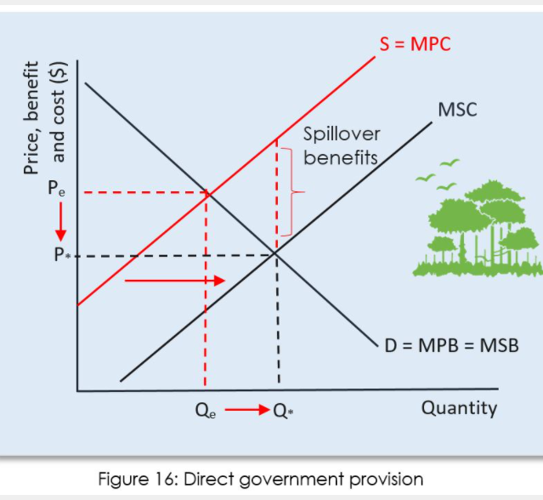
Direct Government Provision to correct Positive Externality of Production
Notes:
CORRECTING POSITIVE EXTERNALITIES OF PRODUCTION
Direct government provision
A government can provide the good or service that is creating a positive externality of production. A good example of this is that governments will often fund and engage in research and development programmes in many diverse areas such as food and agricultural science, new technologies, defence, pharmaceuticals and medicine.
Governments will often directly provide education and training for workers – schools, tertiary institutions such as universities and polytechnics, and back to work courses for the unemployed.
All such activities are paid for through government funding that comes from taxes. As can be seen in Figure 16 below, direct provision of the good generating the positive externality of production increases the supply of the good (shifts the supply curve – MPC – right) towards the MSC curve. At MSC the socially optimum quantity of the good or service is produced at Q* and the price will decrease from Pe to P*.

