Slide 1
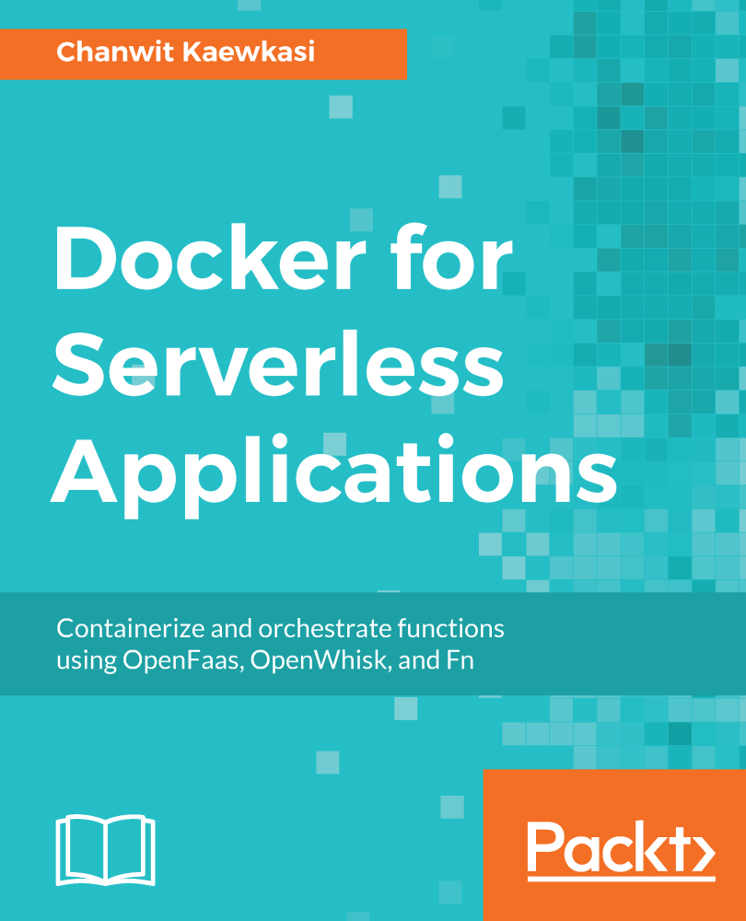
DOCKER COMPOSE
Lecturer: Michael Dacey
E-mail: michael.dacey@uwtsd.ac.uk
https://github.com/wsargent/docker-cheat-sheet

Slide 2
Why?
Orchestrate running multiple containers when you need multiple services for you application to execute
For example, to run different environments e.g. Development, Testing and Production
docker-compose up
ContainerA
DockerFile
Docker
Compose
Tool
ContainerB
DockerFile
Docker Compose file
docker-compose.yml

Slide 3
Restriction
Docker Compose can only be executed on a single machine
Use Docker Swarm or Kubernetes for clustering

Slide 4
Docker Compose File
Determines which services to run
YAML file format
Can be named anything you like
  docker-compose.yml is the default,
  otherwise the file name must be specified when executing the
  docker-compose command e.g.
  docker-compose up --file my_compose.yml
Version of file format to which this file adheres. Currently the latest is 3.7
version: ‘2’
services:
my_server1:
image: ……
environment: ……
ports: ……
command: ……
my_server2:
image: ……
environment: ……
ports: ……
command: ……
Define multiple services

Slide 5
General Service Layout
version: ‘3’
services:
servicenameA:
image: image-name
environment:
-AAAA=b
ports:
-”8080:80”
networks:
-my_network
volumes:
-my_volume:/dirpath
networks:
my_network:
driver: bridge
volumes:
my_volume:
Service name (hostname)
Docker image
Environment variables passed to the container (Not best practice)
Port mapping
Networks used by container
Volumes used

Slide 6
Link YAML Files
You can subdivide the services into separate YAML files and the main YAML file can read them in
service1.yml
version: ‘2’
services:
some_service:
image: ……
environment: ……
ports: ……
command: ……
version: ‘2’
services:
my_server1:
extends:
file: service1.yml
service: my_service1
my_server2:
extends:
file: service2.yml
service: my_service2
service2.yml
version: ‘2’
services:
apple_service:
image: ……
environment: ……
ports: ……
command: ……
NO LONGER SUPPORTED IN V3 AND ABOVE but you may see it around

Slide 7
Docker Compose File
(docker-compose.yml)
Not compatible with Docker Swarm
build
Build the image for the container
Either a string containing a path to the build context
build: ./dir
OR as an object with the path specified in “context” and optionally the “dockerfile” name and the ”args”
build:
context: ./dir
dockerfile: filename
args:
argname = argvalue
Give your built image a name and tag using the keyword “image”
build: ./dir
image: my-image:my-tag
context:
Either a path to a directory containing a Dockerfile, or a url to a git repository
dockerfile:
name of file at this path
args:
values passed to DockerFile
https://docs.docker.com/compose/compose-file/

Slide 8
Example
build: Build a custom image described in the DockerFile
. = look for DockerFile in the current directory
image: used in conjunction with build, it names the image we built e.g. the docker userID/registry name and image name we require
environment: specify an environment value for our application e.g.
BUILD_TYPE = development
ports: mapping the host port to the port number used by our application running in the container (HostPort : ContainerPort)
version: ‘3’
services:
my_app:
build: .
image: registryname/my_imagename
environment:
- env_optname=value
ports:
- “80:80”
existing_service:
image: base_image
Note the dot here
Two services in this example
An existing already built baseline OS image, pulled from DockerHub

Slide 9
Checking the Config File
A good way of sanity checking your docker-compose.yml file is to use the command
docker-compose config
Essentially, this dumps out the file contents but you can check if docker-compose will be reading the correct information

Slide 10
Passing Args to DockerFile
Makes DockerFile more flexible
Example: Change version
docker-compose.yml
build:
context: ./dir
dockerfile: filename
args:
APP_VERSION = 2.4.0-someapp4.6
DockerFile
ARG APP_VERSION
FROM nginx:$APP_VERSION
WORKDIR /usr/src/app
etc., etc.
Substitute value here

Slide 11
Build Specific Docker Stage
docker-compose.yml
build:
context: ./dir
dockerfile: filename
target: targetname
Example: docker-compose.yml
version: "3.6“
services:
webserver:
build:
context: .
dockerfile: Dockerfile
target: webserver
image: node-obs-webserver
restart: always
ports:
- "81:80"
networks:
- dbnetwork
Directory containing the dockerfile
The Docker build stage name (target) is “webserver”
Dockerfile
FROM nodeenv as webserver
EXPOSE 80
WORKDIR /var/www/node
etc., etc.

Slide 12
env_file
Environment variables can be placed in a separate text files
Use instead of “environment” option
env_file:
- ./common.env
- ./apps/web.env
- /opt/secrets.env
somefile.env
optname=value
optname2=value2
services:
my_app:
build: .
image: my_imagename
environment:
- env_optname=value
services:
my_app:
build: .
image: my_imagename
env_file:
- ./somefile.env

Slide 13
Centralise Build Decisions
Using env_file
Example
Choose build versions
docker-compose.yml
image:myrepo/${NGINX_VERS}
build:
context: ./dir
dockerfile: filename
args:
APP_VERSION = ${APP_VER}
env.txt
NGINX_VERS = niginx2.4
APP_VER = 2.4.0-someapp4.6
DockerFile
ARG APP_VERSION
FROM nginx:$APP_VERSION
WORKDIR /usr/src/app
etc., etc.
services:
my_app:
build: .
image: my_imagename
env_file:
- .env.txt

Slide 14
Container Naming
This is not compatible with Docker Swarm
By default containers are named after the service name provided in the Docker Compose file (which is often the same as the image name if you are pulling a public image)
These names must be unique
You can provide a custom name using the option in the Docker Compose file
container_name : my_containername
version: "3"
services:
my_servicename:
container_name: ‘my_containername'
build:
context: ./bin/webserver
etc., etc.
Note: we can also specify a specific container name using the option --name e.g. when running a public image

Slide 15
Default Network
If we do not specify a network, a default network is created
Containers connected to the default bridge network can communicate with each other by IP address.
Docker does not support automatic service discovery on the default bridge network.
If you want containers to be able to resolve IP addresses by the container name (by default this is the service name), you should use user-defined networks instead. → uses a build in DNS server so this name can be used in your code running the container if it needs to connect to another container
C:/> docker network ls
NETWORK ID NAME DRIVER
d83839999 my_imagename bridge
C:/> docker network inspect my_imagename
The containers are connected to the “default” network

Slide 16
User-defined Network
Containers connected to a user-defined network can refer to each other by their names
  This name may be “service name” specified in the Docker Compose file i.e. to talk to each other the containers can just refer to these names
  Write your code using the “service name” when code in one container needs to connect to the other
Specify networks in Docker compose file
https://docs.docker.com/v17.09/engine/userguide/networking/#bridge-networks

Slide 17
Networks
version: '2'
services:
web:
build: ./web
networks:
- new
worker:
build: ./worker
networks:
- legacy
db:
image: mysql
networks:
new:
aliases:
- database
legacy:
aliases:
- mysql
networks:
new:
legacy:
Create networks to connect services
You can specify IPV4 and IPV6 addresses if you wish
Containers on each network are identified by their service names. However, you can optionally use aliases (alternative hostnames) for a service per network the service is on
You can optionally specify the driver as bridge for a network on a single host or as overlay for a named network across multiple hosts
Three services “web”, “worker”, “db” connected by two networks “new” and “legacy”.
The db service is reachable at the hostname db or database on the new network, and at db or mysql on the legacy network.

Slide 18
The Networks
web
db
worker
mysql
database
new
legacy
List all networks
docker network ls
Tidy up unused networks:
docker network prune

Slide 19
links
You may come across docker-compose.yml files using the keyword “links“
However, this is now obsoleted and we should use networks instead
NEW APPROACH
services:
web:
image: someimage
networks:
- my_network
database:
image: someimage
networks:
- my_network
networks:
my_network
OBSOLETE APPROACH
services:
web:
image: someimage
links:
- database
database:
image: someimage

Slide 20
Ports
LONG FORMAT
ports:
- target: 80
published: 8080
protocol: tcp
mode: host
EQUIVALENT SHORT FORMAT
ContainerPort e.g. “3000”
“HostPort:ContainerPort” e.g.
“8080:80” web server port 80 is exposed to host as 8080 i.e. use 8080 in your browser (Default protocol is TCP)
ports:
- "3000"
- "3000-3005"
- "8000:8000"
- "9090-9091:8080-8081"
- "49100:22"
- "127.0.0.1:8001:8001"
- "127.0.0.1:5000-5010:5000-5010"
- "6060:6060/udp"
Note: In a docker compose file, when using the short format always explicitly specify your port mappings as strings.
YAML parsing of numbers produces erroneous results for port numbers less than 60 ☹
Needs UDP not TCP

Slide 21
Building the Services
Build the Docker containers, volumes and networks
docker-compose build
  By default it looks for the file docker-compose.yml
Built images are cached so they do not rebuild if they have not been changed
  To turn off the caching use
docker-compose build --no-cache
Build and Run
docker-compose up will build the images if they do not already exist.
  However, if you make changes to a Dockerfile an image is based on, then this command will not rebuild that image.
  Therefore, it might be safer to explicitly force a rebuild by specifying the --build option e.g.
docker-compose up --build
https://www.youtube.com/watch?v=4EqysCR3mjo

Slide 22
Docker Compose Commands
Similar to Docker container commands
docker-compose help
docker-compose ps: look at running services (i.e. containers)
docker-compose top
docker-compose logs --follow
docker-compose logs my_service --follow
docker-compose start
docker-compose stop
docker-compose restart
docker-compose build
docker-compose up [--build [--no-cache]]
docker-compose down
docker-compose kill
docker-compose rm

Slide 23
Up
Builds, (re)creates, starts, and attaches to containers for a service….only builds services that need rebuilding
  Unless they are already running, this command also starts any linked services
  Applies port mapping specified in compose file
Aggregates the output of each container (essentially running docker-compose logs -f).
When the command exits, all containers are stopped OR -d or --detach starts the containers in the background and leaves them running
Example: MySQL Server
(Optionally)
Force build
docker-compose -f mysql.yml up -d
--build
--file
-f
Specify compose file name
Specify name of docker compose file, the default is docker-compose.yml

Slide 24
Down
Stops containers and removes containers, networks, volumes, and images (as defined in the Compose file) created by a call to the “up” command
Remove the images when we finish
docker-compose down
docker-compose down --rmi

Slide 25
Execute Command
Execute commands on already running container
docker-compose exec my_service somecommand
Example 1: running a single command line on a container
docker-compose exec unix_service ls /usr/dev
Example 2: enter a bash shell on a container
docker-compose exec unix_service /bin/bash

Slide 26
Docker Compose Run
Starts container and runs one command against the service
Example1: Run the command “bash” against the service named “web”
docker-compose run web bash
Example2: Run the “python” command on file “app.py” against the service named “web”
docker-compose run web python app.py
Note: in “running” a container port mapping is not applied from the compose file, if required you have specifiy ports on the command line
docker-compose run -p 8080:80 -p 2022:22
-p 127.0.0.1:2021:21 web python manage.py shell
Run and remove containers when command completes by adding --rm option (ignored if --detach specified)
docker-compose run --rm web bash

Slide 27
Clean Up
We can clean up and force docker compose to rebuild containers as follows:
$ docker-compose rm -f
$ docker-compose build
$ system prune ???

Slide 28
Exercise
From Moodle, download the “docker-compose-lamp-master.zip” file and unzip it in a new directory
This file describes a small network of 3 services:
  An Apache webserver
  http://localhost
  A mysql database
  username: root password: docker
  A phpmyadmin site
  http://localhost:8080
webserver
mysql
phpmyadmin
Containers →
Virtual network “dbnetwork”

Slide 29
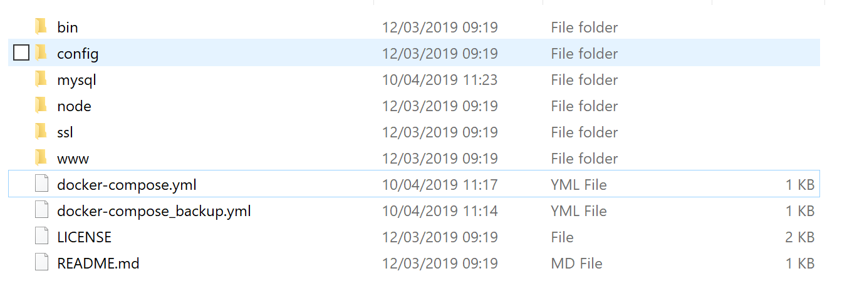
Exercise: Host Folders
You should get a host file structure that looks like this
$ ls
volumes:
- ./node:/opt/node
- ./www:/var/www/html
- ./config/apache2/custom.conf:/etc/apache2/mods-enabled/my.conf
- ./config/php/php.ini:/etc/php/7.2/apache2/conf.d/custom.ini
- ./config/vhosts:/etc/apache2/sites-enabled
- ./ssl:/etc/letsencrypt
NOTE:
To show PHP errors, in ./config/php/php.ini file you need to add the line
display_errors=1
These directories are created for you

Slide 30
Exercise
Open the index.php to the ./www directory
Notice it dumps out a PHP info screen
index.php
<?php
phpinfo();
?>

Slide 31
Exercise: Starting Services and Viewing Webpages
If using your Virtual Machine (VM) then login using Remote Desktop Connection
Bring up the services. Make sure you are in the directory containing the docker-compose.yml file
Run up browser in the VM
  To view the webpages type http://localhost
Shutdown the services using
docker-compose up
Unix guys, don’t forget sudo
<Ctrl> + <C>
or
docker-compose down
A limitation of machines running our lab is that we have to use the browser on the Linux machine to see the results. You do not have public access to port 80 or 8080.

Slide 32
Exercise
Part A
version: "3.6"
services:
webserver:
image: davidecesarano/docker-compose-lamp
restart: always
ports:
- target: 80
published: 80
protocol: tcp
mode: host
- target: 443
published: 443
protocol: tcp
mode: host
networks:
- dbnetwork
volumes:
- ./node:/opt/node
- ./www:/var/www/html
- etc, etc,
networks:
dbnetwork:
Open the docker-compose.yml file
Explain the highlighted fields.
Use spaces not tabs when typing a .yml file
← All networks available for
services to use

Slide 33
Answer LAMP
Part A
COMPOSE FILE STARTS WITH….
version: "3.6"
services:
webserver:
image: davidecesarano/docker-compose-lamp
restart: always
ports:
- target: 80
published: 80
protocol: tcp
mode: host
- target: 443
published: 443
protocol: tcp
mode: host
networks:
- dbnetwork
volumes:
- ./node:/opt/node
- ./www:/var/www/html
- ./config/apache2/custom.conf:/etc/apache2/mods-enabled/my.conf
- ./config/php/php.ini:/etc/php/7.2/apache2/conf.d/custom.ini
- ./config/vhosts:/etc/apache2/sites-enabled
- ./ssl:/etc/letsencrypt
Baseline image
LONG FORMAT PORT DEFINITION
target: port inside container
published: publicly exposed port
protocol: the port protocol (tcp/udp)
mode: host publish host port, ingress for swarm mode port to be load balanaced
Shorthand equivalent is 80:80 and 443:443
volumes:
Mounting local directories so the container can see them e.g. ./www is mounted as /var/www/html in the container

Slide 34
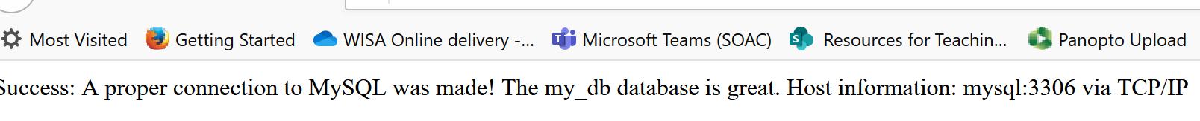
Exercise: Run Database Service
Replace the content “docker-compose.yml” with the content of the “docker-compose-db.yml” file
In the ./www directory, replace the content of the “index.php” file with the content of the “index_db.php”
Bring up the services. Make sure you are in the directory containing the docker-compose.yml file
Run up browser in the VM
  To view the webpages type http://localhost
docker-compose up
Success message !!

Slide 35
Exercise Part B
Look in the docker-compose.yml file
Explain the highlighted fields
mysql:
image: mysql:latest
ports:
- "3306:3306“
command: --default-authentication-plugin=mysql_native_password
restart: always
environment:
- MYSQL_ROOT_PASSWORD=docker
- MYSQL_ROOT_HOST=webserver
- MYSQL_DATABASE=adv-web
- MYSQL_USER=root
- MYSQL_PASSWORD=docker
networks:
- dbnetwork
volumes:
- ./mysql:/var/lib/mysql-files
- ./config/mysql:/etc/mysql
webserver
mysql
dbnetwork

Slide 36
Answer LAMP
Part B
COMPOSE FILE CONTINUES….
mysql:
image: mysql:latest
ports:
- "3306:3306"
environment:
- MYSQL_ROOT_PASSWORD=docker
- MYSQL_ROOT_HOST=webserver
- MYSQL_DATABASE=adv-web
- MYSQL_USER=root
- MYSQL_PASSWORD=docker
networks:
- dbnetwork
volumes:
- ./mysql:/var/lib/mysql
- ./config/mysql:/etc/mysql
MySQL database image
Shorthand port syntax:
target port: inside container is 3306
published port: is also 3306
target
pub
Set “root” user password to “docker” for the database
Webserver and database server are both on the same network “dbnetwork”
https://github.com/davidecesarano/docker-compose-lamp

Slide 37
Exercise: Run PhpMyAdmin Service
Replace the content “docker-compose.yml” with the content of the “docker-compose-full.yml” file
Bring up the services. Make sure you are in the directory containing the docker-compose.yml file
Run up browser in the VM
  To use phpmyadmin type http://localhost:8080
docker-compose up

Slide 38
Exercise Part C
Open the docker-compose.yml file
Explain the highlighted fields
phpmyadmin:
image: phpmyadmin/phpmyadmin
ports:
- "8080:80“
environment:
- PMA_HOST=mysql
- PMA_PORT=3306
networks:
- dbnetwork
webserver
mysql
phpmyadmin
dbnetwork

Slide 39
Answer LAMP Part C
We can use phpadmin by running a separate docker image and connecting it to the database server
COMPOSE FILE EXTENDED….
mysql:
…… etc
MYSQL_ROOT_PASSWORD: docker
- ./mysql:/var/lib/mysql
- ./config/mysql:/etc/mysql
phpmyadmin:
image: phpmyadmin/phpmyadmin
ports:
- “8080:80”
environment:
- PMA_HOST=mysql
- PMA_PORT=3306
networks:
- dbnetwork
networks:
dbnetwork:
https://docs.phpmyadmin.net/en/latest/setup.html#linux-distributions
See Docker Examples
Use browser to connect to http://localhost:8080
Note: the root password is “docker” as defined by us previously
The image to use
Browser sees it at port 8080
The MySQL database server container name and port
webserver
mysql
phpmyadmin
Same network as other services
80
3306
8080
dbnetwork

Slide 40
FYI: For PDO
The connection string of PHP Data Objects is
$dsn = 'mysql:host=mysql;port=3306;dbname=TestDatabase';
$dbUName = "root";
$dbPassword = "docker";
On our machine, we can access a service using the container name. In this case, the MySQL database service is running in a container named “mysql”.
That is, name resolution is performed for us.
Assuming “TestDatabase” is the database name

Slide 41
Push/Pull
Push the services(i.e. containers) to a Docker registry
docker-compose push
Note: You have to manage the docker-compose.yml file separately i.e. you will need to keep a copy of it where ever you need to pull the services
This means you will need to transfer the file into the cloud after a “push”…hopefully you are using Git anyway!!
Pull all the images required to run services
docker-compose pull

Slide 42
NOTE
If you use Google you will probably find the docker compose file you need and the initial setup
It is probably easier to use an existing solution and modify it to meet your needs

Slide 43
Start Multiple Services
Composer can scale by starting multiple instances of a service
docker-compose up --scale my_app=3
This only works if the services are not using fixed port numbers i.e. if you specify ports for the service then it will not scale

Slide 44
Investigating a Broken Container
Replace the current entrypoint for the containers service as shown below, then connect to the container and have a look around
services:
SERVICE_NAME:
# for debugging
#entrypoint: ["sh", "-c", "sleep infinity"]
entrypoint: ["sh", "-c", "sleep 2073600"]

Slide 45
Keeping Containers Running
What happens if a service/application running in a container crashes?
What happens if a machine goes down?
What if we want multiple containers running 24/7?
Currently we are manually starting up and shutting down containers
What we need is software that monitors the containers and restarts them
We need Container Orchestration Software for managing a swarm/cluster e.g.
  Docker Swarm
  Kubernetes

