Slide 1
Evaluating the NHS App in Healthcare
SWOT Analysis
Shakan Pitters| 2319072
BMHP6026 | Zakiyyah Ahmed
Component 2- Oral Presentation
1

Slide 2
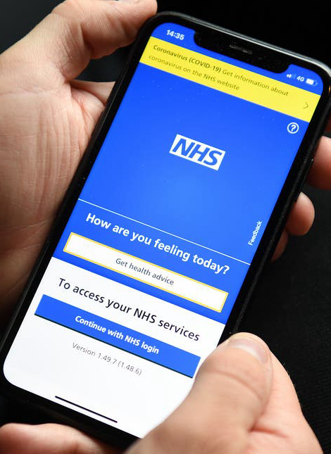
Introduction
- Digital transformation is a priority in UK healthcare
- NHS services face rising demand and resource pressure
- The NHS App aims to improve access and efficiency
- This presentation evaluates the innovation using SWOT analysis
2

Slide 3
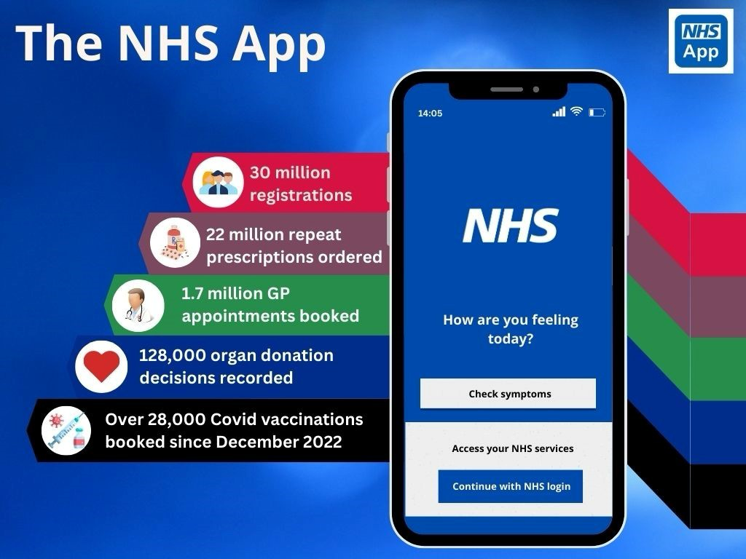
What Is the NHS App?
It will critically examine the benefits, challenges, and future potential of the NHS App within modern healthcare systems.
(NHS England, 2023)
More than 30 million users in England have registered for the NHS App, demonstrating its growing importance in healthcare delivery.
(NHS England, 2023)
Digital platform providing access to NHS services
–Patients can book GP appointments
–Order repeat prescriptions online
–View medical records and receive health updates
–Over 30 million registered users
3

Slide 4

Problems In Healthcare Services.
Increasing patient demand for services
Long waiting times and appointment shortages
Administrative pressure on GP practices
Workforce shortages across NHS services
Limited access to services outside working hours
Research shows digital technologies can improve workflow but require staff adaptation.
(Baird, Maguire and Das, 2020)

Slide 5
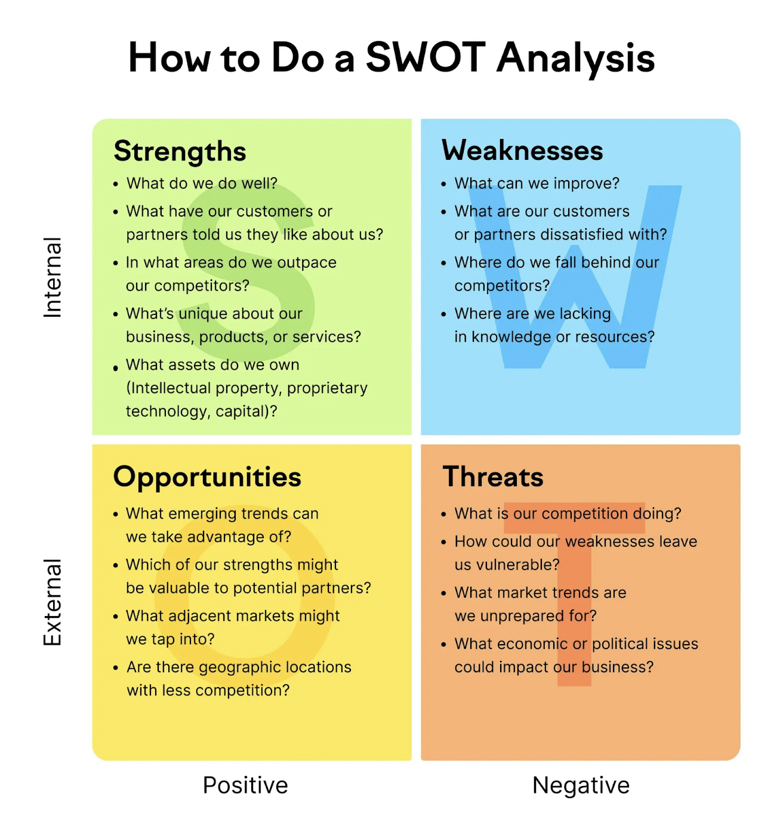
SWOT Analysis Framework
•Strategic tool for evaluating innovations
–Strengths – internal advantages
–Weaknesses – internal limitations
–Opportunities – future development potential
–Threats – external risks and challenges
- STRENGTHS: Convenient access to health records and services, appointment booking, repeat prescriptions, and health advice.
- WEAKNESSES: Limited functionality compared to the NHS website, potential security vulnerabilities, and dependence on patient digital literacy.
- OPPORTUNITIES: Expansion of services, integration with other health apps, and use of AI to personalize healthcare.
- THREATS: Data breaches, lack of patient adoption, and competition from other health apps.
5

Slide 6

STRENGTHS
The app forms part of the government’s wider strategy to expand digital healthcare services and improve system efficiency.
(Department of Health and Social Care, 2022)
–Improves access to healthcare services
–Convenient 24/7 digital access for patients
–Reduces phone demand on GP reception staff
–Supports digital transformation of healthcare
–Increases patient engagement with health services

Slide 7

WEAKNESSES
Barrier: Limited funding for digital initiatives
Solution: Shared NHS funding and digital transformation strategies.
(Department of Health and Social Care, 2022)
–Digital literacy barriers for some users
– Older adults may struggle with digital systems
– Not all services fully integrated
– Increased online demand may add pressure to GPs
– Requires staff training and technical support.

Slide 8

OPPORTUNITIES
Digital health tools encourage patients to actively manage their own health through access to information and services.
(The Health Foundation, 2020)
– Expansion of digital healthcare services
– Integration with wearable health technologies
– Improved remote monitoring of patients
– Supports preventative healthcare strategies
– Potential to enhance long-term NHS efficiency

Slide 9

THREATS
Easier digital access may increase appointment requests and consultations, potentially placing additional pressure on healthcare providers.
(Murphy et al., 2021)
Digital exclusion for disadvantaged groups
–Cybersecurity risks and data breaches
–Over-reliance on digital healthcare systems
–Resistance to digital change from staff or patients
–Potential widening of health inequalities

Slide 10

LEGAL AND ETHICAL CONSIDERATIONS
“Legal and ethical considerations are foundational to maintaining professional integrity, trust, and compliance. Legal standards are mandatory.” (NHS England, 2023)
•Protection of sensitive patient information
–Compliance with UK GDPR
–Data Protection Act 2018 responsibilities
–Maintaining confidentiality in digital healthcare
–Ethical duty to ensure equal access to services

Slide 11
KEY FINDINGS
The NHS App improves convenience and service access
Over 30 million people registered for the NHS App, increasing digital access to healthcare services
(NHS England, 2023)
It supports healthcare system efficiency
Digital prescription requests and appointment booking reduce administrative workload in GP practices
(Baird et al., 2020; The King’s Fund, 2021)
However digital inequality remains a challenge
Older adults and low-income groups are less likely to use digital health technologies
(van Dijk, 2020; The Health Foundation, 2020)
Successful adoption requires training and inclusion support
Digital transformation policies highlight the need for workforce training and digital inclusion programmes
(Department of Health and Social Care, 2022)

Slide 12
CONCLUSION
The NHS App represents a significant digital innovation
The app is a central part of the NHS digital transformation strategy
(Department of Health and Social Care, 2022; NHS England, 2023)
It can enhance healthcare accessibility and efficiency
Digital tools improve patient access to services and support more efficient healthcare delivery
(The King’s Fund, 2021; The Health Foundation, 2020)
Challenges include digital exclusion and system pressures
Research highlights barriers such as digital literacy and unequal access to technology
(van Dijk, 2020; The Health Foundation, 2020)
Future success depends on inclusive and secure digital healthcare
National policy emphasises the importance of digital inclusion, workforce training, and strong data protection frameworks
(Department of Health and Social Care, 2022)
12

Slide 13
REFERENCES
- Baird, B., Maguire, D. and Das, P. (2020) Understanding factors that enable digital change in general practice. London: The King’s Fund.
-Department of Health and Social Care (2022) A plan for digital health and social care. London: DHSC.
-Greenhalgh, T., Wherton, J., Papoutsi, C., Lynch, J., Hughes, G., A’Court, C., Hinder, S., Fahy, N., Procter, R. and Shaw, S. (2017) ‘Beyond adoption: A new framework for theorising and evaluating non-adoption, abandonment, and challenges to the scale-up of health and care technologies’, Journal of Medical Internet Research, 19(11).
-The Health Foundation (2020) How digital technology is transforming health and care. London: Health Foundation.
-NHS England (2023) NHS App usage statistics. Available at: https://www.nhs.uk/nhs-app (Accessed: 7 March 2026).
-The King’s Fund (2021) The digital revolution: Eight technologies that will change health and care. London: The King’s Fund.
-van Dijk, J. (2020) The digital divide. Cambridge: Polity Press.
- UK General Data Protection Regulation (2018) UK GDPR legislation.
- Data Protection Act 2018 (2018) London: UK Government.
- The King’s Fund (2021) The digital revolution in health care. London: The King’s Fund.
- UK Government (2018) Data Protection Act 2018.
- Murphy, M. et al. (2021) ‘Implementation of remote consulting in UK primary care’, British Journal of General Practice, 71(704).
- UK Government (2018) UK General Data Protection Regulation.
13

