Slide 1


The disappearance of Dr Hart
Academic skills for the digital era (BMSW4013)
Lariana Sliskova (24221445)
Ffion Cumberpatch

Slide 2

Introduction
Who ? 🤔
Dr Hart - aspiring researcher at novatech
When? ⏰
Vanished on January 5, 2025
Possible motives:
﻿Clashes with Novatech's CEO
﻿Rivalry with another Al researcher
﻿Exposed Al biases - possible discrimination and threats
Key clues:
• Security footage
Suspicious vehicle outside her home
• Signs of company corruption?

Slide 3


Trashed Office
Peter Singh- Witness no.1
Scenery:
Signs of intrusion : equipment scattered, drawers opened
Suggests the suspect was searching for something important?
Witness statements:
Singh was the last person who saw her before her disappearance, also the first person to report her missing after finding her office ransacked.
Analysis:
Their close relationship raises suspicions
Could they have possibly teamed up with Alaric to 'get rid' of their competition

Slide 4

Security footage
Witness no.2: Dr Avery Cho
Cho noted that Dr Hart was stressed about the ethics of AI usage and also funding costs— a growing issue in global finance as it expands (OECD, n.d)
Claimed she was worried about things that weren’t ‘real issues’ yet
Could he be referring to the urgent subjects of the mysterious email to the CEO ? 🤔
Security footage confirmed by Dr Avery Cho shows Dr Hart left Novatech at 9:30 PM on January 5 2025
Footage shows her last movements before her disappearance

Slide 5

Email to CEO
Witness no.3 : Felix Morgan
Fact:
Dr Hart emailed Dr Morgan at 8:30 on the day of her disappearance wanting to discuss something high - priority
Witness statements (opinions/ analyzation)
“Her claim that ‘Ai could replace human doctors within 10 years’ is misleading - there’s no evidence to support that timeframe”
“Dr Hart’s work was valuable but she was being alarmist about the dangers of AI in medicine”
His dismissal to Hart’s concerns a wider issue in tech workplaces
⬇️
Ethical concerns are often dismissed or ignored
⬇️
Similar to the ouster of ethicist Timmit Gebru for speaking out
⬇️
(Hicks (2021)

Slide 6
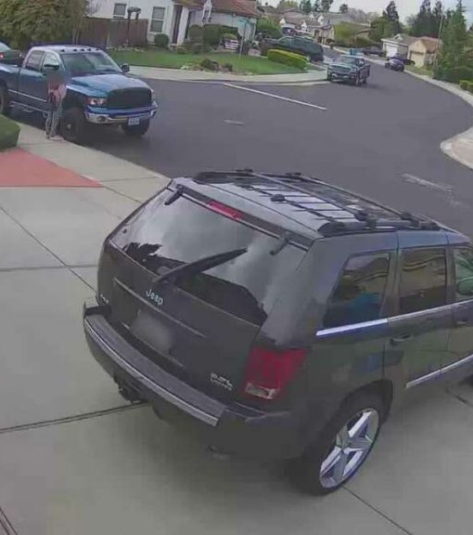
Suspicious SUV
Majority of SUV drivers are male
(Mark, 2024)
Witness statements and facts:
Hart's neighbor, Cynthia Ramirez saw a suspicious SUV parked outside her home the night before she disappeared
The vehicle remained stationary for a while and Hart was not seen returning home
Could this mean Hart was taken hostage and threatened?

Slide 7
Hart’s last research paper witnesses Jamie Patel + Dr Alaric
Rival researcher, Dr Fox Alaric rumoured to have disagreements with Dr. Hart over the ethics of AI
Hart's last paper exposed:
* ﻿﻿Bias in medical diagnosis systems
* ﻿﻿Showed disproportionate impact on marginalised communities
﻿﻿* Raised ethical concerns about Al in healthcare
Patels testimonies:
Claimed that Hart believed AI should never make life or death decisions without supervision—aligns with Wallach’s (2018) view on AI limitations in healthcare and how using AI in healthcare could risk lack of accuracy, risking patients health
Patel believed her stance challenged powerful figures who possibly wanted to silence her

Slide 8
Theories behind disappearance
Theory 2️⃣
Threatened into silence
Hart’s research put her odds with powerful figures
Singh and Alaric may have confronted her about her findings
The ransacked lab suggests an attempt to steal info
Theory 1️⃣
Kidnapped by Singh and Alaric
- Singh, the last person to see her, possibly had access to her office whilst Dr Alaric had a motive—protecting his career
- The SUV outside her home suggests someone was waiting to kidnap her
Theory 3️⃣
She fled on her own
Knowing she was being watched, Hart may have planned her escape
She wasn’t seen the night before she went missing whilst she was under surveillance by the SUV, suggesting she knew she was in danger

Slide 9
Conclusion
Wether she was kidnapped, threatened, or fled on her own, all signs point to powerful figures wanting to silence her. Singh and Alaric had potentials motives, while Felix Morgan dismissal of her concerns suggests she was stepping on dangerous ground. The ransacked lab, parked SUV, and urgent email all indicate to immediate danger
Reflection
This investigation presented several challenges such as:
Lack of concrete evidence
No definitive evidence or proof, making it hard to determine the whole truth
Identifying perpetrator
Singh, Alaric and Morgan all had potential reasons to want to silence Hart but without solid evidence, it’s hard to pinpoint
Unanswered Questions
What were the contents of the email?
What did Hart uncover?

