Slide 1
BASIL’S BAKERY
Customer Retention and Local Competition
Problem Solving and Decision Making
Individual Presentation
Student Name: Adam Solomon Afloarei
Student ID: 2537669
Module Code: LCLM4004
Academic Year: 2026–2027

Slide 2
THE BUSINESS PROBLEM - What are the reasons for the lower sales?
Business Situation
Basil’s Bakery opened a bakery in Coventry in 2015.
The bakery specialises in organic bread, cakes and pastries.
Sales in 2023-25 were around 25% lower than in 2019.
The amount of the local retail park’s consumption of pedestrian traffic has been impacted.
Problem areas for possible customer retention
Reduced visits: customers may no longer visit as often as before.
They will be tempted by the additional options: Supermarkets and other food retailers.
Household budgets may limit customers’ ability to purchase the most expensive products.
Habit change: Customers might want to use businesses that conform to their daily habits.
Why It Matters
Customers’ attitudes and repeat buying are responsible for customer loyalty (Dick and Basu, 1994).
It can be important to the long-term success of a business to keep existing customers (Reichheld and Sasser, 1990).

Slide 3
PESTEL ANALYSIS - External Factors Affecting Customer Retention
PESTEL is a tool that can be used to consider six external factors that may impact a business.
PESTEL Applied to Basil’s Bakery
Political: The government policies and business support can affect small retailers.
Economic: People's budgets may be stretched with increased living costs and they will opt for lower alternatives.
Social: Perhaps, fewer visits will be made due to hybrid working and changing shopping habits.
Technological: Potential competitor providing online services might be more convenient.
Environmental: Organic products range could become an opportunity due to the demand for sustainable products.
Legal: Food safety and labelling regulations affect the sale of bakery products.
Limitation
Does not identify personalised reasons for customers not to re-enter.
Advantage
Helps identify external threats and opportunities
Key Findings
The drop in sales could be due to changing customer habits and competition in the area.
The awareness of customers' needs and the strategies of competitors can help a business increase its market positioning (Porter, 1980; Grönroos, 2007).

Slide 4
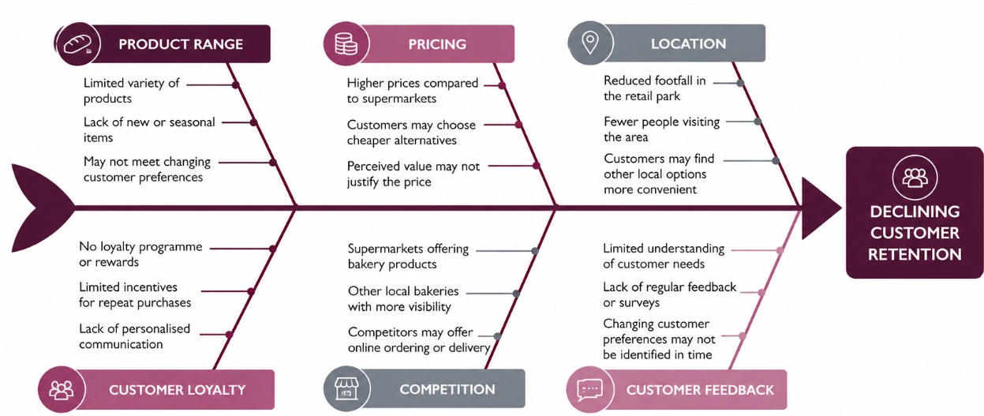
FISHBONE DIAGRAM - Understand why customers leave your business.
Fishbone Analysis
Purpose: Identifies possible reasons why customers stop returning.
Advantage: Helps organise different causes of customer loss.
Limitation: Further research is needed to confirm the actual causes.

Slide 5
CONCLUSION TO THE ANALYSIS - Identifying the decision-making process of the customer
Customer Behaviour
Fewer visits by customers as the working and shopping habits have changed.
Location of stores may affect the places customers shop.
Positive experiences can fortify better customer relationships (Zeithaml, Bitner and Gremler, 2018).
Business weaknesses to be explored
The bakery may have to consider the appropriateness of its product line to customer taste.
Lack of loyalty incentives may lead to fewer repeat purchases.
Management may not be aware of changing needs because of limited customer feedback.
Most Important Findings
Customer loyalty is not just a matter of providing good products (Oliver, 1999).
Good relationships with customers rely on the knowledge of customer needs (Buttle and Maklan, 2019).
The quality of services and satisfaction can help to improve business performance (Heskett et al., 1994).
Main Priority - Know why customers are not visiting as often as you think they should and avoid costly changes.

Slide 6
RECOMMENDATIONS & FINAL CONCLUSION
What can Basil’s Bakery do to regain the loyalty of their customers?
Recommended Actions
Implement a loyalty card: Give rewards to customers when they make a few purchases.
Request feedback: Make use of quick surveys to get what customers want.
Review range of products: Test new products according to customer preference.
Provide specific promotions: Encourage customers to return when less busy.
Prosper Relationships: Keep in mind ordering habits of the regulars and be friendly and consistent in your service.
Measure results: Monitor repeat purchases, customer feedback and sales over time.
The rationale for the following actions
Customer relationship management is about building relationships that are important and long-lasting (Kumar and Reinartz, 2018).
Customer retention helps to support long-term business performance (Reichheld and Sasser, 1990).
Final Conclusion
Basil’s Bakery is not responsible for changes to the local retail park.
It can, however, help it to learn more about and serve its current customers.
The main objective is not just to attract new customers but to make the existing customers return.

Slide 7
References
Buttle, F. and Maklan, S., 2019. Customer relationship management: concepts and technologies. Routledge.
Dick, A.S. and Basu, K., 1994. Customer loyalty: toward an integrated conceptual framework. Journal of the academy of marketing science, 22(2), pp.99-113.
Grönroos, C., 2007. Service management and marketing: Customer management in service competition. John Wiley & Sons.
Heskett, J.L., Jones, T.O., Loveman, G.W., Sasser, W.E. and Schlesinger, L.A., 1994. Putting the service-profit chain to work. Harvard business review, 72(2), pp.164-174.
Kumar, V. and Reinartz, W., 2018. Customer relationship management.
Oliver, R.L., 1999. Whence consumer loyalty?. Journal of marketing, 63(4_suppl1), pp.33-44.
Porter, M.E. and Strategy, C., 1980. Techniques for analyzing industries and competitors. Competitive Strategy. New York: Free, 1, p.76.
Reichheld, F.F. and Sasser Jr, W.E., 1990. Zero defections: Quality comes to services. Harvard business review, 68(5), pp.105-111.
Zeithaml, V.A., Bitner, M.J. and Gremler, D.D., 2018. Services Marketing: Integrating Customer Focus Across the Firm, 7/E.

