Slide 1
Flower FACE
Pre-Production
ADGD7006
Hongjing YU
GROUP PRESENTATION

Slide 2
My Work
Research and Discuss relevant history about this animation
Design and Modeling Castle
Combination
Shot Production

Slide 3
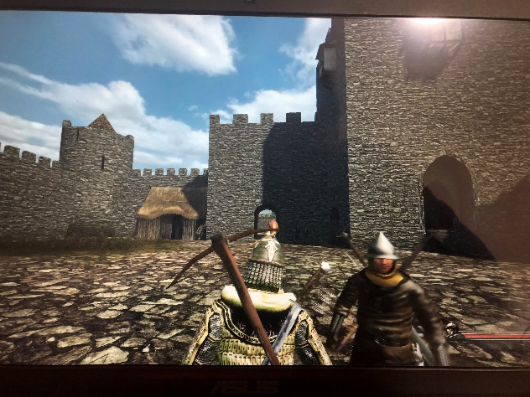
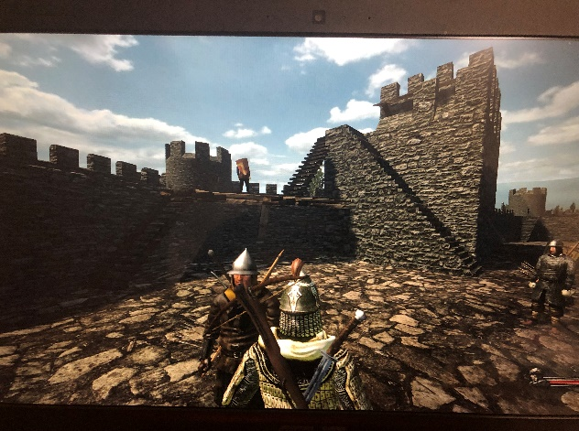
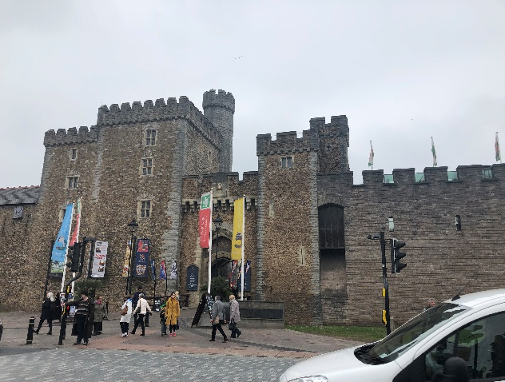
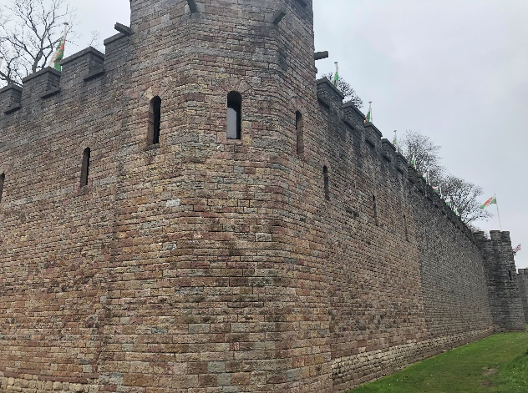
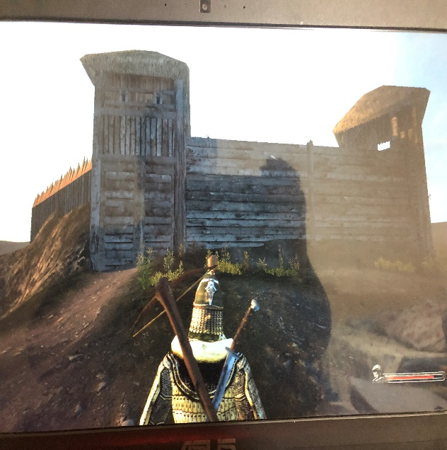
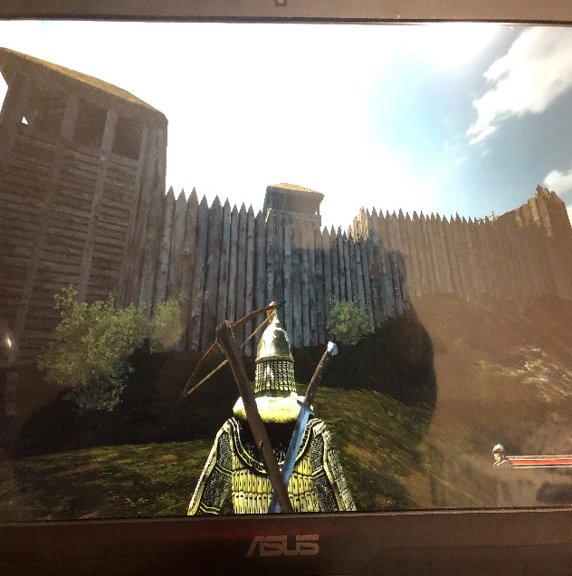
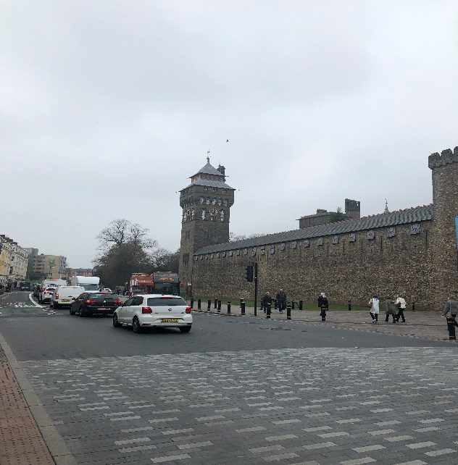
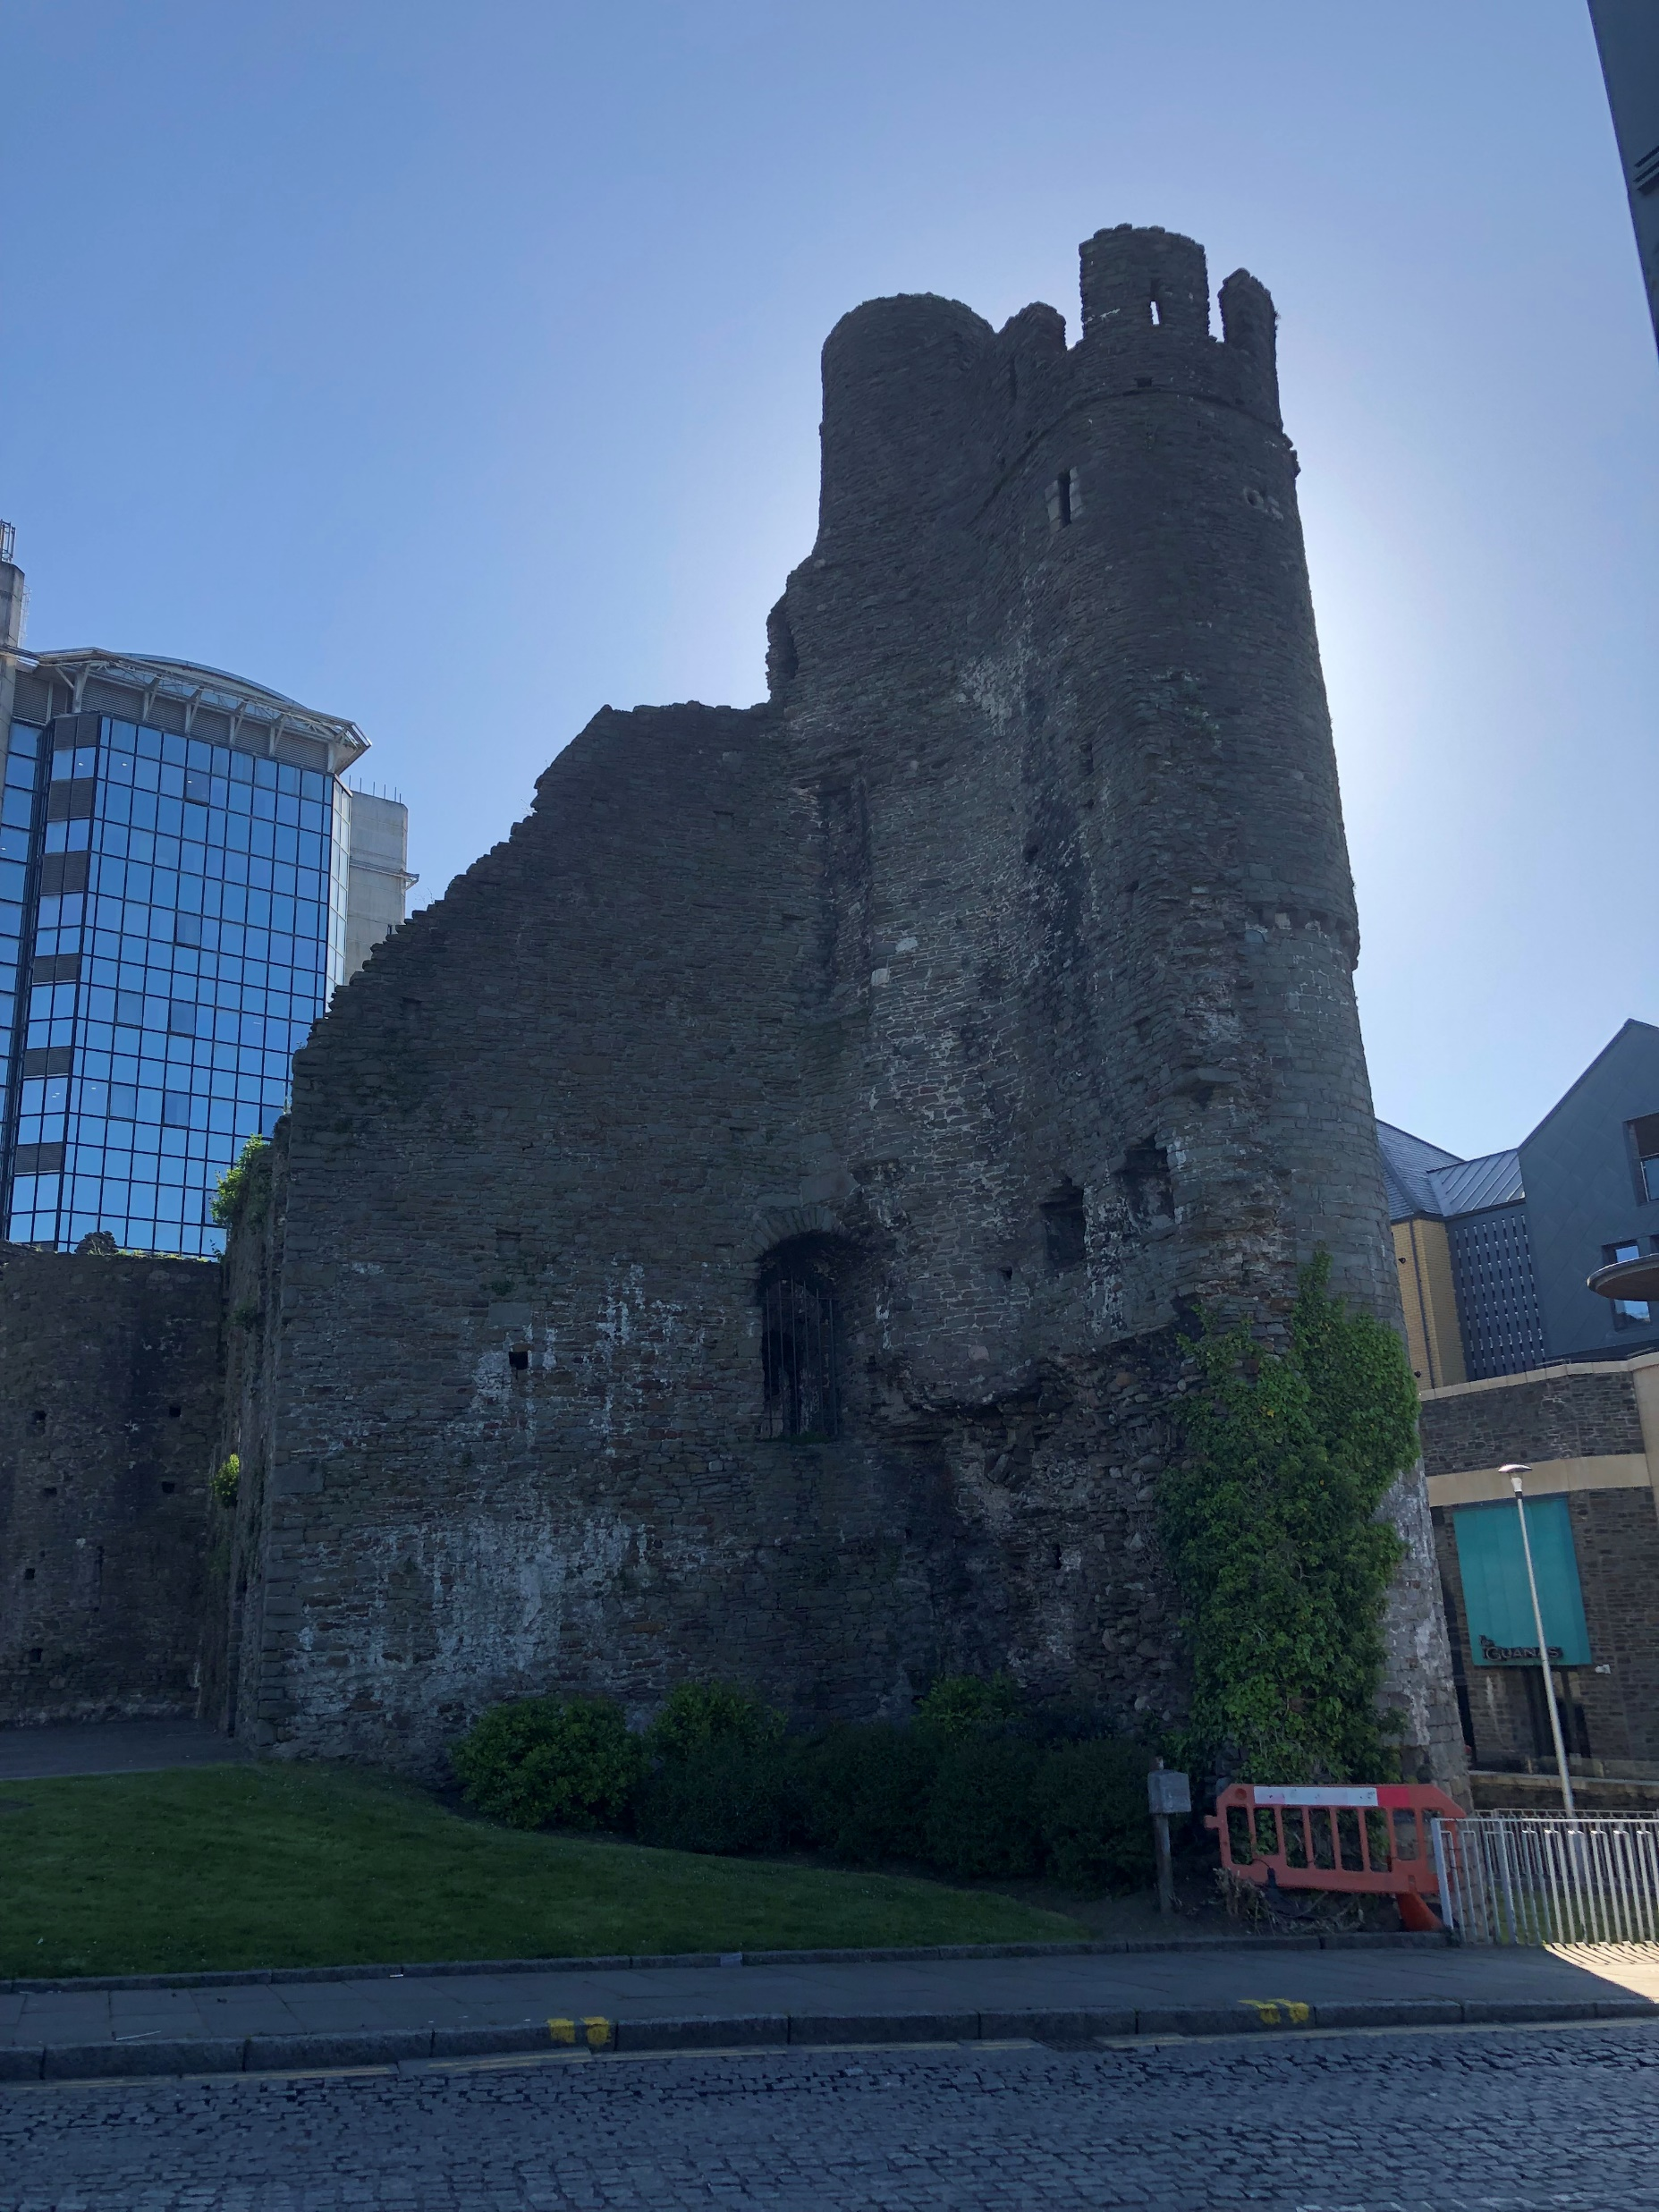
Reference Castle
From Games From Me

Slide 4
Age
Welsh Folklore A set of tarot cards The original story is extremely complicated.
The original story was happened in 6 Century welsh
In 6th century few stone Castle(made by Rome Empire). Main Wooden Castle(Made by Local)
wedding castle church cloth

Slide 5
Age
group discussion and summary:
The Story was happened in 12th century(Stone castle)
Non-Christian Wedding (No church)
Must has Circular tower(no Cube tower)
Castle Gate(no draw bright)
Must has windows
Castle wall difference(lower and higher)

Slide 6
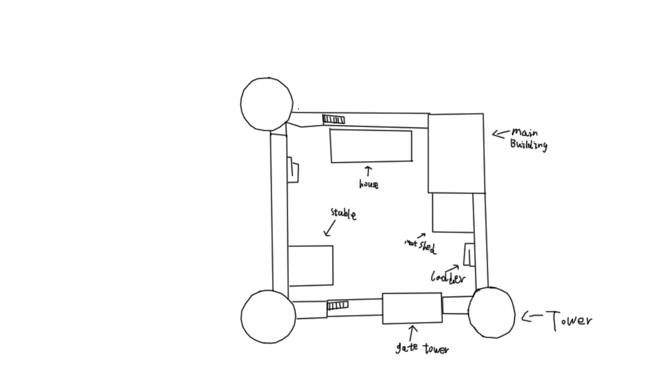
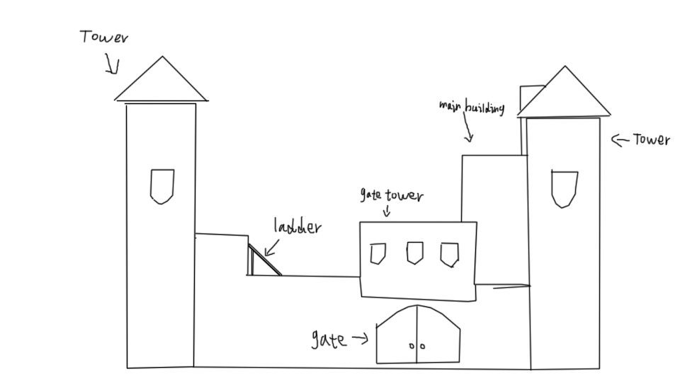
Castle Design
Draft

Slide 7
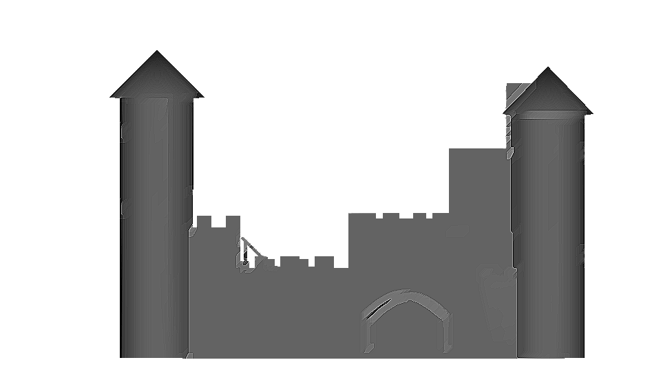
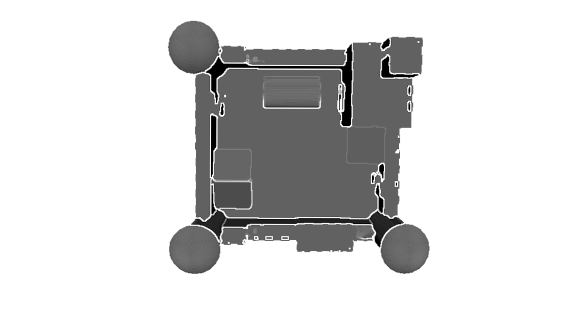
Castle Design-Demonstrate Picture
Demonstrate Picture

Slide 8
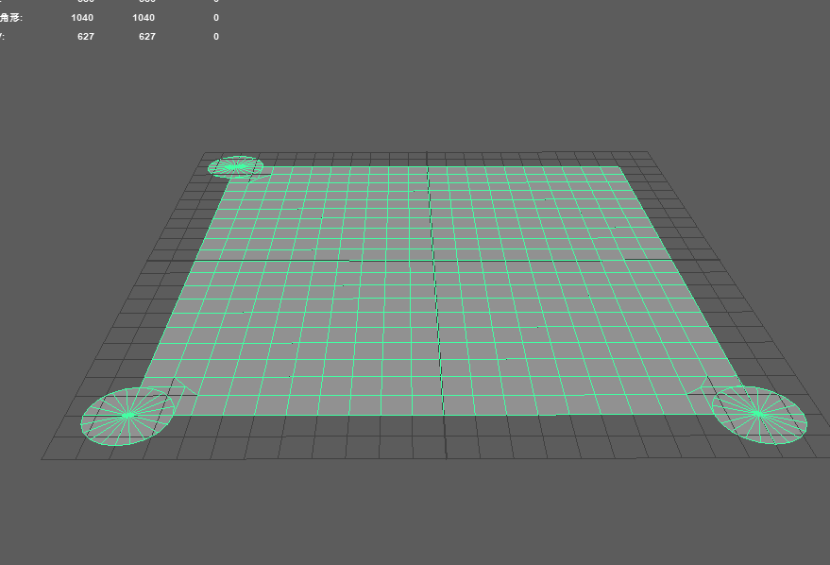
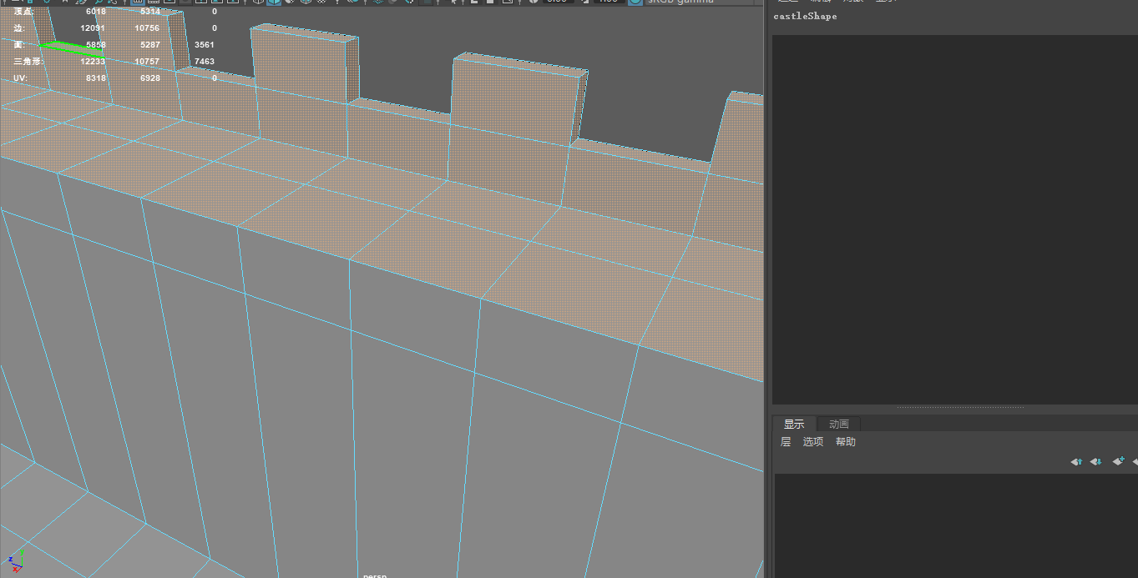
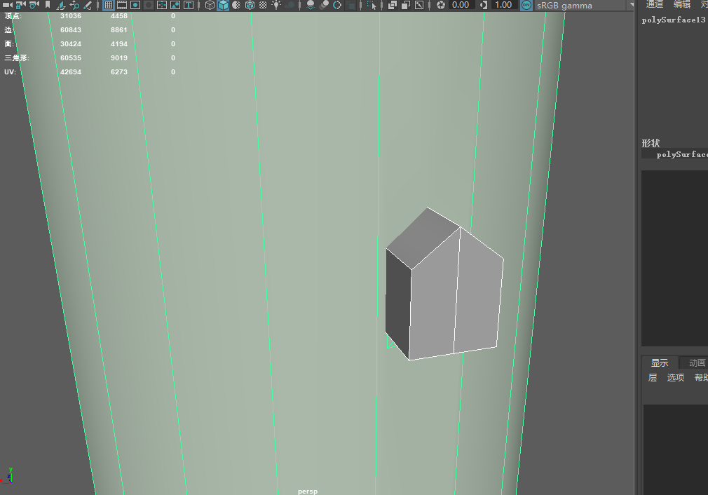
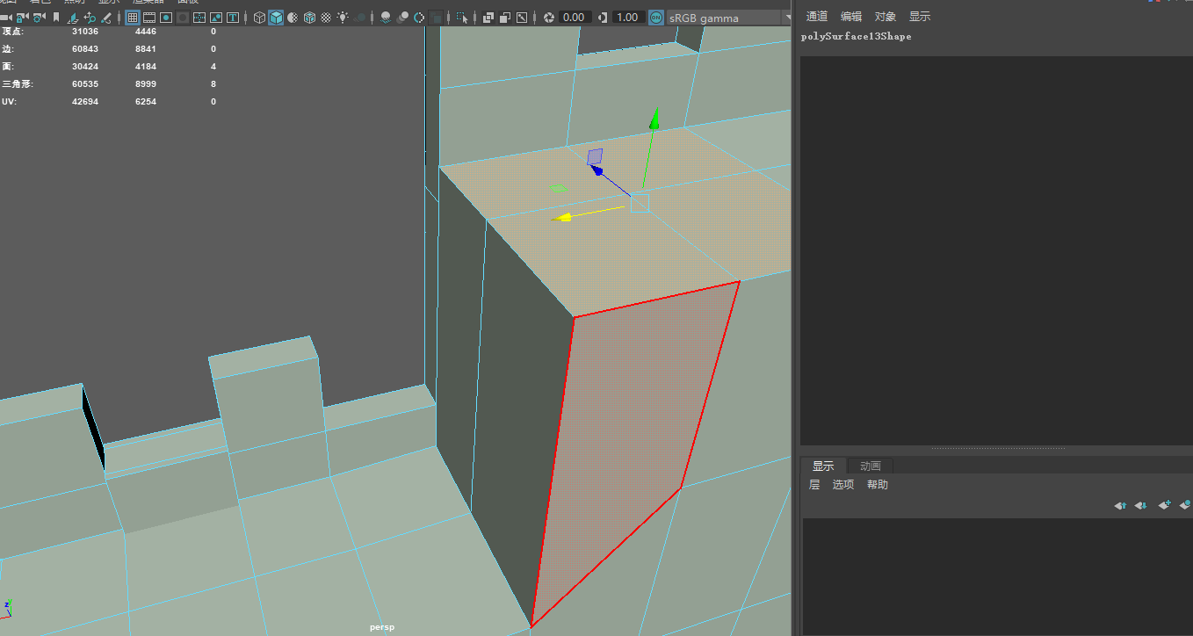
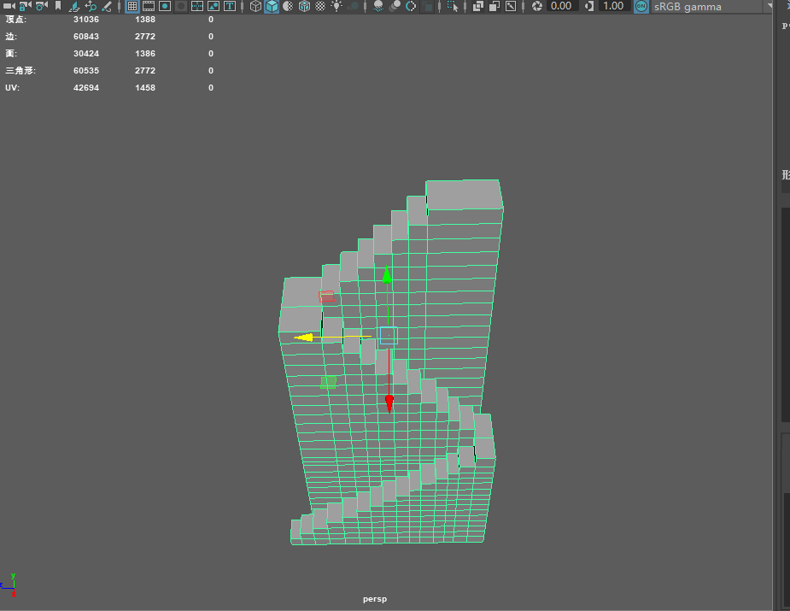
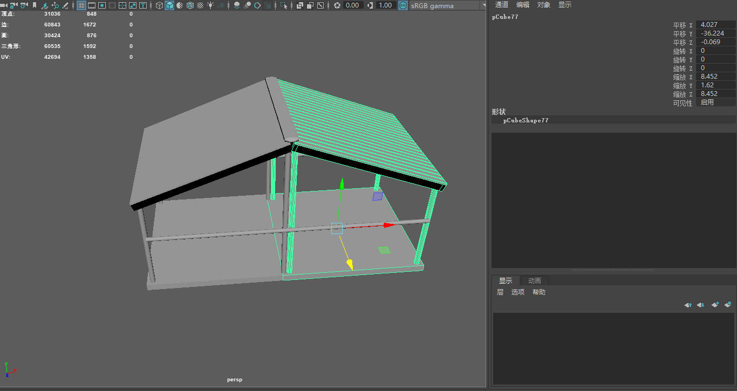
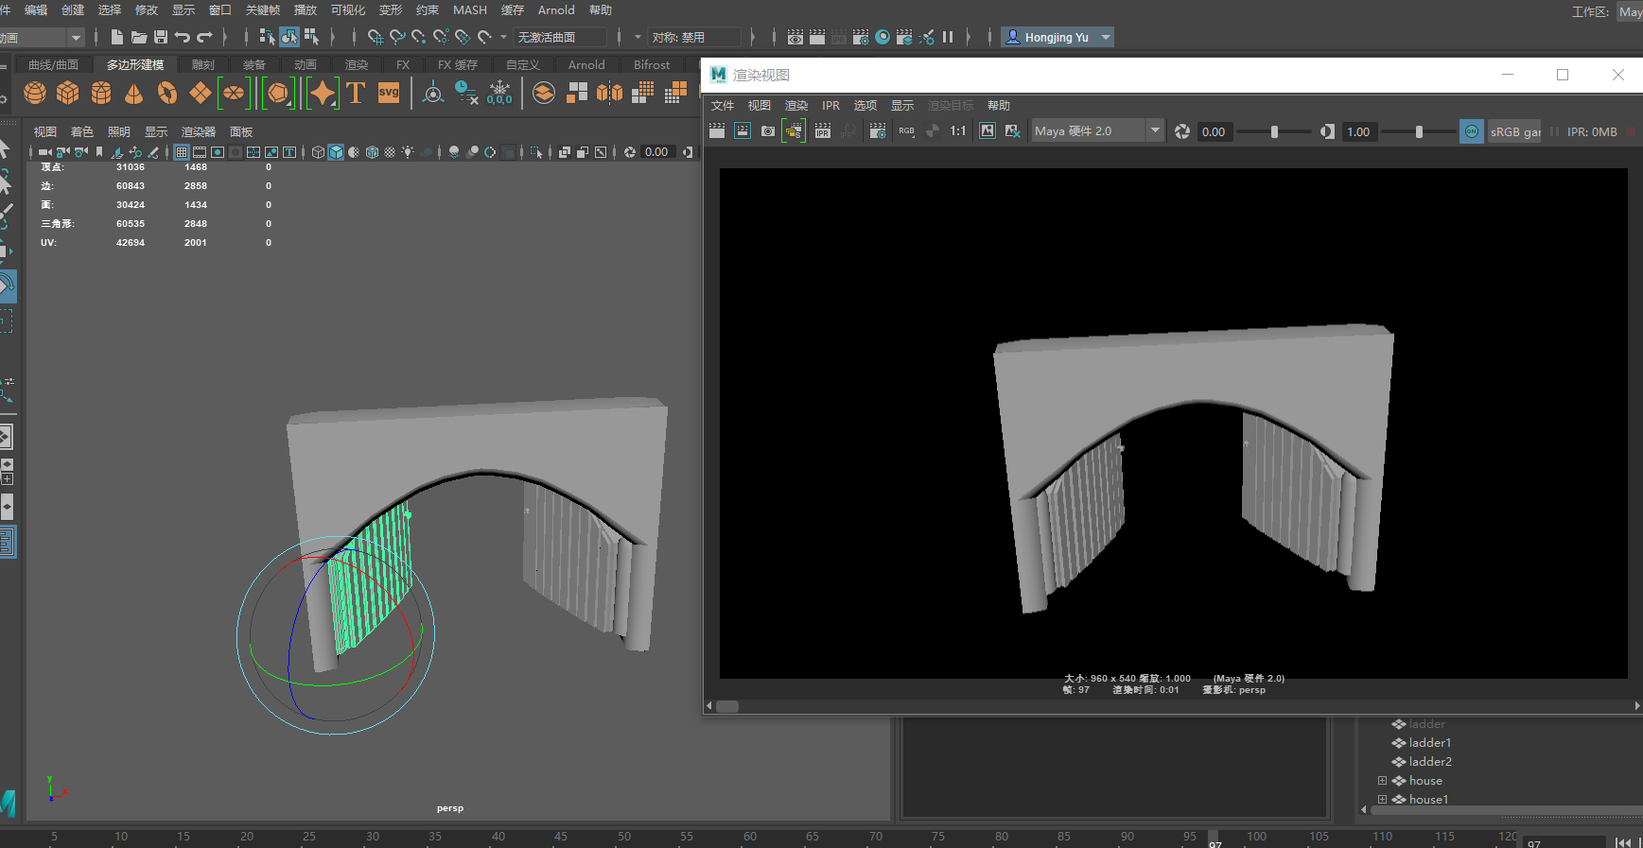
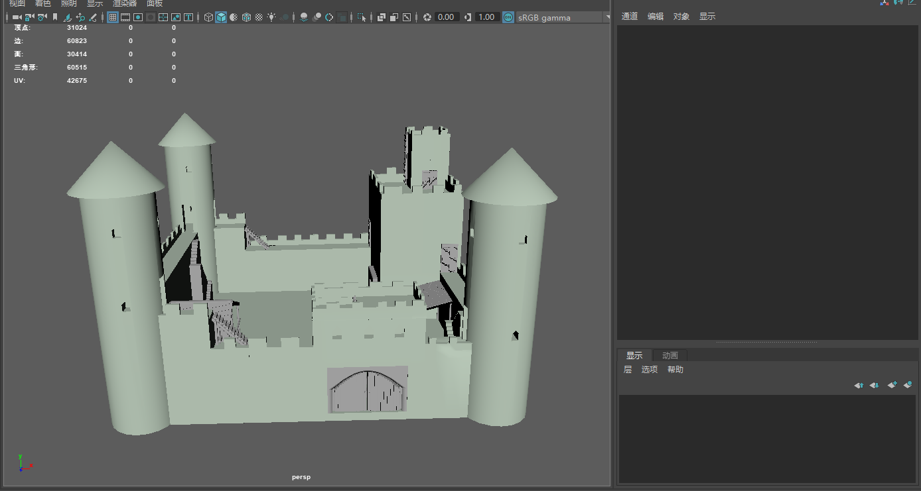
Castle Design-process
Process
Foundation Build castle wall Build Tower and main building Adjust castle wall
Build Ladder Build stable Build Castle Gate Combine all element

Slide 9
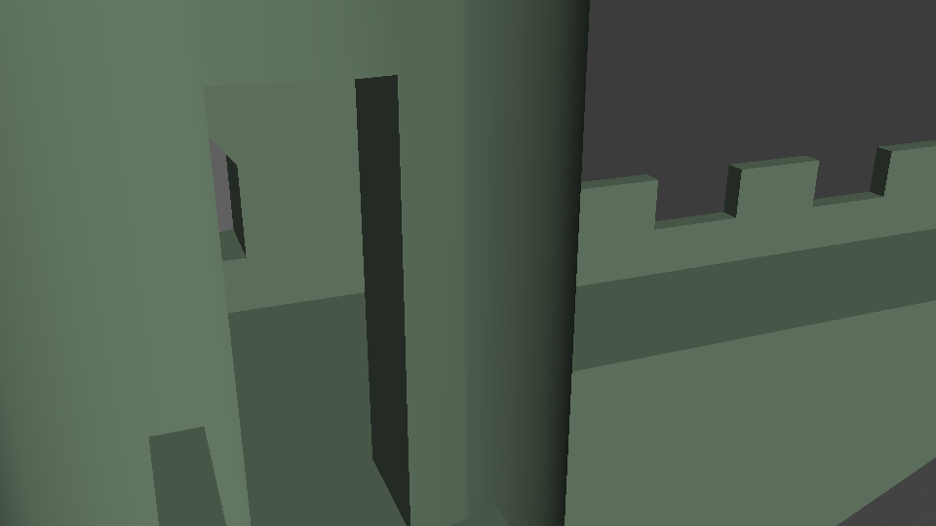
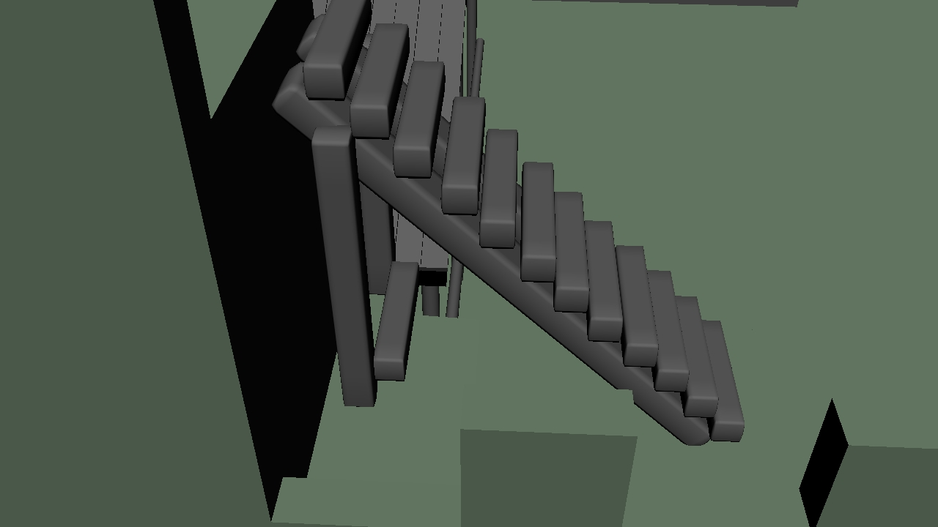
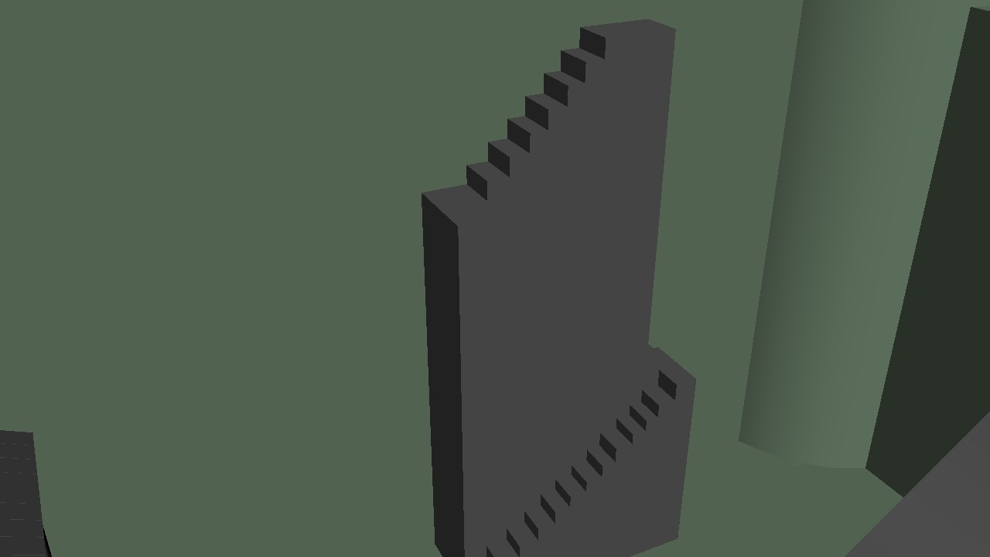
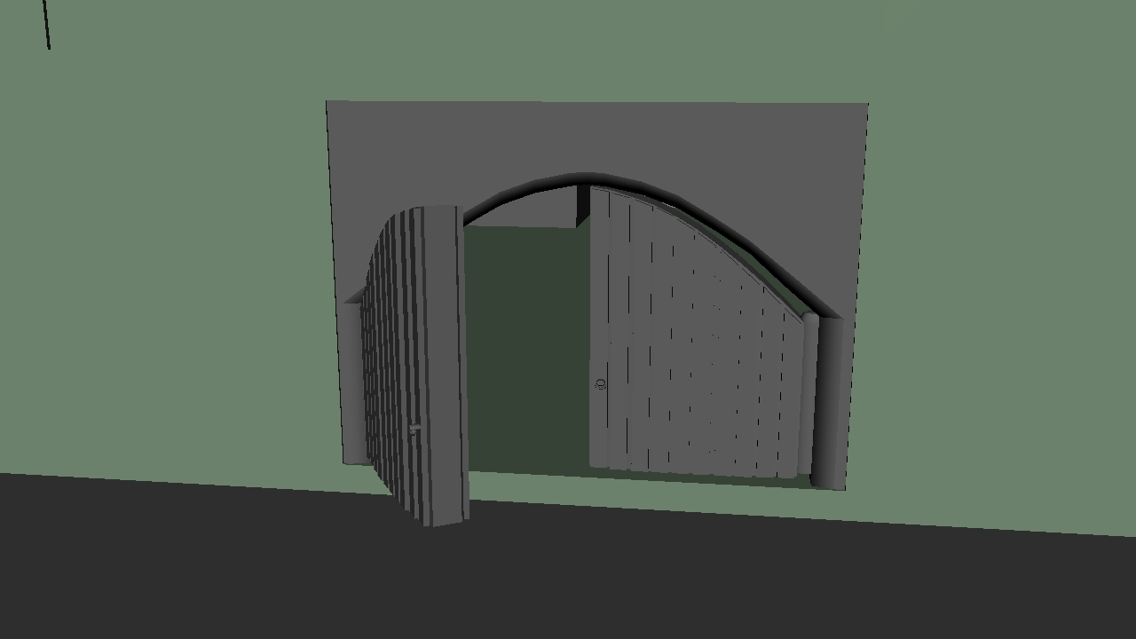
Castle-Detail
The detail about castle
Tower indoor Castle
ladder
Stone Castle
stage Gate

Slide 10
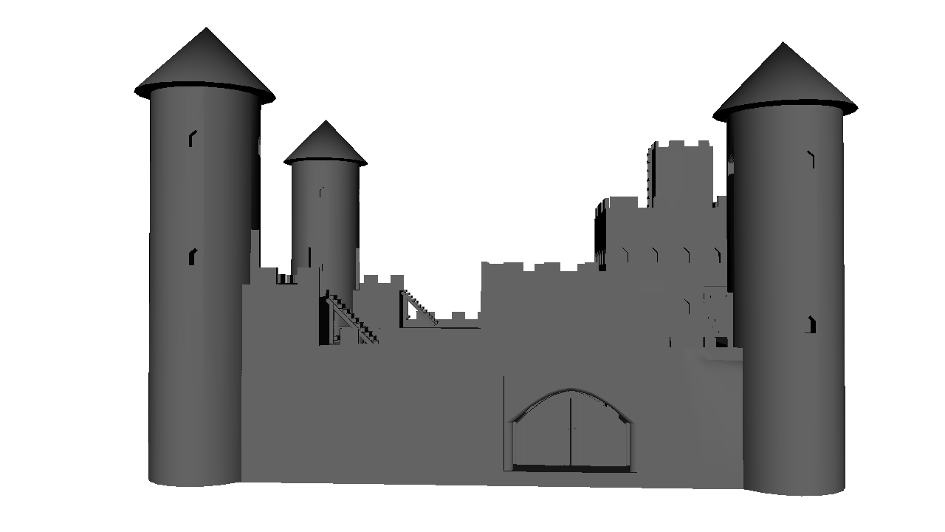
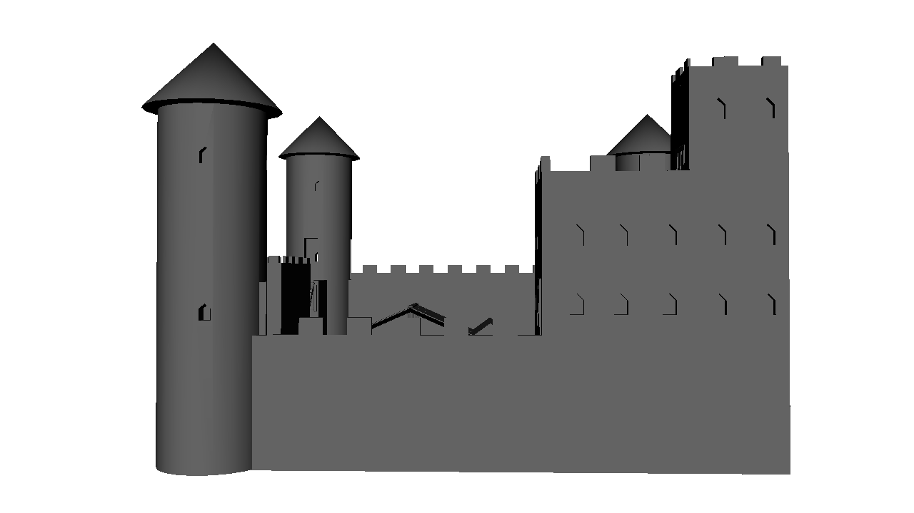
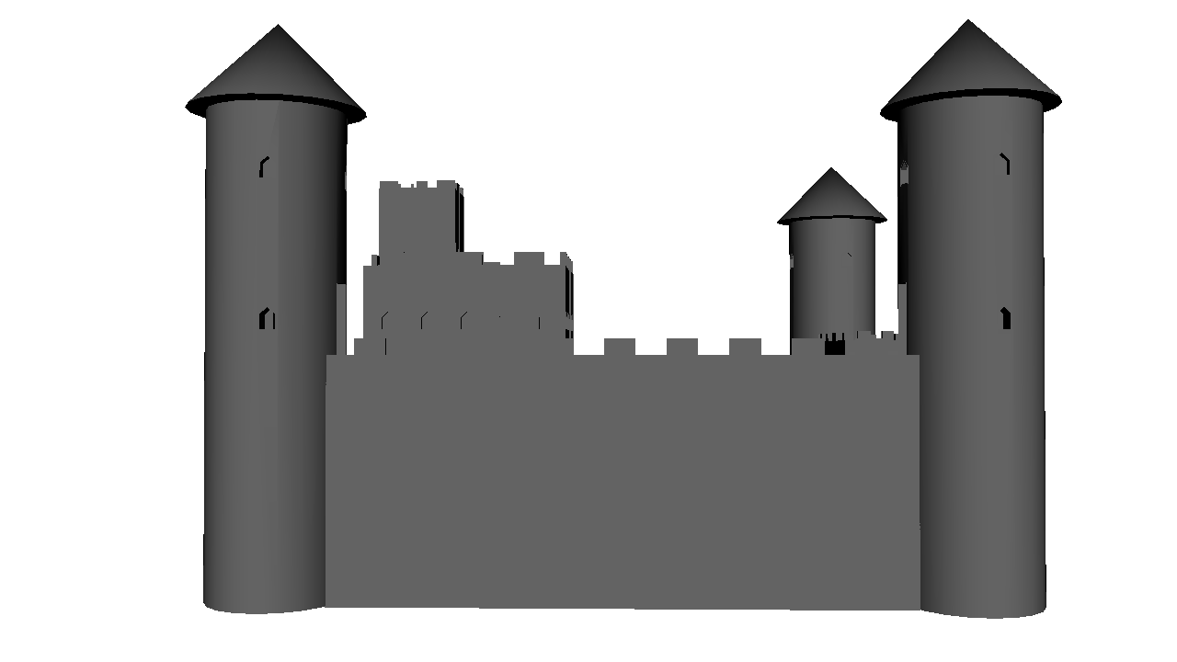
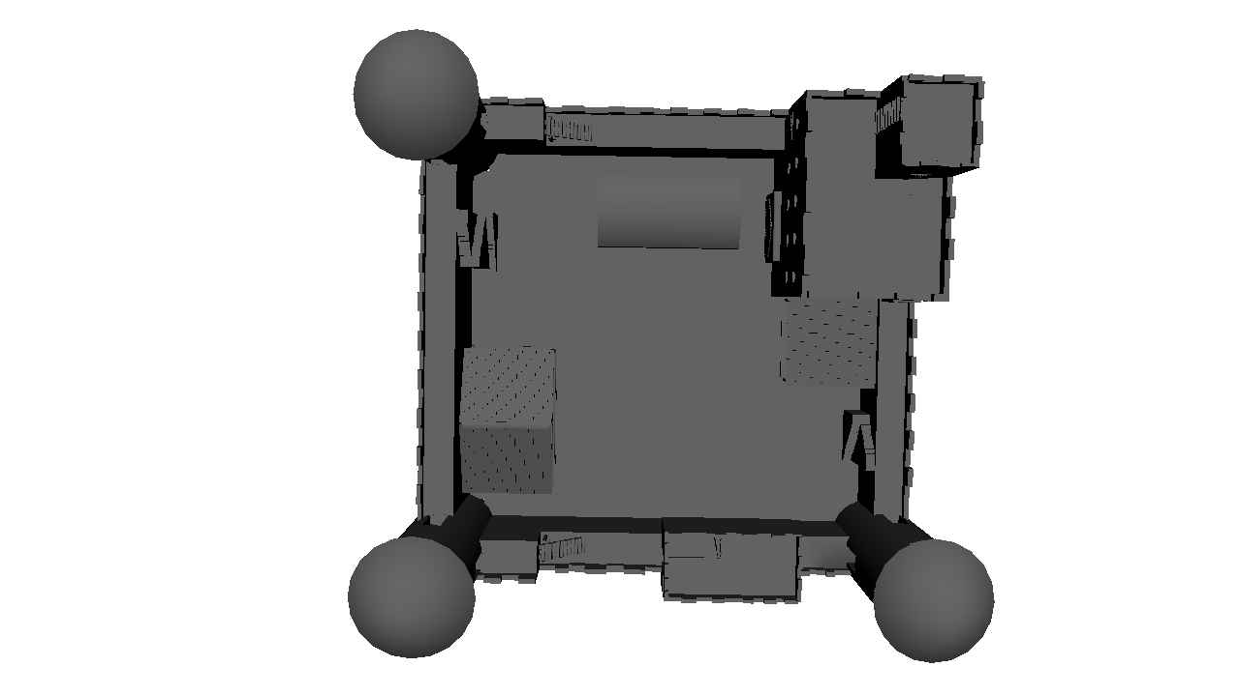
Castle-Final
Final Design

Slide 11
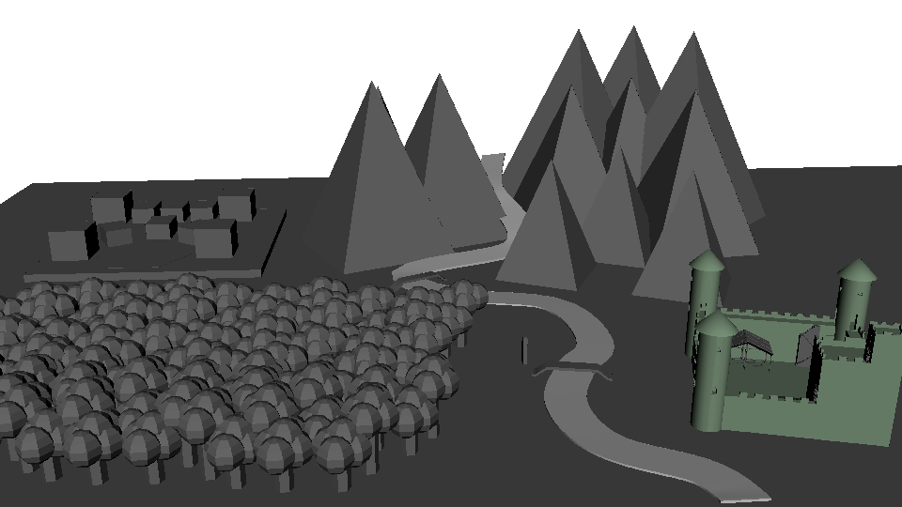
Combination
I respond for environment combination according to character’s size

Slide 12
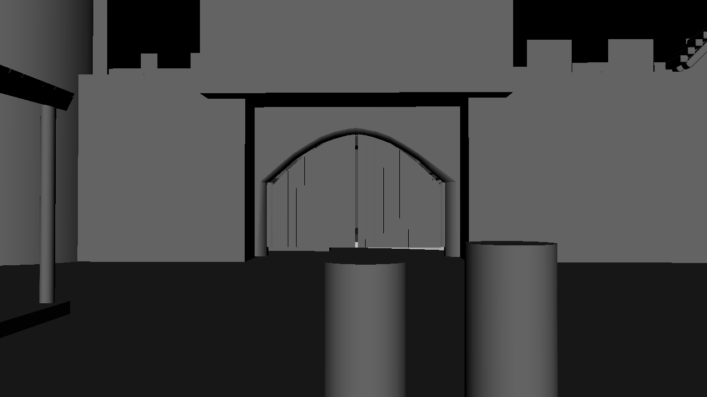
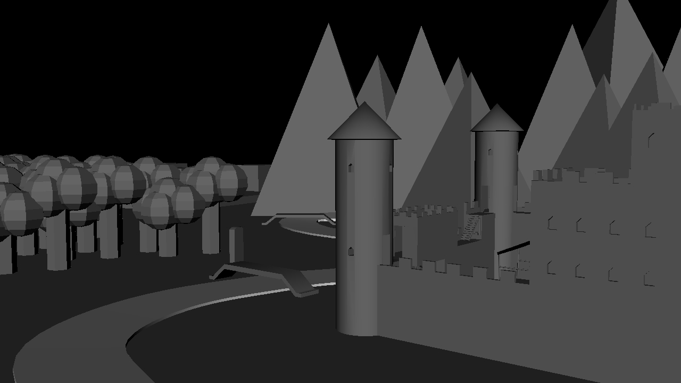
Shot Production
Shot4 season change

Slide 13
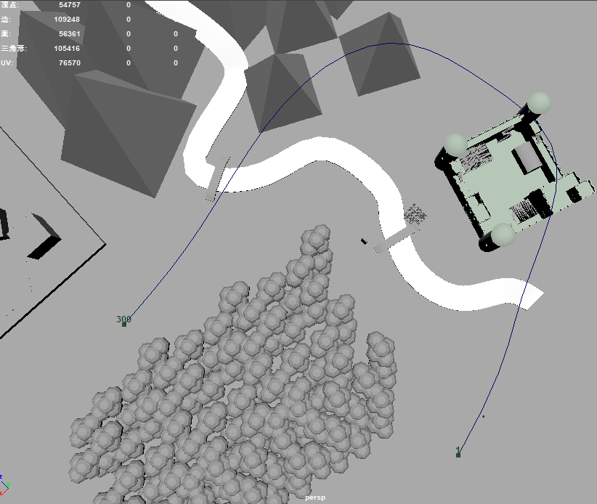
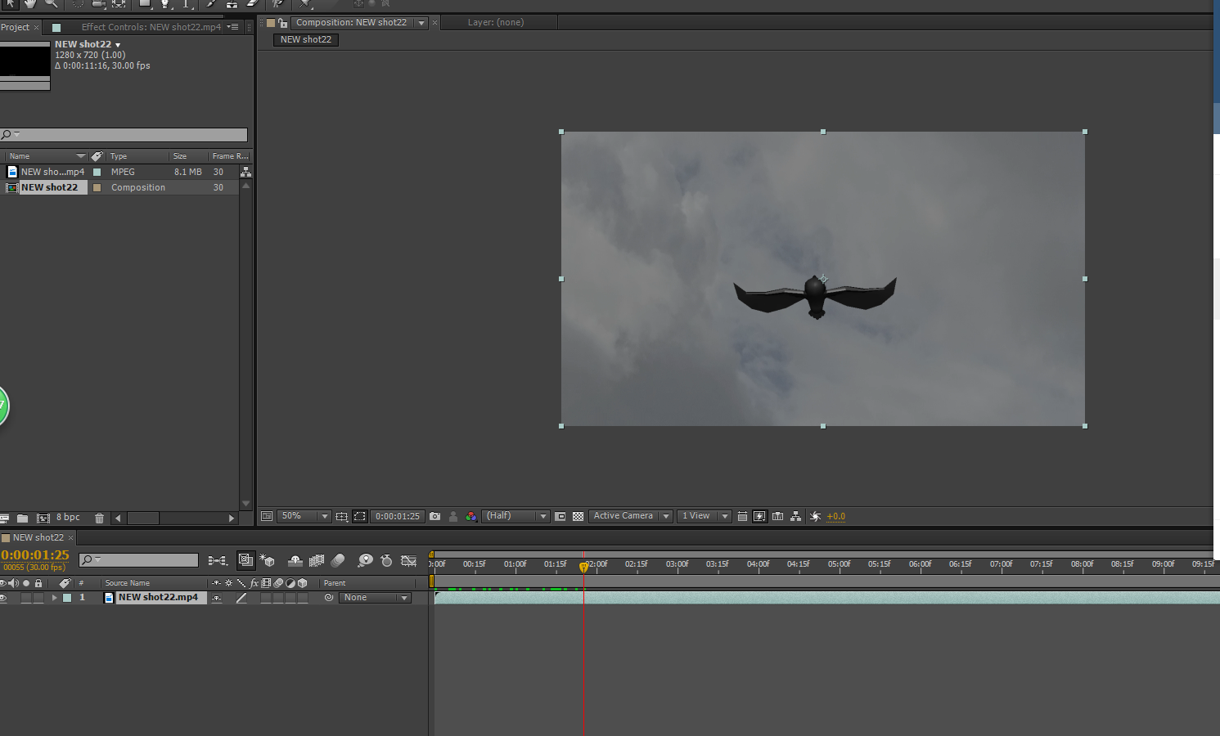
Shot Production
Shot 16 Use curve Motion path to link curve and owl. Then compose it in after effect.

Slide 14
Summary
Some things that I do well
Castle design and model(tower, Gate)
Shot curve to link with owl ,effect

Slide 15
Summary
Some things that I Learned
The structure of a building must be planned before modeling. It is very hard to adjust the structure of building(cube tower to circle tower, castle wall difference)
In the motion path, curve’s moving time can not change when the associated object is established.

Slide 16
Summary
Some things that I can do better
Christian Wedding church(more character)
More detail about castle(window, wall,)
More decorations (to let scene not empty)

Slide 17
Thanks For watching
End

