Slide 1
AHHI5016 Week 3
Virtuous Expansion: From Jeffersonian Democracy to Manifest Destiny – Monday
1. Debating the Early Republic
The Federalist
Republicanism v Democracy
Structure of US government
Bill of Rights (and key amendments)
Inclusions and exclusions
2. Jeffersonian Democracy
Hamilton v Jefferson
Championing the yeoman farmer
Jefferson as slaveholder
3. Expansion and Consolidation
‘Empire of Liberty’
Louisiana Purchase
Lewis and Clark
War of 1812
Monroe Doctrine
4. The Age of Jackson
Jackson as war hero
Democrats v Whigs
Jacksonian Democracy
Indian Removal and the Trail of Tears
5. War with Mexico
Independence in Spanish America
Texas Revolution
‘Annexation’ and Manifest Destiny
Treaty of Guadalupe Hidalgo
Competing memories
AIMS
Provide overview of 50 years from ratification of constitution up to Mexican-American War
Outline emergence of party system in US politics
Sketch key ideas underpinning Jeffersonian and Jacksonian notions of democracy, and the ideology of ‘Manifest Destiny’
Chart the events and ideologies which led to US territorial expansion

Slide 2
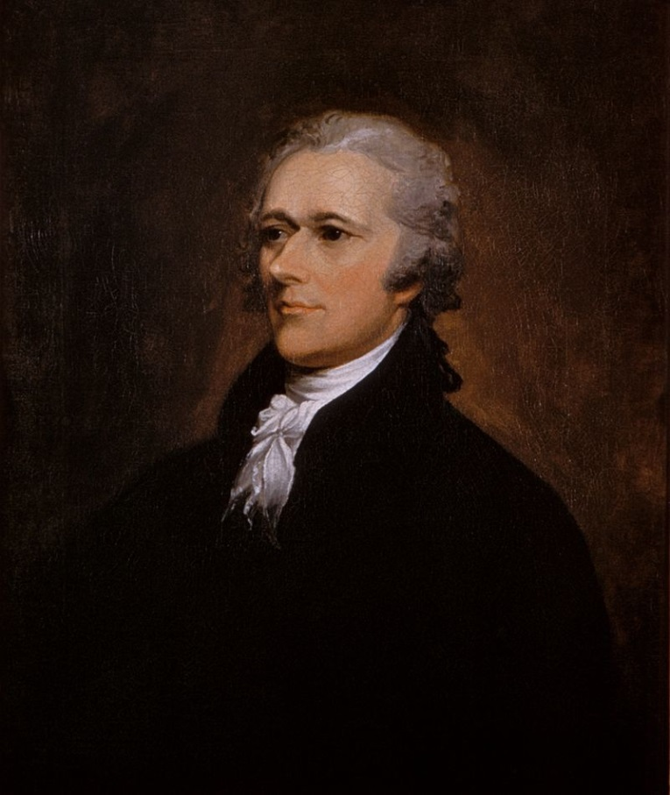
1. Debating the Early Republic: The Federalist
The Federalist Nos. 1 and 6: Hamilton
Who was Alexander Hamilton (1755–1804), and what his significance in American history?

Slide 3
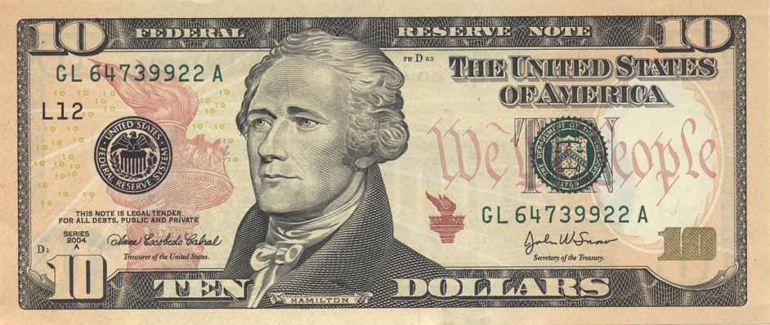
1. Debating the Early Republic: The Federalist
The Federalist Nos. 1 and 6: Hamilton
Who was Alexander Hamilton (1755–1804), and what his significance in American history?
  New York delegate to Congress of the Confederation (est. by Articles of Confederation, 1781)
  Aide to Washington in Revolutionary War
  First United States Secretary of the Treasury in Washington administration (finance minister, analogous to Chancellor of the Exchequer)
  Founded First National Bank
  Leader of Federalist Party

Slide 4
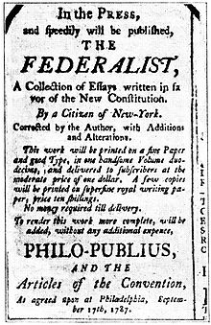
1. Debating the Early Republic: The Federalist
The Federalist Nos. 1 and 6: Hamilton
Can Hamilton’s first letter be read as a manifesto for subsequent issues of The Federalist, and if so in what ways?
  How does Hamilton’s first letter explain the function and purpose of The Federalist papers?
  What prompted him to write the letter?
  What arguments and political positions is the letter intended to promote?
How does The Federalist No. 1 work as a piece of literature? What writing techniques to Hamilton use to try and convince his readership? Does he employ any literary or rhetorical devices to press his points home? Do you find his style convincing?

Slide 5
1. Debating the Early Republic: The Federalist
The Federalist Nos. 1 and 6: Hamilton
What type of government does Hamilton favour, and how does he distinguish it from other available options?
What sorts of rights and liberties – and for whom – does Hamilton deem particularly important in The Federalist No. 1?
Does Hamilton’s tone and line of argument change at all in The Federalist No. 6? Are any additional factors or events discussed that were overlooked in the first letter?

Slide 6
1. Debating the Early Republic: The Federalist
The Federalist Nos. 1 and 6: Hamilton
Interpret the significance of the following phrases and extracts from The Federalist Nos. 1 and 6:
  “… the fate of an empire in many respects the most interesting in the world;”
  “… heresies can rarely be cured by persecution;”
  “… the vigor of government is essential to the security of liberty;”
  “… an enlightened zeal for the energy and efficiency of government;”
  “… the specious mask of zeal for the rights of the people;”
  “ … favorites of a king or of a people;”
  “ … the spirit of commerce has a tendency to soften the manners of men”?

Slide 7
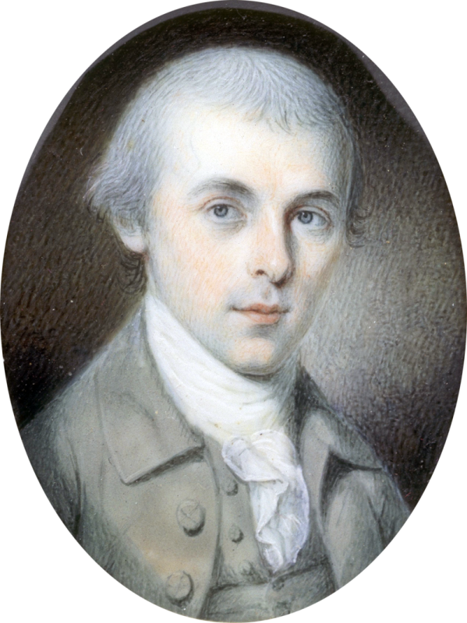
1. Debating the Early Republic: The Federalist
The Federalist No. 10: Madison
Who was James Madison (1751–1836), and what his significance in American history?

Slide 8
1. Debating the Early Republic: The Federalist
The Federalist No. 10: Madison
Who was James Madison (1751–1836), and what his significance in American history?
  Did not see military service due to ill health
  Served in the Virginia state legislature (1776–1779, 1784–1786); protégé of Thomas Jefferson
  Delegate to Continental Congress (1780–1783)
  Member of US House of Representatives (1789–1797)
  US Secretary of State (1801–1809) (foreign affairs minister)
  4th President of the United States (1809–1817)
  ‘The Father of the Constitution,’ drafted and promoted Constitution and Bill of Rights

Slide 9
1. Debating the Early Republic: The Federalist
The Federalist No. 10: Madison
Does Madison’s tone and line of argument differ at from those pursued by Hamilton? Does he cite any additional factors or events that were overlooked in The Federalist Nos. 1 and 6?

Slide 10
1. Debating the Early Republic: The Federalist
The Federalist No. 10: Madison
How does Madison define ‘faction’? Are different types of ‘factions’ discussed in The Federalist No. 10, and if so how does Madison characterise them?
What two means does Madison suggest are available to prevent factions forming, and why does he reject them both?
What structures and functions of government does Madison propose for helping balance or mitigate “the mischief of faction”?

Slide 11
1. Debating the Early Republic: The Federalist
The Federalist No. 10: Madison
What sorts of rights and liberties – and for whom – does Madison deem particularly important in The Federalist No. 10? Why and how is property an important concept for him?
How does Madison differentiate between democracy and republicanism? What is his verdict on what he terms “pure democracy”?

Slide 12
1. Debating the Early Republic: Democracy v Republicanism
Democracy
The idea of democracy, drawn from the Ancient Greeks, emphasises self-governance, in which people participate fully in the political decisions that affect their lives.
Republicanism
The idea of republicanism, again derived from antiquity, begins with an assembly of enlightened citizens which governs objectively and in the best interests of the whole society. Republican thought places great emphasis on individual virtue. This quality guarantees the general good of society against individual desires or the specific interests of social groups. For Republicans, then, public virtue is opposed to private vice.

Slide 13
1. Debating the Early Republic: Structure of US Government
“We the People of the United States, in Order to form a more perfect Union, establish Justice, insure domestic Tranquility, provide for the common defence, promote the general Welfare, and secure the Blessings of Liberty to ourselves and our Posterity, do ordain and establish this Constitution for the United States of America …”
Article I. Legislative Branch – powers of Senate and House of Representatives (Congress)
House of Representatives composed of representatives from each state in proportion to their population
Senate composed of two members per state
Article II. Executive Branch – powers of the President and offices of the President
Article III. Judicial Branch – powers of the Supreme Court and other Federal courts

Slide 14
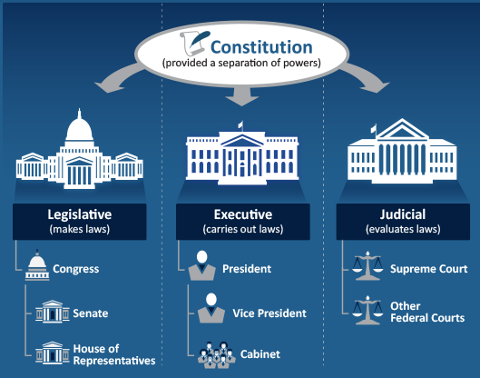
1. Debating the Early Republic: Balance of powers

Slide 15
1. Debating the Early Republic: Structure of US Government
“We the People of the United States, in Order to form a more perfect Union, establish Justice, insure domestic Tranquility, provide for the common defence, promote the general Welfare, and secure the Blessings of Liberty to ourselves and our Posterity, do ordain and establish this Constitution for the United States of America …”
Article IV. States, Citizenship, New States – Congress permitted to admit new states; requires each state to enact Republican form of government
Article V. Amendment Process.
Article VI. Debts, Supremacy, Oaths, Religious Tests – establishes the Constitution, and all federal laws and treaties of the United States made according to it, to be the supreme law of the land
Article VII. Ratification

Slide 16
1. Debating the Early Republic: Bill of Rights
Amendment I
Rights pertaining to freedom of religion, speech, the press; the right to assemble and to petition the Government
Amendment II
“A well regulated Militia, being necessary to the security of a free State, the right of the people to keep and bear Arms, shall not be infringed.”
Amendment III
Quartering of soldiers
Amendment IV
Protections against searches/seizures without warrants and probable cause
Amendments V–VIII
Rights pertaining to trials, jury, common law, bail.

Slide 17
1. Debating the Early Republic: Bill of Rights
Amendment IX
“The enumeration in the Constitution, of certain rights, shall not be construed to deny or disparage others retained by the people.”
Amendment X
“The powers not delegated to the United States by the Constitution, nor prohibited by it to the States, are reserved to the States respectively, or to the people.”

Slide 18
1. Debating the Early Republic: Key Amendments
13th Amendment to US Constitution abolished slavery
Submitted January 1865; ratified December 1865
14th Amendment grants citizenship rights to “all persons born or naturalized in the US” (inc. former slaves)
Submitted June 1866; ratified July 1868
15th Amendment prohibits federal/state governments from denying the right to vote based on “race, color, or previous servitude”
Submitted February 1869; ratified February 1870
  -
  19th Amendment ensures “the right of citizens of the United States to vote shall not be denied or abridged by the United States or by any State on account of sex.”
Ratified August 1920

Slide 19
1. Debating the Early Republic: Key Amendments
  25th Amendment formalises process for succession to the Presidency and establishes procedures both for filling a vacancy in the office of the Vice President and in event of President is deemed unable to discharge their duties
  Proposed July 1965; Ratified February 1967
Section 4. Whenever the Vice President and a majority of either the principal officers of the executive departments or of such other body as Congress may by law provide, transmit to the President pro tempore of the Senate and the Speaker of the House of Representatives their written declaration that the President is unable to discharge the powers and duties of his office, the Vice President shall immediately assume the powers and duties of the office as Acting President.
Thereafter, when the President transmits to the President pro tempore of the Senate and the Speaker of the House of Representatives his written declaration that no inability exists, he shall resume the powers and duties of his office unless the Vice President and a majority of either the principal officers of the executive department or of such other body as Congress may by law provide, transmit within four days to the President pro tempore of the Senate and the Speaker of the House of Representatives their written declaration that the President is unable to discharge the powers and duties of his office. Thereupon Congress shall decide the issue, assembling within forty-eight hours for that purpose if not in session. If the Congress, within twenty-one days after receipt of the latter written declaration, or, if Congress is not in session, within twenty-one days after Congress is required to assemble, determines by two-thirds vote of both Houses that the President is unable to discharge the powers and duties of his office, the Vice President shall continue to discharge the same as Acting President; otherwise, the President shall resume the powers and duties of his office
Ratified August 1920

Slide 20
1. Debating the Early Republic: Inclusions and exclusions
“The Congress shall have Power to … make all Laws which shall be necessary and proper for carrying into Execution the foregoing Powers, and all other Powers vested by this Constitution in the Government of the United States, or in any Department or Officer thereof.”
Article One of US Constitution, section 8, clause 18 “The Necessary and Proper Clause,” also known as the Elastic Clause”
versus
“Each state retains its sovereignty, freedom, and independence, and every power, jurisdiction, and right, which is not by this Confederation expressly delegated.”
Articles of Confederation
“The powers not delegated to the United States by the Constitution, nor prohibited by it to the States, are reserved to the States respectively, or to the people.”
Tenth Amendment to US Constitution

Slide 21
1. Debating the Early Republic: Inclusions and exclusions
“We hold these truths to be self-evident, that all men are created equal, that they are endowed by their Creator with certain unalienable Rights, that among these are Life, Liberty and the pursuit of Happiness.”
Declaration of Independence
“Representatives and direct Taxes shall be apportioned among the several States which may be included within this Union, according to their respective Numbers, which shall be determined by adding to the whole Number of free Persons, including those bound to Service for a Term of Years, and excluding Indians not taxed, three fifths of all other Persons.”
Article I, Section 2 of US Constitution

Slide 22
1. Debating the Early Republic: Hamilton v Jefferson
Hamilton | Jefferson
Federalist Party | (Democratic-)Republican Party
Believed an enlightened body of citizens should exercise political power – ‘republicanism’ | Embraced mass participation in politics – ‘democratic’
All communities divide themselves into the few and the many. The first are the rich and well-born, the other the mass of the people. The voice of the people has been said to be the voice of God; however this maxim is not true. The people are turbulent and changing; they seldom judge or determine right. Give therefore to the first class a distinct, permanent share in the government. They will check the unsteadiness of the second, and as they cannot receive advantage by a change, they will ever maintain good government … Nothing but a permanent body can check the imprudence of democracy. There turbulent and uncontrolling disposition requires checks. Hamilton at Constitutional Convention, 1787 | Governments wherein the will of everyone has influence, as in England in a slight degree and in our states in a great one … [have] a great deal of good in [them]. The mass of mankind under that enjoys a precious degree of liberty and happiness. It has its evils too: principal[ly] the turbulence to which it is subject. But weigh this against the oppressions of monarchy, and it becomes nothing … Even this evil is productive of good. It prevents the degeneracy of government and nourishes a general attention to the public affairs. I hold that a little rebellion now and then is a good thing, and as necessary in the political world as storms in the physical. Letter to James Madison regarding Shays’ Rebellion, 1787

Slide 23
1. Debating the Early Republic: Hamilton v Jefferson
Hamilton | Jefferson
Federalist Party | (Democratic-)Republican Party
Expansive interpretation powers invested to Federal government by the Constitution | Federal government powers limited to those expressly stated in the Constitution
There are implied as well as express powers … the whole turn of the clause containing it indicates, that it was the intent of the convention, by that clause to give a liberal latitude to the exercise of the specified powers. The expressions have peculiar comprehensiveness. They are ‘to make all laws, necessary and proper for carrying into execution the foregoing powers and all other powers vested by the constitution in the government of the United States, or in any department or office thereof.’ Hamilton to Washington, 1791, quoting so-called ‘elastic clause’ | I consider the foundation of the Constitution as laid on this ground that ‘all powers not delegated by the Constitution … are reserved to the states or to the people’. To take a single step beyond the boundaries thus drawn is to take possession of a boundless field of power, no longer susceptible of any definition. ... The second general phrase is ‘to make all laws necessary and proper for carrying into execution the enumerated powers.’ But they can all be carried into execution without a bank . A bank therefore is not Necessary, and consequently not authorized by this phrase. Jefferson to Washington, 1791

Slide 24
Hamilton | Jefferson
Federalist Party | (Democratic-)Republican Party
Strong central government | States’ rights and limited central government
Believed an enlightened body of citizens should exercise political power – ‘republicanism’ | Embraced mass participation in politics – ‘democratic’
Represented interests of commerce and manufacturing | Represented interests and agriculture and farming
Strongest support in New England and northeast | Strongest support in south
Diplomatic links to Britain; support for Britain in conflicts with France | Diplomatic links to France; support for French Revolution
Centralised banking system | State autonomy over financial affairs
Federal bank pays foreign debts and assumes states’ debts | Federal bank pays foreign debts only; states’ retain debts
Expansive interpretation powers invested to Federal government by the Constitution | Federal government powers limited to those expressly stated in the Constitution

Slide 25
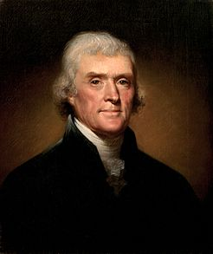
2. Jeffersonian Democracy
Jefferson defeated incumbent Federalist President John Adams (1735–1826) in 1800 Presidential Election
“We have called by different names brethren of the same principle. We are all Republicans, we are all Federalists.”
First Inaugural Address, March 4 1801
Thomas Jefferson
(1743–1826)

Slide 26
2. Jeffersonian Democracy
Jefferson’s vision of American democracy championed the interests of agriculture and farming. Why? What arguments did Jefferson present in favour of agriculture as opposed to manufacturing?
Hamilton | Jefferson
Federalist Party | (Democratic-)Republican Party
Represented interests of commerce and manufacturing | Represented interests and agriculture and farming
Strongest support in New England and northeast | Strongest support in south

Slide 27
2. Jeffersonian Democracy: Championing the Yeoman Farmer
Jefferson’s vision of American democracy championed the interests of agriculture and farming. Why? What arguments did Jefferson present in favour of agriculture as opposed to manufacturing?
  Notes on the State of Virginia (originally published 1785)
  To John Jay, Paris, August 23 1785
  To James Currie, Paris August 4 1787
  To George Washington, Paris August 14 1787
  To Thomas Pinckney, Monticello September 1795
  ‘Summary of Public Service,’ after September 2 1800

Slide 28
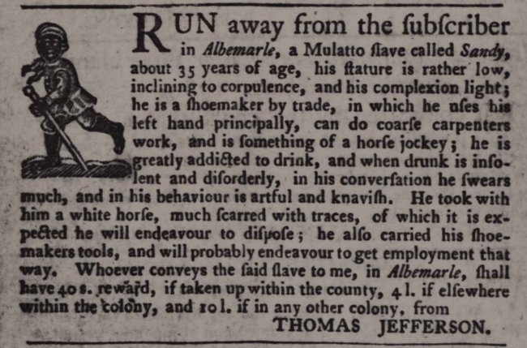
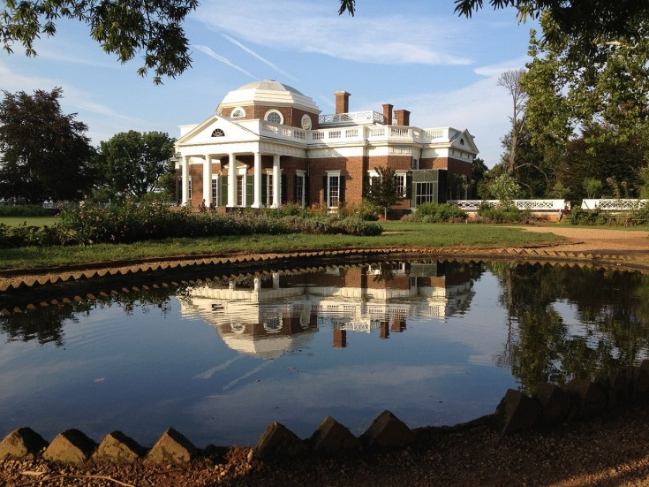
2. Jeffersonian Democracy: Jefferson as slaveholder
Jefferson, like many of the Founding Fathers (including George Washington and Benjamin Franklin), owned slaves (600+)
Owned and ran Monticello plantation (pictured). See: https://www.monticello.org/slavery-at-monticello
Widely believed Jefferson fathered six children by his slave Sally Heming. See: https://www.monticello.org/site/plantation-and-slavery/thomas-jefferson-and-sally-hemings-brief-account
Argued against slave trade, but ambivalent towards abolition
Views on slavery underpinned by assumptions of African American racial inferiority
See: Jefferson, ‘Laws,’ ‘Manners’ Notes on the State of Virginia (1785)

Slide 29
3. Expansion and Consolidation: ‘Empire of Liberty’
Jefferson’s championing of agriculture and farming went hand-in-hand with advocacy of US territorial expansion
“A rising nation, spread over a wide and fruitful land, traversing all the seas with the rich productions of their industry, engaged in commerce with nations who feel power and forget right, advancing rapidly to destinies beyond the reach of mortal eye – when I contemplate these transcendent objects, and see the honor, the happiness, and the hopes of this beloved country committed to the issue and the auspices of this day, I shrink from the contemplation, and humble myself before the magnitude of the undertaking.”
First Inaugural Address, March 4 1801

Slide 30
3. Expansion and Consolidation: ‘Empire of Liberty’
Jefferson’s championing of agriculture and farming went hand-in-hand with advocacy of US territorial expansion
To George Rogers Clark, Richmond, December 25 1780
.. . In the event of peace on terms which have been contemplated by some powers we shall a barrier against the dangerous extension of the British Province of Canada and add to the Empire of liberty an extensive and fertile Country thereby converting dangerous Enemies into valuable friends.

Slide 31
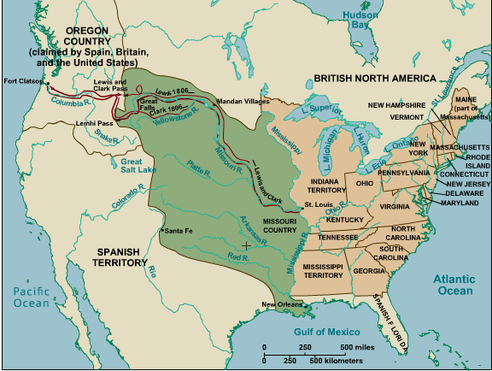
3. Expansion and Consolidation: Louisiana Purchase (1803)
Settled perennial disputes over territory West of the Mississippi
Negotiated between Jefferson and Napoleon Bonaparte (France had made a secret agreement with Spain over ownership in 1800)
By 1803, Kentucky (1792), Tennessee (1796) and Ohio (1803) (plus Vermont in the East, 1791) already added to the original 13 colonies as full states within the union
Jefferson commissions Lewis and Clark expedition (Meriwether Lewis and William Clark) to survey new territories and to map a route to the Pacific, 1804–1806

Slide 32
3. Expansion and Consolidation: Louisiana Purchase (1803)
Jefferson to Joseph Priestley Jan 29 1804
… I very early saw that Louisiana was indeed a speck in our horizon which was to burst in a tornado … The denouement has been happy; and I confess I look to this duplication of area for the extending a government so free and economical as ours, as a great achievement to the mass of happiness which is to ensue. Whether we remain in one confederacy, or form into Atlantic and Mississippi confederacies, I believe not very important to the happiness of either part. Those of the western confederacy will be as much our children & descendants as those of the eastern, and I feel myself as much identified with that country, in future time, as with this; and did I now foresee a separation at some future day, yet I should feel the duty & the desire to promote the western interests as zealously as the eastern, doing all the good for both portions of our future family which should fall within my power.

Slide 33
3. Expansion and Consolidation: Louisiana Purchase (1803)
To James Madison, Monticello, April 27 1809
As to Bonaparte, I should not doubt the revocation of his edicts, were he governed by reason, but his policy is so crooked that it eludes conjecture … He ought to conciliate our good will, as we can be such an obstacle to the new career opening on him in the Spanish colonies.
… But, altho’ with difficulty, he will consent to our receiving Cuba into our union to prevent our aid to Mexico & the other provinces. That would be a price, & I would immediately erect a column on the Southernmost limit of Cuba & inscribe on it a Ne plus ultra as to us in that direction. We should then have only to include the North in our confederacy, which would be of course in the first war, and we should have such an empire for liberty as she has never surveyed since the creation: & I am persuaded no constitution was ever before so well calculated as ours for extensive empire & self-government. … It will be objected to our receiving Cuba, that no limit can then be drawn for our future acquisitions. Cuba can be defended by us without a navy, & this develops the principle which ought to limit our views.

Slide 34
3. Expansion and Consolidation: Louisiana Purchase (1803)
To William Ludlow, Monticello September 6 1824.
…. Let a philosophic observer commence a journey from the savages of the Rocky Mountains, eastwardly towards our sea-coast. These he would observe in the earliest stage of association living under no law but that of nature, subscribing and covering themselves with the flesh and skins of wild beasts. He would next find those on our frontiers in the pastoral state, raising domestic animals to supply the defects of hunting. Then succeed our own semi-barbarous citizens, the pioneers of the advance of civilization, and so in his progress he would meet the gradual shades of improving man until he would reach his, as yet, most improved state in our seaport towns. This, in fact, is equivalent to a survey of the progress of man from the infancy of creation to the present day. I am 81-years-of-age, born where I now live, in the first range of mountains in the interior of our country. And I have observed this march of civilization advancing from the sea coast, passing over us like a cloud of light, increasing our knowledge and improving our condition, insomuch as that we are at this time more advanced in civilization here than the seaports were when I was a boy. And where this progress will stop no one can say. Barbarism has, in the meantime, been receding before the steady step of amelioration; and will in time, I trust, disappear from the earth.

Slide 35
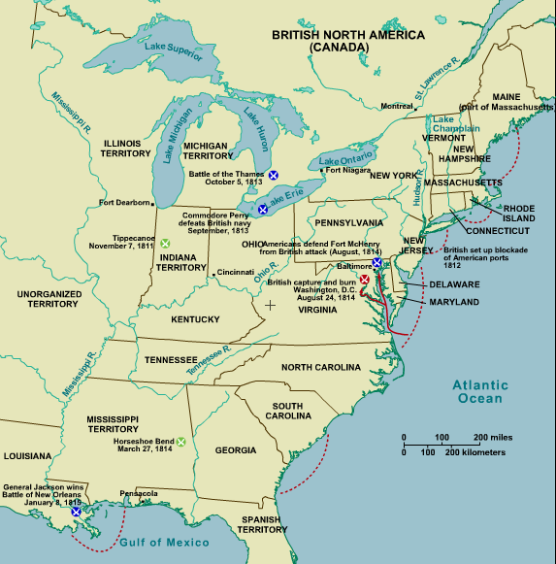
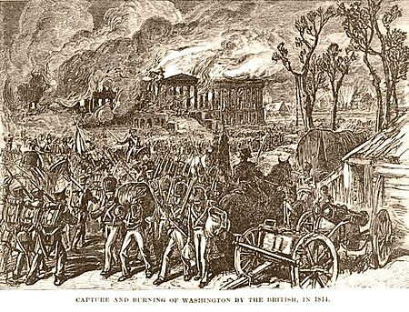
3. Expansion and Consolidation: The War of 1812
War between US, Britain and its Indian tribe allies
Failed US attempted invasion of Canada
British blockade East Coast, burn Washington DC and Baltimore, 1814
Largely a stalemate but demonstrated US lack of reliance on external powers - ‘the second war of independence’
Legacy of Anglophobia

Slide 36
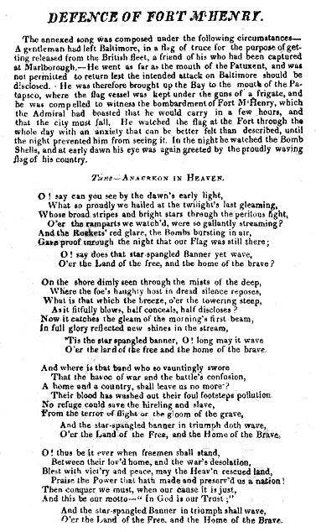
3. Expansion and Consolidation: The War of 1812

Slide 37
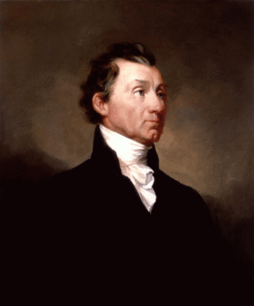
3. Expansion and Consolidation: The Monroe Doctrine (1823)
“The occasion has been judged proper for asserting, as a principle in which the rights and interests of the United States are involved, that the American continents, by the free and independent condition which they have assumed and maintain, are henceforth not to be considered as subjects for future colonization by any European powers.
… We should consider any attempt on their part to extend their system to any portion of this hemisphere as dangerous to our peace and safety. With existing colonies or dependencies of any European power we have not interfered and shall not interfere. But with governments who have declared their independence and maintained it, and whose independence we have acknowledged, we could not view any interposition for the purpose of oppressing them, or controlling in any other manner their destiny, by any European power in any other light than as the manifestation of an unfriendly disposition toward the United States.”
James Monroe, 5th US President (1817–1825), message to Congress, December 2 1823

Slide 38
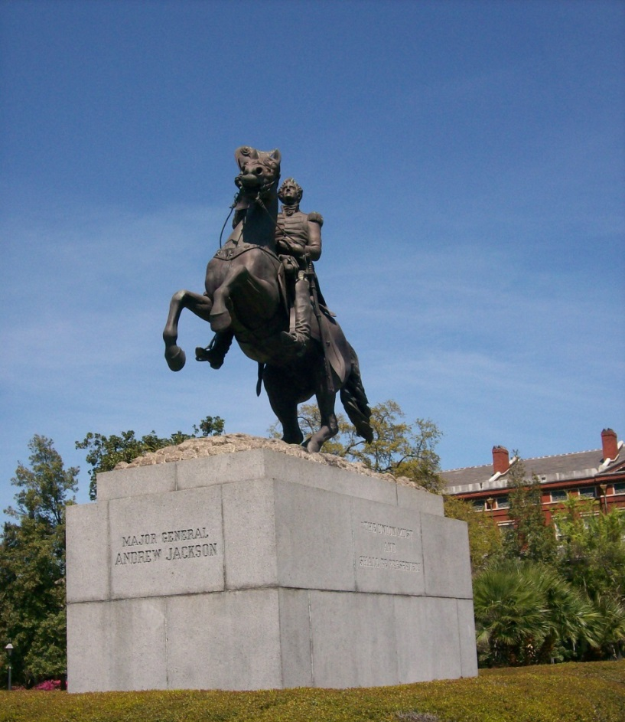
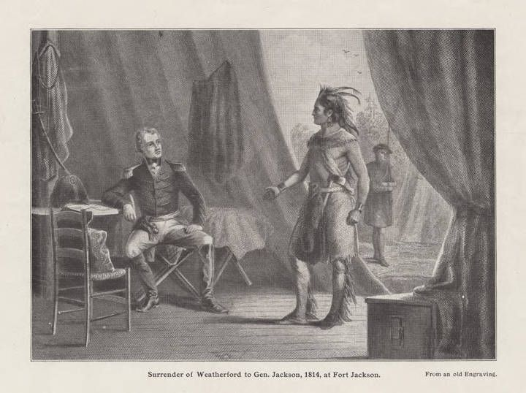
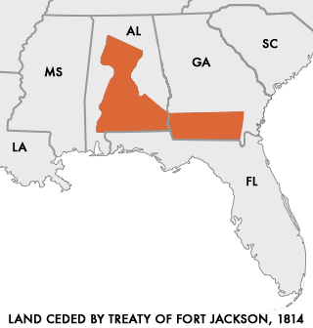
4. The Age of Jackson:
Jackson as War Hero
Andrew Jackson (1767–1845), rose to national prominence as a colonel in the Tennessee Militia
Famed for his leadership in War of 1812
  Victory in Creek War (1813–1814); imposed harsh terms on British-allied Creeks; occupied parts of Spanish East Florida
  Victory at Battle of New Orleans, January 1815
General in First Seminole War (1816–1819); led excursions into Spanish Florida; Adams–Onís Treaty concessions Florida to the United States
Statue of Andrew Jackson, St Louis Cathedral, New Orleans

Slide 39
4. The Age of Jackson: Jacksonian Democracy
Presidential election 1824
Adams gains office, despite Jackson winning popular vote and first run of electoral college votes (99 to 84) – rival candidate Henry Clay delegated his 37 votes to Adams
John Quincy Adams | Andrew Jackson
Federalist Party | (Democratic-)Republican Party
Strong central government | States’ rights and limited central government
Believed an enlightened body of citizens should exercise political power – ‘republicanism’ | Embraced mass participation in politics – ‘democratic’
Represented interests of commerce and manufacturing | Represented interests of ‘common man’
East-coast, New Englander | ‘Western’ (born on Carolina frontier, settled in Tennessee), Scots-Irish background
Political dynasty, Harvard-educated and professor | ‘Self-made man,’ autodidact

Slide 40
4. The Age of Jackson: Jacksonian Democracy
Presidential election 1828
Electoral college reform: states’ electors decided by popular vote rather than appointment
Jackson carries popular vote and electoral college
John Quincy Adams | Andrew Jackson
Federalist Party | Democratic Party
Strong central government | States’ rights and limited central government
Believed an enlightened body of citizens should exercise political power – ‘republicanism’ | Embraced mass participation in politics – ‘democratic’
Represented interests of commerce and manufacturing | Represented interests of ‘common man’
East-coast, New Englander | ‘Western’ (born on Carolina frontier, settled in Tennessee), Scots-Irish background
Political dynasty, Harvard-educated and professor | ‘Self-made man,’ autodidact

Slide 41
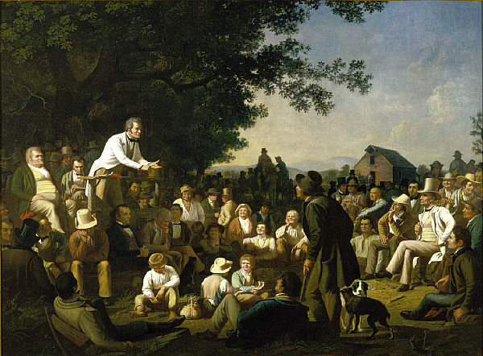
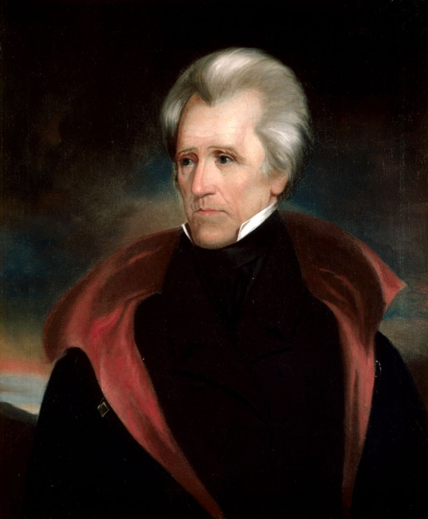
4. The Age of Jackson: Jacksonian Democracy
Informalises politics: nicknames (e.g. ‘Old Hickory,’ the ‘jackass’ [Jackson], ‘Old Bullion’ [Thomas Hart Benton]); ‘plain-folk’ language (e.g. ‘dark horse,’ ‘lame duck,’ ‘bunkum,’ ‘gerrymandering,’ ‘lobbying’); stump speeches
Jackson (a lawyer, planter, land- and slave-owner) flags up humble origins and ‘common man’ credentials
  Enthusiasm for cockfighting and horseracing
  Dueller
Stump Speaking, George Caleb Bingham; Jackson by Ralph Eleaser Whiteside Earl

Slide 42
4. The Age of Jackson: Jacksonian Democracy
Broadens franchise: property-requirements removed; voting extended to all white males
Office of President seen as exerciser of popular will
Democratic Party established
Attracted agrarian vote plus new working-class and immigrant support

Slide 43
4. The Age of Jackson: Jacksonian Democracy
Broadens franchise: property-requirements removed; voting extended to all white males
Office of President seen as exerciser of popular will
Democratic Party established
Attracted agrarian vote plus new working-class and immigrant support
But
Extended policy-making powers of the executive and patronage; labelled ‘King Andrew I’ by detractors
Establishment of ‘Second Party System’ - Whig Party founded in opposition (Zachary Taylor, William Henry Harrison later win Presidency as Whigs

Slide 44
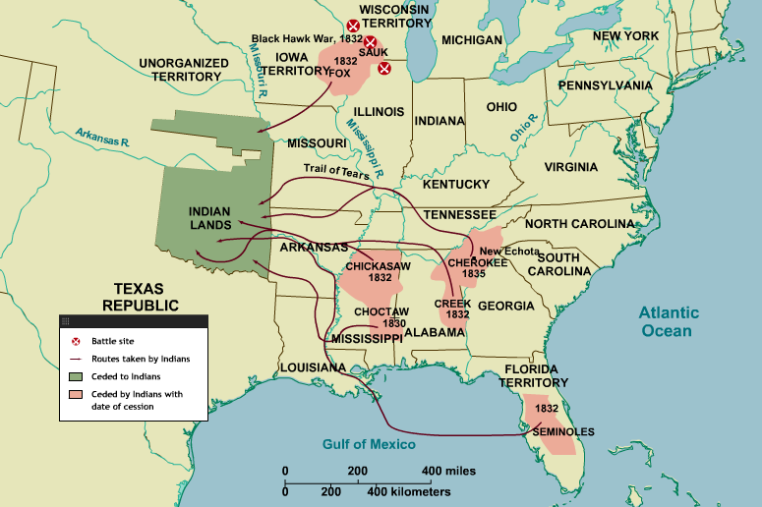
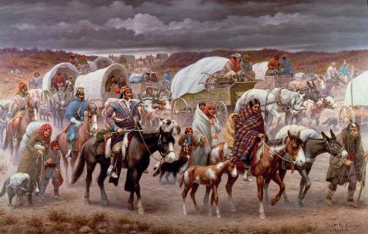
4. The Age of Jackson: Indian Removal
Policy of removing of Indian tribes from eastern states and territories
‘The Trail of Tears’
State of Georgia recognised Cherokee as nation with own laws & customs 1791
Discovery of gold on Cherokee land, 1828; Georgia nullifies 1791 agreement
Supreme Court rules in favour of Cherokee; Jackson endorses Georgia’s policy
Cherokee driven from homes at gunpoint; c. 2,000-6,000 of 16,500 relocated perished during 1000-mile trek to Indian Territories (‘Trail of Tears’)
But
Protested and resisted by Cherokee Nation

Slide 45
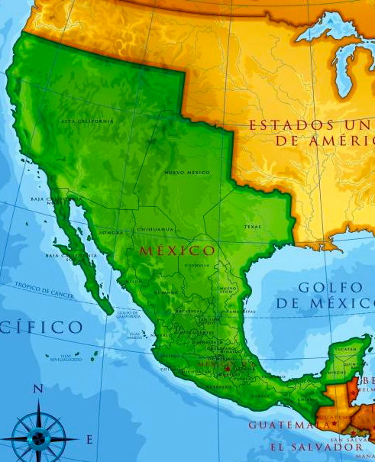
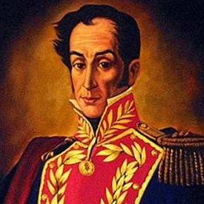
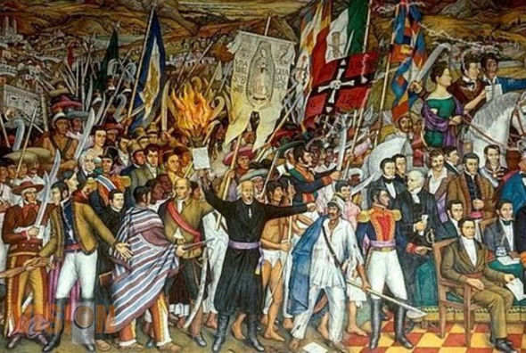
5. War with Mexico: Independence in Spanish America
Nation Argentina | National independence day 9 July 1816 (from Spain)
Bolivia | 6 August 1825 (from Spain)
Brazil | 7 September 1822 (from Portugal)
Chile | 18 September 1810 (from Spain)
Colombia | 20 July 1810 (from Spain)
Costa Rica | 15 September 1821 (from Spain)
Ecuador | 24 May 1822 (from Spain)
El Salvador | 15 September 1821 (from Spain)
Guatemala | 15 September 1821 (from Spain)
Honduras | 15 September 1821 (from Spain)
Mexico | 16 September 1810 (from Spain)
Nicaragua | 15 September 1821 (from Spain)
Panama | 3 November 1903 (from Colombia)
Paraguay | 14 May 1811 (from Spain)
Peru | 28 July 1821 (from Spain)
Uruguay | 25 August 1825 (from Brazil)
Venezuela | 5 July 1811 (from Spain)
Simon Bolivar
Mexican independence mural, Juan O’Gorman

Slide 46
5. War with Mexico: Texas Revolution
1821 Conclusion of Mexican war of independence
1830s Insurrection: US settlers and adventurers (“filibusters”) fight for Independence of Texas from Mexico
1836 February 23–March 6 Siege of the Alamo: Defeat begins the heroic myth of the Alamo featuring James Bowie, Davy Crockett and William Travis’s “line in the sand” – 187 American martyrs against 1,400 Mexicans
April Texas War (Battles of Goliad and San Jacinto)
Sam Houston’s army defeats General Santa Anna at the Battle of San Jacinto, winning independence for a Texan republic. Outcome of the war and the extent of Texas’s borders disputed by the Mexican government.
1836–1845 Republic of Texas (Lone Star Republic)
1845 Annexation of Texas (becomes a member of the USA)

Slide 47
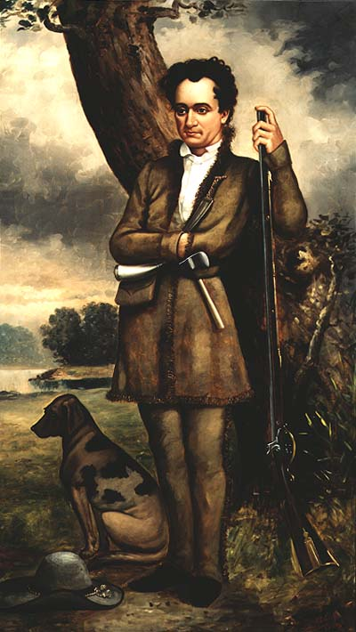
5. War with Mexico: Texas Revolution
“Nothing shall daunt my courage or abate my object to Americanize Texas. My sole and only desire is to redeem [Texas] from the wilderness … to settle it with intelligent and honorable and enterprising people.”
[A conflict was between] “the mongrel Spanish-Indian [verus] civilisation and the Anglo-Saxon race.”
Stephen Austin, 1834
Austin (1793–1836) = leader of the ‘old 300’ – 300 American families who in 1825 settled in Texas
(image = painting of Austin by William Howard, 1833)

Slide 48
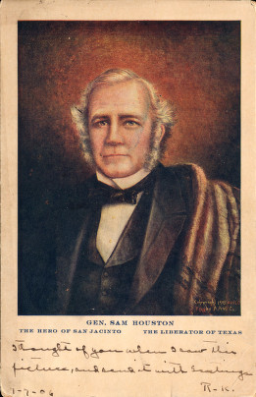
5. War with Mexico: Texas Revolution
[The Lone Star Republic reflected] “glory on the Anglo-Saxon race . . . we will march across the Rio Grande, and ere the banner of Mexico shall triumphantly float upon the banks of the Sabine, the Texan standard of the single star, borne by the Anglo-Saxon race, shall display its bright folds in Liberty’s triumph on the isthmus of Darien.”
Sam Houston, 1836
Houston (1793–1863) = signatory of Texas independence declaration (March 1836) and first President of Texas; military general who led decisive victory in Battle of San Jacinto, (April 1836)
(image = postcard, c. 1905)

Slide 49
5. War with Mexico: ‘Annexation’ and Manifest Destiny
“Texas is now ours … the fulfilment of our manifest destiny to overspread the continent allotted by Providence for the free development of our yearly multiplying millions.
“ … Texas, has been absorbed into the Union in the inevitable fulfilment of the general law which is rolling our population westward; the connexion of which with that ratio of growth in population which is destined within a hundred years to swell our numbers to the enormous population of two hundred and fifty millions (if not more), is too evident to leave us in doubt of the manifest design of Providence in regard to the occupation of this continent.
“ … California probably, next fall away from the loose adhesion which, in such a country as Mexico, holds … The Anglo-Saxon foot is already on its borders. Already the advance guard of the irresistible army of Anglo-Saxon emigration has begun to pour down upon it, armed with the plough and the rifle, and marking its trail with schools and colleges, courts and representative halls, mills and meeting-house.”
- John L O’Sullivan, ‘Annexation,’ United States Magazine and Democratic Review (July–August 1845), pp. 5–10

Slide 50
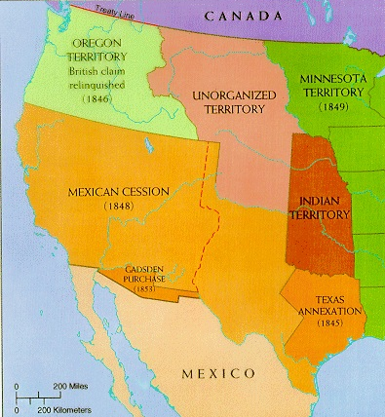
5. War with Mexico
1846–1848 Mexican-American War
(US forces destroy or capture many Mexican cities including Vera Cruz, Matamoros [in which civilians were massacred], Monterey, and Mexico City)
Treaty of Guadalupe Hidalgo. Mexico accepts Rio Grande river as Texas’s border with Mexico and cedes present day territory of California, New Mexico, Nevada, and parts of Colorado, Arizona, and Utah, to the United States.
Mexican-American War hero Zachary Tyler elected president

Slide 51
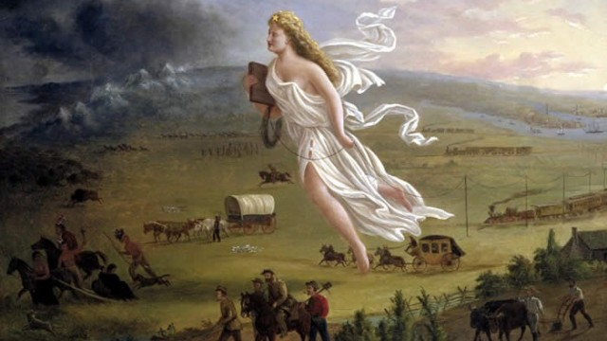

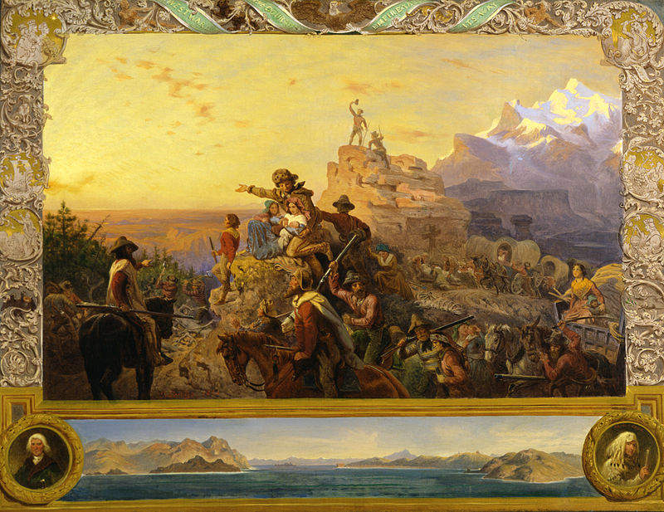
5. War with Mexico: Competing interpretations and memory
Manifest destiny, American exceptionalism
Poster for The Alamo (1960); American Progress, by John Gast (1872); Emanuel Leutzem Westward the Course of Empire Takes Its Way (1861).

Slide 52
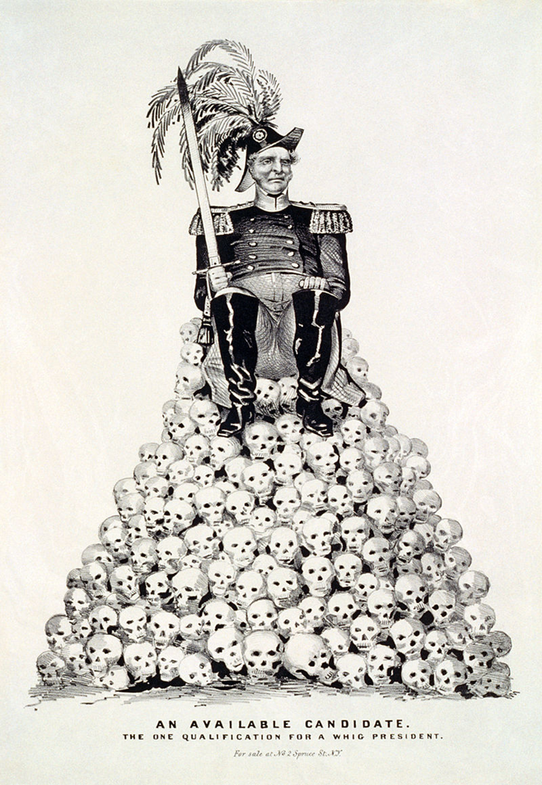
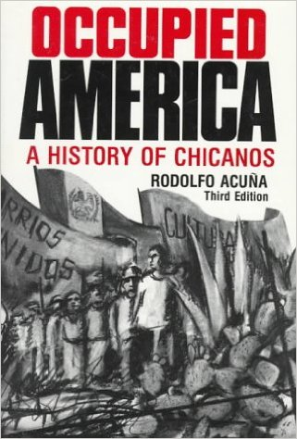

5. War with Mexico: Competing interpretations and memory
“We did not come to America, America came to us”
Nathaniel Currier, ‘An Available Candidate: The One Qualification for a Whig President,’1848; Yolanda Lopez poster, 1978

Slide 53
In Focus: ‘Other’ Americans
The ‘in focus’ session concentrates on two demographic groups excluded from Jeffersonian and Jacksonian Democracy: women and Native Americans.
Workshop readings:
Abigail Adams, ‘Remember the Ladies,’ Letter to John Adams (1776)
William Apess, An Indian’s Looking Glass for the White Man (1833)
Elias Boudinot, ‘An Address to Whites’ (1826)
Elizabeth Cady Stanton, ‘The Seneca Falls Declaration’ (1848)
'Appeal of the Cherokee Nation' (1830)
What grievances do the different writers direct towards the United States?
How do the writers deploy the language and rhetoric of the US Constitution and the Declaration of Independence to support their points?

