Slide 1

Student Name: VASUDEV TADVI
Student Number: 2315952
Course Name: Human Capital management
Lecturer Name: Gladius David Kulothungan
Session: June 2024 Term
Component 2
Group Presentation
COMPONENT 2
GROUP PRESENTATION

Slide 2
Table of Contents
Introduction of chosen organisation
Strategic Goal of Chosen organisation
Job Analysis / Position
Job Description
Person Specification
Required skills
Pay and working Conditions
Flexible working arrangement with justifications
Conclusion

Slide 3
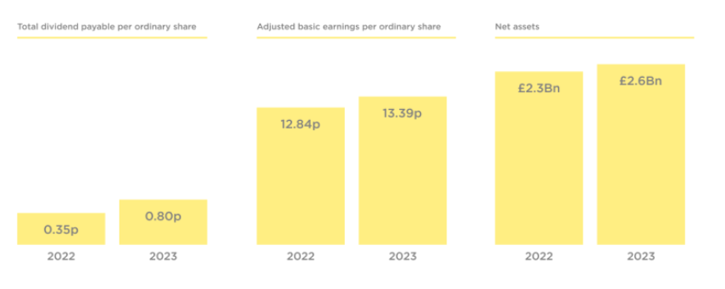
Introduction of chosen organisation
JD Sports company stands for John Wardle and David Makin company
The total revenue of the company is 440.9 million euros (JDPLC, 2024).
This company was established in the year 1981 and it is the leading global retailer of Sports fashion.
On the other hand, Sports Direct is also one of best retailers with quality, reputation and overall impression in the UK market (Sportsdirect, 2023).
Notes:
This company has more than 3400 stores in the 38 territories and has a strong presence in the UK market and around the Asia Pacific. The company has flexible working hours and supports stock inventory processes. Whereas the annual revenue of Sports direct is 5665.2 million euros in 2023 compared to JD sports. The core values of this company are to maintain entrepreneurial, competitiveness, responsibilities and integrity.

Slide 4

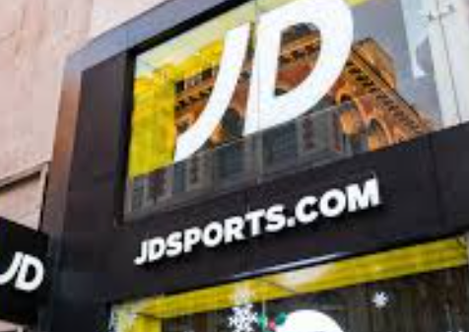
Strategic Goal of Chosen organisation
The strategic goals of JD sports is to extend the entrepreneurial and competitive domain to accelerate the growth of the business firms.
The company aims to achieve net zero waste to landfills in order to safeguard the planet and future.
Whereas the goal of Sports Direct is to help everyone to achieve greatness in the field of sporting profession and its main mission is to use power in order to raise the inner champion.
Notes:
JD sports aids to promote engagement with the help of vivid campaigns and charities to raise inclusivity and educate and train the student by focusing on the diversity, equality concepts (JDPLC, 2023). The company is focusing on the ESG that is environmental, social and government in order to achieve sustainability and protect the planet. With the help of engagement plans the company is organising campaigns to enhance diversity and equality within the employees of JD sports.

Slide 5
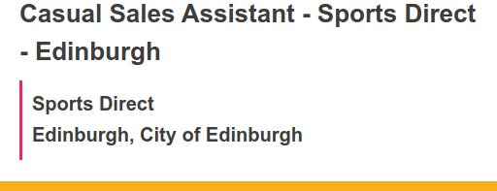
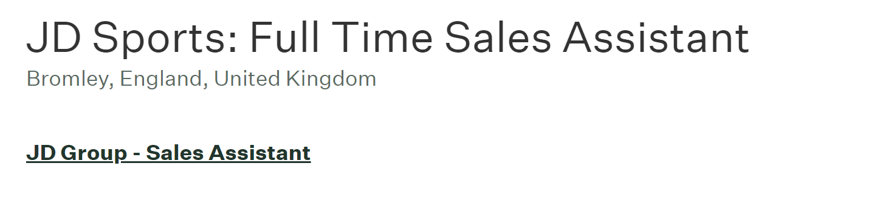
Job Analysis / Position
Casual Sales Assistant at Sports Direct
Maximising the profit margins of the stores by exceeding the sales targets.
Maintaining effective communication within the workplace and with the customers to raise the profit margins of the store (Smartrecruiter, 2023).
To ensure the customers are achieving proper support from the company and queries are resolving on time.
Full Time Sales Assistant at JD Sport
Providing excellent customer experience for everyone who enters the store
Maintaining proper hygiene within the store and adhering to tidy stock standards
Collaborating with all team members to achieve sales and KPI targets through being knowledgeable (Greenhouse.io, 2024)
Notes:
The job position in Sports Direct is supposed to greet the customers and manage the cash registers and help the store managers to enhance the quality of service (Smartrecruiter, 2023).
As a Full Time Sales Assistant, the person is liable to be in a pace with current trends and be knowledgeable about in-store promotions and continuously evolving store processes (Greenhouse.io, 2024).

Slide 6
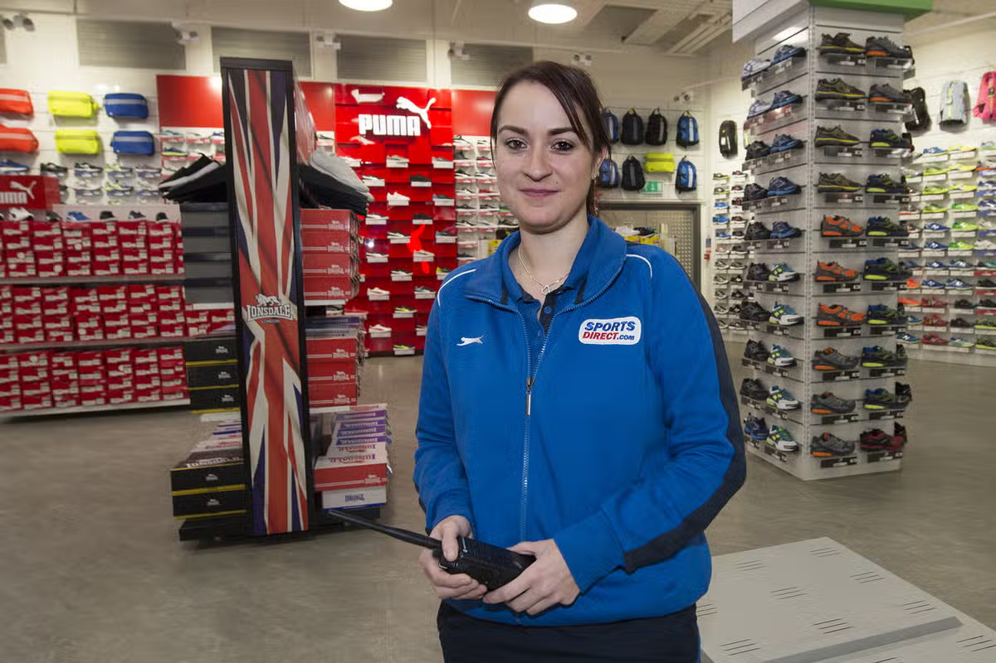
Job Description
Sales and services domain of this job needs to handle the sales targets and store targets
It comes under the foremost responsibility of employees working as Casual Sales Assistant at Sports Direct to help customers by providing them with knowledge of the products and sports footwear (Smartrecruiter, 2023)
Always helping the consumers to deliver quality customer services and maintaining the standards of the stores are other roles
Contrarily, it comes under the foremost responsibility of a Full Time Sales Assistant at JD Sport to possess positive attitude towards the customer-focused retail environment (Greenhouse.io, 2024)
Possessing the ability to look at any challenges as opportunities enthusiastically is also a mandate
Notes:
In order to work in the Sports Direct company, a person must know the job criteria that is he or she needs to handle the store target sincerely in order to deliver quality services to the customers.
It comes under the foremost responsibility of employees working as a Casual Sales Assistant to help customers by providing them with knowledge of the products and sports footwear (Smartrecruiter, 2023).

Slide 7


Person Specification
The person should be customer focused and must have a Bachelor's degree in Marketing domain (Smartrecruiter, 2023)
Should follow the work ethics and promote sport direct values
He or she needs to be confident and must have strong communication skills
Notes:
In order to become a sales assistant, he or she needs to have strong communication skills, which will help to mitigate all the challenges and consequences.

Slide 8
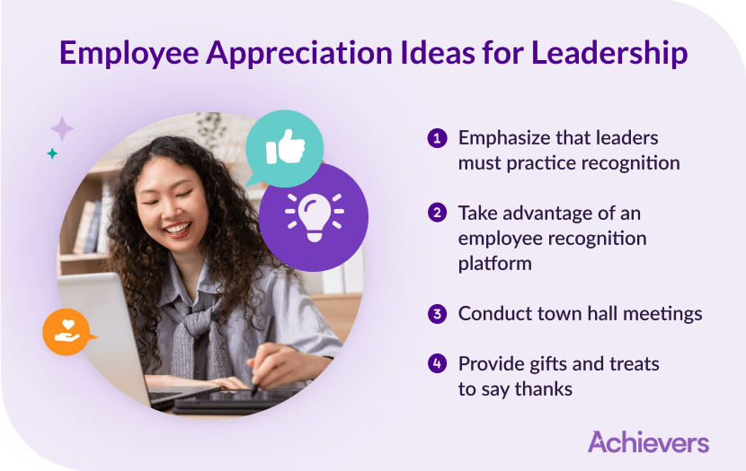
Required skills
The Casual Sales Assistant job at Sports Direct is a customer-facing position with an optimism for target achievement
Casual Sales Assistants need to be very fast with several kinds of task orientation, flexible in their approach when working, and proactive in their work (Parker, and Knight, 2024).
Effective communication is a mandate that will help to interact well with customers and also team members
Like the considered job position at Sports Direct, the Full Time Sales Assistant job role at JD Sport is also customer-centric
As a result, the person is required to possess necessary skills for delivering an exceptional shopping experience to all customers (Greenhouse.io, 2024)
Similarly, effective communication skills, active probing skills and being creative are required to interact well with customers
Notes:
Self-confidence and being outgoing contribute to the promotion of the values and culture that drive Sports Direct. Apart from this, they have the ability to learn and apply product knowledge in methods that will improve customers' experience and drive sales performance.

Slide 9
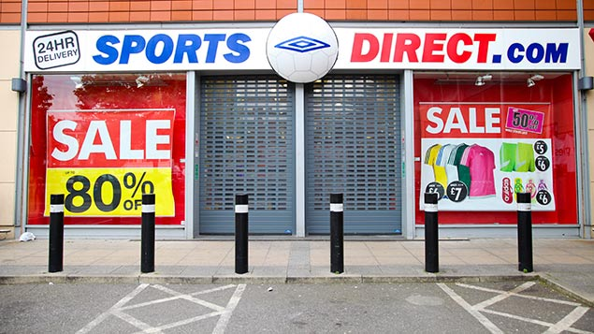

Pay and working Conditions
The Sports Direct Casual Sales Assistant works flexibly, with part-time hours that are not guaranteed, on a week-by-week basis
This opportunity has the possibility of extra earnings from additional Sales Commission and monthly Group Rewards and Recognition.
The role comes with a 20% discount across all brands of Frasers Group and an in-store uniform discount (Frasers, 2024).
Contrarily, with more than 3,400 stores globally, JD Sports offer unparalleled service to its consumers
With this, this sportwear brand strives to inspire the emerging generation through a captivating connection. As a results, the Full Time Sales Assistant is required to work 40 Hours a week.
Notes:
The group further gives its staff discounted gym memberships and quite a good number of Development courses that offer national qualifications. This role offers many career growth opportunities because of our team leader programs and constant development of a great place to work.

Slide 10
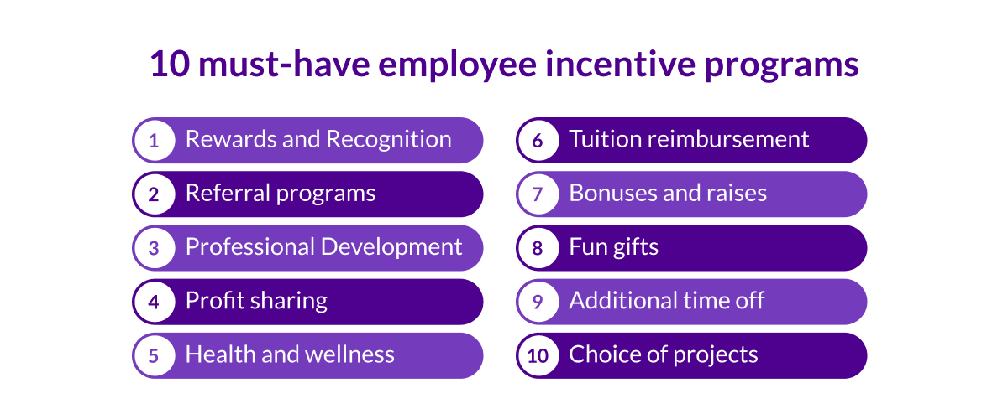
Flexible working arrangement with justifications
Some of the benefits that employees can have entitlement to include a 20% discount across all brands of Frasers Group, additional commissions made on sales, and a discounted gym membership offer.
Some benefits of being an employee at JD Sport include 25% off all staff, performance-related bonuses, pre-launch chances of new products (Jdsports, 2024).
Sports Direct offers highly variable hours that make available more flexibility, while JD Sports provides structured part-time contracts for more stability.
Notes:
This casual sales assistant role is offered with flexible working arrangements whereby there are no guaranteed hours as far as work schedules are concerned that vary on a weekly basis. It thus suits those looking for part-time employment or seeking an extra source of income. Sports Direct has also highlighted the teamwork environment, rewarding roles, and career progression opportunities available through its development programs and Team Leader Programmes. JD Sports provides consistent shifts that are easier for employees to work around their other commitments. Put differently, the former case details different approaches adopted by both companies toward achieving a balance of diverse workforce needs.

Slide 11

Conclusion
Both Sports Direct and JD Sports offer interesting opportunities to work with them because of the flexibility in working hours in the job, career development opportunity, and overwhelming benefits.
Both make provisions for staff to learn and upgrade through training and provide promotion based on performance.
Notes:
Sports Direct is mostly preferred because of its flexible working hours and Sport Direct dynamic team working styles, while JD Sports gives its employees more flexible but structured part-time contracts with a view to allow staff to have continuous shifts. Basically, one falls back on the decision between Sports Direct and JD Sports being based on personal preference. Either way, being bent toward flexibility or stability in the working schedule in order to meet your individual and professional goals.

Slide 12
List of References
JDPLC (2024). ‘KEY FACTS’. Available at: https://www.jdplc.com/investor-relations/key-facts (Accessed 1st August 2024)
JDPLC (2023). ‘ESG REPORT OF JD SPORTS FASHION’. Available at:https://www.jdplc.com/sites/jd-sportsfashion-plc/files/homepage/esg-report-2021.pdf (Accessed 1st August 2024)
Sports Direct (2023). ‘About us’. Available at:https://www.sportsdirect.com/about-us (Accessed 1st August 2024)
Smartrecruiter, (2023). ‘Casual Sales Assistant’- Sports direct. Available at:https://jobs.smartrecruiters.com/FrasersGroup/744000004413682-casual-sales-assistant-sports-direct?utm_campaign=google_jobs_apply&utm_source=google_jobs_apply&utm_medium=organic (Accessed 1st August 2024)
Frasers (2024). ‘our brands A collection of the world's leading retail brands.’. Available at: https://frasers.group/brands (Accessed 2nd August 2024)
Jdsports (2024). ‘Terms Of Use’. Available at: https://www.jdsports.com/terms-of-use (Accessed 2nd August 2024)
Greenhouse.io (2024). ‘JD Sports: Full Time Sales Assistant’. Available at: https://job-boards.eu.greenhouse.io/jdsports/jobs/4364873101 (Accessed 2nd August 2024)
Parker, S.K. and Knight, C., 2024. The SMART model of work design: A higher order structure to help see the wood from the trees. Human Resource Management, 63(2), pp.265-291.

